Slide 1
Wireless Security Unit 1 – Introduction to Wireless Networks and 802.11 Medium
Dr. Haitham Alani
Faculty of Computer Engineering
Course number: 25444

Slide 2


Course Outline
Wireless Technology
Types of Wireless
Wireless Network Advantages and Disadvantages
IEEE Standards
Wireless Modulations
Wireless Operating Modes
Wireless Antennas
Wireless MAC Frame structure
Interacting with Wireless Networks

Slide 3
Wireless Technology
The computer world is heading towards a new era of technological evolution, using wireless technologies
Wireless networking is revolutionizing the way people work and play. By removing the physical connection or cable, individuals are able to use networks in newer ways to make data portable, mobile and accessible.
In a wireless network, data transmits by means of electromagnetic waves to carry signals over the communication path

Slide 4
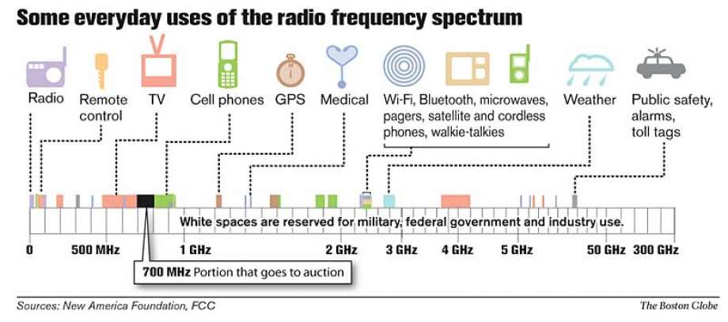
Wireless Technology (Cont’d)

Slide 5
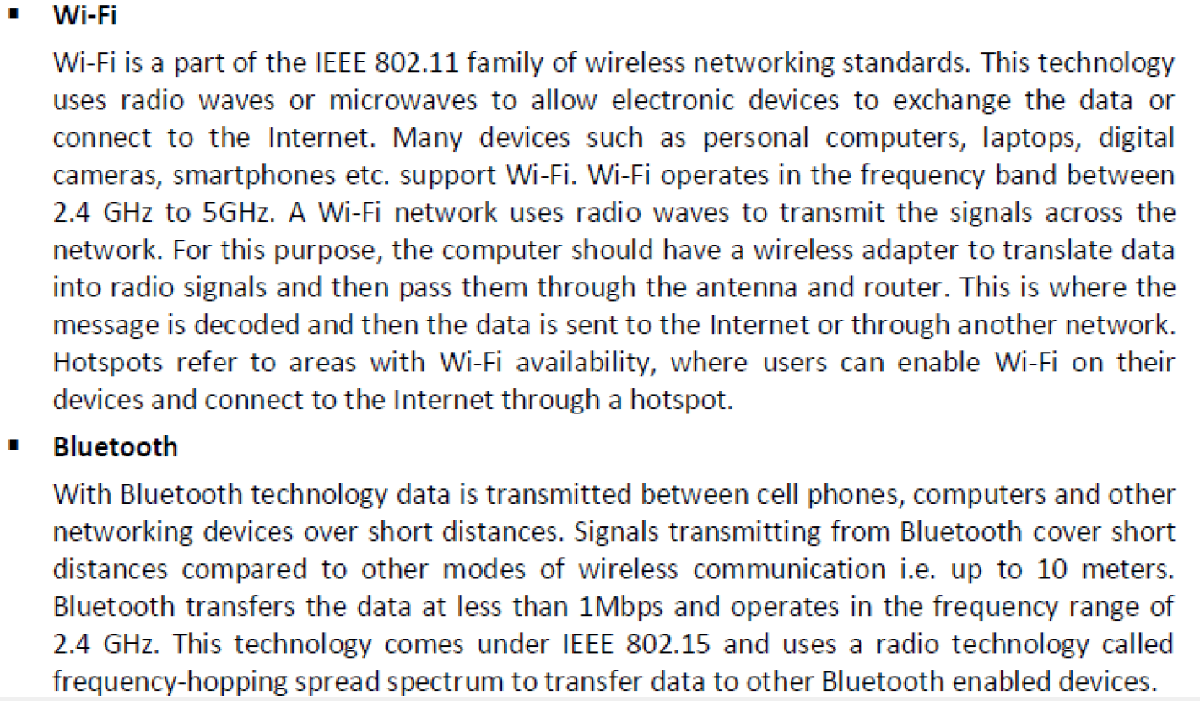
Types of Wireless

Slide 6
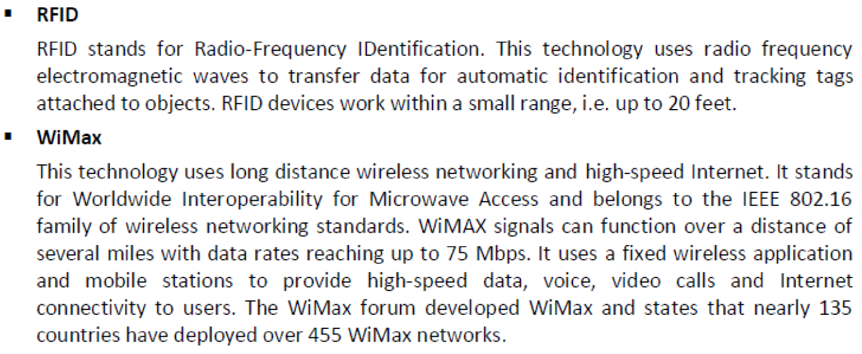
Types of Wireless (Cont’d)

Slide 7
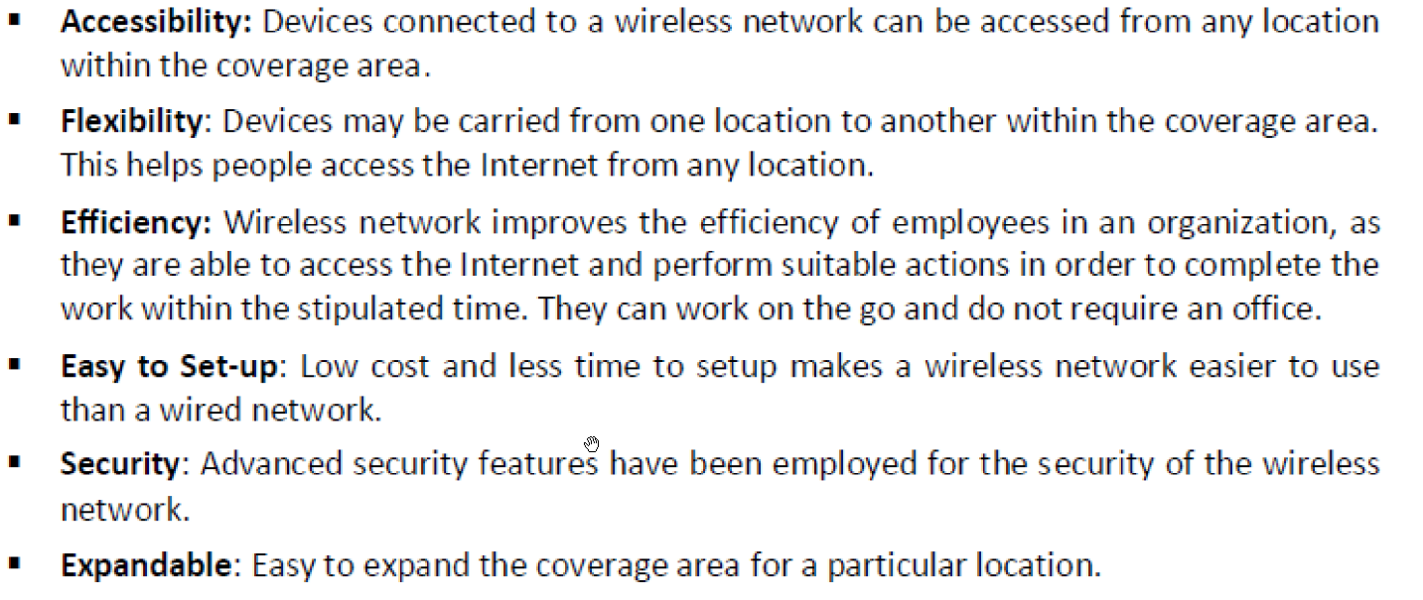
Wireless Networks Advantages

Slide 8
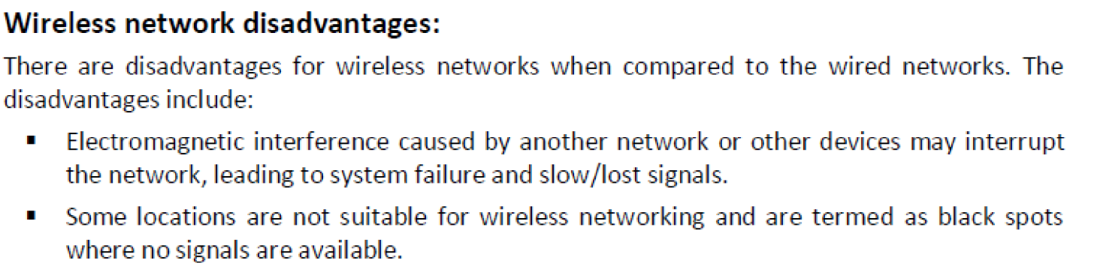
Wireless Networks Disdvantages

Slide 9
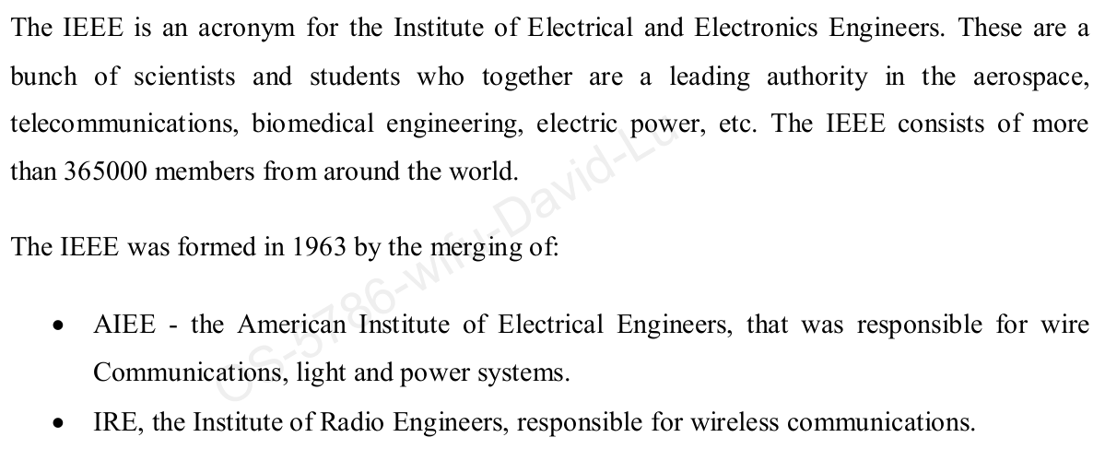
IEEE Standards

Slide 10
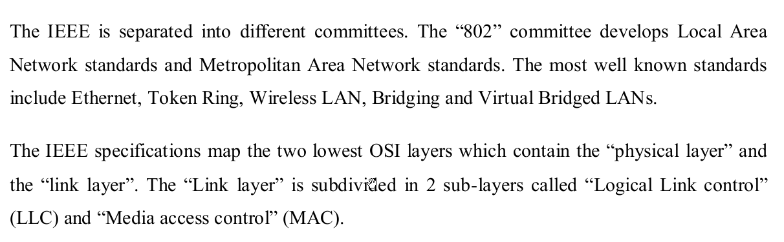
IEEE Standards (Cont’d)

Slide 11
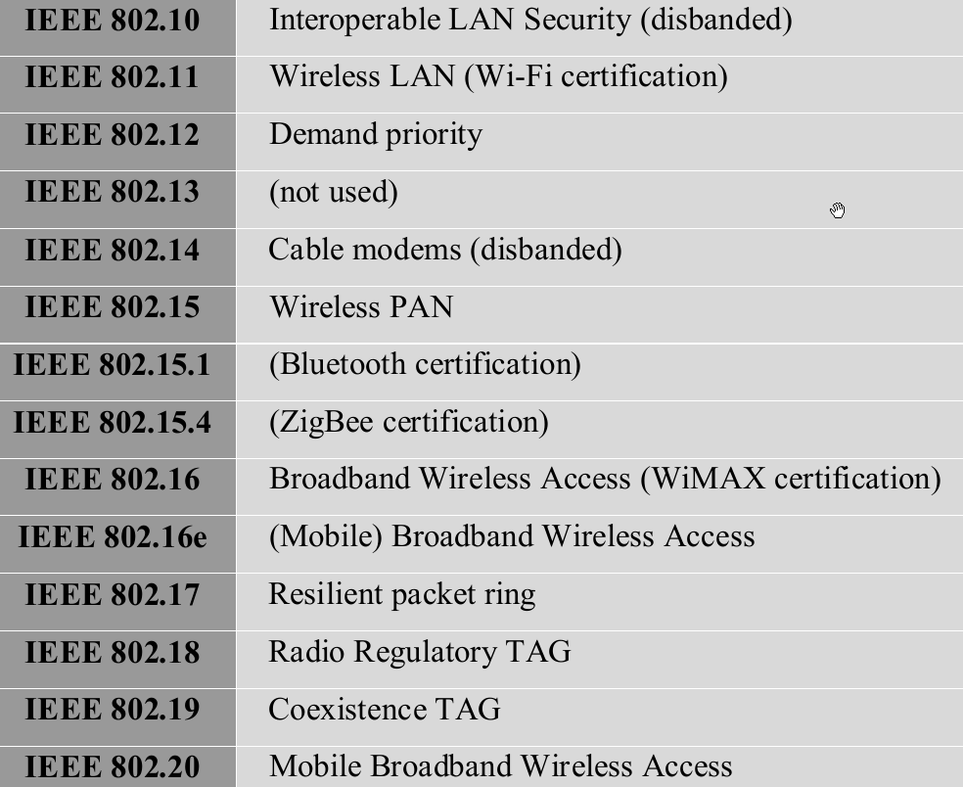
IEEE Standards (Cont’d)

Slide 12
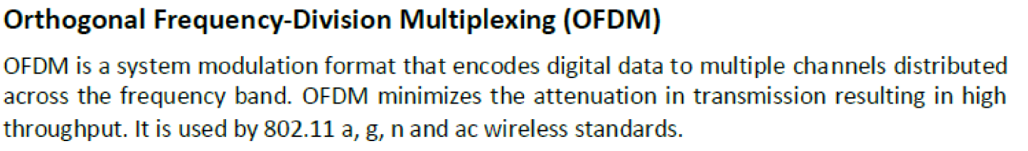
Wireless Modulations
is a spread-spectrum modulation technique primarily used to reduce overall signal interference. The direct-sequence modulation makes the transmitted signal wider in bandwidth than the information bandwidth

Slide 13
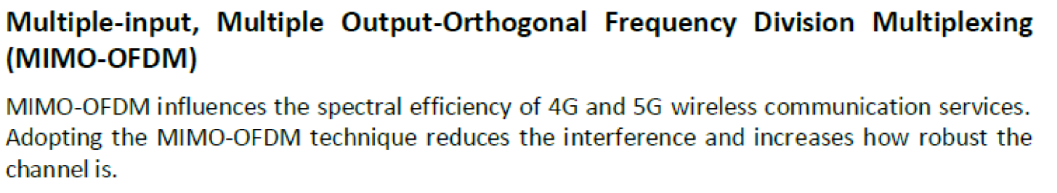
Wireless Modulations (Cont’d)

Slide 14
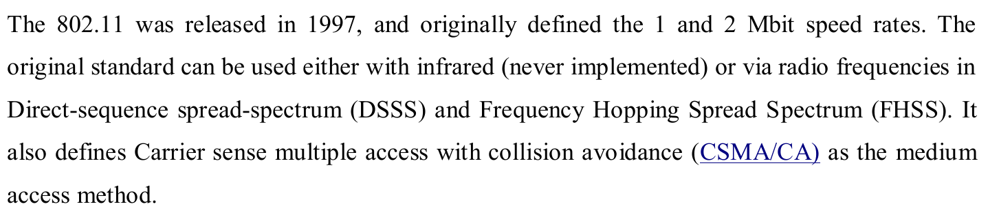
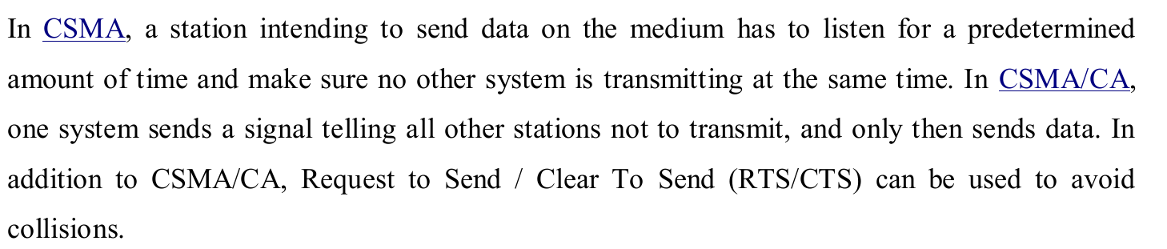
IEEE 802.11

Slide 15
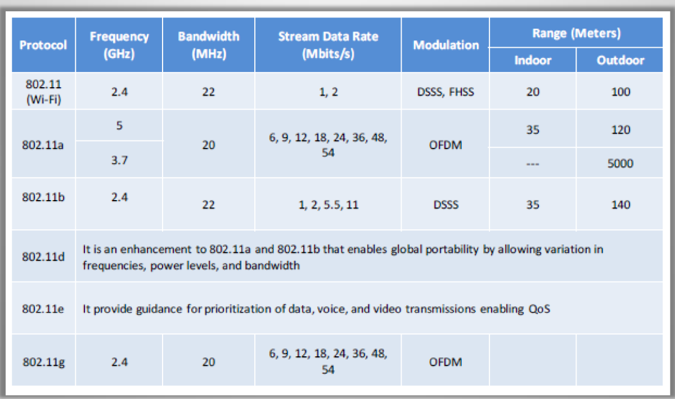
IEEE 802.11 Standards

Slide 16
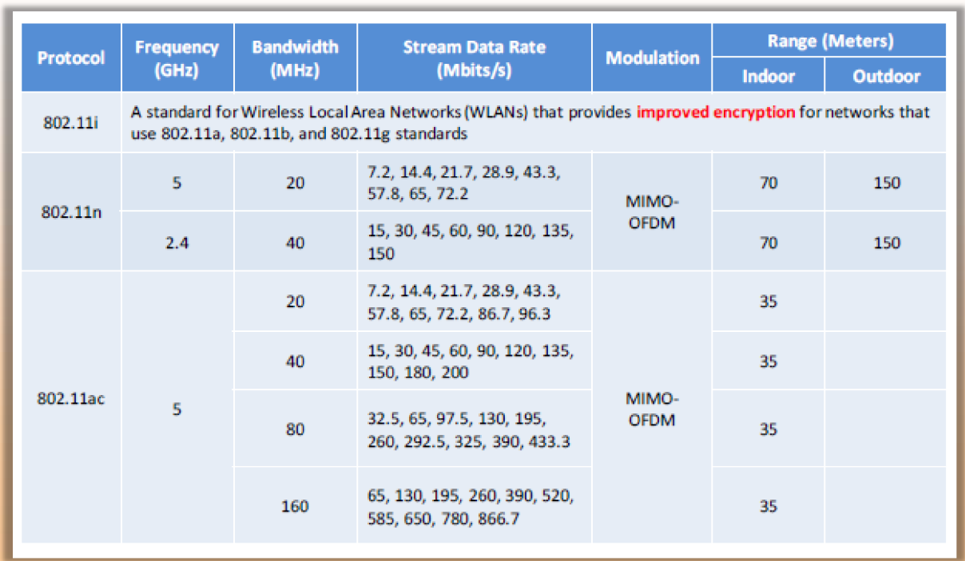
IEEE 802.11 Standards (Cont’d)

Slide 17
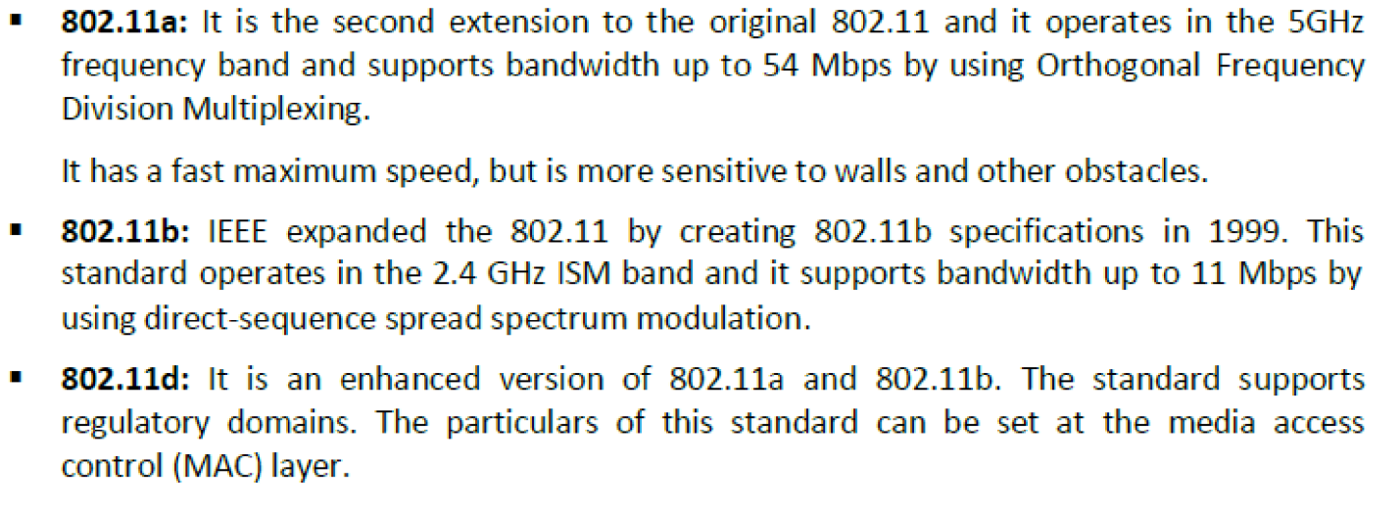
IEEE 802.11 Standards (Cont’d)

Slide 18
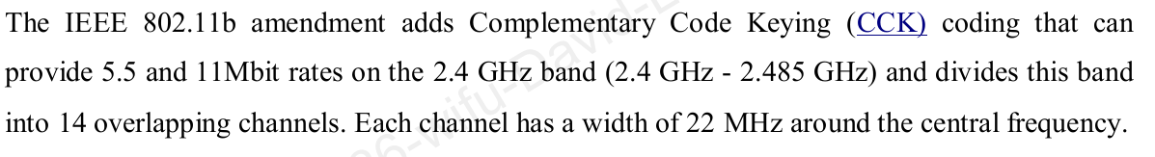
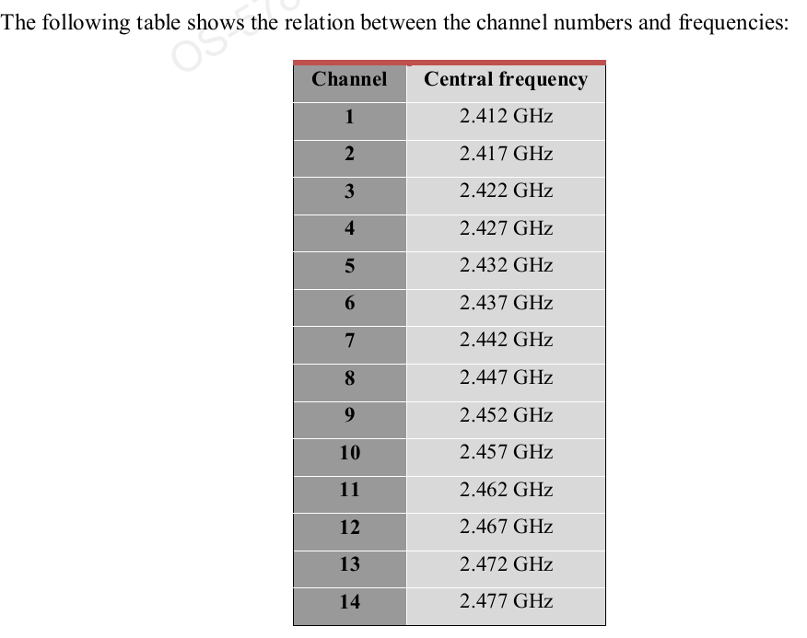
IEEE 802.11 Standards (Cont’d)

Slide 19
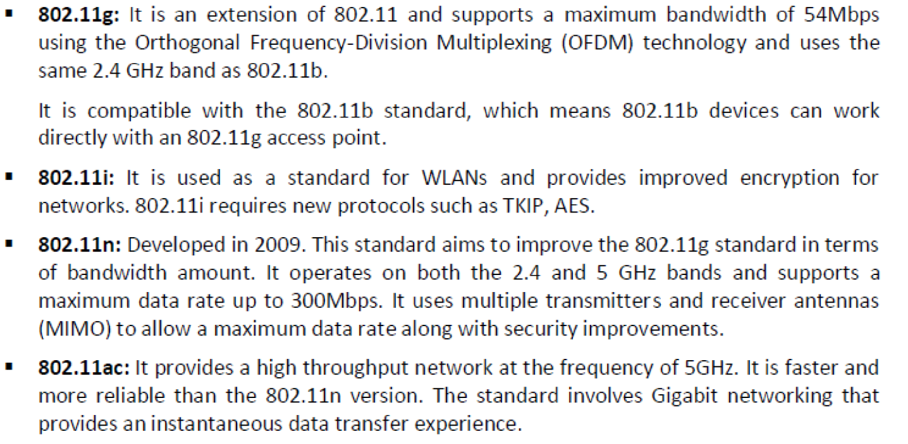
IEEE 802.11 Standards (Cont’d)

Slide 20
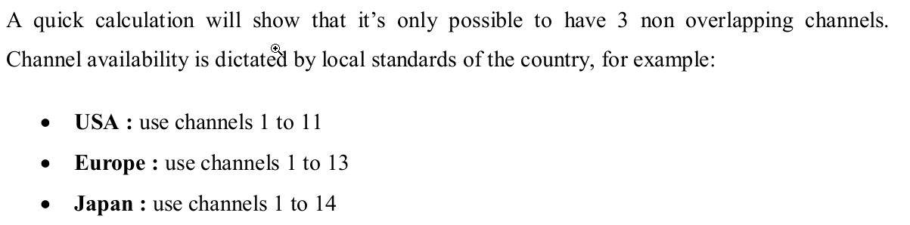
IEEE 802.11 Standards (Cont’d)
.

Slide 21
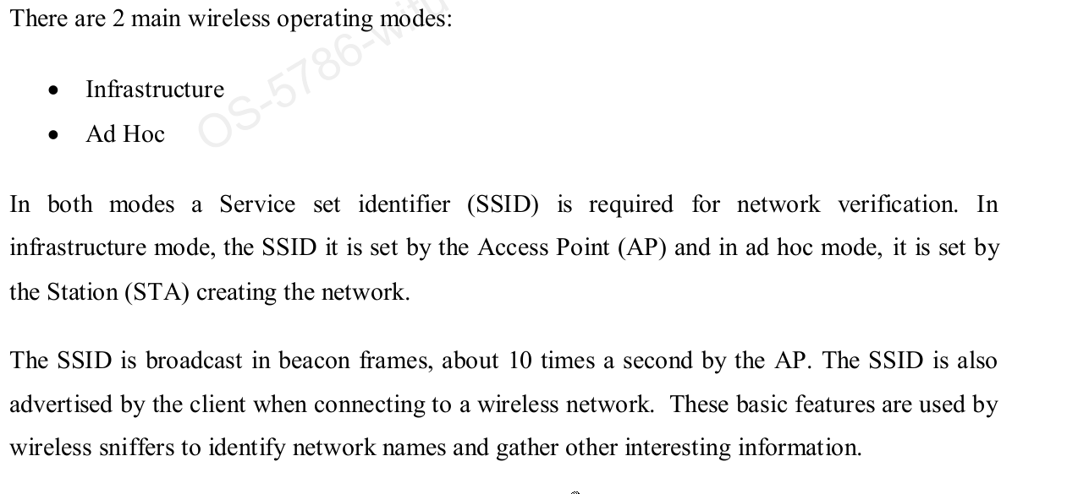
Wireless Operating Modes

Slide 22
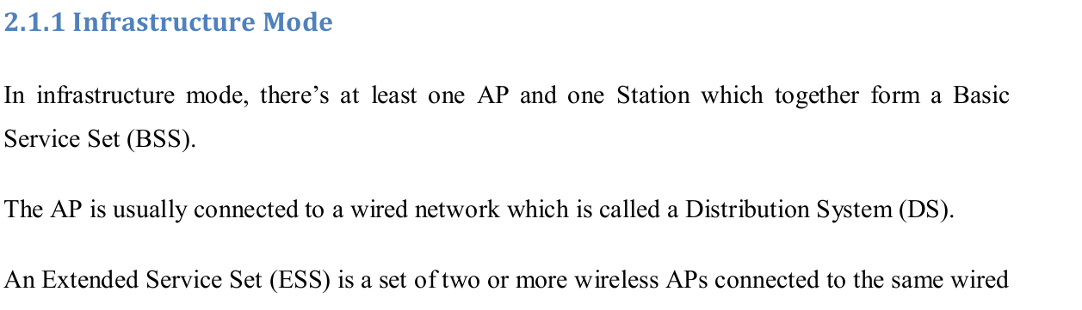
Wireless Operating Modes (Cont’d)

Slide 23
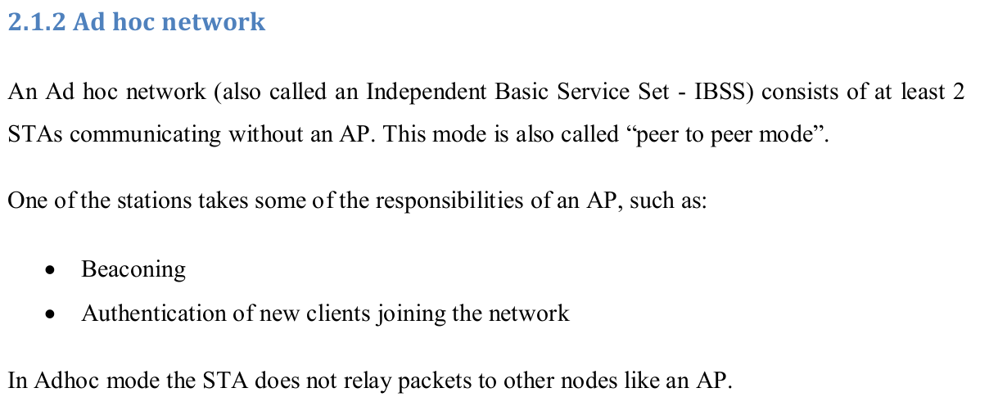
Wireless Operating Modes (Cont’d)

Slide 24
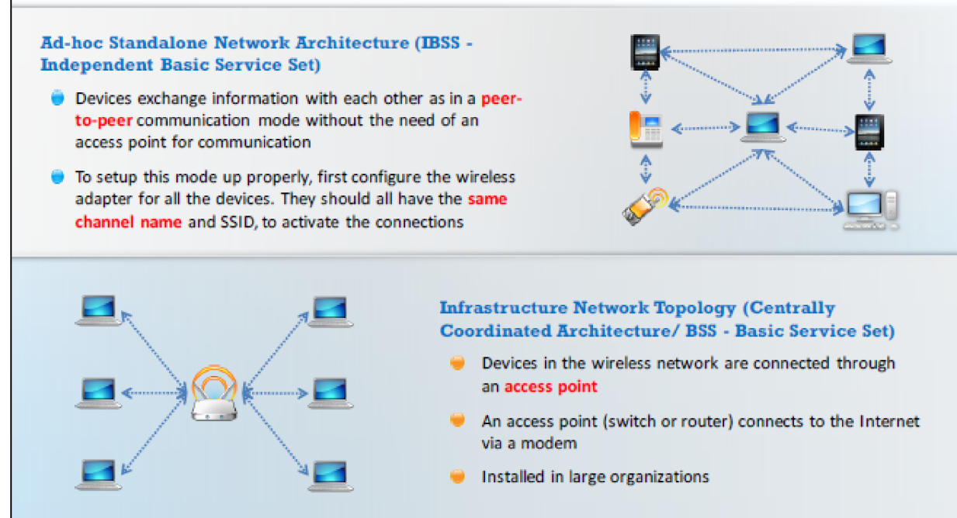
Wireless Operating Modes (Cont’d)

Slide 25

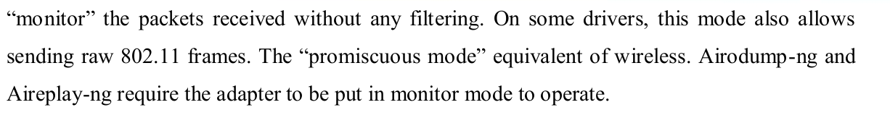
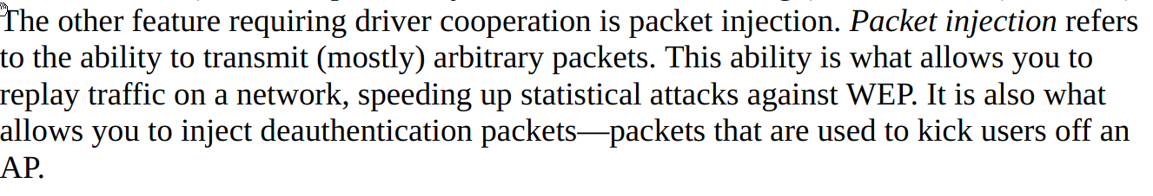
Wireless Operating Modes (Cont’d)
G

Slide 26
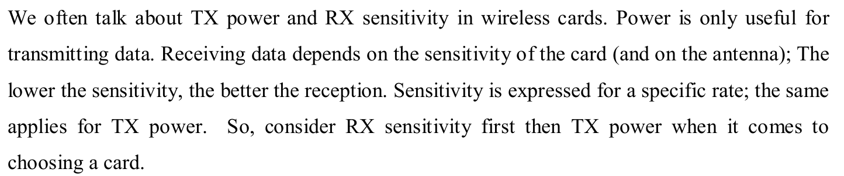
Choosing a Network Card
1- Atheros is the recommended chipset to use under Linux
* TP-LINK TL-WN610G (One of the cheapest Cardbus Atheroos cards available (Light budget)
2- Realtek 8187
* Alfa AWUS036H

Slide 27
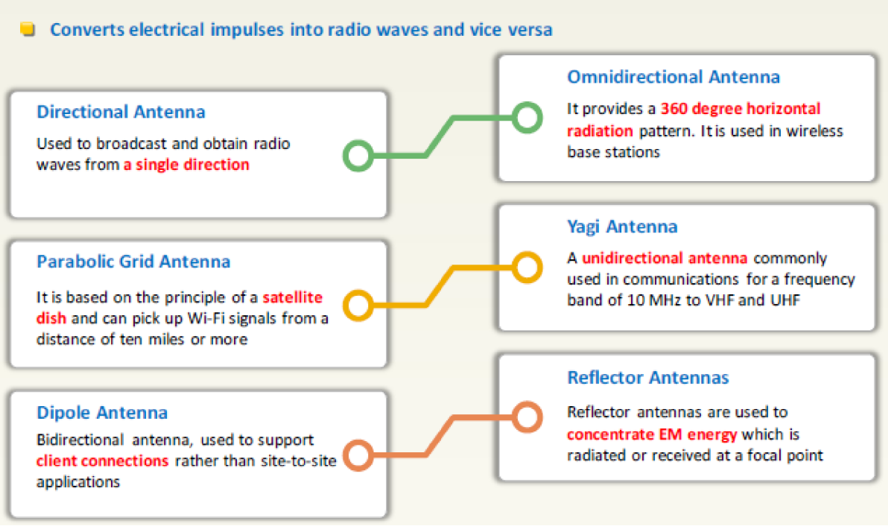
Wireless Antennas
G

Slide 28
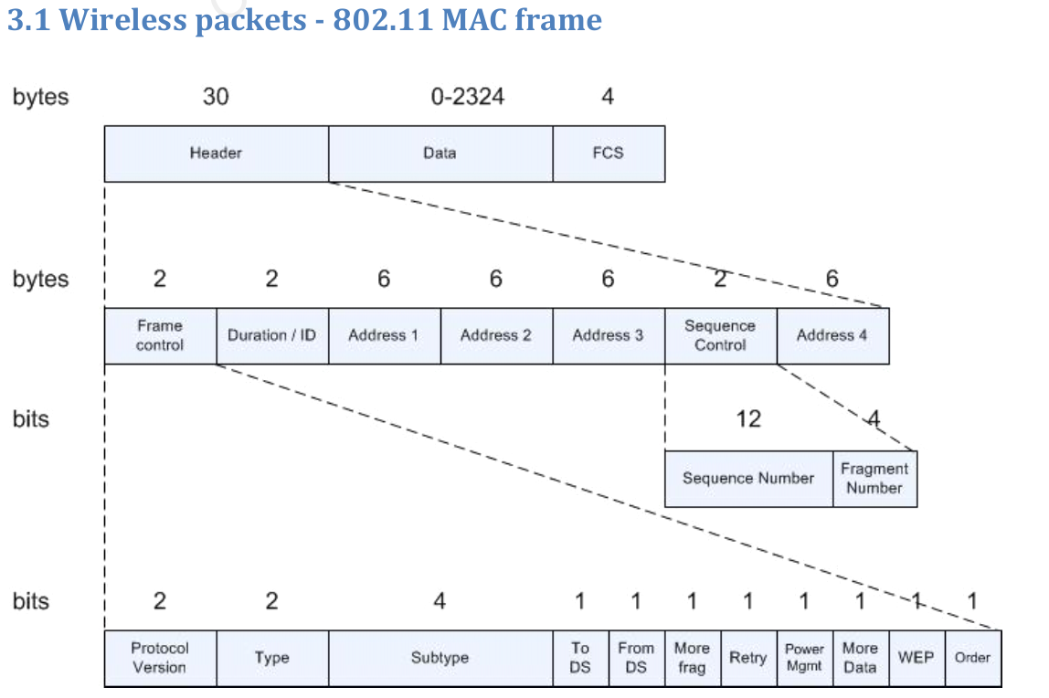
802.11 MAC Frame
G

Slide 29
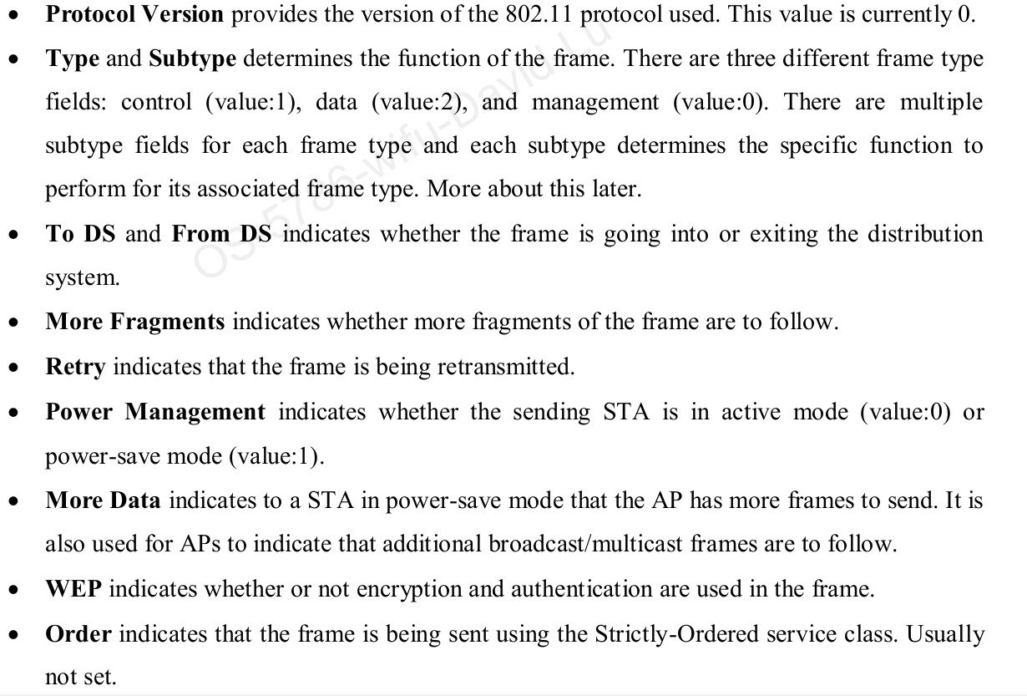
802.11 Header – Frame Control
G

Slide 30
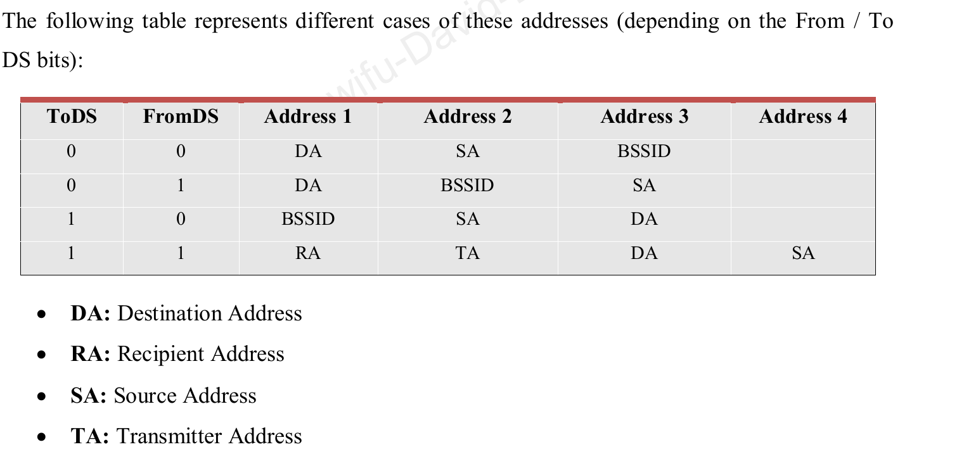
802.11 Header – Addresses
G

Slide 31
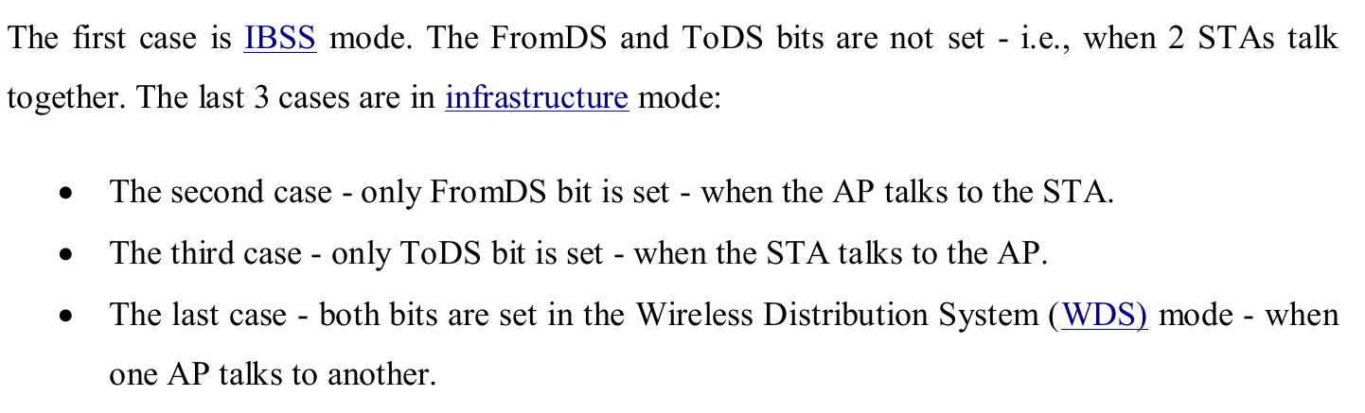
802.11 Header – Addresses
G

Slide 32
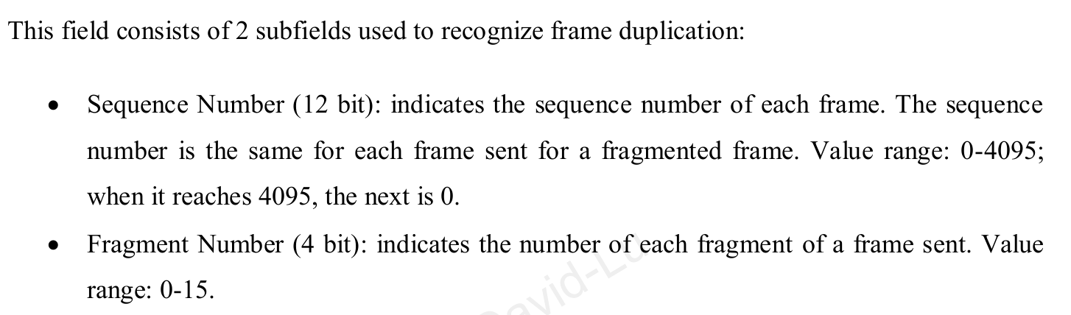
802.11 Header – Sequence Control
G

Slide 33
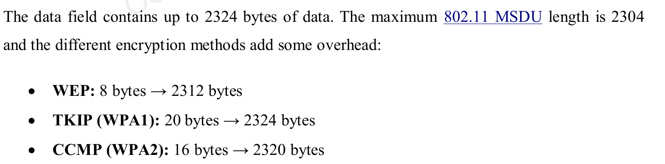
802.11 – Data
G

Slide 34
802.11 –Types
G
There are three types of 802.11 frames:
Management Frames (Type 0)---Govern communications between stations, except flow con­troll
Control Frames (Type 1) --- Support flow control and checksum.
Data Frames (Type 2)--- It is where encryption algorithms like WEP and WPA2 implemented to encrypt the transmitted data between the access point and the clients

Slide 35
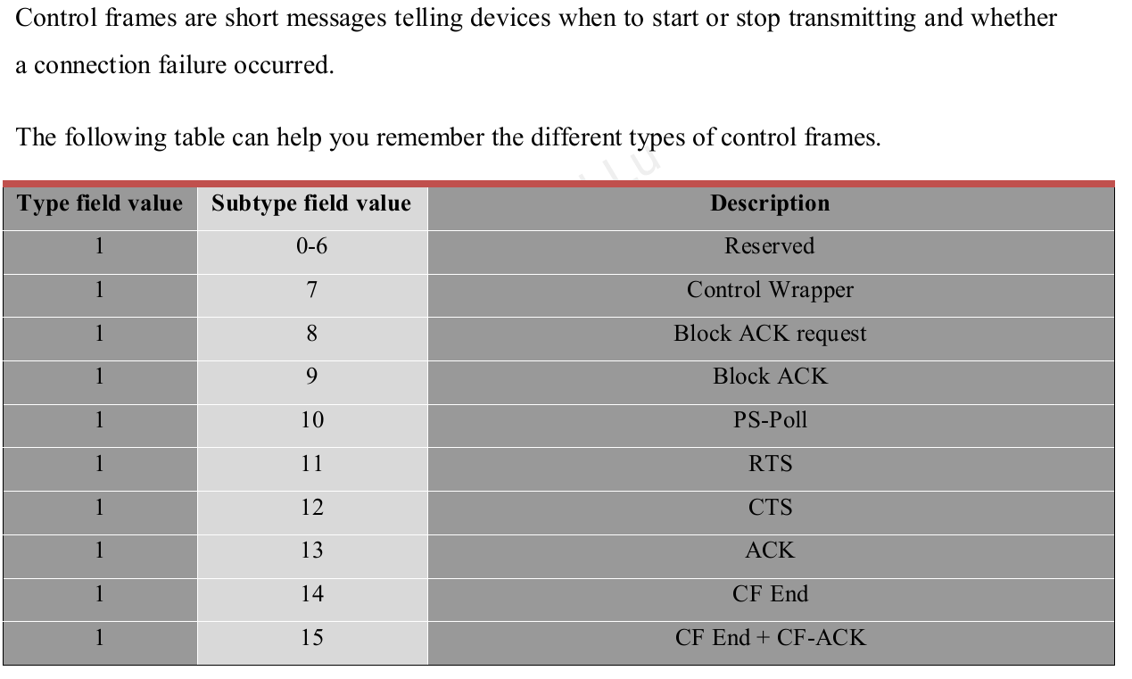
802.11 Control Frame – Type 1
G

Slide 36
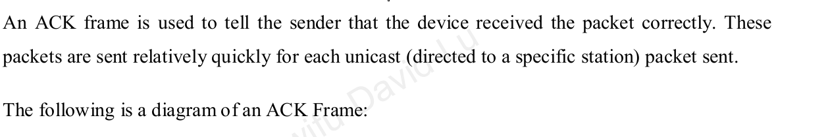
802.11 Control Frame – Type 1
G
Ack

Slide 37
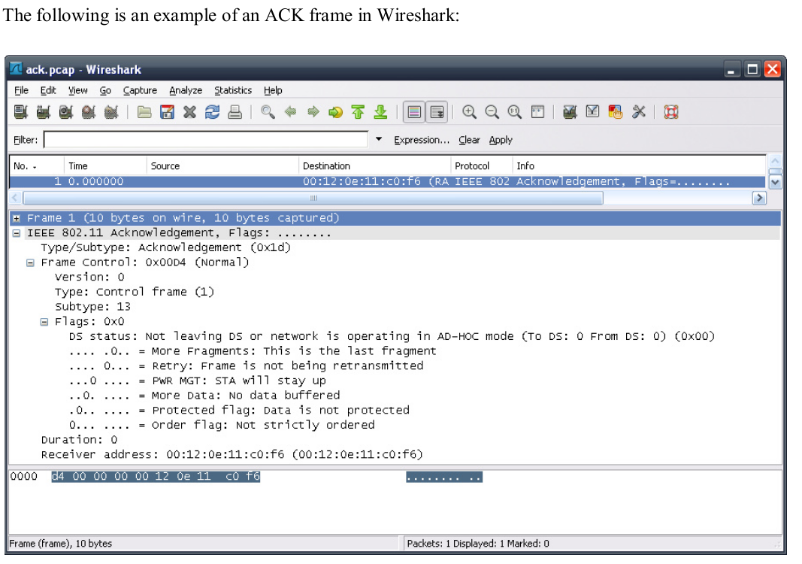
802.11 Control Frame – Type 1
G

Slide 38
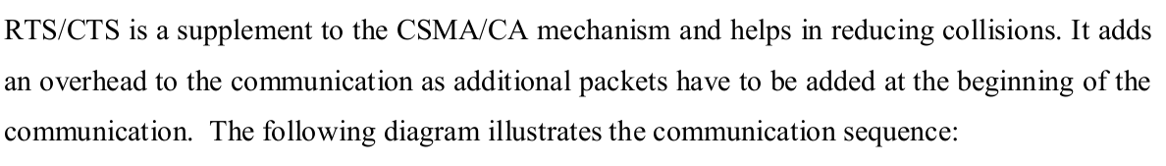
802.11 Control Frame – Type 1
G
PS-Poll
Adapters can be put in power-saving mode (nearly-off) to increase battery lifetime. When a station is in power save mode, the traffic to it is buffered by the AP.
RTS/CTS

Slide 39
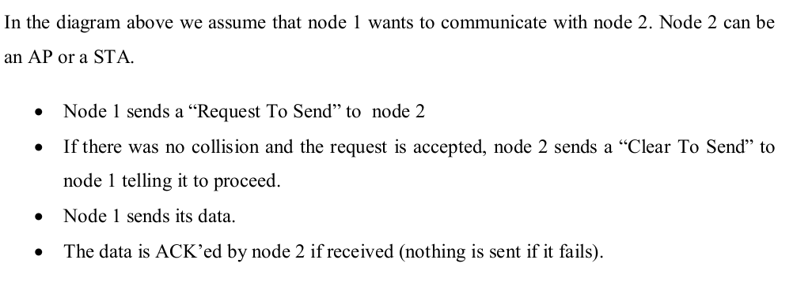
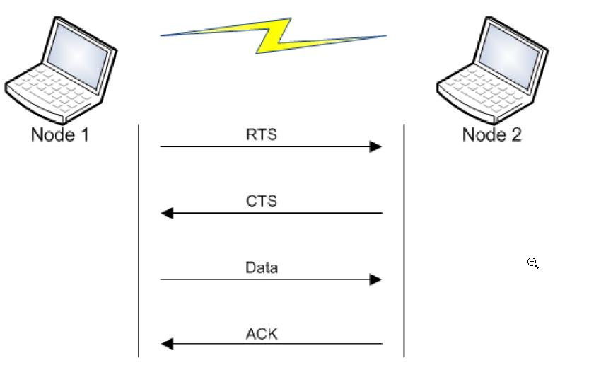
802.11 Control Frame – Type 1
G

Slide 40
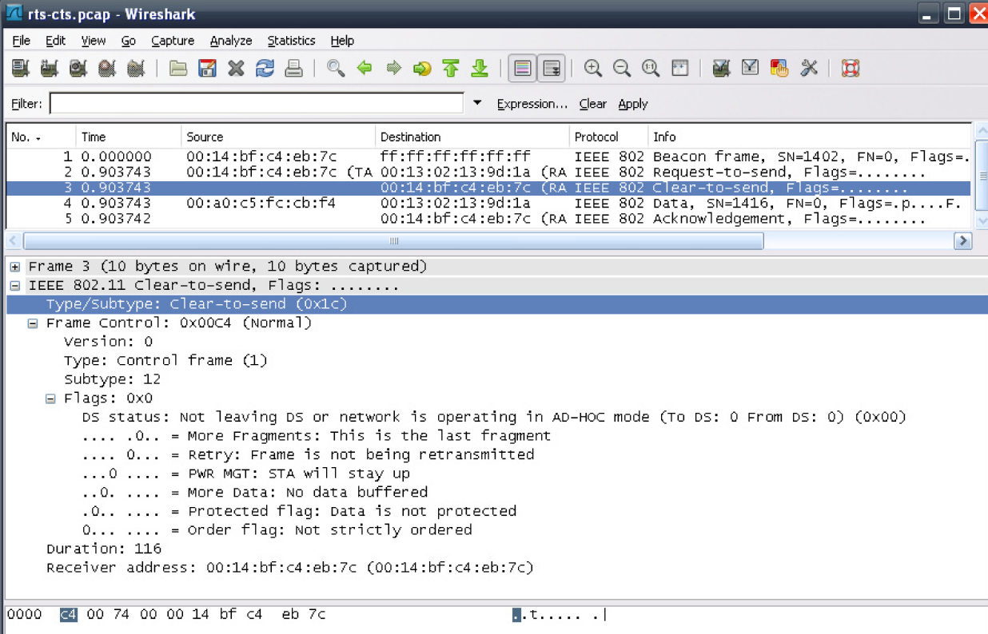
802.11 Control Frame – Type 1
Clear-to-Send example in Wireshark
G

Slide 41
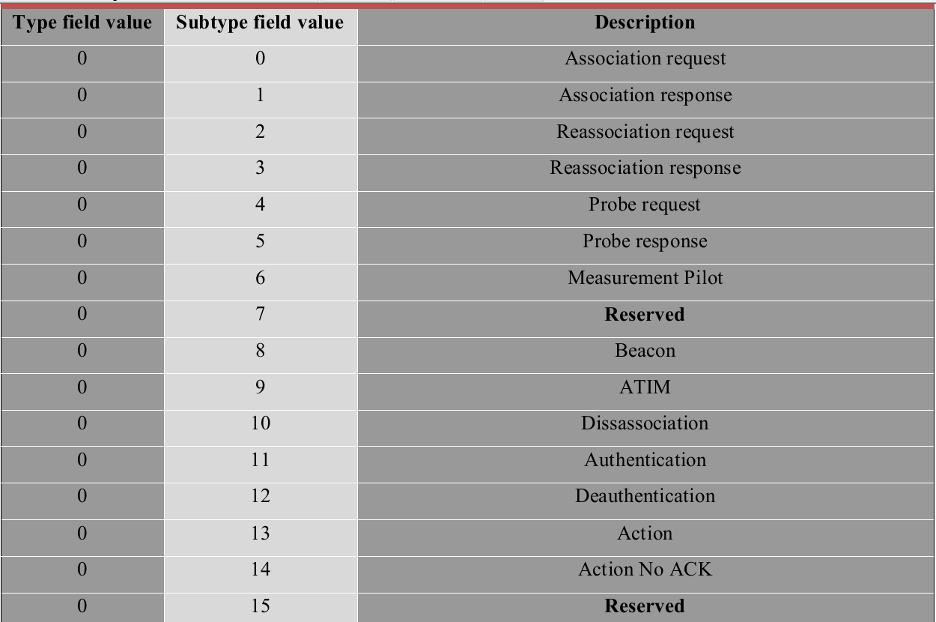
802.11 Management Frame – Type 0
G

Slide 42
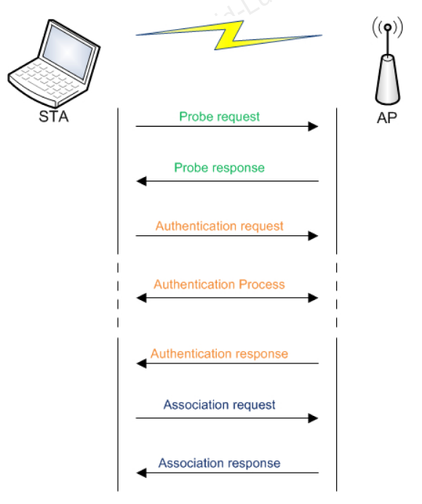
802.11 Management Frame – Type 0
The following diagram illustrates the stages involved in connecting to a network
G

Slide 43
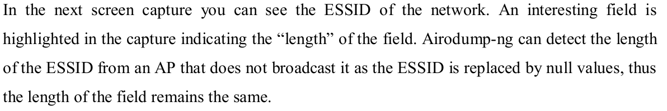
802.11 Management Frame – Type 0
Beacon Frame
Beacon frame are the most common packets as they are sent at a rate of around 10 times per second. Technically, they are sent to keep the network synchronized.
The beacons contain useful information about the network, such as the network name (unless SSID broadcast is disabled), the capabilities of the AP, the rates available and so on.
G

Slide 44
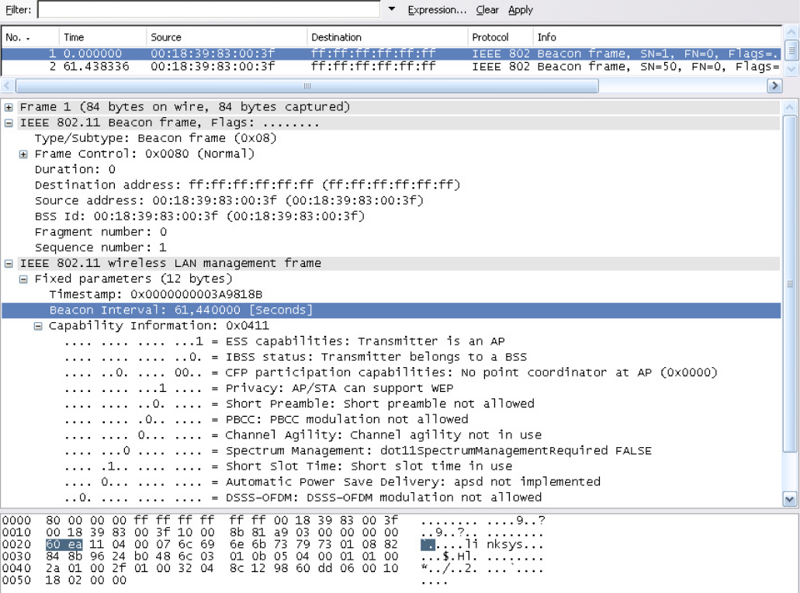
802.11 Management Frame – Type 0 Beacon Frame
G

Slide 45
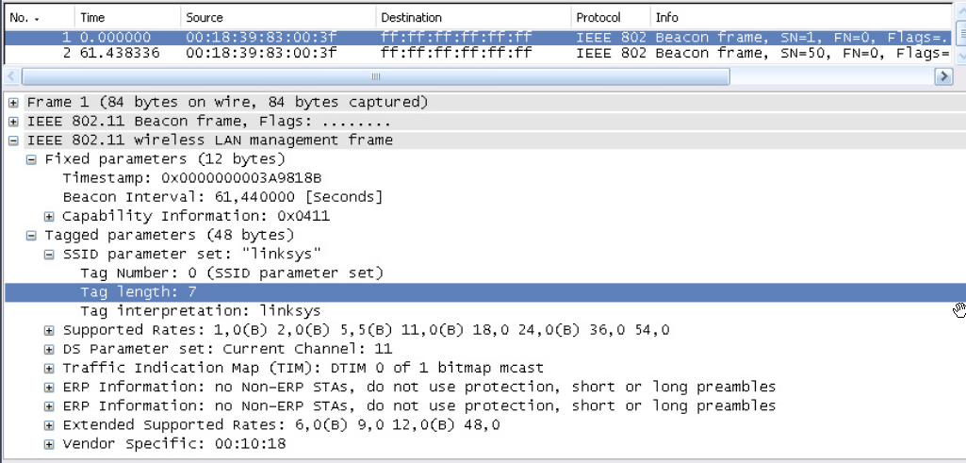
802.11 Management Frame – Type 0 Beacon Frame
Sniffing tools can detect the “length” of the ESSID from an AP that does not broadcast it.
The ESSID is replaced by null values this the length of the field remains the same
G

Slide 46
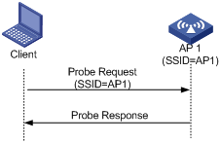
802.11 Management Frame – Type 0 Prob Request
Sniffing tools can detect the “length” of the ESSID from an AP that does not broadcast it.
The ESSID is replaced by null values this the length of the field remains the same
For security reason, some networks and access points can be configured to conceal the transmitted SSID in beacon frames.
The option can be accomplished by transmitting either a single SSID or a broadcast SSID, however, it should be sent as exactly as it was set
Networks and Access points that tend to hide its SSID will basically tend to not respond to any received probe request with a broadcast SSID but must respond to probe requests with the exact given SSID

Slide 47
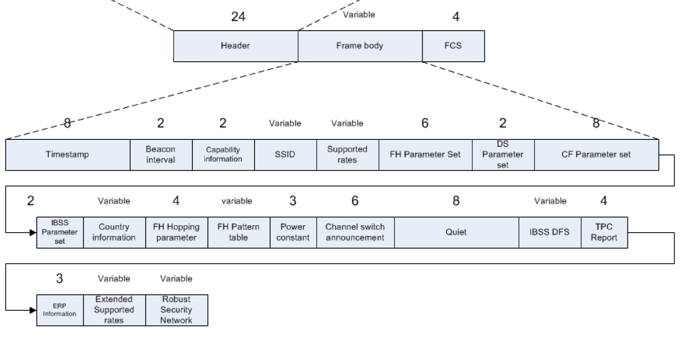
802.11 Management Frame – Type 0 Prob Response
Sniffing tools can detect the “length” of the ESSID from an AP that does not broadcast it.
The ESSID is replaced by null values this the length of the field remains the same
A response is sent only if the values found in the request (rates and ESSID) are the same as the ones that the node supports.
The node that answers to the request is the last node that sent a beacon.

Slide 48
802.11 Management Frame – Type 0 Authentication
Sniffing tools can detect the “length” of the ESSID from an AP that does not broadcast it.
The ESSID is replaced by null values this the length of the field remains the same
The authentication Algorithm number identifies the type of authentication used.
A ‘0’ value indicates an open system authentication, “1” indicates shared key authentication
The authentication process consists of several authentication frames (the number of frames
exchanged vary).
The Authentication Transaction Sequence Number keeps track of the current state of the authentication process. It takes values from 1 to 65535.
The Status code indicates success (0 value) or failure (a value other than 0) in the authentication.
The challenge text is only present on share

Slide 49
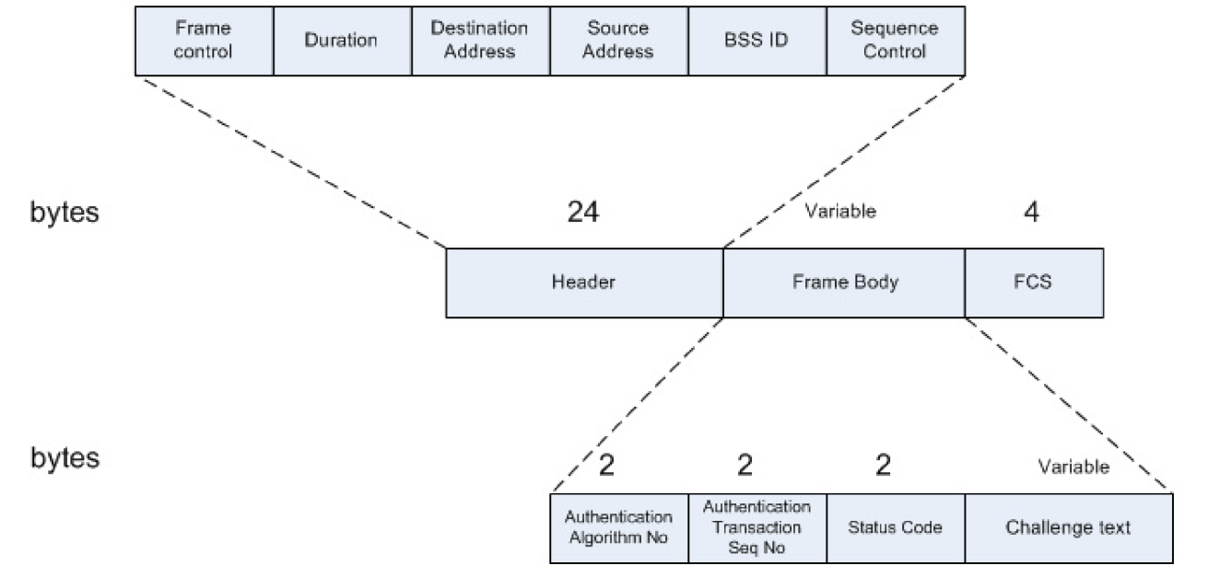
802.11 Management Frame – Type 0 Authentication
Sniffing tools can detect the “length” of the ESSID from an AP that does not broadcast it.
The ESSID is replaced by null values this the length of the field remains the same

Slide 50
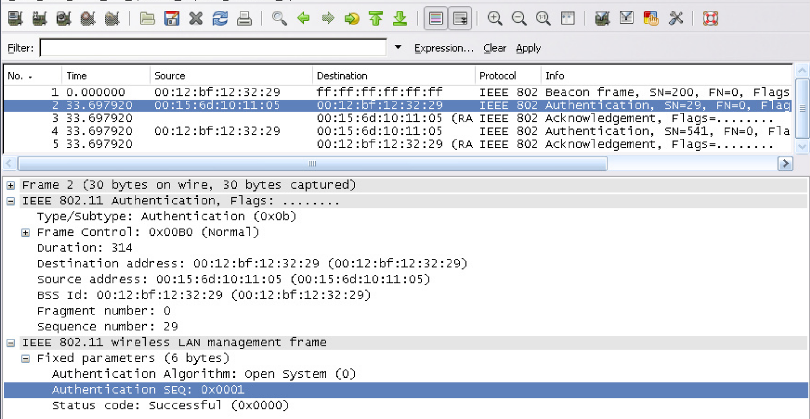
802.11 Management Frame – Type 0 Authentication
Sniffing tools can detect the “length” of the ESSID from an AP that does not broadcast it.
The ESSID is replaced by null values this the length of the field remains the same

Slide 51
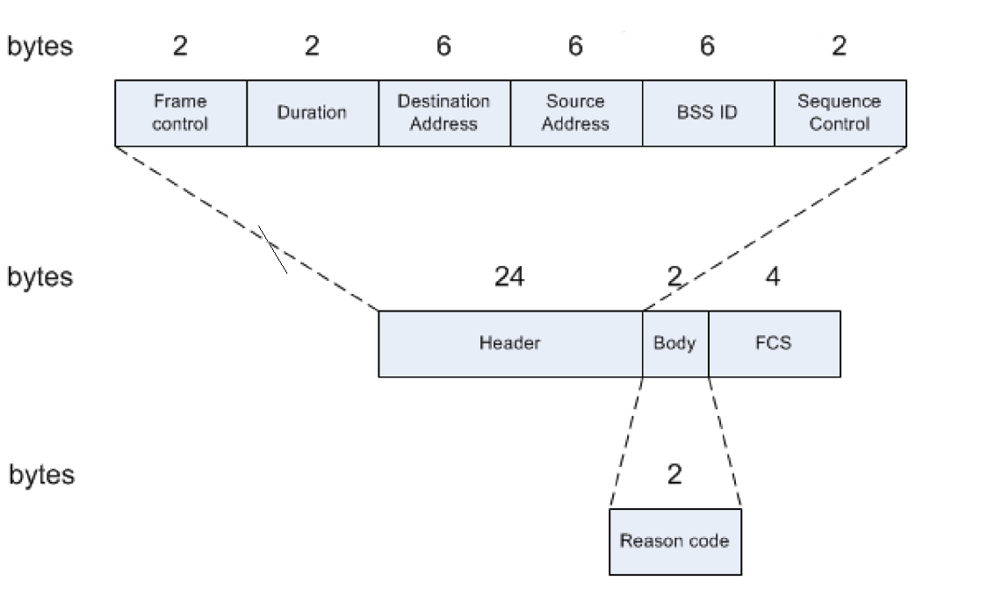
802.11 Management Frame – Type 0 Deauthentication
Sniffing tools can detect the “length” of the ESSID from an AP that does not broadcast it.
The ESSID is replaced by null values this the length of the field remains the same

Slide 52

802.11 Management Frame – Type 0 Deauthentication Bytes Structure
Sniffing tools can detect the “length” of the ESSID from an AP that does not broadcast it.
The ESSID is replaced by null values this the length of the field remains the same

Slide 53

802.11 Management Frame – Type 0 Different Reason Code
Sniffing tools can detect the “length” of the ESSID from an AP that does not broadcast it.
The ESSID is replaced by null values this the length of the field remains the same

Slide 54

802.11 Data Frame
Sniffing tools can detect the “length” of the ESSID from an AP that does not broadcast it.
The ESSID is replaced by null values this the length of the field remains the same
The purpose of the data frame is to transfer data from an upper layer of a station to another wireless (or wired) machines. The subtypes of data frames are as follow:

Slide 55

802.11 NULL Function
Sniffing tools can detect the “length” of the ESSID from an AP that does not broadcast it.
The ESSID is replaced by null values this the length of the field remains the same

Slide 56

Interacting with Networks
Sniffing tools can detect the “length” of the ESSID from an AP that does not broadcast it.
The ESSID is replaced by null values this the length of the field remains the same

Slide 57

Interacting with Networks
Sniffing tools can detect the “length” of the ESSID from an AP that does not broadcast it.
The ESSID is replaced by null values this the length of the field remains the same
Let’s discuss these stages on the following given network:

Slide 58

Interacting with Networks (Cont’d)
Sniffing tools can detect the “length” of the ESSID from an AP that does not broadcast it.
The ESSID is replaced by null values this the length of the field remains the same

Slide 59

Interacting with Networks (Cont’d)
Sniffing tools can detect the “length” of the ESSID from an AP that does not broadcast it.
The ESSID is replaced by null values this the length of the field remains the same

Slide 60

Interacting with Networks (Cont’d)
Sniffing tools can detect the “length” of the ESSID from an AP that does not broadcast it.
The ESSID is replaced by null values this the length of the field remains the same

Slide 61

Interacting with Networks (Cont’d)
Sniffing tools can detect the “length” of the ESSID from an AP that does not broadcast it.
The ESSID is replaced by null values this the length of the field remains the same

Slide 62


Interacting with Networks (Cont’d)
Sniffing tools can detect the “length” of the ESSID from an AP that does not broadcast it.
The ESSID is replaced by null values this the length of the field remains the same

Slide 63


Interacting with Networks (Cont’d)
Sniffing tools can detect the “length” of the ESSID from an AP that does not broadcast it.
The ESSID is replaced by null values this the length of the field remains the same
Authentication using WEP

Slide 64
Interacting with Networks (Cont’d)
Sniffing tools can detect the “length” of the ESSID from an AP that does not broadcast it.
The ESSID is replaced by null values this the length of the field remains the same
The main difference between the two is the actual conduct of the authentication.
Shared actually does an actual authentication while open automatically authenticates any client regardless of whether he actually has the correct WEP keys.
In WEP shared, a client initiates the connection by requesting authentication from the access point, which then sends out a clear text challenge.
The client needs to encrypt the clear text then send it back to the access point.
The access point decrypts the encrypted message and compares it to the clear text it sent out. If the two matches, the authentication succeeds and the client is connected.

Slide 65
Interacting with Networks (Cont’d)
Sniffing tools can detect the “length” of the ESSID from an AP that does not broadcast it.
The ESSID is replaced by null values this the length of the field remains the same
With WEP open, there is no challenge and clear text.
The request of the client is automatically authenticated and connected.
Using WEP open doesn’t really mean that anyone can openly use the network.
Even if they manage to connect to the network, they still need to have the WEP keys since it is used to encrypt all the traffic and the client will not be able to decrypt that without the appropriate WEP keys.

Slide 66

Interacting with Networks (Cont’d)
Sniffing tools can detect the “length” of the ESSID from an AP that does not broadcast it.
The ESSID is replaced by null values this the length of the field remains the same
Shared Authentication

Slide 67

Interacting with Networks (Cont’d)
Sniffing tools can detect the “length” of the ESSID from an AP that does not broadcast it.
The ESSID is replaced by null values this the length of the field remains the same
Shared key Authentication packets

Slide 68

Interacting with Networks (Cont’d)
Sniffing tools can detect the “length” of the ESSID from an AP that does not broadcast it.
The ESSID is replaced by null values this the length of the field remains the same
The text will be encrypted and sent to the AP

Slide 69

Interacting with Networks (Cont’d)
Sniffing tools can detect the “length” of the ESSID from an AP that does not broadcast it.
The ESSID is replaced by null values this the length of the field remains the same
Open Authentication

Slide 70

Interacting with Networks (Cont’d)
Sniffing tools can detect the “length” of the ESSID from an AP that does not broadcast it.
The ESSID is replaced by null values this the length of the field remains the same
The following snapshot is an example of the open authentication

Slide 71

Interacting with Networks (Cont’d)
Sniffing tools can detect the “length” of the ESSID from an AP that does not broadcast it.
The ESSID is replaced by null values this the length of the field remains the same
The authentication is successful

Slide 72

Interacting with Networks (Cont’d)
Sniffing tools can detect the “length” of the ESSID from an AP that does not broadcast it.
The ESSID is replaced by null values this the length of the field remains the same
Association
It is the third and last stage before able to connect to and participate in a network.

Slide 73

Interacting with Networks (Cont’d)
Sniffing tools can detect the “length” of the ESSID from an AP that does not broadcast it.
The ESSID is replaced by null values this the length of the field remains the same
Open Networks
Open networks (public networks) do not involve encryption. Anyone running a wireless sniffer can intercept and see the traffic “as is”.
Hotspots and public mesh networks are good examples

