Slide 1
Wireless Security Unit 2 – Scanning and Enumerating 802.11 Networks
Dr. Haitham Alani
Faculty of Computer Engineering
Course number: 25444

Slide 2


Course Outline
Discovery Basics
Passive Scanning
Active Scanning
Scanning Countermeasure
Understanding Wardriving
Crucial commands for scanning
Scan the air with Linux core utility
Aircrack-ng Suite
Tips on Scanning
Wi-Fi Pineapple

Slide 3
Discovery Basics
Many tools can be used to scan for wireless networks, however they all fall into one of the two major categories: passive, and active.
Passive tools are designed to monitor the airwaves for any packets on a given channel.
They analyze the packets to determine which clients are talking to which access points
Active scanning tools work by sending out probe request packets hoping to get a response

Slide 4
Passive Scanning
Passive scanning tools don’t transmit packets themselves; instead, they listen to all the packets on a given channel then analyze those packets to see what’s going on.
Wireless card needs to support “monitor mode” to passively sniff the surrounding packets.
Putting a wireless card into monitor mode is similar to putting a normal wired Ethernet card into promiscuous mode.
Passive monitoring tools do not send prob requests, instead, they only listen to prob response.
Tools that implement passive scanning are called “scanners”

Slide 5
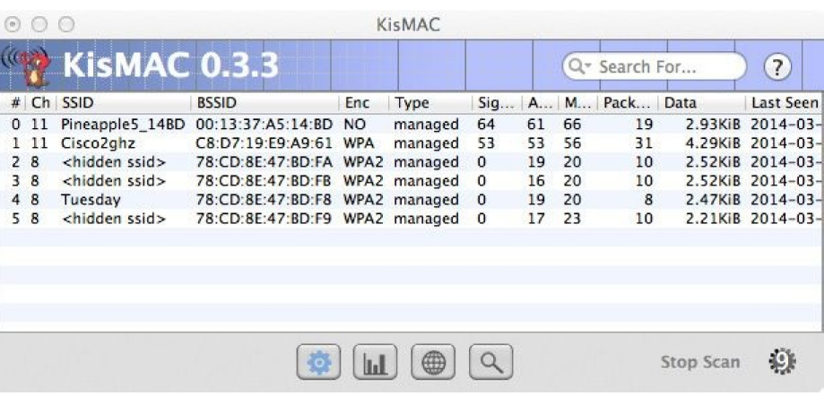
Passive Scanning (Cont’d)
NetMon, kismac and Airodump-ng are examples for some tools that are based on passive scanning

Slide 6
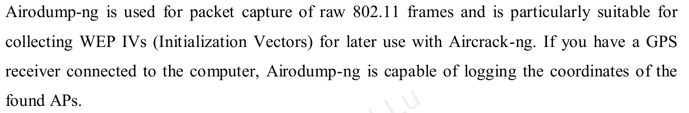
Passive Scanning (Cont’d)

Slide 7
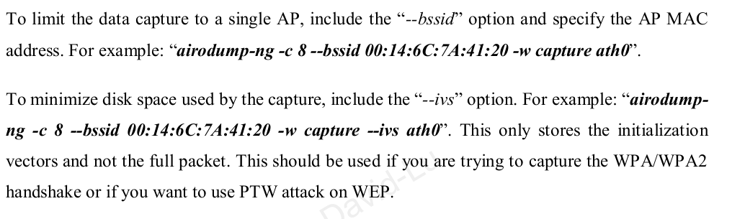
Passive Scanning (Cont’d)

Slide 8
Active Scanning
Tools that implement active scanning periodically send out probe request packets.
These packets are used by clients, whenever the are looking for a network.
Clients may send out targeted probe requests (“Network X, are you there?”)
Most operating systems will utilize active scanning when looking for networks to join
Tools that implement active scanning are called “Stumblers”

Slide 9
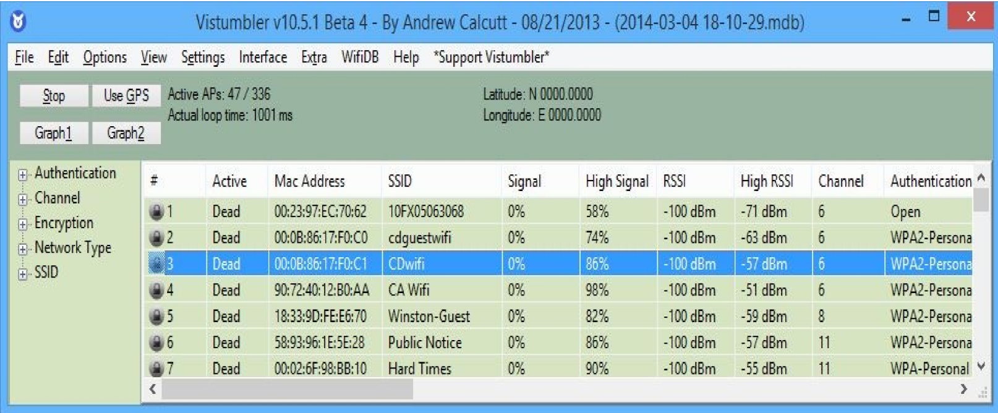
Active Scanning (Cont’d)
There are many tools that use Active scanning techniques
Vistumbler, Netstumbler and CommeView For Wifi are all considered Active Scanning Tools
These tools can be integrated with GPS to provide exact pinpoint to Access Points

Slide 10
Scanning Countermeasure
From your own perspective, how can you protect your network from Passive and Active scanning?

Slide 11
Wardriving
Wardriving is the practice of driving around with a wireless equipped computer that has a wireless network card and some sort of wireless tracking software, discovering and logging wireless networks.
Hackers use wardriving to :
Finding insecure access points
Intercepting unencrypted data
Wardriving (passively) is not illegal

Slide 12
Understanding Wardriving
An attacker or security tester simply drives around with the following equipment:
Wireless NIC
Laptop
An Antenna
Scanner or Stumbler
Most scanning software detects the company’s SSID, the type of security enabled, and the signal strength, indicating how close the AP is to the attacker.
Always pay attention to card sensitivity when it comes to scanning,
Sensitivity is measured in dBm. The more negative the number the better (-90 is better than -80)

Slide 13
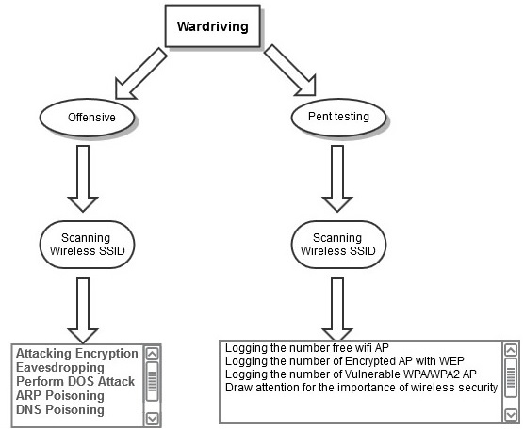
Understanding Wardriving (Cont’d)

Slide 14
Understanding Wardriving (Cont’d)
Some Wardrivers tend to leave signs to indicate the encountered access points security.
Leaving signs on the grounds is called “Warchalking”

Slide 15
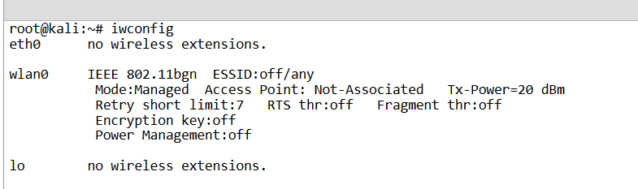
Crucial Commands for Scanning
To display the interfaces information, you can use iwconfig tool in Linux

Slide 16
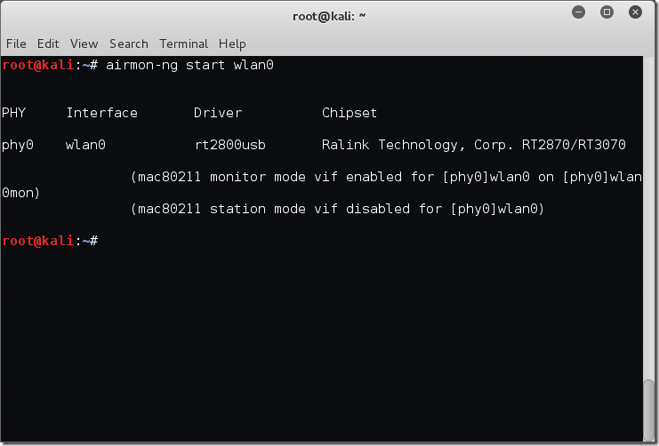
Crucial Commands for Scanning (Cont’d)
To turn your Wlan interface into a monitor mode, you can use airmon-ng tool that is part of aircrack-ng suite as follows:

Slide 17
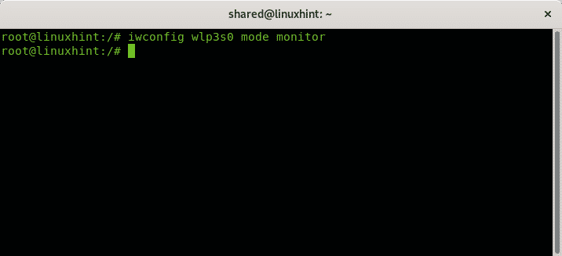
Crucial Commands for Scanning (Cont’d)
An alternative way to airmon-ng, you can use iwconfig also to turn your interface into a monitor mode:

Slide 18
Crucial Commands for Scanning (Cont’d)
To shutdown a particular interface, for example “wlan0” you can use the following command:
Sudo ifconfig wlan0 down
To bring it up again, you can use:
Sudo ifconfig wlan0 up
To tune your interface to a particular channel, type the following command:
Sudo iwconfig wlan0 channel 7

Slide 19
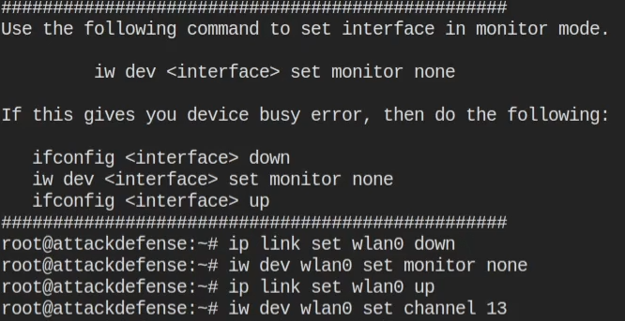
Crucial Commands for Scanning (Cont’d)
Alternative commands:

Slide 20
netsh wlan show profiles name=[profile name] key=clear
Crucial Commands for Scanning (Cont’d)
In Windows Operating system, netsh is the swiss army tool when it comes to wifi
To view your (saved) wireless network profiles,
netsh wlan show profiles
To recover the network security key of a particular network
netsh wlan show profiles name=[profile name] key=clear
To stop automatically connecting to a wireless network
netsh wlan set profileparameter name=[profile name] connectionmode=manual
To retrieve the Wireless hosted network details
netsh wlan show hostednetwork

Slide 21
Scan the air with Linux core utility
iwlist is a tool that comes pre-installed on almost every Linux system in the package core.
This is the same package that gives you all the useful commands like ls,ps,mv
You can use the following command to avoid NIC issues:
Service network-manager stop
Scan the air for available access points
iwlist wlan0 scan
Let’s see the output of the previous command:

Slide 22
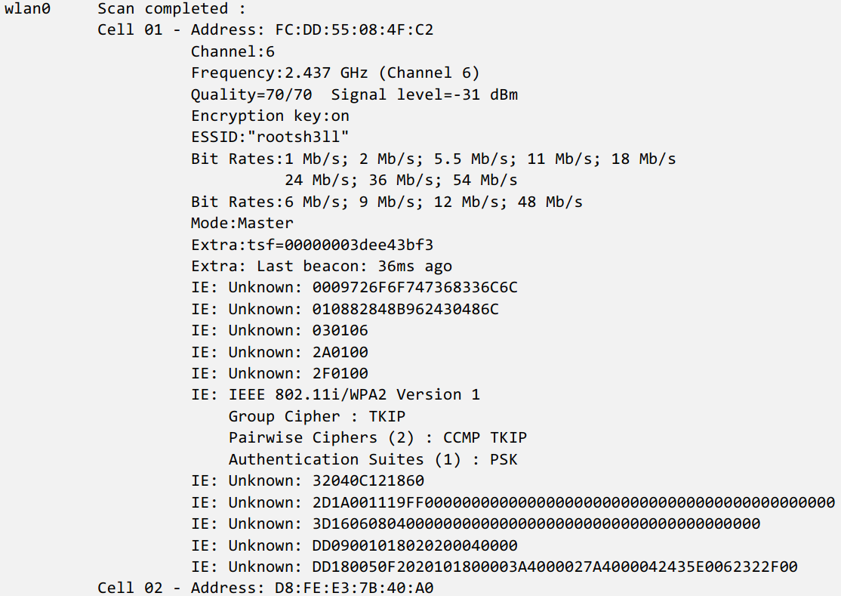
netsh wlan show profiles name=[profile name] key=clear
Scan the air with Linux core utility (Cont’d)

Slide 23
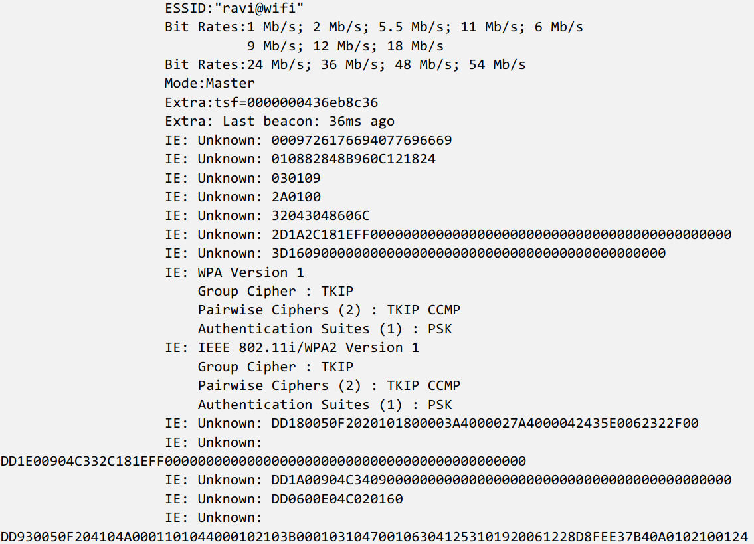
Scan the air with Linux core utility (Cont’d)

Slide 24
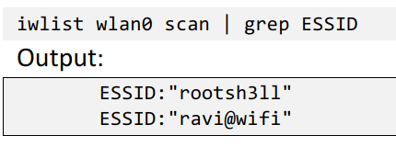
Connecting to a Network
The output of the previous command is very much cluttered.
We can use the power of grep to filter the output as follows:
How to connect to one of these networks using commands?
Let’s assume you want to connect to SSID “rootsh3ll”
You will need to create a configuration file using the tool wpa_passphrase

Slide 25
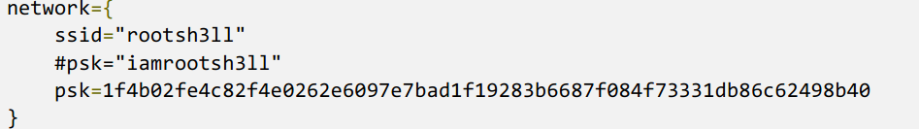
Connecting to a Network (Cont’d)
Now you will need to kill network manager:
Service network-manager stop
Install wpa_supplicant, if necessary using the command:
apt-get install wpasupplicant
Wpa_passphrase rootsh3ll iamrootsh3ll > wpa.conf
To display wpa.conf content:
cat wpa.conf

Slide 26
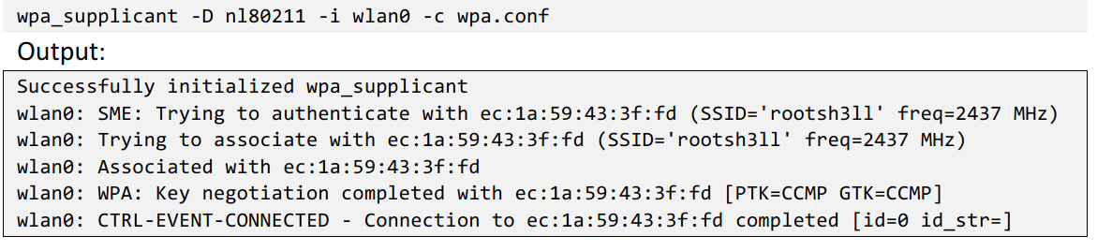
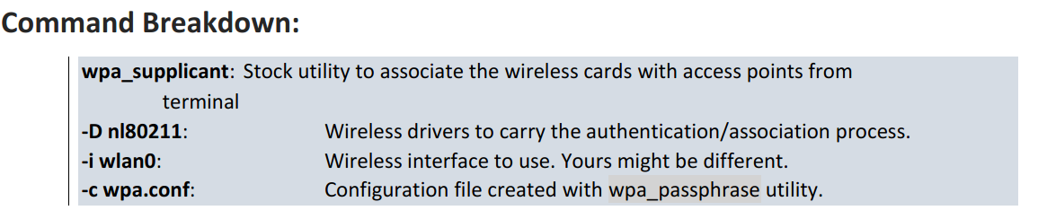
Connecting to a Network (Cont’d)
Now connect using the following command:

Slide 27
Aircrack-ng Suite
Aircrack-ng is a suite of tools used by both beginners and experts for wireless sniffing, cracking and creating rogue access points.
To put it in another way, aircrack-ng is an 802.11 WEP and WPA/2-psk keysonce enough data packets have been captured.
Aircrack-ng suite includes many tools:
Airmon-ng
Airodump-ng
Airbase-ng
Aireplay-ng
Airolib-ng
Aircrack-ng

Slide 28
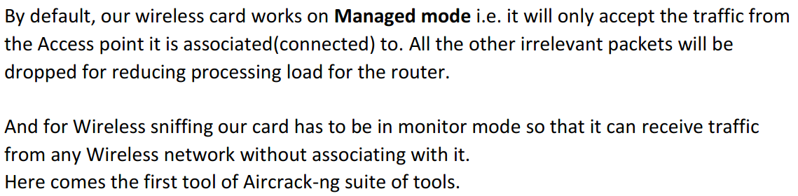
W
What is managed mode

Slide 29
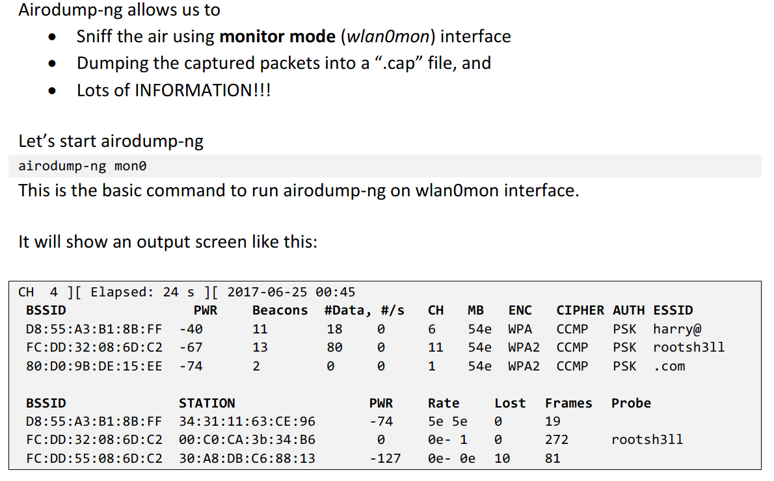
Airodump-ng

Slide 30
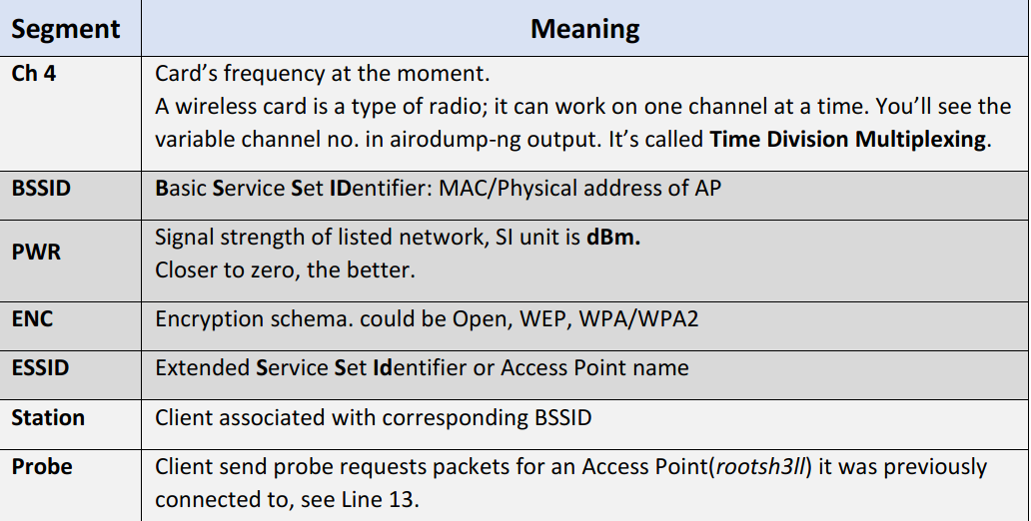
W
Airodump-ng

Slide 31
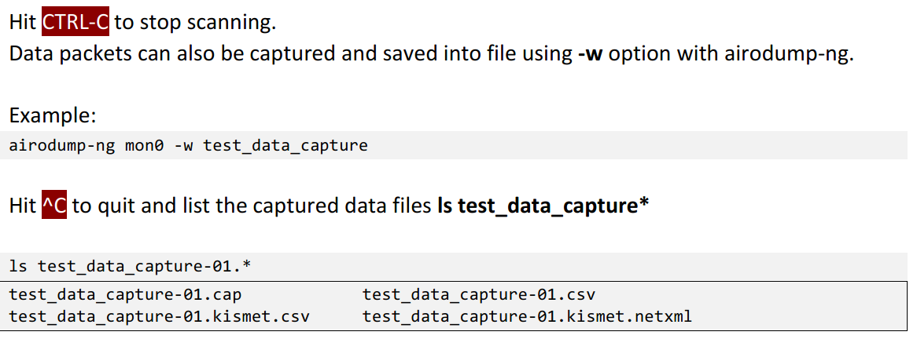
W
Airodump-ng (Cont’d)

Slide 32
Airodump-ng (Cont’d)
The “lost” field measures lost packets coming from the client.
To determine the number of packets lost, measurements are made on the sequence filed on every non-control frame.
The following are the reasons for the lost packets:
You cannot send data and listen to the network at the same time. Every time you send data you can’t hear the packets being transmitted for that interval
There is too much noise on the current channel (other Aps, microwave ovens)
You are losing packets due to a high transmit power

Slide 33
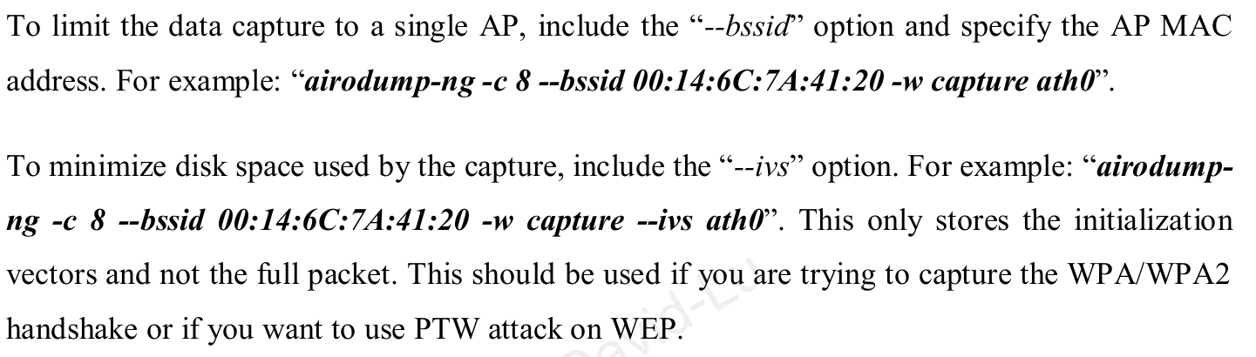
sudo iwconfig wlan0 channel 1
W
Various Tips

Slide 34
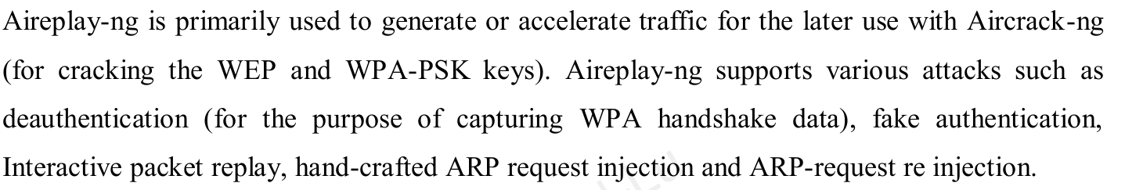
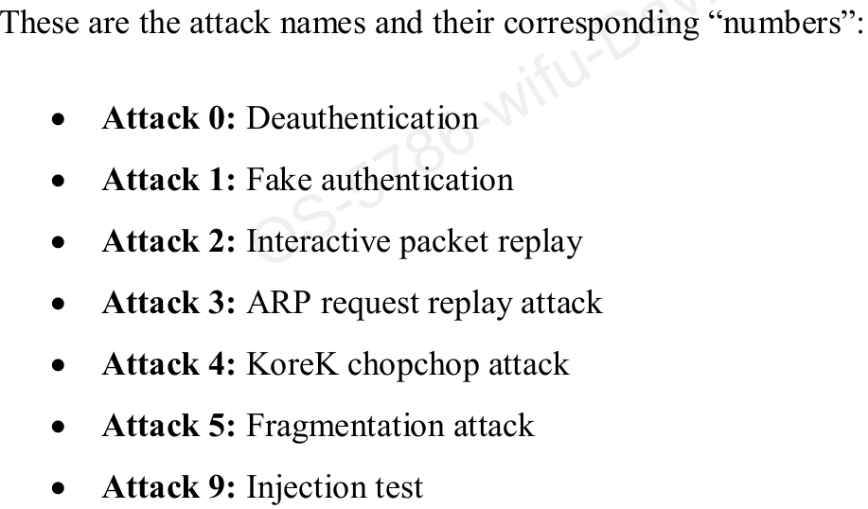
W
Aireplay-ng

Slide 35
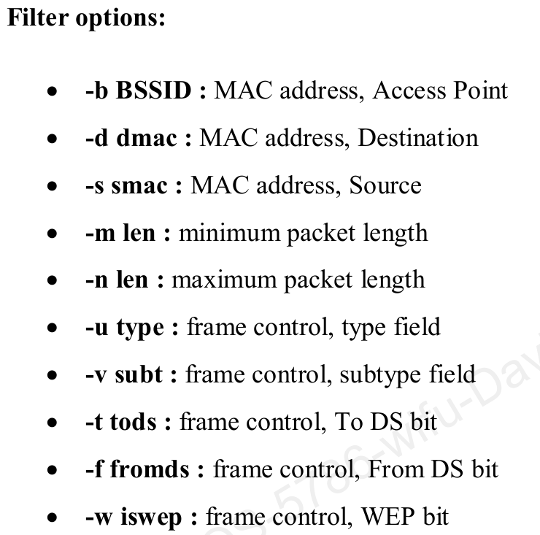
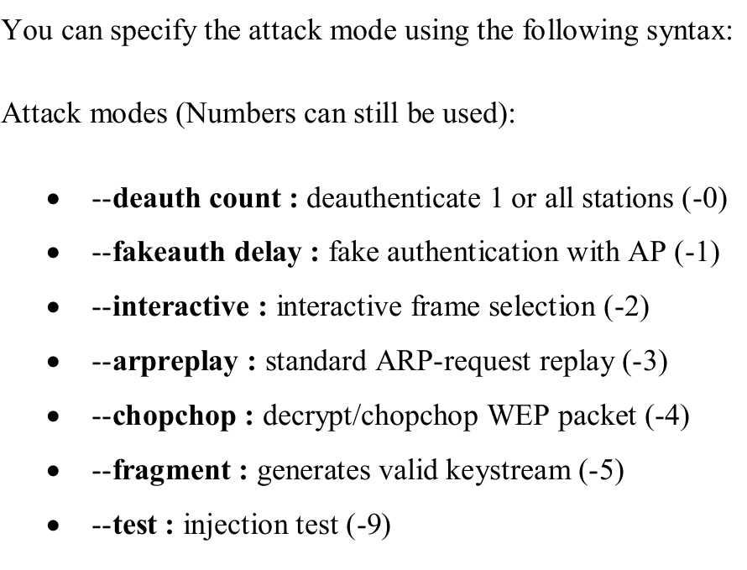
W
Aireplay-ng (Cont’d)

Slide 36
W
MAC Changer
In some situations you need to fake / change / spoof a MAC address of your network interface.
macchanger Linux command does this job in no time.
With this tool you can change your mac address of any Ethernet network device wired or wireless. Here is a small example:

Slide 37
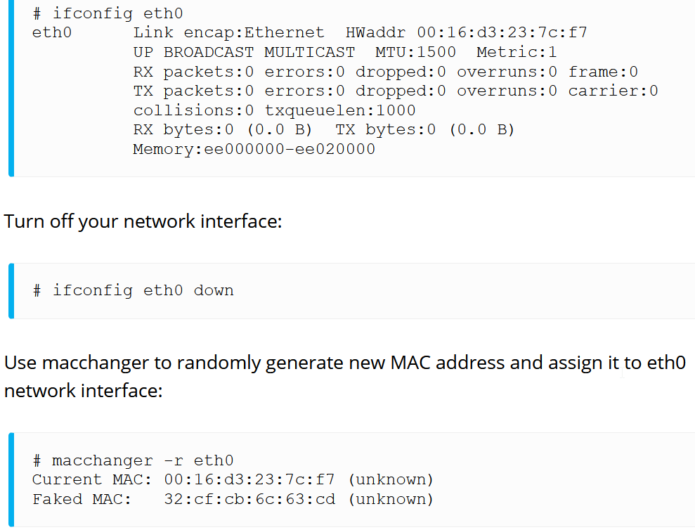
W
MAC Changer (Cont’d)

Slide 38

W
MAC Changer (Cont’d)

Slide 39
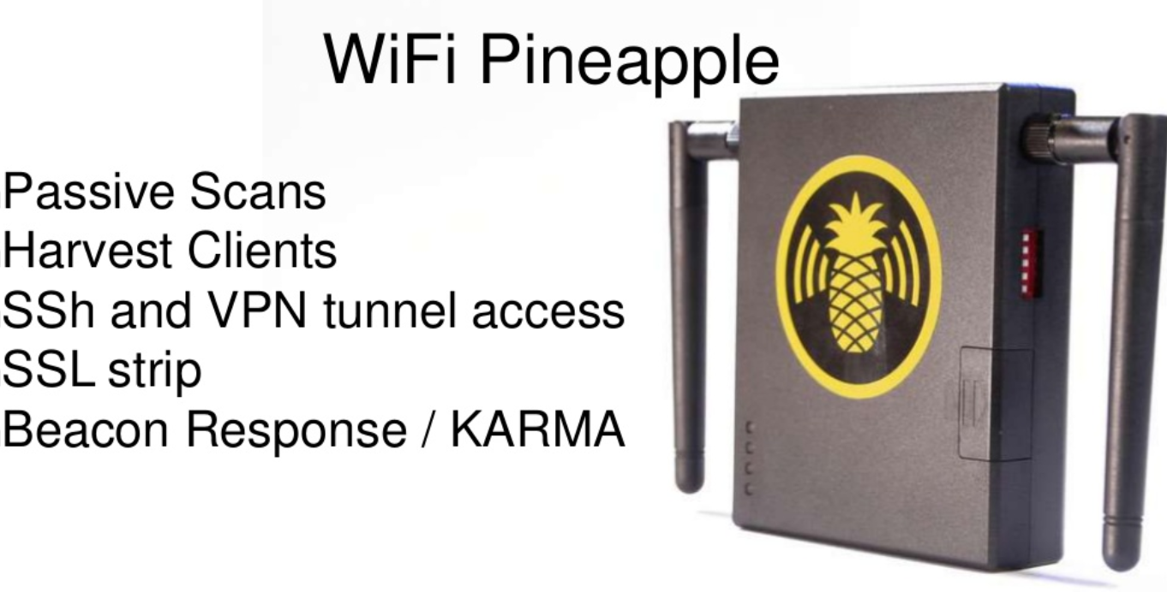
W
Wi-Fi Pineapple

Slide 40
W
Wi-Fi Pineapple (Cont’d)
Wifi Pineapple can perform passive scans using kismet or other tools found in Kali Linux.
Kismet can detect probes used by wifi devices set to automatically connect to an access point Wireshark can also be used

Slide 41
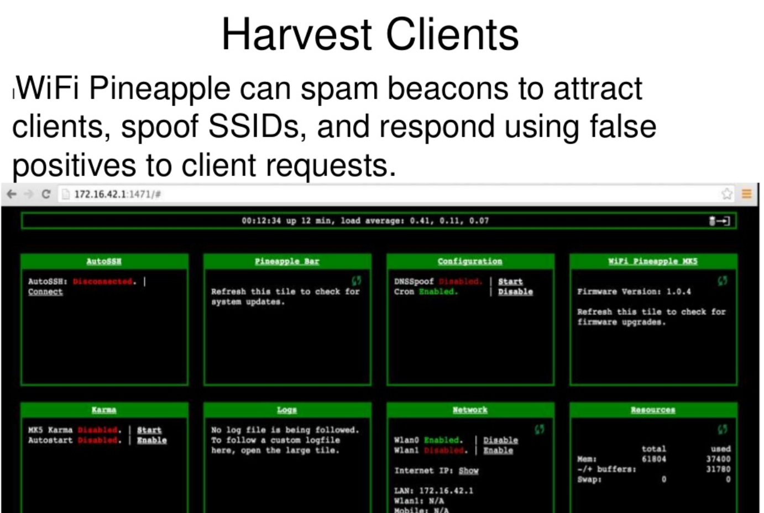
W
Wi-Fi Pineapple (Cont’d)

Slide 42
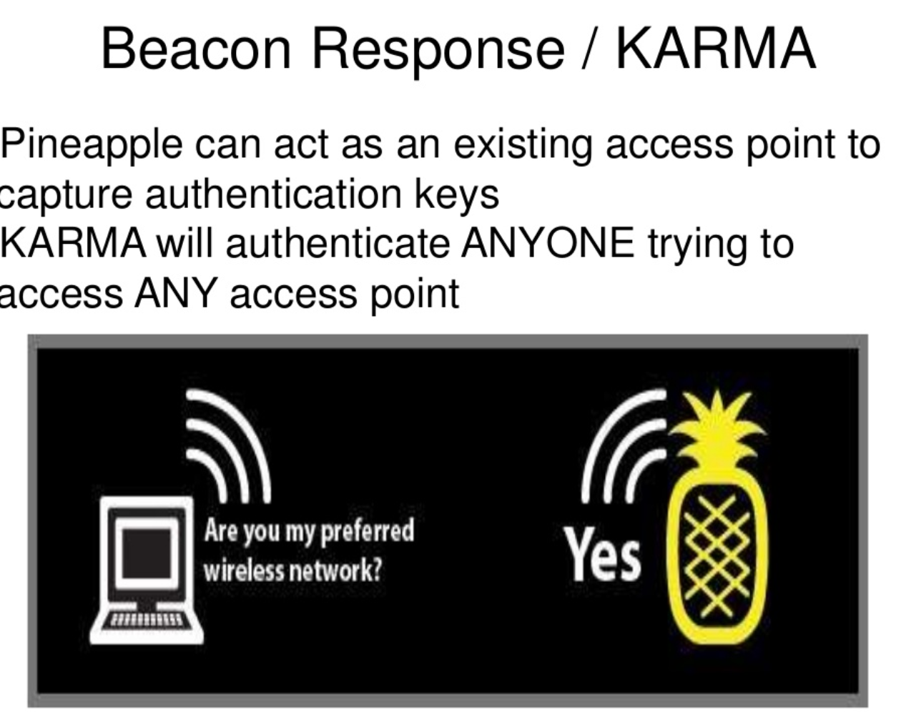
W
Wi-Fi Pineapple (Cont’d)

