Slide 1
Wireless Security Unit 3 – Attacking Wireless 802.11 Networks – Part 2-
Dr. Haitham Alani
Faculty of Computer Engineering
Course number: 25444

Slide 2


Course Outline
WPA/WPA2
WPA in Depth
WPA Handshaking
WPA/WPA2/WPA3
Cracking WPA
Speeding up WPA2 Cracking
Connecting to WPA/WPA2 Network
Cracking WPA/WPA2 with a client
Wi-Fi protected setup (WPS)
Cracking WPS with brute force
Final words

Slide 3
WPA/WPA2
WPA primarily uses the TKIP encryption algorithm
TKIP was aimed at improving WEP, without requiring completely new hardware to run it
WPA2 in contrast mandatorily uses the AES-CCMP algorithm for encryption which is more robust than the TKIP
Both WPA and WPA2 allow for either EAP-based authentication using Radius servers (Enterprise Mode) or a Pre-Shared key (Personal Mode) authentication

Slide 4
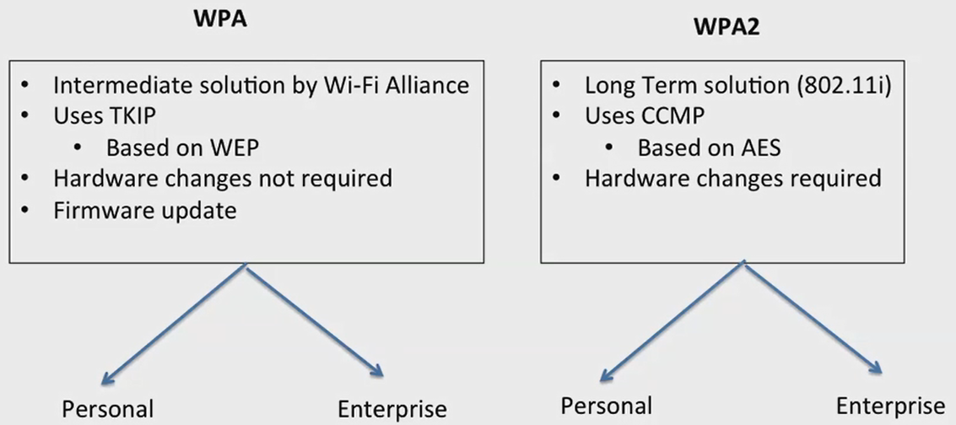
WPA/WPA2 (Cont’d)
Both WPA/WPA2 PSK is vulnerable to dictionary attack. The inputs required for this attack are the four-way WPA handshake between client and access point, and a wordlist containing common passphrases
Then, using tools like Aircrack-ng we can try to crack the WPA WPA2 PSK passphrase

Slide 5
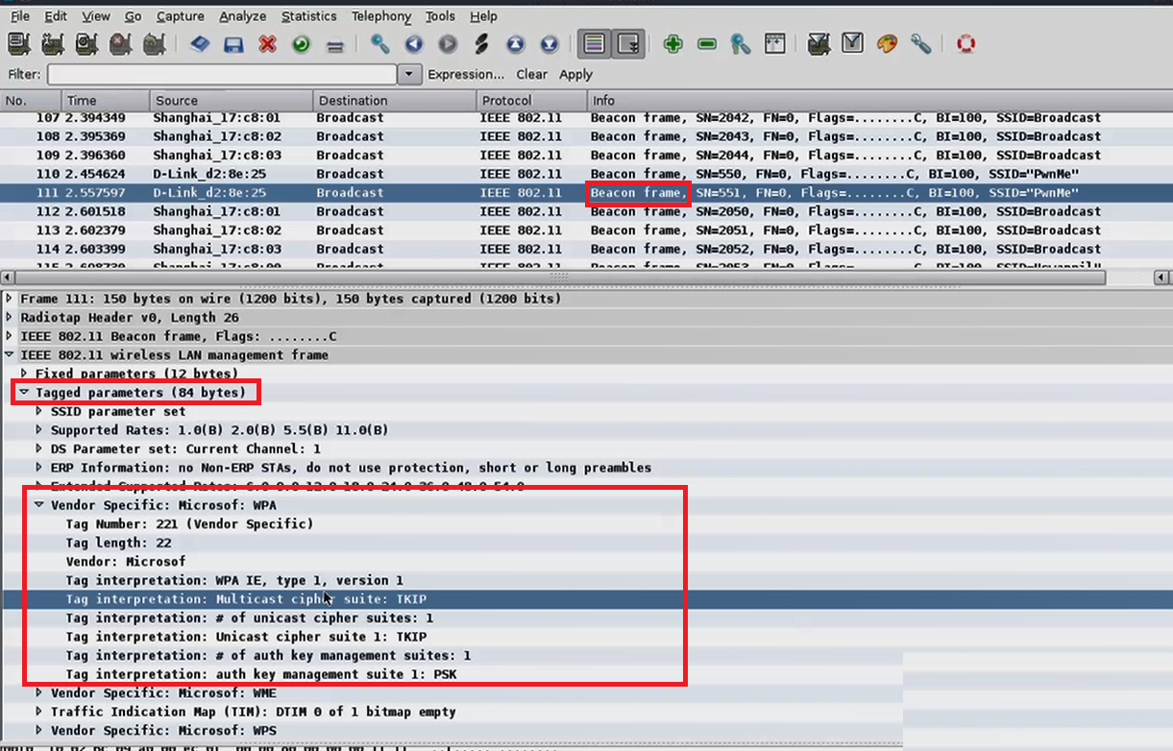
WPA/WPA2 (Cont’d)
How does the client know the AP configuration? (Beacons ? Probe requests? Association Response?)

Slide 6
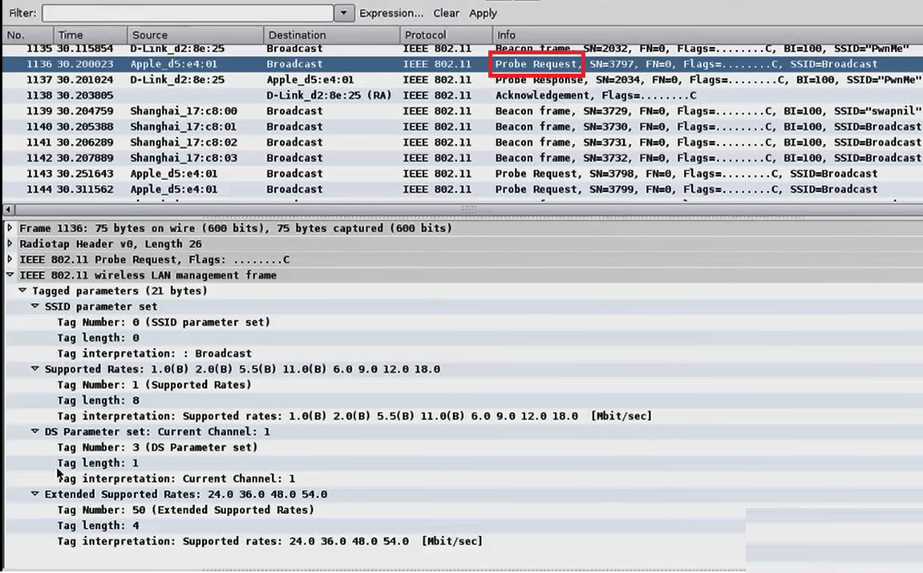
WPA/WPA2 (Cont’d)
What about Prob Requests?

Slide 7
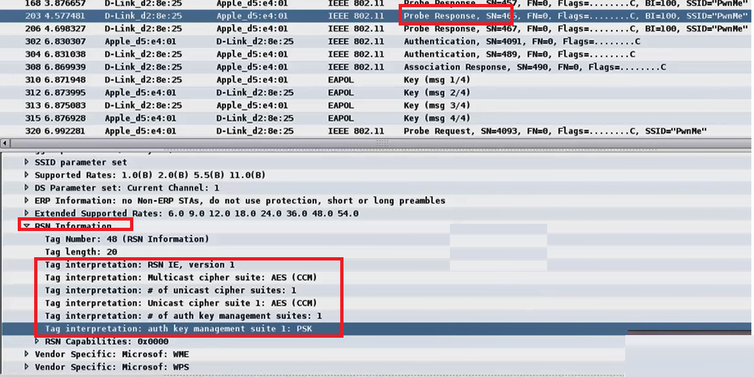
WPA/WPA2 (Cont’d)
And here goes the Probe Response!

Slide 8
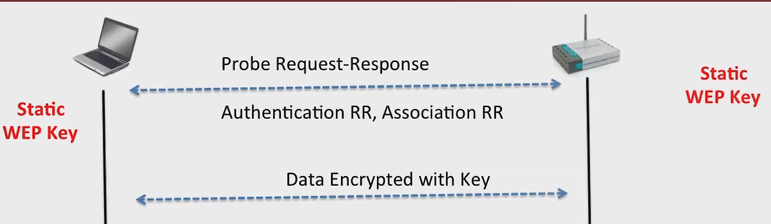
WPA (Wi-Fi Protected Access) in Depth
Remember the WEP ?

Slide 9
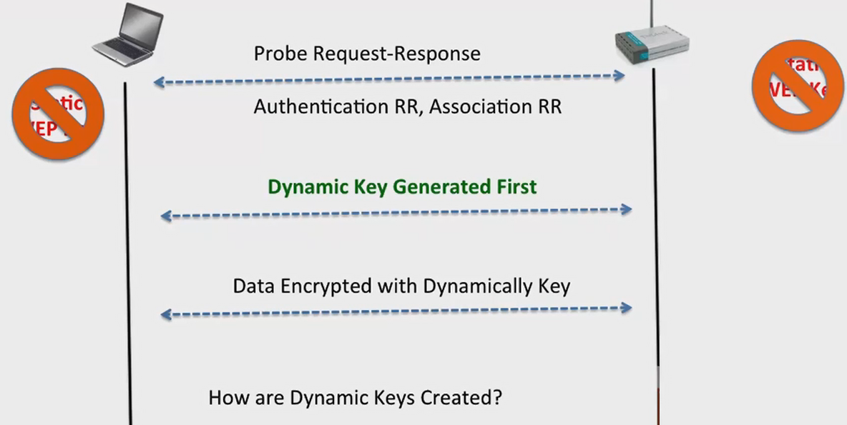
WPA (Wi-Fi Protected Access) in Depth (Cont’d)
Meanwhile in WPA

Slide 10
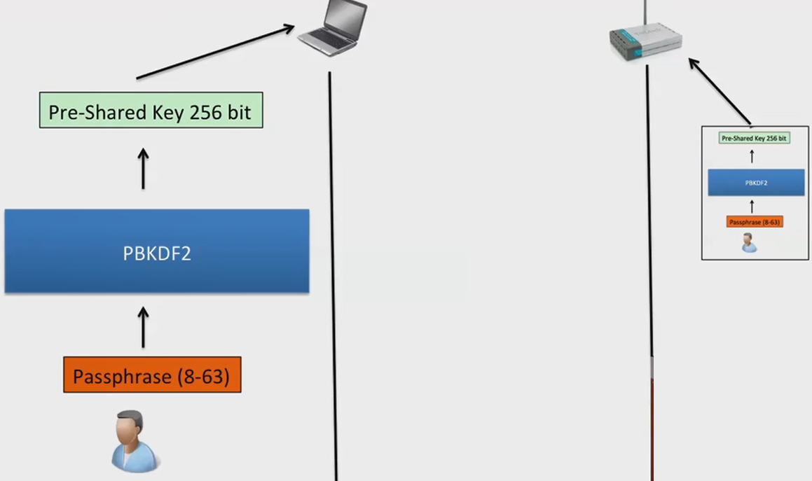
WPA Pre - Shared Key

Slide 11
WPA - PBKDF2
PBKDF2 (Password Based Key Derivation Function)
RFC 2898
PBKDF2 ( Passphrase, SSID, ssidLen, 4096, 256)
4096 – Number of times the passphrase is hashed
256 – Intended key length of PSK (The output)

Slide 12
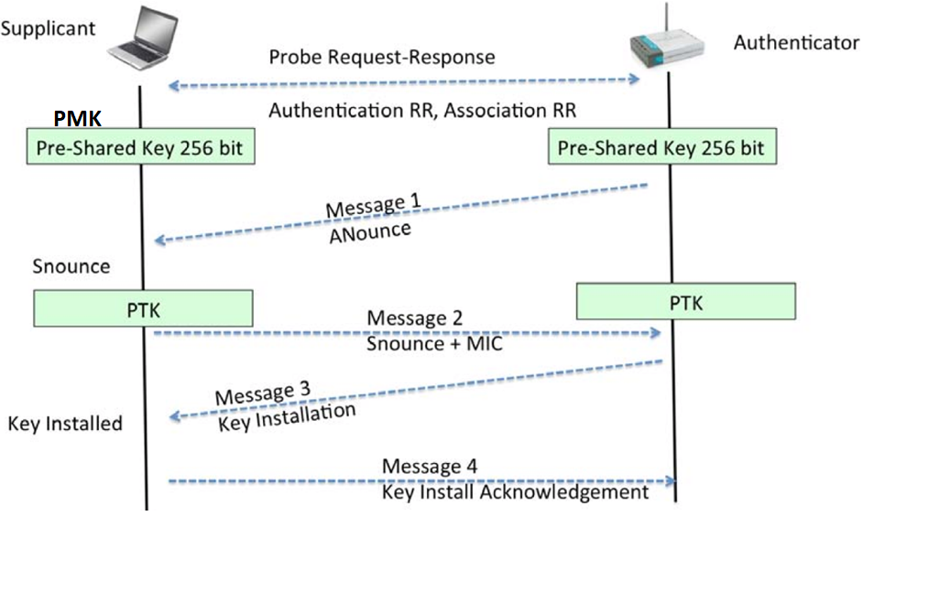
WPA - Let’s “Shake Hands”: 4-Way Handshakes

Slide 13
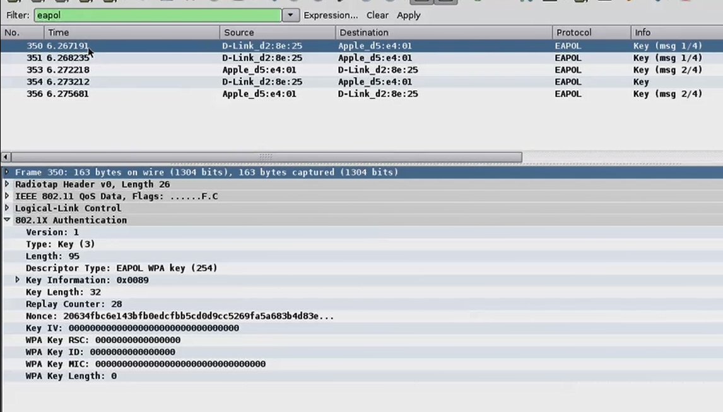
WPA - 4-Way Handshakes in Wireshark

Slide 14
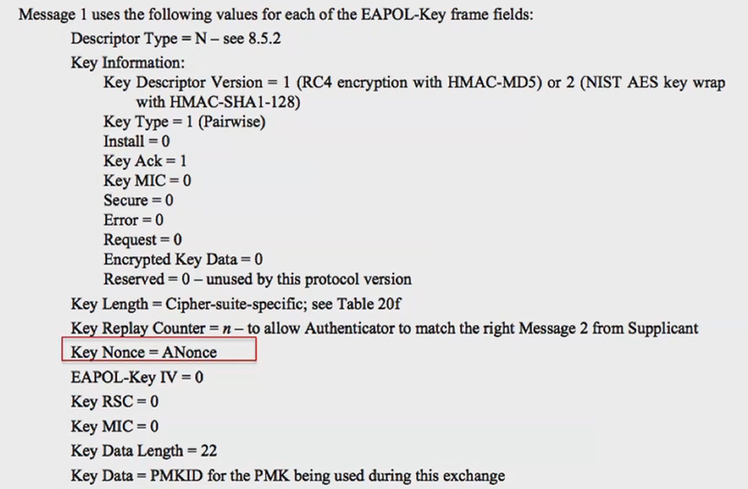
WPA - 4-Way Handshakes (Message 1)

Slide 15
WPA - 4 - Way Handshake - Pairwise Transient Key
PTK (Pairwise Transient Key) = Function (PMK, ANounce, SNounce, Authenticator MAC, Supplicant MAC)
PMK= Pre-Shared Key (Pairwise Master key)
ANounce= Random by AP
SNounce= Random by Client
Authenticator MAC= AP MAC
Supplicant MAC= Client MAC

Slide 16
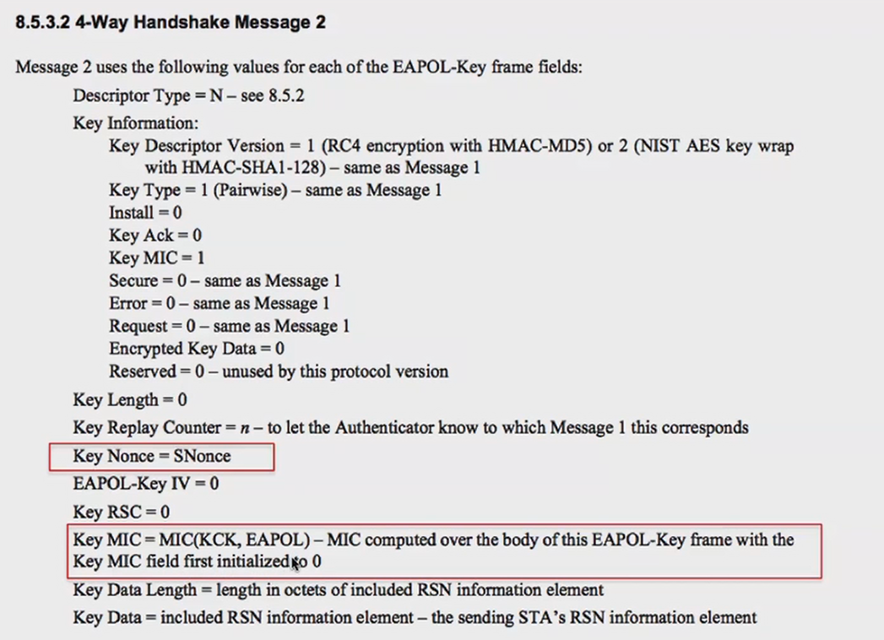
WPA - 4 - Way Handshake - Message 2

Slide 17
WPA - 4 - Way Handshake - Message 2
The MIC (Message Integrity Check) is generated using Michael Algorithm
The MIC is actually created using the PTK
The access point goes ahead and calculate the MIC if it matches the same MIC it means the client has successfully generated the right PTK which means the client knows the PSK
The next message is the key installation message otherwise the AP sends a deauth message

Slide 18
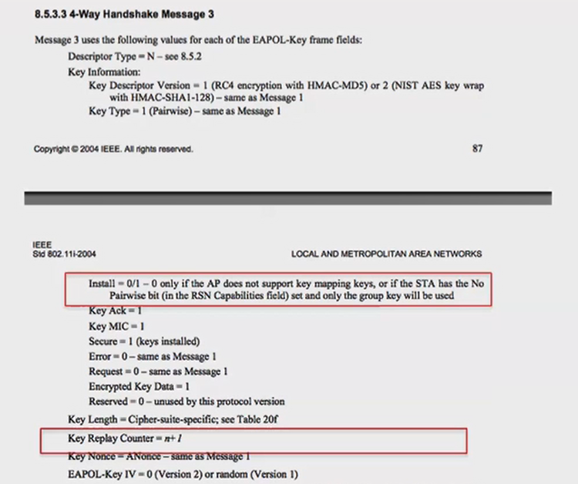
WPA - 4 - Way Handshake - Message 3
The key reply counter is (n+ 1)

Slide 19
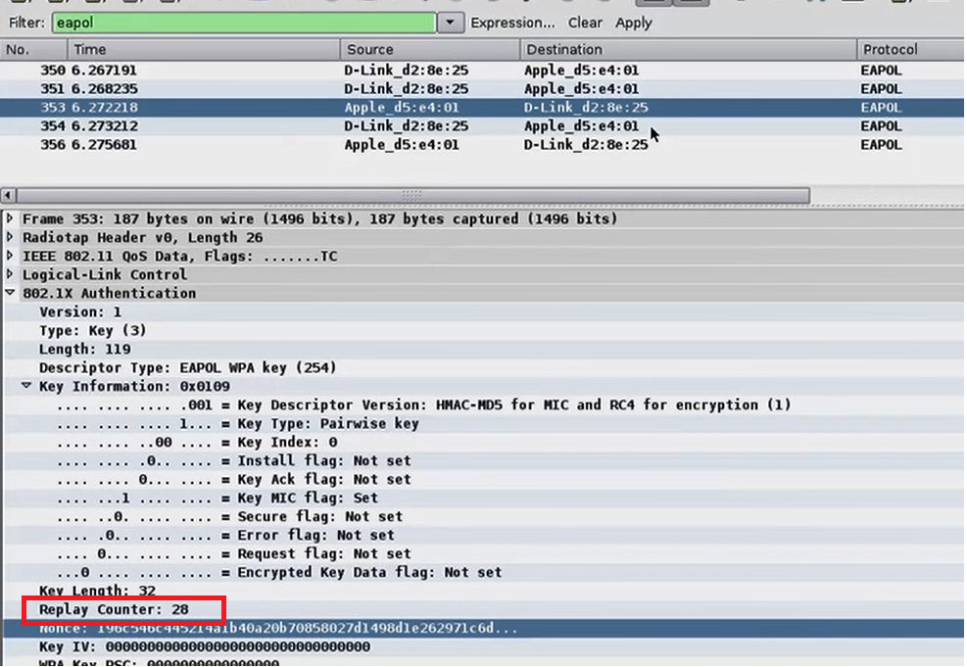
WPA - 4 - Way Handshake - Back to Wireshark

Slide 20
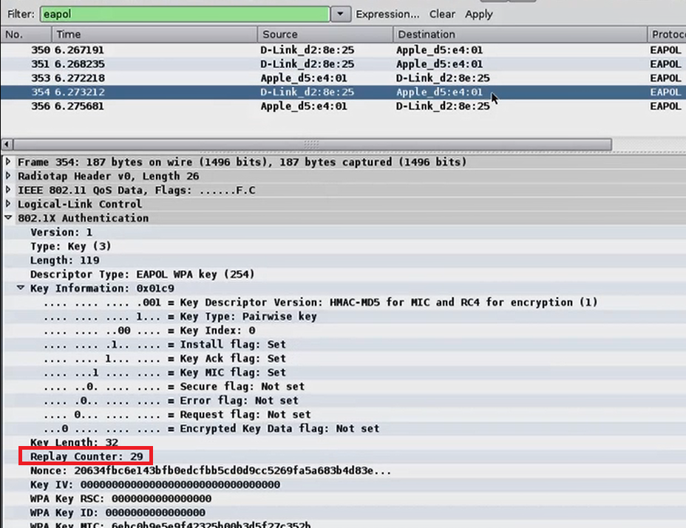
WPA - 4 - Way Handshake - Back to Wireshark

Slide 21
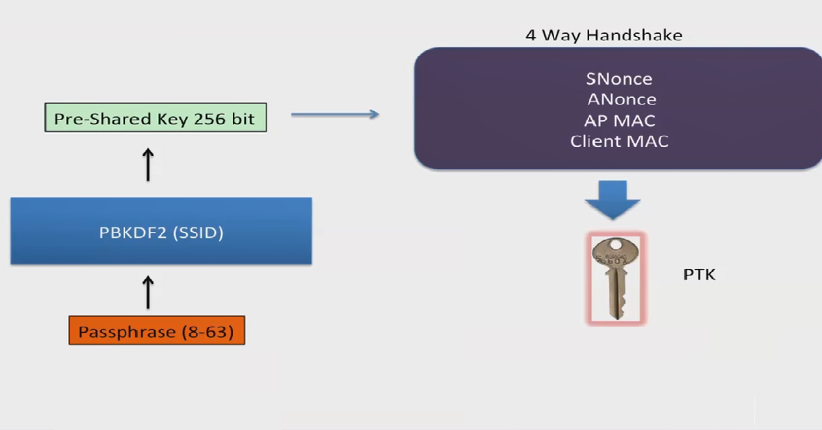
A Quick Block Diagram

Slide 22
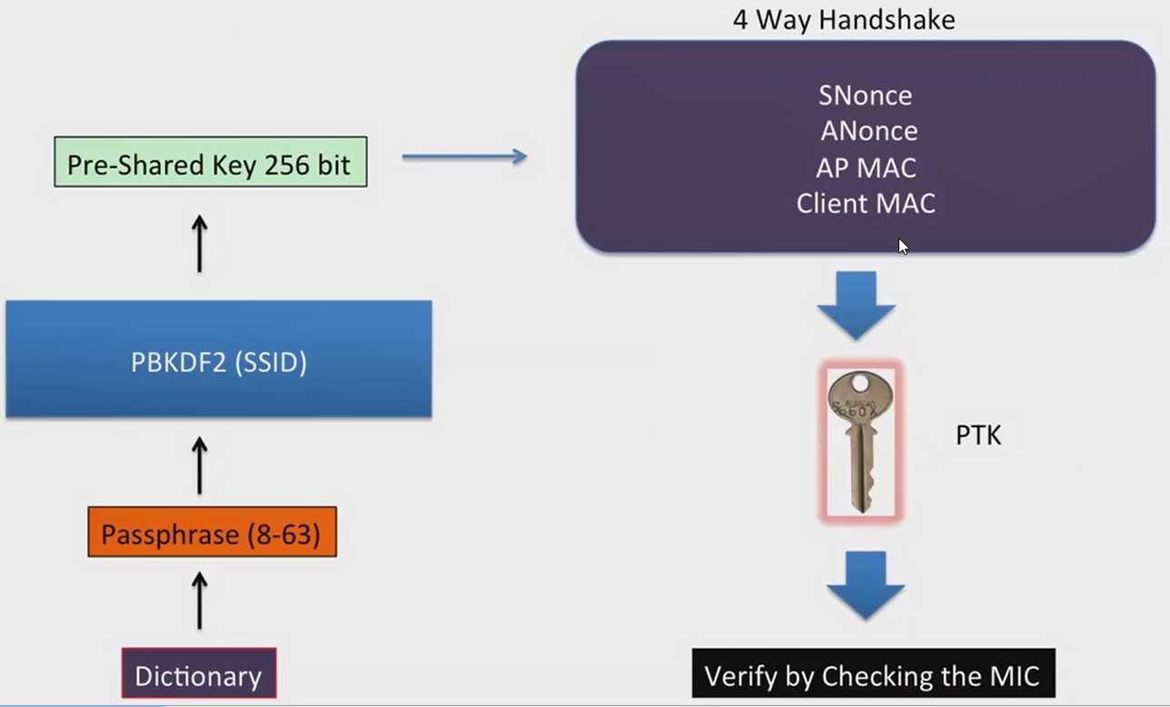
WPA – PSK Dictionary Attack

Slide 23
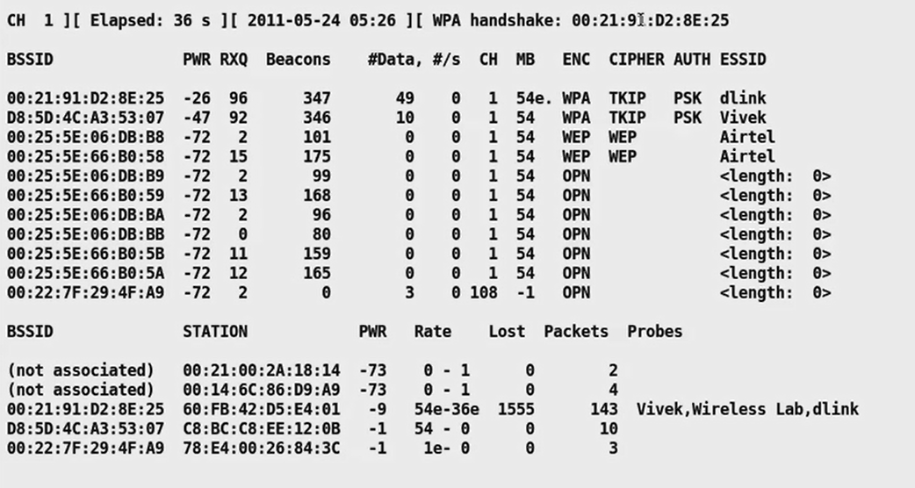
WPA – PSK Dictionary Attack using Aircrack
First you need to obtain the 4 way handshake and save it into a cap file using Airodump-ng

Slide 24

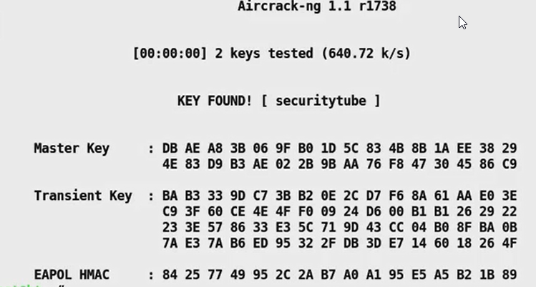
WPA – PSK Dictionary Attack using Aircrack
Second step involves running Aircrack-ng tool against the file

Slide 25
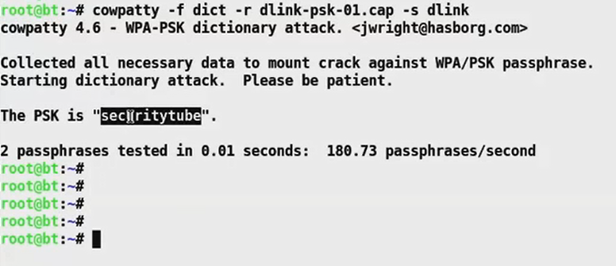
WPA – PSK Dictionary Attack using Cowpatty
You can also use a tool that came before Aircrack-ng “Cowpatty” to crack the WPA

Slide 26
WPA2 and WPA3
In 2004, WiFi Protected Access 2 became available.
The main difference with WPA2 is that it uses the Advanced Encryption Standard (AES) instead of TKIP. Additionally, it provides longer passphrase than WPA
WPA3 provides improvements to the general Wi-Fi encryption, thanks to Simultaneous Authentication of Equals (SAE) replacing the Pre-Shared Key (PSK) authentication method used in both WPA and WPA2.
This allows for better functionality so WPA3-Personal networks with simple passphrases aren’t so simple for hackers to crack using off-site, brute-force, dictionary-based cracking attempts like it was before.

Slide 27
What is the best Wireless Internet Security Method?
If you have the option, here is the list of the best security protocols, ordered from most secure to least secure:
Open (risky):
WEP 64 (risky):
WEP 128 (risky):
WPA-PSK (TKIP):
WPA-PSK (AES):
WPA2-PSK (TKIP
WPA2-PSK (AES):
WPAWPA2-PSK (TKIP/AES)

Slide 28
CPU and GPU Roles in PSK Cracking
Attackers can harness GPU power to crack Wi-Fi (Much faster than a CPU 10 -100x) this can be done using Pyrit tool.
INTEL P4 3.2Ghz: 150 keys/sec
AMD Turion 64 X2 TL-60 (2Ghz) 230 keys/sec
Nvidia 280GTX 11000 Keys/sec

Slide 29
CPU and GPU Roles in PSK Cracking
Assume you have a 8 characters passphrase.
62 possibilities per character: [A-Z] [a-z] [0-9]
Using a 280GTX (11000 keys/sec)
62^8= 218 340 105 586 896 possible keys
218 340 105 586 896 / 11000 k/s = 19 849 100 508 sec
19849100508 sec = 5 513 639 hours
5513639 hours = 229 735 days
229735 days = 630 years !!

Slide 30
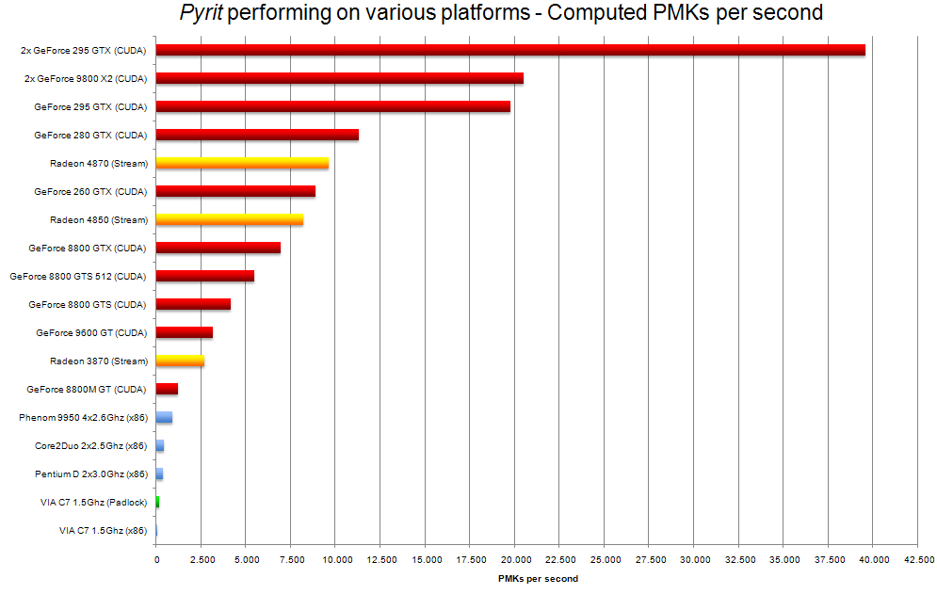
May The Force of The GPU Be With You!

Slide 31
Speeding up the cracking with Time-Memory Tradeoff Concept
The aim of a time-memory trade-off is to mount a cryptographic attack that has a lower online processing complexity than exhaustive key search and lower memory complexity than a table lookup, neglecting the precomputations (hence, it only makes sense if the attack has to be performed multiple times)
How can we benefit from this concept to speed up the cracking?
If some calculations can be done way ahead in advance and that calculation can be reused all the time. Then by using a lot of memory to store these calculations we can bring down the overall time in actuall practice.

Slide 32
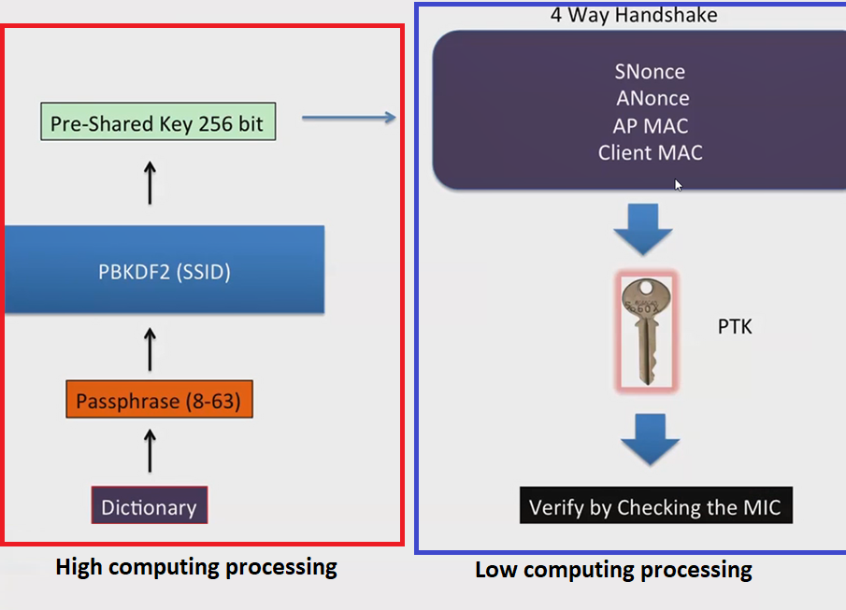
Speeding up the cracking with Time-Memory Tradeoff Concept

Slide 33
Speeding up the cracking with Time-Memory Tradeoff Concept
PMK = PBKDF2 ( Passphrase, SSID, ssidLen, 4096, 256)
We can calculate the PMK and store it in a Database (for a given SSID) and for a list of passphrases from the dictionary
And hence this huge calculations can be done before going to the second part of the attack
The second part which involves (Snonce, Anonce, Supplicant MAC, Authenticator MAC” cannot be pre-calculated
Let’s assume the victim SSID is “Wireless Lab”

Slide 34
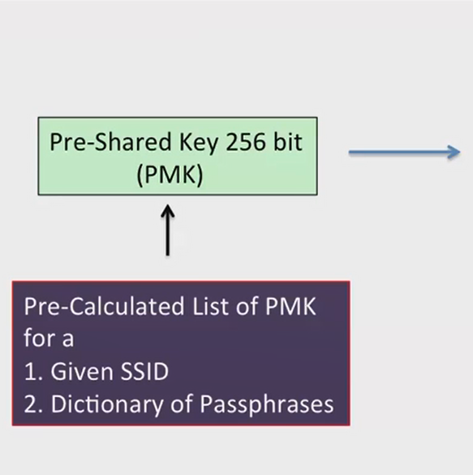
Speeding up the cracking with Time-Memory Tradeoff Concept

Slide 35
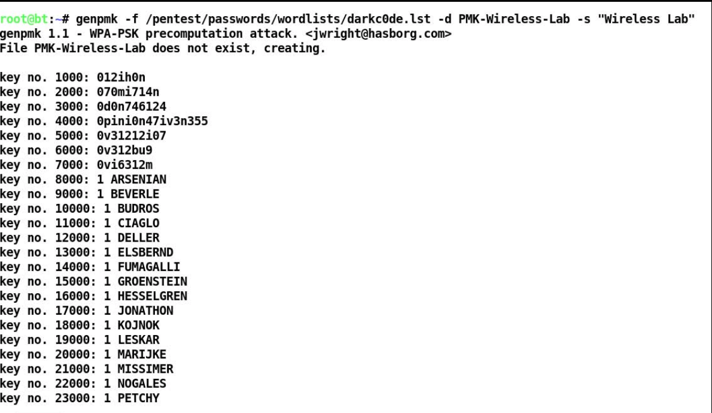
Speeding up the cracking with Time-Memory Tradeoff Concept
We can use a tool by Joshua Wright dubbed “genpmk” to calculate the pmk by providing the dictionary of wordlists along with the SSID

Slide 36
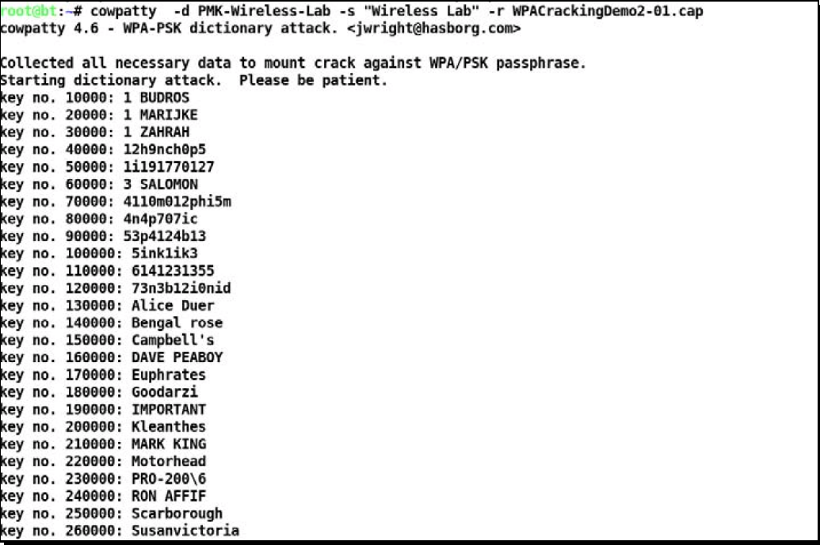
Speeding up the cracking with Time-Memory Tradeoff Concept
Now we can use the tool “Cowpatty” to crack the password faster as follows:

Slide 37
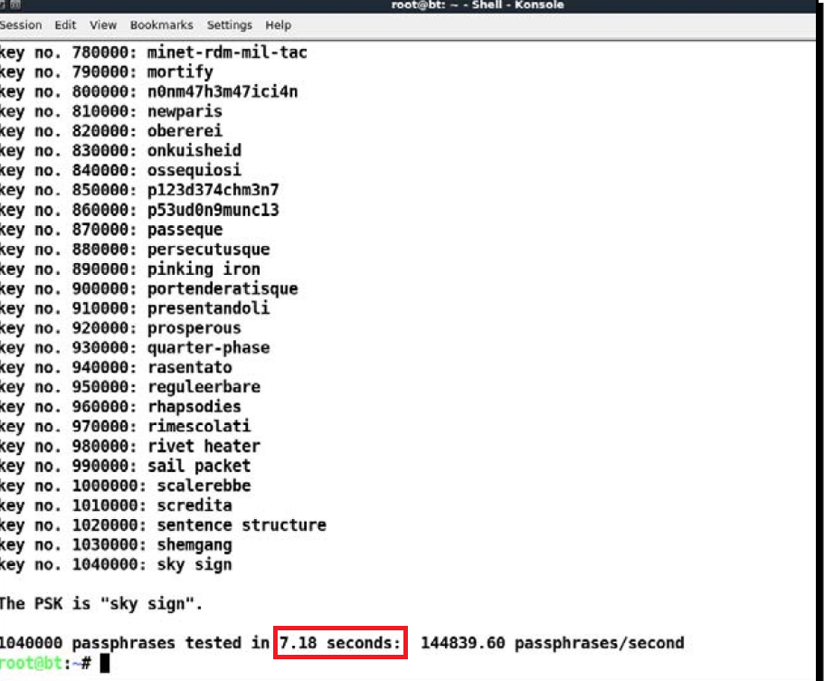
Speeding up the cracking with Time-Memory Tradeoff Concept
It takes approximately 7.18 seconds for Cowpatty to crack the key, using the pre-calculated PMKs as shown in the following Figure

Slide 38
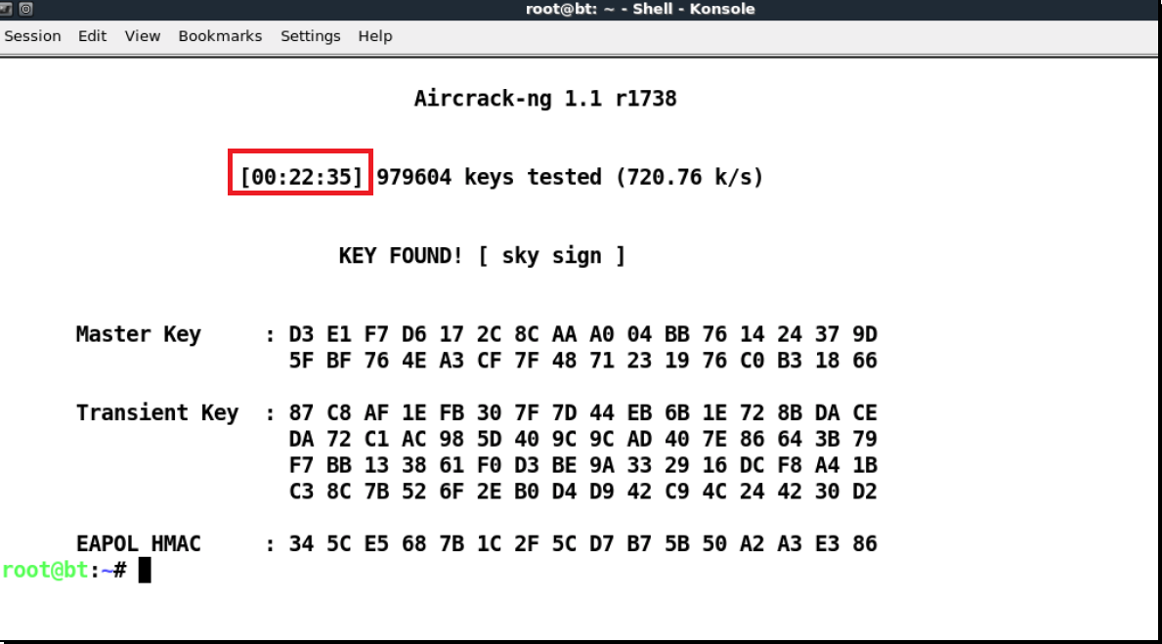
Speeding up the cracking with Time-Memory Tradeoff Concept
How many seconds will it take if we used the classic method using Aircrack-ng?

Slide 39
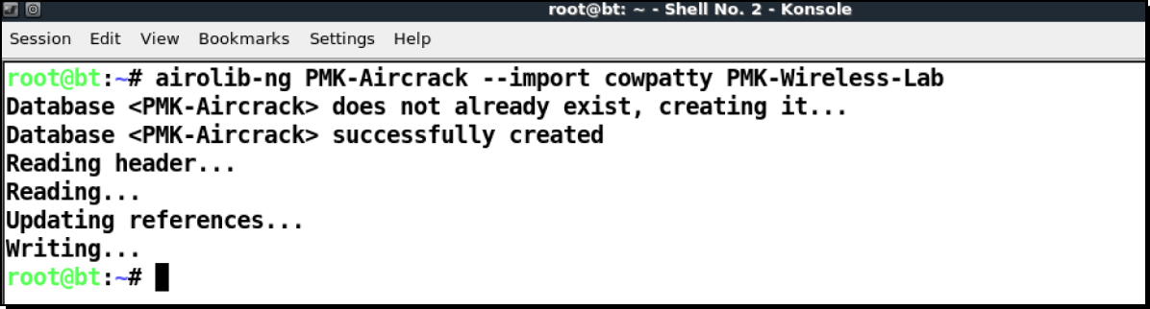
Speeding up the cracking with Time-Memory Tradeoff Concept
How can we use Aircrack-ng with PMK file?
We need to use a tool called “airolib-ng”.

Slide 40
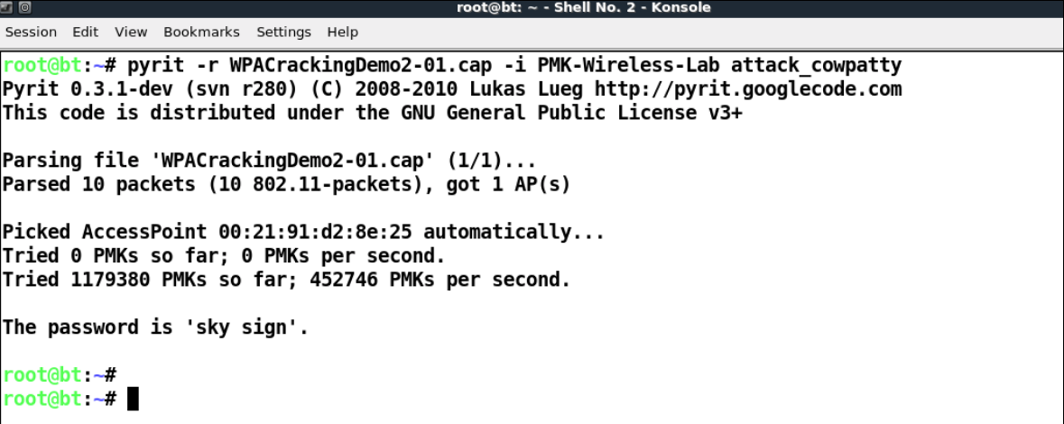
Speeding up the cracking with Time-Memory Tradeoff Concept
We can then feed the generated file to aircrack-ng using the following command:
Aircrack-ng –r PMK-Aircrack WPACrackingDemo2-01.cap
You can even use the tool Pyrit to speed it up even more using the following parameters:

Slide 41
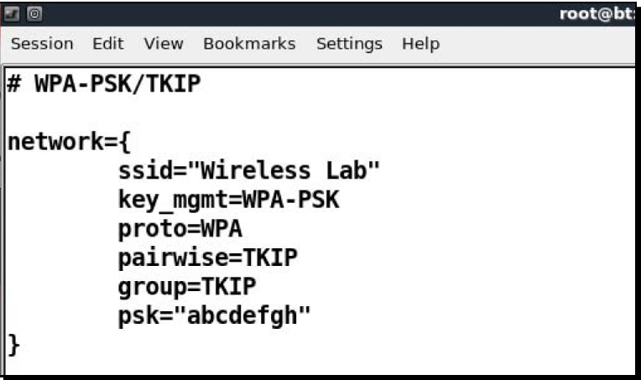
Connecting to WPA/WPA2 Network
Here’s the configuration file that you need to create in order to connect to WPA/TKIP network

Slide 42
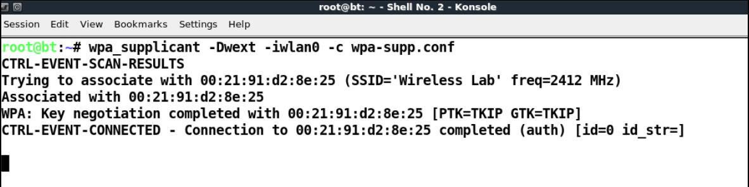
Connecting to WPA/WPA2 Network
Then you can connect to the network using the following command:

Slide 43
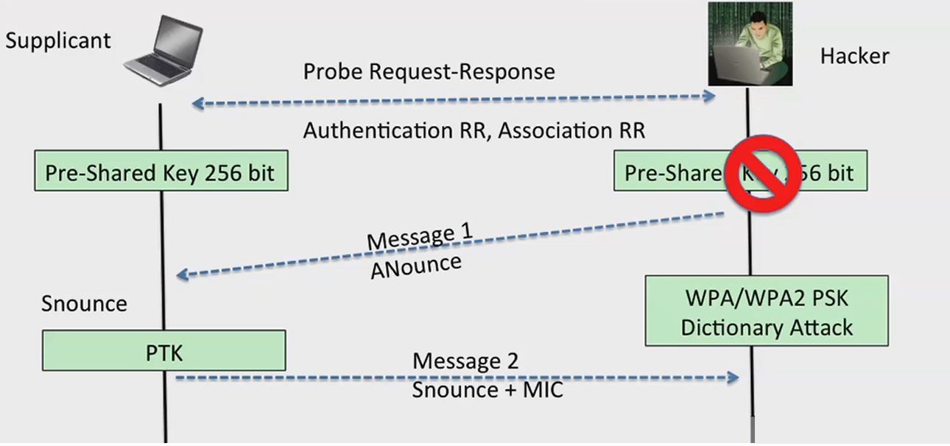
Cracking WPA/WPA2-PSK with just a Client

Slide 44
Cracking WPA/WPA2-PSK with just a Client (Cont’d)
We will assume that the wireless client has a network “Wireless Lab” configured on it and it actively sends Probe Requests for this network when it is not connected to a network.
In order to find the security configuration of this network, we will need to create multiple access points (Honeypots!)
The client profile will be either an open network, WEP protected, WPA-PSK or WPA2-PSK
This would mean we would have to create four access points in which each runs on an interface (mon0 to mon3)

Slide 45
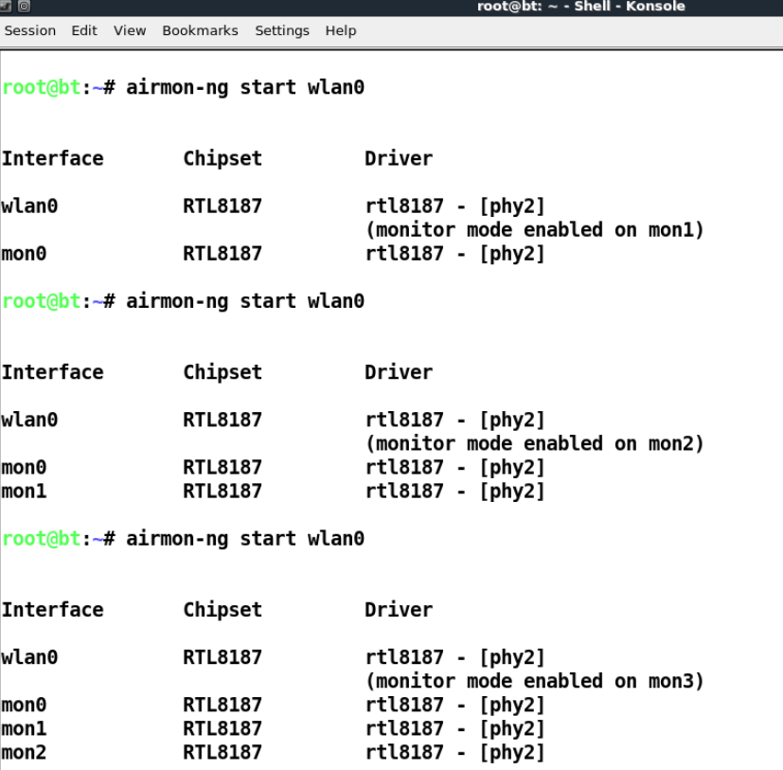
Cracking WPA/WPA2-PSK with just a Client (Cont’d)

Slide 46
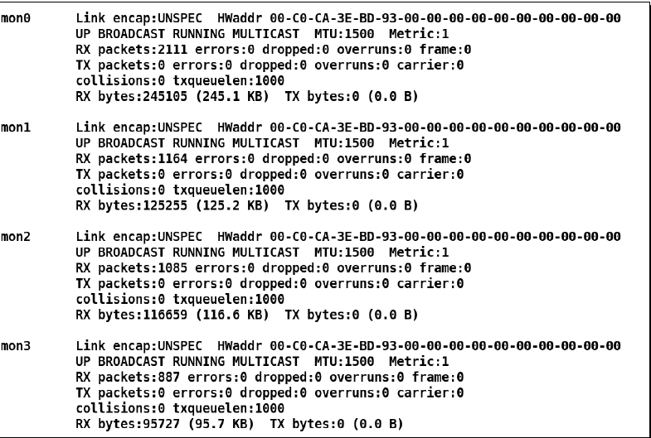
Cracking WPA/WPA2-PSK with just a Client (Cont’d)
We could view all these newly created interfaces using the Ifconfig –a command:

Slide 47
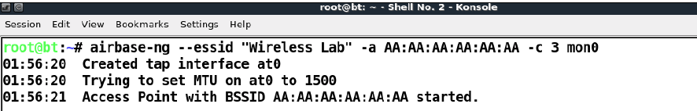
Cracking WPA/WPA2-PSK with just a Client (Cont’d)
Now we create the Open AP on mon0:
We create the WEP AP on mon1
The WPA-PSK AP will be on mon2
The WPA2-PSK AP will be on mon3

Slide 48
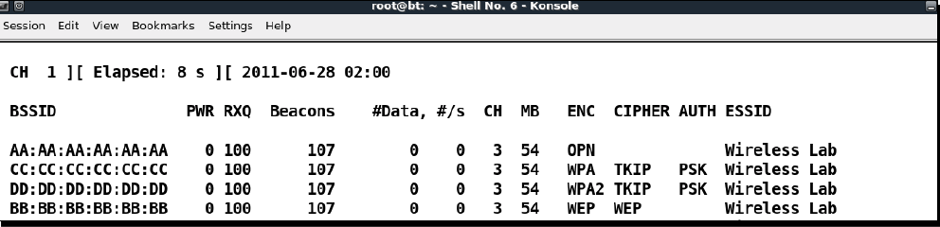
Cracking WPA/WPA2-PSK with just a Client (Cont’d)
You can run airodump-ng on the same channel to ensure all the four access points are up and running as shown:
Now switch the Wi-Fi on the roaming client, depending on which “Wireless Lab” network you had connected it to previously, it will connect to that security configuration

Slide 49
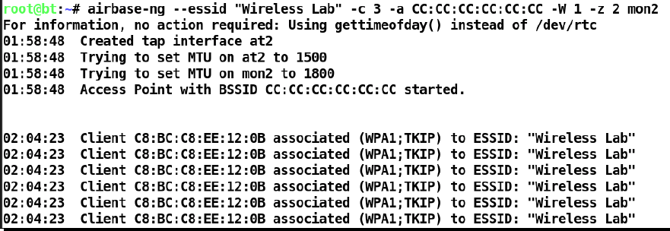
Cracking WPA/WPA2-PSK with just a Client (Cont’d)
Presumably, the client has configured to use WPA-PSK network, thus he’s going to connect to that particular network.
Obtaining the handshake now is just as real as it is
This technique is dubbed “Wifishing”

Slide 50
Attacking WPA/WPA2 with Phishing
Wifiphisher is a rogue Access Point framework for conducting red team engagements or Wi-Fi security testing.
Using Wifiphisher, penetration testers can easily achieve a man-in-the-middle position against wireless clients by performing targeted Wi-Fi association attacks.
Another tool can be used to carry out this attack is called “Linset”
Both these tools are based on Evil twin attack concept

Slide 51
WI-Fi Protected Setup (WPS)
In 2007, the Wi-Fi alliance began work on an extension to IEEE 802.11 security called Wi-Fi Protected Setup (WPS) that would simplify the configuration of home networks.
The general goal was that nontechnical end-users wouldn’t then be responsible for remembering (and potentially never even having to generate0 a secure WPA passphrase
In order to connect to the AP using the WPS, both client and AP should be supporting the WPS technology (also it should be enabled on the AP itself)

Slide 52
WI-Fi Protected Setup (WPS) (Cont’d)
WPS works only with networks that support WPA/WPA2 encryption
WPS retrieve the network configuration and even set the network
The client can connect to the AP by either pushing the button or entering the eight digit PIN
Devices that authenticate themselves with this PIN would then be sent the credentials needed to connect to the network, the client would then store the PSK and use it to connect to the network.

Slide 53
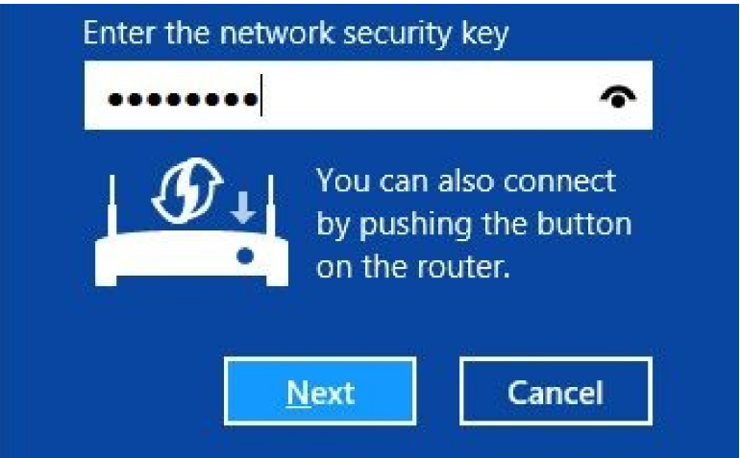
WI-Fi Protected Setup (WPS) (Cont’d)
The following illustration shows what Windows displays when prompting for PIN-based authentication credentials

Slide 54
WI-Fi Protected Setup (WPS) (Cont’d)
The problem is the AP doesn’t care if you incorrectly enter 100 million (10^8) PIN values in a row. At that rate, it would take 578 days to try half of all the possible PINs
Unfortunately, although the PIN appears to be a random eight-digit number, the last digit is a checksum, which means that instead of 578 days needed to brute force the PIN, it now takes 57.8 days. Not ideal, but still probably unfeasible
A secondary deficiency that makes it possible to brute force the WPS PIN is that the protocol trats it as two separate numbers as shown

Slide 55
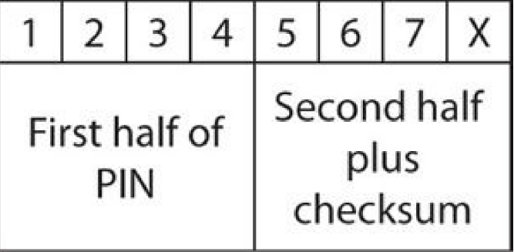
WI-Fi Protected Setup (WPS) (Cont’d)
When authenticating to WPS, the first half of the PIN is transmitted in one packet, if this doesn’t match, the AP sends a negative acknowledgement to the client
Consequentially, instead of trying to brute-force 10^7 possible PINs, the attacker is essentially trying to brute force two independent PINs one with 10^4 and the other is 10^3

Slide 56
Wi-Fi Protected Setup (WPS) (Cont’d)
Although it only takes one second for each PIN guess, in practice it takes several due to the overhead of the remaining protocol in the exchange.
If a router is vulnerable to a WPS pin guessing attack it can take anywhere between 2 and 14 hours to complete the attack
Interestingly, although WPS was first met with widespread deployment in 2007/2008. The WPS PIN guessing vulnerability wasn’t publicly disclosed until 2011.
Both Craig Heffner and Stefan Viehbock discovered the vulnerability independently once Viehbock released his paper, Heffner responded by open sourcing his tool Reaver which implements the attack

Slide 57
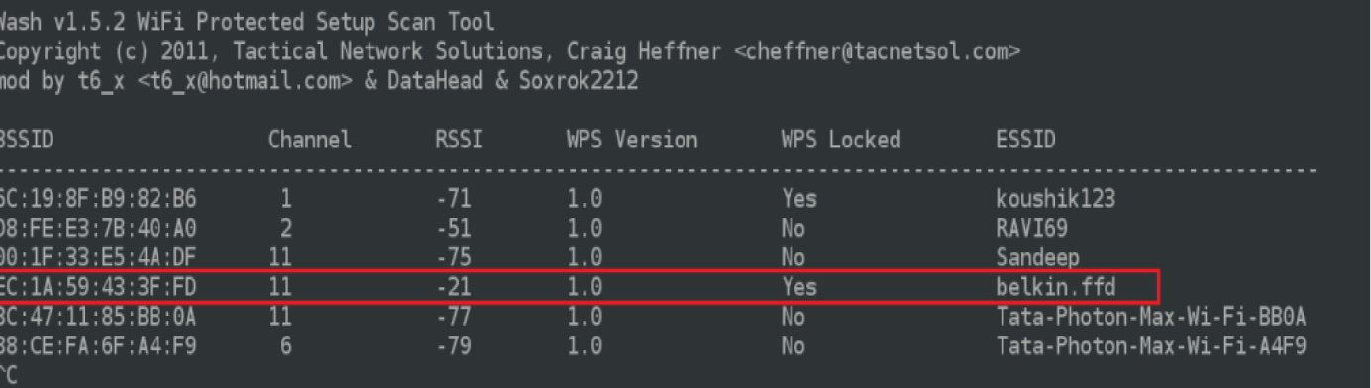
Attacking WPS with Reaver and Wash
Airodump-ng cannot detect WPS enabled routers, se we are going to use a tool dubbed “wash” which installs along with Reaver and helps us scanning for WPS enabled routers
We can use the following command to look for WPS enabled AP
Sudo wash –i wlan0mon

Slide 58
Attacking WPS with Reaver and Wash (Cont’d)
You’ll find that APs which are listed as unlocked are much more likely to be susceptible to brute force
In case you got an error try to add this parameter “ –ignore-fcs”
After getting the target AP’s BSSID, use Reaver to try WPS PIN attack as follows:
The new AP’s no longer have this vulnerability. This attack will only work on routers sold during that 2006 and early 2012.

Slide 59
Final words
You should always update the firmware of the router
Disable the WPS
Use WPA2-AES and strong passphrase
Change your password regularly

