Slide 1
Wireless Security
Unit 3 – Attacking Wireless 802.11 Networks – Part 1-
Dr. Haitham Alani
Faculty of Computer Engineering
Course number: 25444

Slide 2


Course Outline
Introduction
Security Through Obsecurity
Deauthentication Attacks and Countermeasures
Executing Deauthentication in Linux
Beacon Generation
Defeating MAC Filtering
Hotspot Basics and Attacks
WEP in Depth
Defeating WEP Authentication
WEP Key Cracking
Message Modification Attacks
Café Late Attack
Café Late Demo
ChopChop Attack

Slide 3
Introduction
Security on wireless networks has had a very checkered past.
Wireless network defenses fall into a few different categories, the first category which is considered totally ineffective otherwise known as “security through obscurity”
The next type of defense can be classified as “challenging”, WEP and WPA-PSK password fit this category. Given a little time and modest skill, an attacker can recover a static WEP key or a weak WPA passphrase

Slide 4
Security Through Obsecurity
Many wireless networks today operate in hidden or non-broadcasting mode,
These networks don’t include their SSID in beacon packets, and they don’t respond to broadcast probe requests.
People who do this might also be prone to enabling MAC address filtering on the AP
An SSID is not a secret. It is included in plaintext in many packets, not just beacons, in fact (Association and Re-Association requests), the reason the SSID is so important is that you need to know it in order to associate with the AP.

Slide 5
Security Through Obsecurity (Cont’d)
Passive sniffers can easily take advantage of this behavior.
If you have ever seen Kismet or KisMAC fill in the name of a hidden network, it’s because a legitimate client sent one of these frame. If you sniff on the AP’s channel long enough, you will eventually catch someone joining the network and get the SSID
You can do more than just wait; you can force a user’s hand.

Slide 6
Deauthentication Attack
The easiest way to get the name of a network is to kick a legitimate user off the network and observe the user reconnect to the network
This attack is possible because management frames in 802.11 are not authenticated. If management frames were authenticated, the user would be able to differentiate the attacker’s deauthenticate packet from the APs.
All you need to do is to send a packet to the user that looks like it came from the AP. The user can’t tell the difference, and the wireless driver will reconnect immediately.

Slide 7
Deauthentication Attack Countermeasure
Originally drafted as the IEEE 802.11w amendment
This IEEE extention, includes a support for cryptographic hashes in deauthenticate and disassociate frames.
Sometimes referred to as Management Frame Protection (MFP), this enhancement makes it possible to stop common deauthenticate attacks, but does little to stop the many other denial of service (DoS) attacks against Wi-Fi deployments
This standard only works with networks that implement encryption

Slide 8
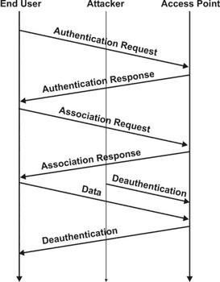
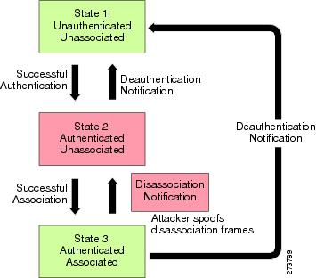
Deauthentication Vs Disassociation

Slide 9
Executing Deauthentication in Linux
Aireplay-ng and mdk3 can be used to execute Deauthentication attack against a particular AP or station.
Assume we have a victim station the has the MAC address 00:23:6C:98:7C:7C and it is currently associated with the network on channel 1 with the BSSID 10:FE:ED:40:95:B5

Slide 10
Executing Deauthentication in Linux
The argument –deauth is a count for the number of times to perform the attack
Each attack consists of 64 packets from the AP to the client and 64 packets from the client to the AP.
By performing th attack, we will transmit 128 deauth packets (64 in both directions) , the net results is the client will see a hiccup in his network connectivity and then reassociate, this attack can be used also to get the WPA handshake.

Slide 11
Beacon Generation
You can turn your wifi adapter into a beacon generator
You technically can create fake beacon generation using the tool mdk4
Usage: mdk4 Interface b

Slide 12
Defeating MAC Filtering
The origin of MAC filtering was first introduced in Ethernet
Port security normally used to whitelist a MAC which will be allowed to send traffic to a particular physical port.
MAC filter is a manufacturer feature, it is not part of 802.11 standard
This feature is a network level filter that added to AP
Fake auth attack also allows you to perform both WEP authentication (Shared and open)

Slide 13
Defeating MAC Filtering (Cont’d)
You can use fake auth feature by aireplay-ng
Aireplay-ng –fakeauth 10 –a ssid mon0
To use fake authentication with spoofed MAC
aireplay-ng –fakeauth 10 –e ssid –h SpoofedMAC mon0

Slide 14
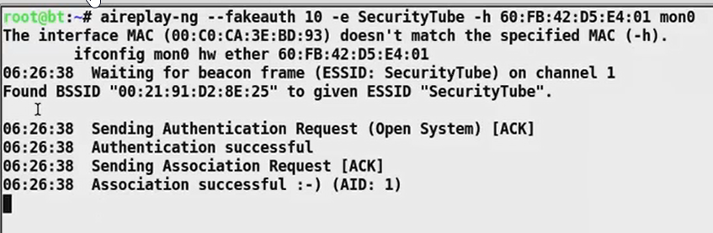
Defeating MAC Filtering (Cont’d)

Slide 15
Hotspot Basics
Free/ Paid Wifi based internet offered in public places like Coffee shops and Airports
Typically uses:
Open Authentication
MAC Filtering at times
No encryption (Distribution of keys would be a nightmare)
Can use captive portals for application layer authentication

Slide 16
Hotspot Attacks (Cont’d)
Create an Evil Twin in the vicinity with same SSID and even same BSSID (sometimes)
Use Deauthnetication attacks to break clients AP connections
If the Evil Twin has higher signal strength, then client will connect to it automatically

Slide 17
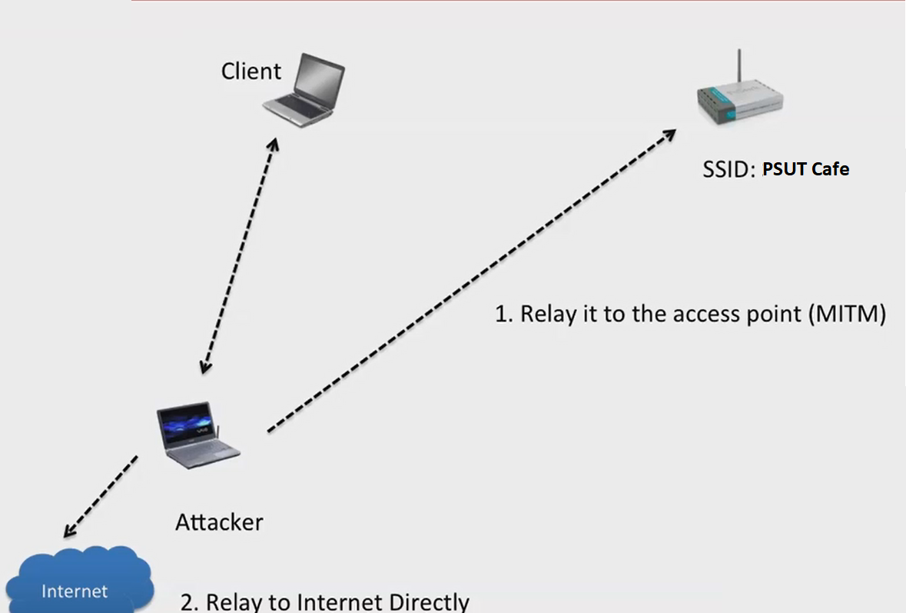
Hotspot Attacks (Cont’d)

Slide 18
Hotspot Attacks (Cont’d)
To create a fake access point first you need to set your monitor mode interface into a specific channel as we explained before
After that, you will need to use the tool Airbase-ng
Airebase-ng –a AA:AA:AA:AA:AA:AA –e Fake SSID mon0
You will notice a new interface has been added which is the tap at0
This is the ethernet interface, you will need to bring it up before you carry on your attack

Slide 19
Hotspot Attacks (Cont’d)
Next step involves deauthenticating the client from the legitimate AP
As soon as the client connects to the rogue AP, you can inspect the wireshark over the Tap interface not the monitor mode interface
The client will look for DHCP server, in case there wasn’t, the client will be assigned with APIPA IP address which is something like
169.254.174.226

Slide 20
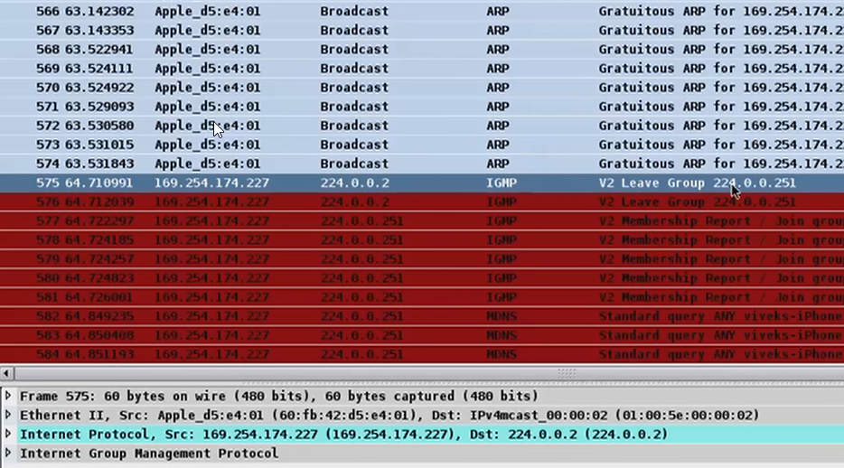
Hotspot Attacks (Cont’d)

Slide 21
Hotspot Attacks (Cont’d)
You will need to attach this IP address with the tap interface using the following command
Ifconfig at0 up
Ifconfig at0 169.254.174.226 netmask 255.255.255.0 up
Now you can scan the victim IP address and look for certain vulnerabilities
If it was iphone, it might be rooted so you can connect to it via ssh using the default username and password which are both alpine

Slide 22
Wired Equivalent Privacy (WEP)
WEP encryption algorithm uses 3 bytes ivs which changes per packets
WEP encryption algorithm relies on RC4 symmetric keystream algorithm
WEP algorithm passes the WEP key (Passphrase) and the IVs to the RC4 algorithm that will create a keystream
The keystream will be XOR’ed with the actual plain text and sent across

Slide 23
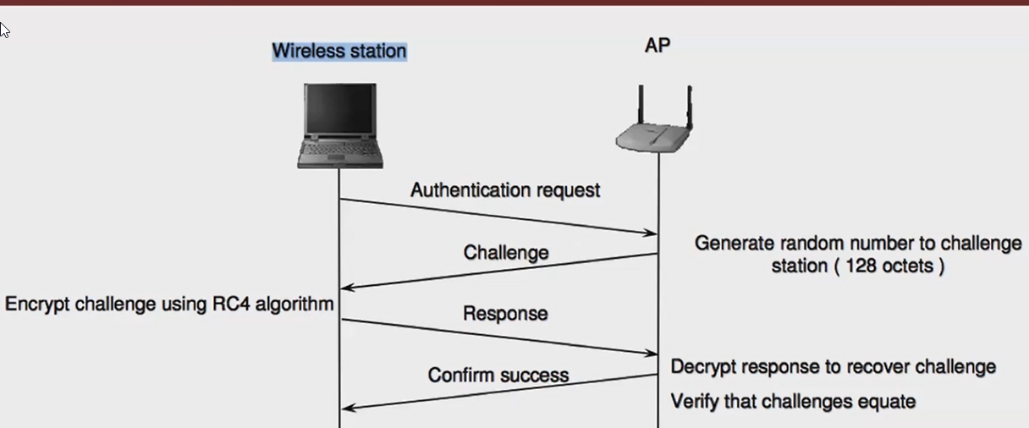
Wired Equivalent Privacy (WEP)

Slide 24
Wired Equivalent Privacy (WEP)
Challenge is encrypted using the WEP key
WEP uses RC4 which is a stream cipher
RC4 keystream is XOR’ed with the plain text challenge and response is returned

Slide 25
Wired Equivalent Privacy (WEP)
Seed → RC4 → Key Stream
Encryption:
Cipher text = (key stream) XOR (Plain text)
Decryption:
Plaintext= Cipher text XOR key stream

Slide 26
WEP in Depth
The AP generate a random 24 bits value which is IV
The AP will take the WEP key (40 or 104) bits and prepend the IV to it
Both will be fed to RC4 Algorithm which consists of (KSA + PGRA)
The output will be the keystream (Random keystream)
They keystream will be used in encryption

Slide 27
WEP in Depth (Cont’d)
Seed= IV + KEY
RC4 Takes seed as input and gives keystream as output
IV (Initializing Vector): 24 bits
Key: 40 bit or 104 bit
Seed : IV + Key (64 or 128 bit)

Slide 28
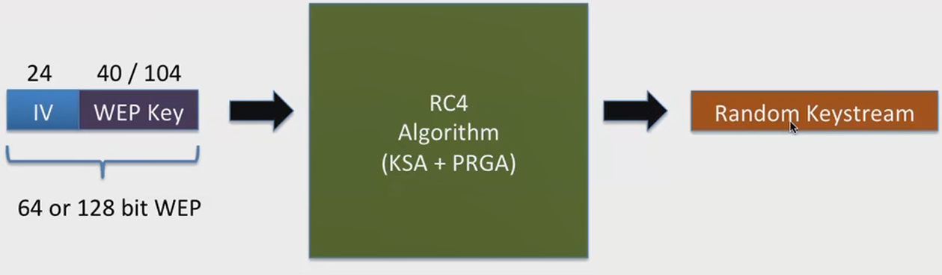
WEP in Depth (Phase 1 – Generation Keystream)

Slide 29
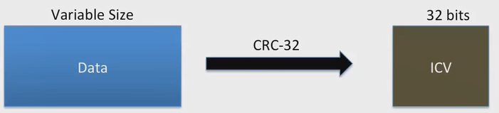
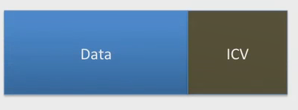
WEP in Depth (Phase 2 – Generating Integrity Check Value
The second step involves generating integrity check value
Then we concatenate the data along with ICV

Slide 30
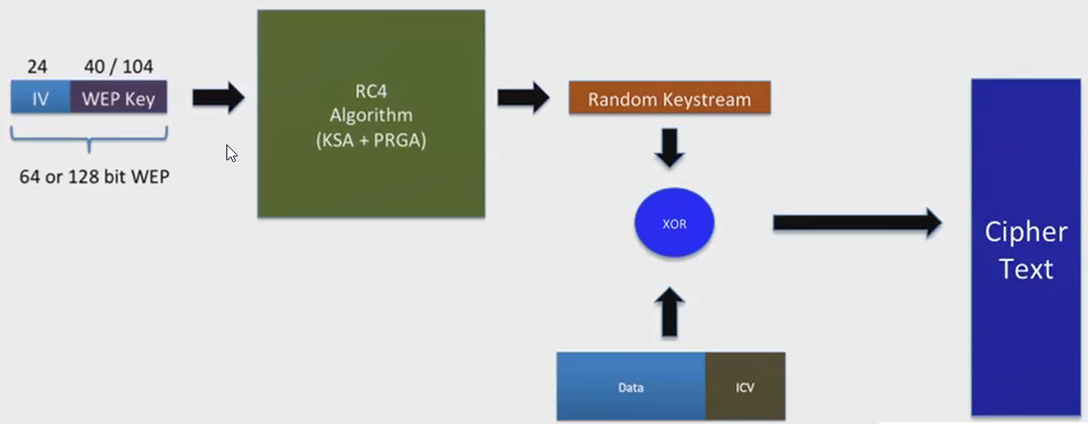
WEP in Depth (Phase 3 – Cipher Text Operation)
Cipher text operation

Slide 31
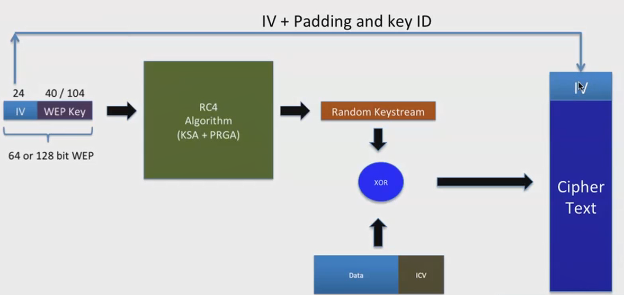
WEP in Depth (Cont’d)
It doesn’t end here, the client doesn’t know the iv, the client only knows the WEP
The AP takes the IV and append it to cipher text

Slide 32
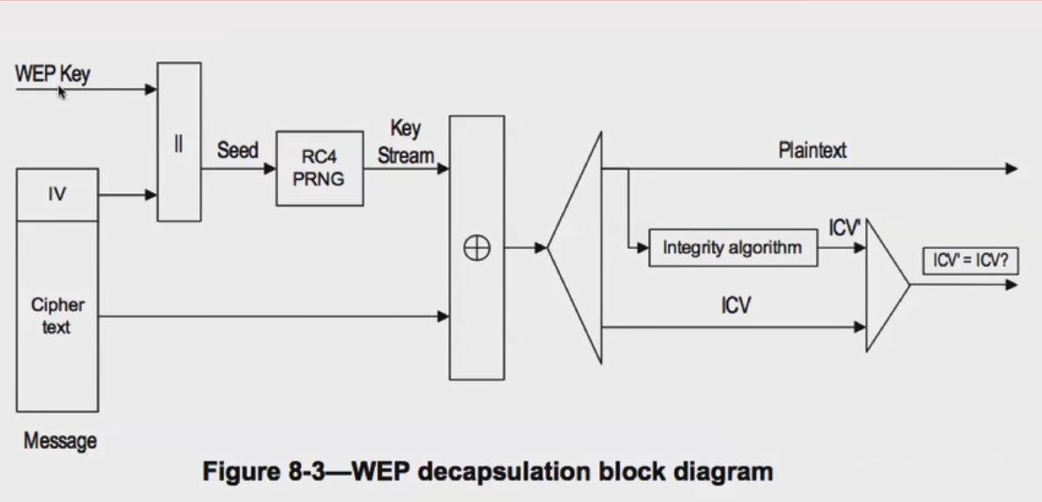
WEP Decryption

Slide 33
Defeating WEP Authentication
Whoever get the keystream will get the network
You may try launching fake authentication against a WEP based network using the keystream yourself
Note: You can use the tool airdcap-ng to decrypt a pcap file with

Slide 34
Cracking WEP Key
The more IVs you receive, the faster the WEP key will be cracked
The attacker tends to force the victim to generate a lot of traffic in order to harvest the IVs within the traffic accordingly
The attacker tends to capture ARP packets on the wireless network using aireplay-ng and inject them back into the network
Replaying these packets a few thousand times will generate a lot of data traffic on the network (aireplay can identify ARP packets by looking at the size of the packets since ARP headers are fixed)

Slide 35
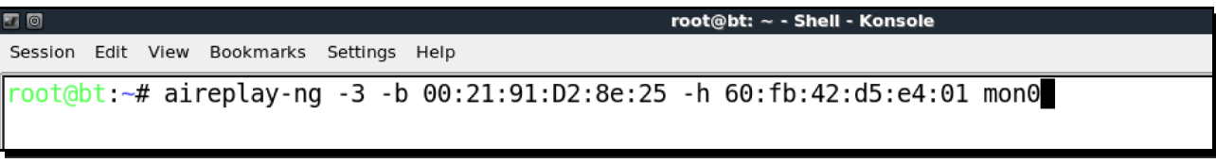
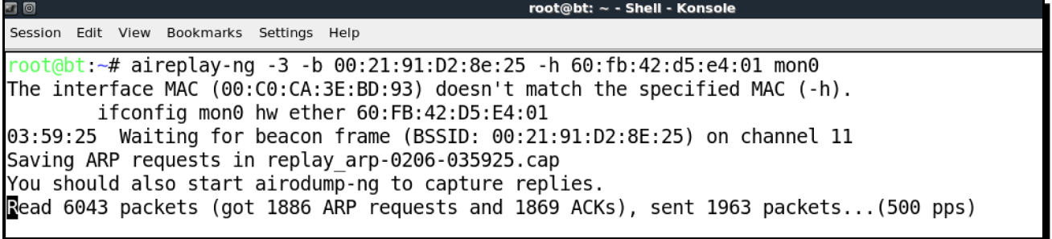
Cracking WEP Key (Cont’d)
Very soon you should see that aireplay-ng was able to sniff ARP packets and has started replaying them into the network

Slide 36
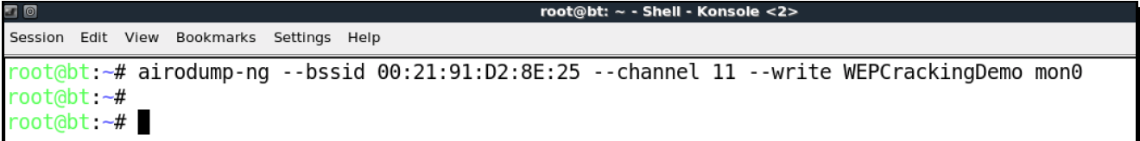
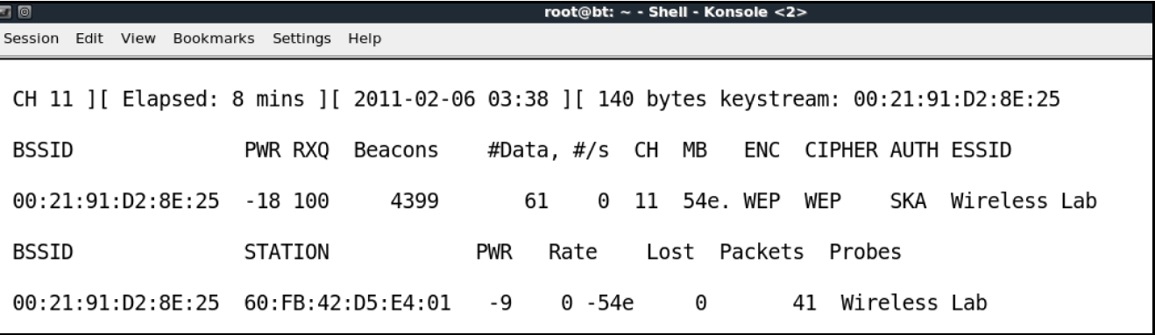
Cracking WEP Key (Cont’d)
At the same time, you should have also running airodump-ng to listen to the traffic of the target network and save it into a cap file
As soon as a victim connects to the network, you should get the following info:

Slide 37
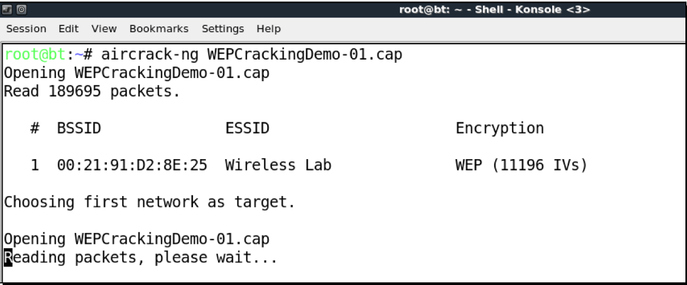
Cracking WEP Key (Cont’d)
The last step involves using Aircrack-ng tool to crack the password

Slide 38
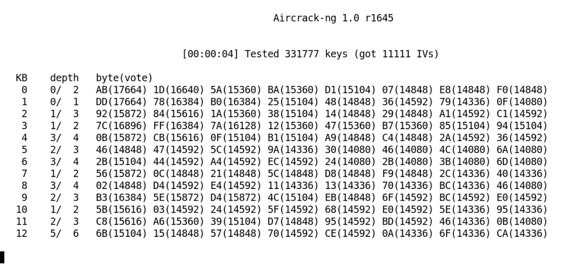
Cracking WEP Key (Cont’d)
You should see the password within the following screen

Slide 39
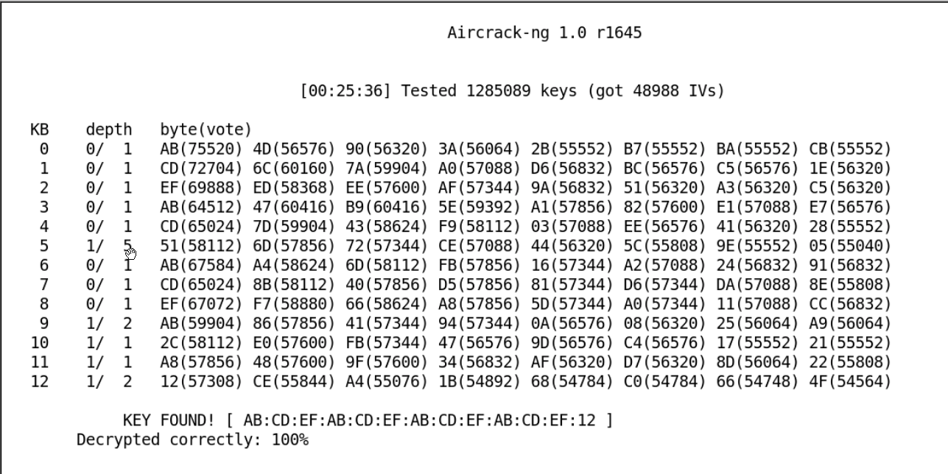
Cracking WEP Key (Cont’d)
The number of data packets required to crack the key is non-deterministic but generally in the order of a hundred thousand or more.
Normally, this should take 5-10 minutes at most

Slide 40
Message Injection Attacks
No replay protection to mitigate against message injection
You can generate fake WEP packets that will be accepted by any AP
A valid WEP encrypted packet can be easily generated
A famous paper presented by prominent Wifi researchers talks about this attacks dubbed
“ Interception Mobile Communications: The insecurity of 802.11”

Slide 41
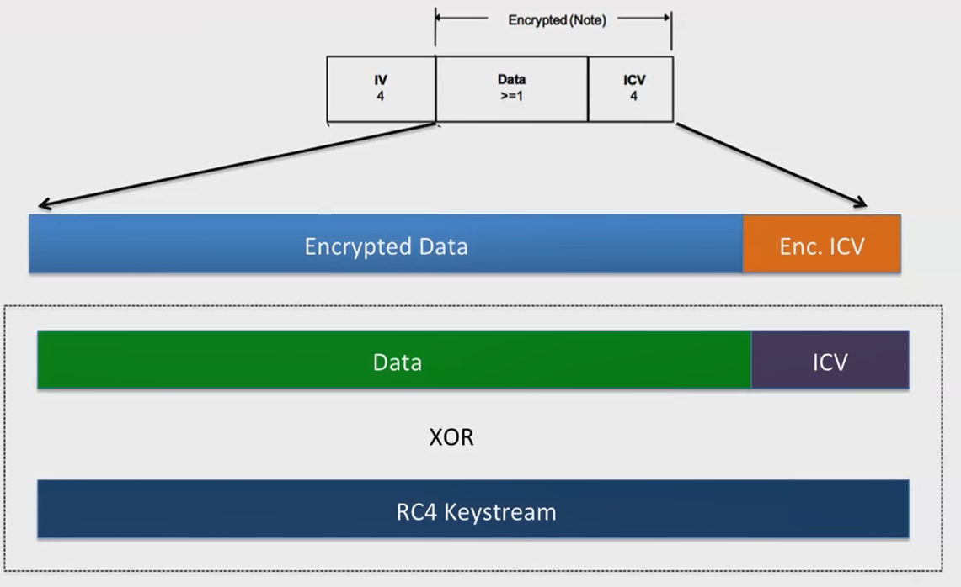
Message Injection Attacks (Cont’d)

Slide 42
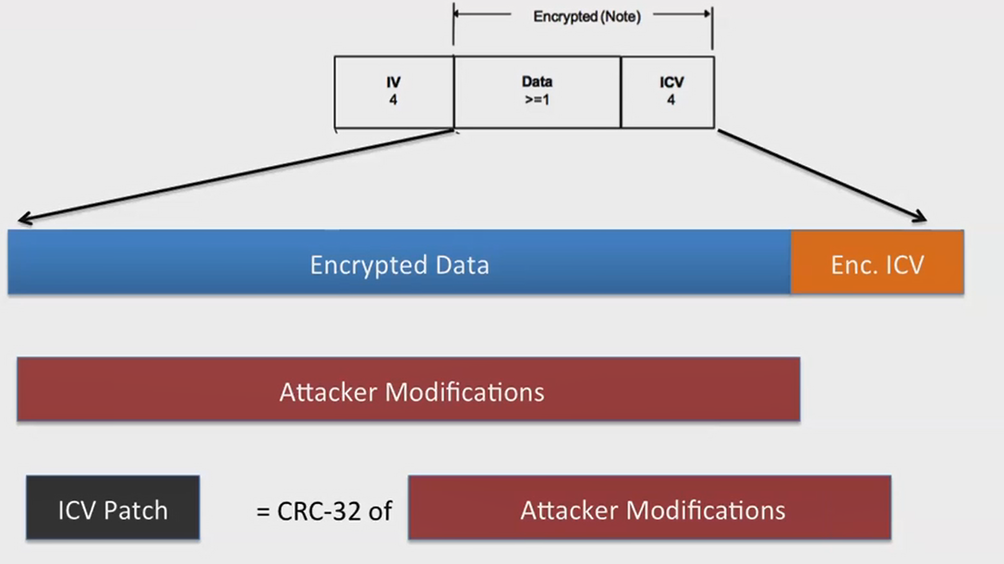
Message Injection Attacks (Create a bit mask without knowing plain text)

Slide 43
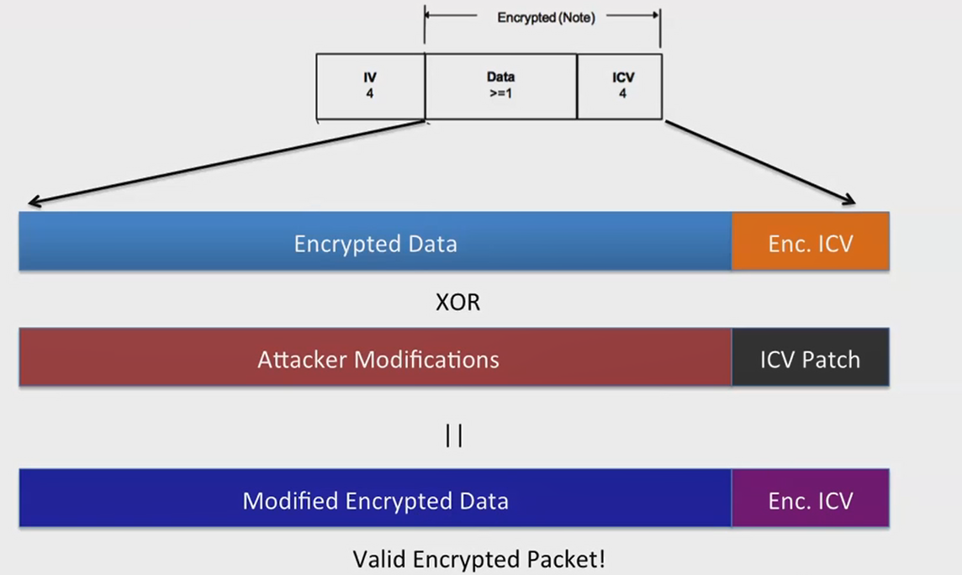
Message Injection Attacks (Patching a valid packet)

Slide 44
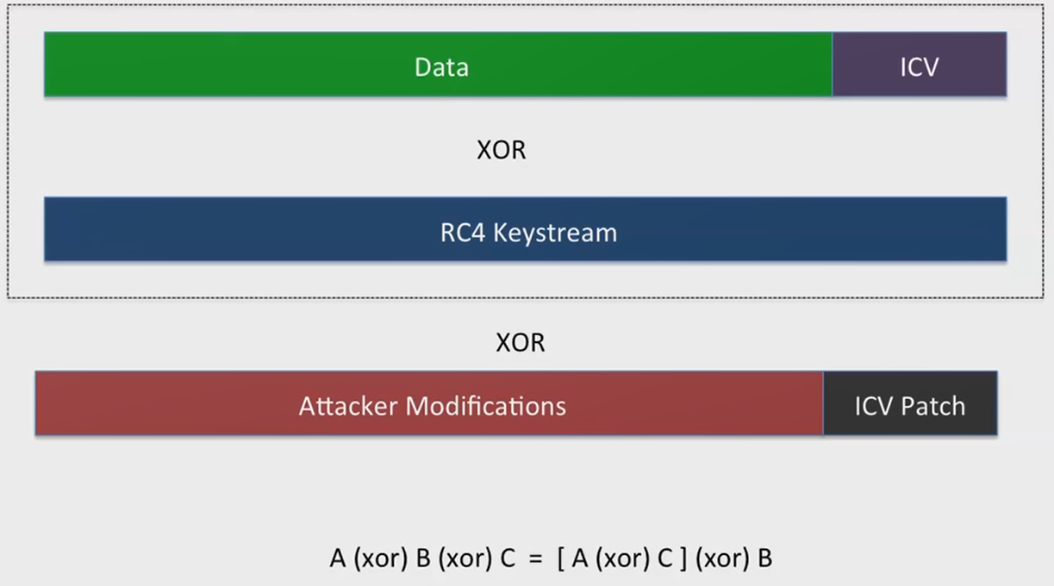
Message Injection Attacks (Behind the scene)

Slide 45
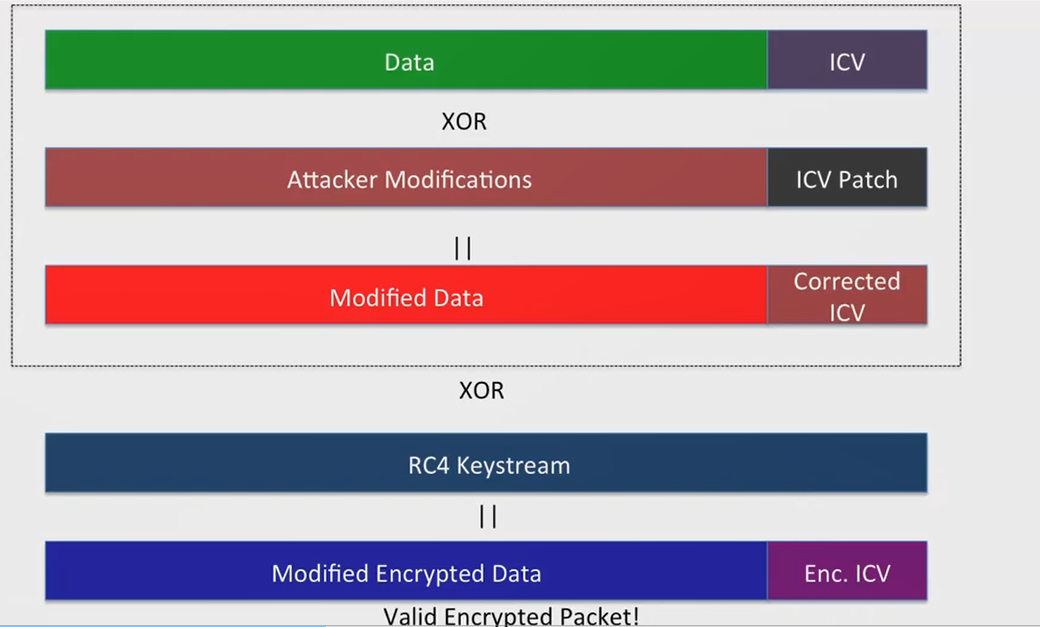
Message Injection Attacks (Modified packet XOR with Keystream)

Slide 46
Because of Message Injection Flow
Message injection flow leads to:
    Café Late
ChopChop Attack
Fragmentation Attack
Hirte Attack

Slide 47
Café Late
As we explained before, clients will continuously probe for SSIDs they have connected to previously.
If the client had connected to an access point using WEP , operating system such as Windows cache and store the WEP key so that the next time the client connects to the same access point Windows wireless configuration manager uses the stored key
Café Late attack is a WEP attack which allows a hacker to retrieve the WEP key of the authorized network using just the client. (Even if there is no AP)

Slide 48
Café Late (Cont’d)
Can we somehow have an isolated client generate WEP encrypted data packets using the authorized network’s key?
To crack WEP all we need is encrypted data packets
Let’s see an example

Slide 49
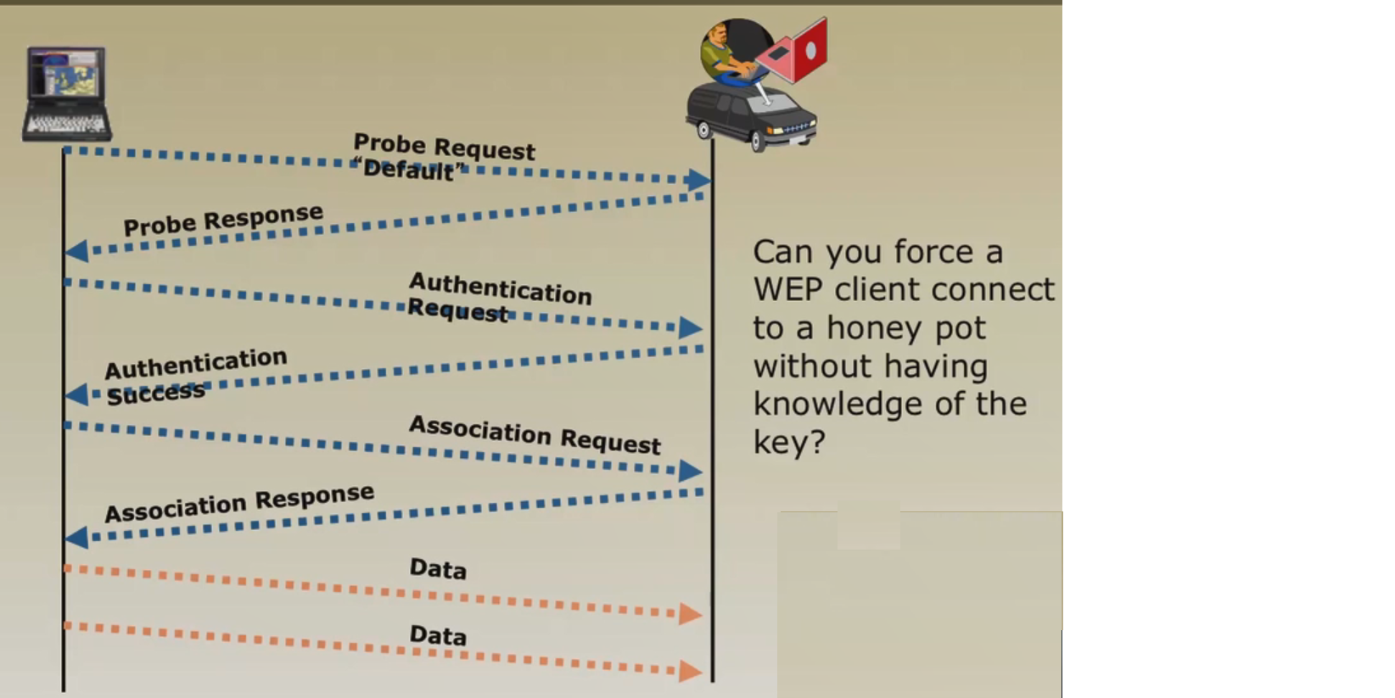
Café Late (Cont’d)

Slide 50
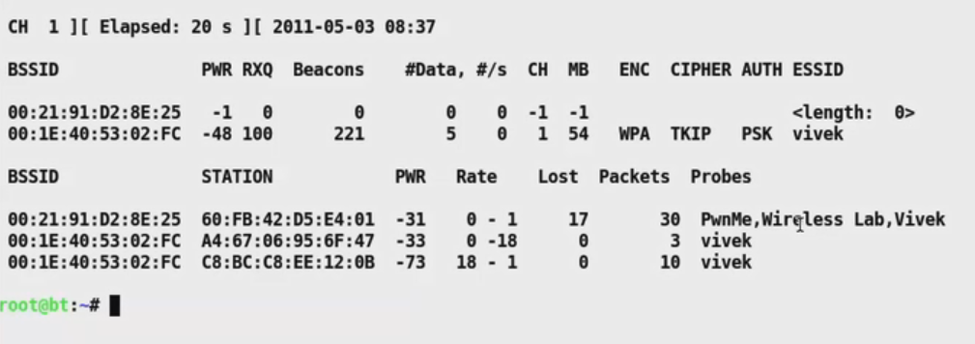
Café Late Demo
First, you will need to listen to the clients probes

Slide 51
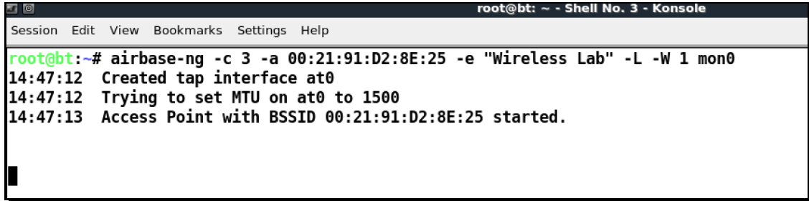
Café Late Demo (Cont’d)
Second step involves running Airbase-ng with the following parameters
As soon as the client connects to the fake AP, the café late attack starts
You should also have started writing the packets into a file to use aircrack-ng against it

Slide 52
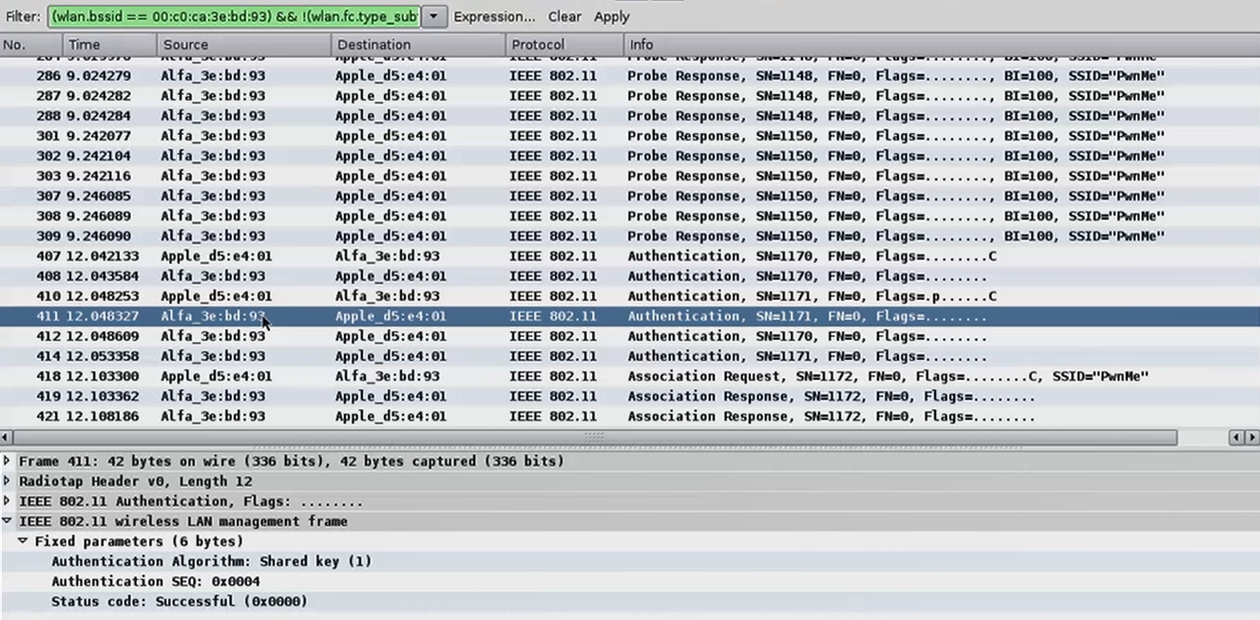
A Look at a Smooth Authentication

Slide 53
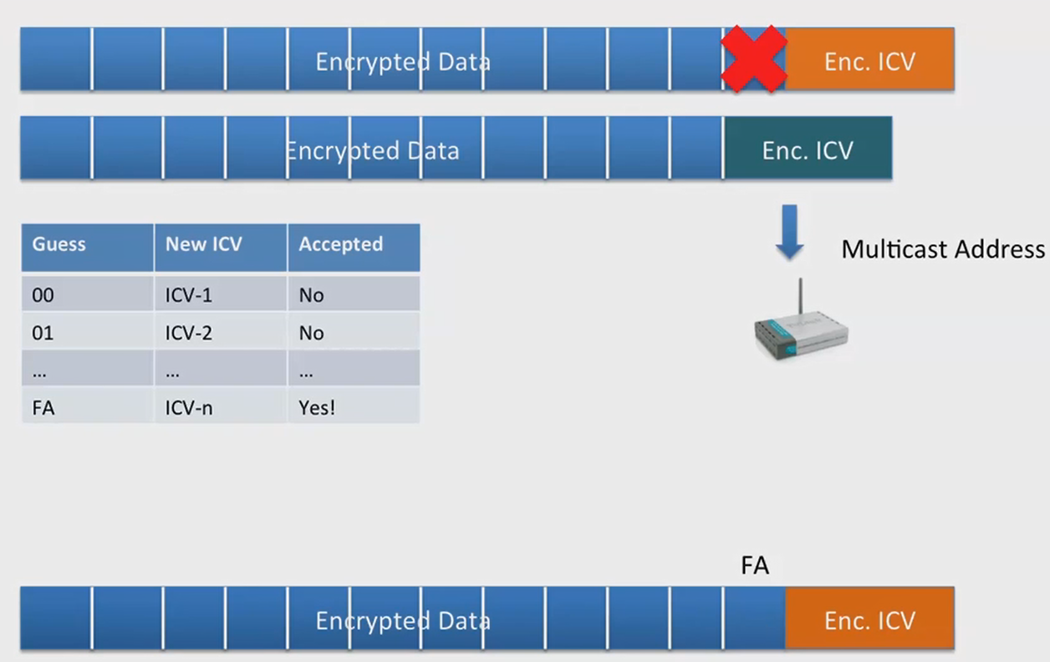
Korek’s ChopChop Attack

Slide 54
Cracking WEP Techniques – The Script kiddie way
Passive way (wait, wait and wait)
Undetectable
Use Directional Antenna (The one in Alfa)
Decrypt traffic once cracked
Caffe Latte Attack
Active way (Patience is not your virtue)
  Replay attacks (Stimulate networks to send encrypted data packets via ARP

