Slide 1
Wireless Security
Unit 4 – Attacking WPA-Enterprise and RADIUS
Dr. Haitham Alani
Faculty of Computer Engineering
Course number: 25444

Slide 2


Course Outline
Introduction
WPA Enterprise Architecture
WPA Enterprise Authentication Types
WPA Enterprise Configuration
Obtaining the EAP Handshakes
EAP-MD5
Monitoring the EAP handshakes
Attacking EAP-MD5
LEAP
Attacking LEAP
EAP FAST
EAP-TLS
PEAP
Attacking PEAP
Security Best Practices

Slide 3
Introduction
Most major organizations leverage WPA Enterprise for their deployments.
It provides fine-grained control over authentication, which translates into better overall security
WPA Enterprise supports a variety of authentication schemes with the use of EAP (Extensible Authentication Protocol) some of these schemes are considered more secure than the others

Slide 4
WPA Enterprise Architecture
These schemes are for example – EAP-MD5, PEAP, EAP-TLS, LEAP
All of those schemes rely on RADIUS server for authentication
Depending on EAP types used both the Client and the Server will to be configured
De facto open source server → FreeRadius www.freeradius.org

Slide 5
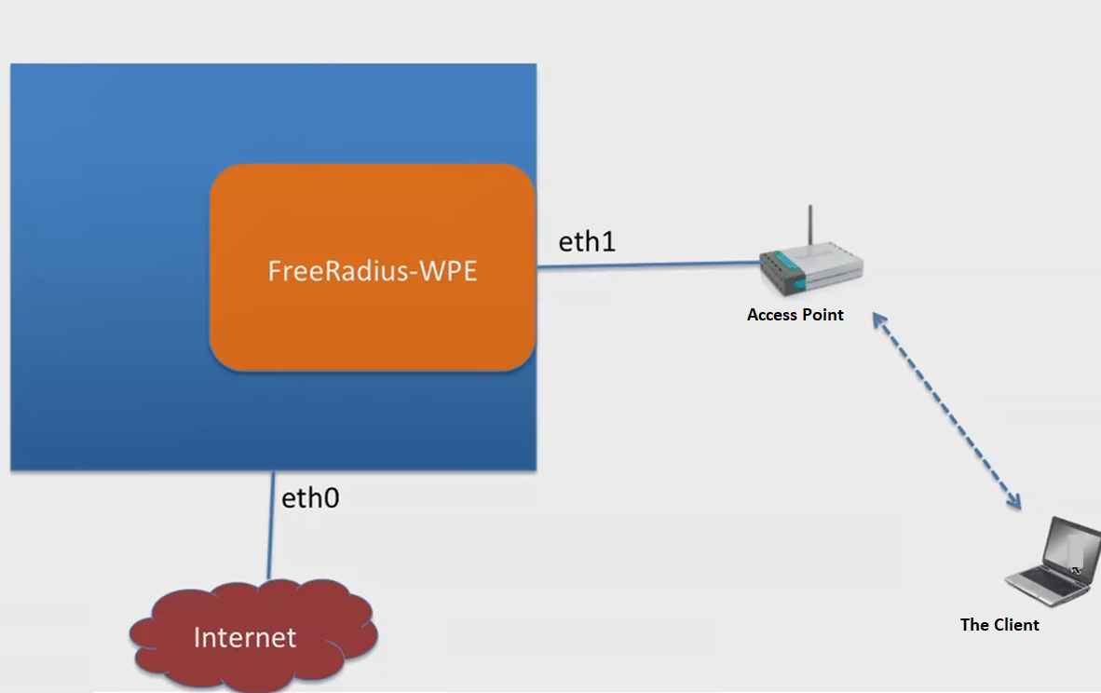
WPA Enterprise Architecture (Cont’d)

Slide 6
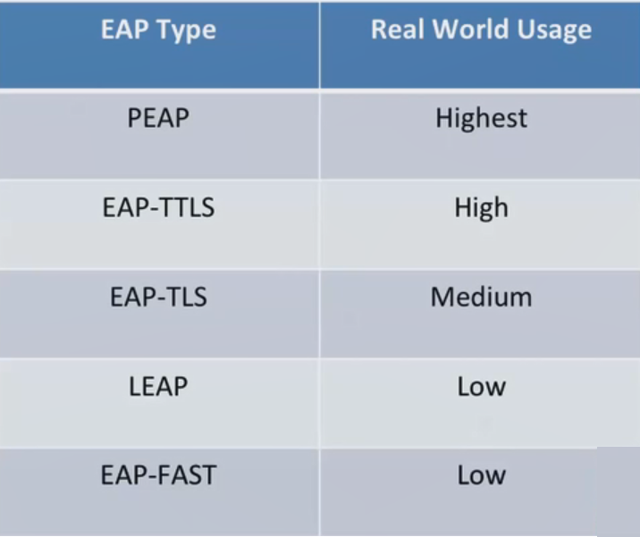
WPA/WPA2 Enterprise Authentication Types

Slide 7
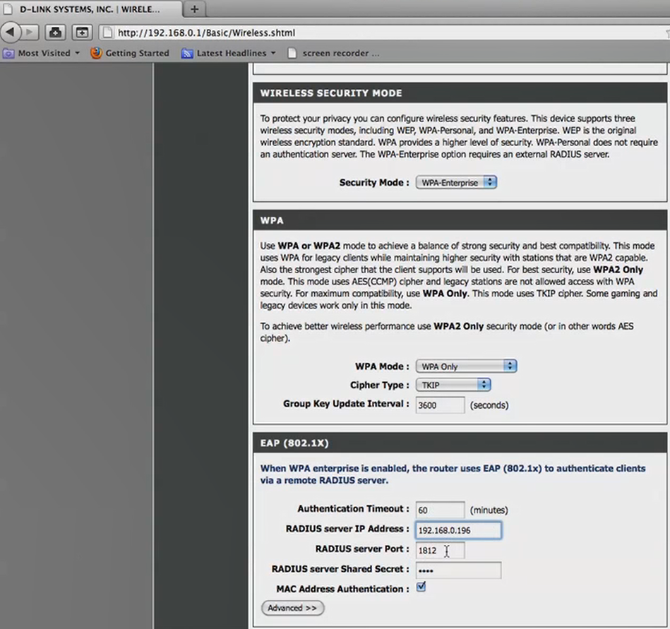
WPA Enterprise Configuration

Slide 8
Obtaining the EAP Handshake
Just as the four-way handshake was important for attacking WPA-PSK, the EAP handshake is important for attacking WPA Enterprise.
It tells what EAP type is being used and depending on the configuration, can provide more information to launch an attack
The attacker can use one of the active or passive methods to attack the WPA-PSK Enterprise

Slide 9
EAP Response Identity
The EAP Response Identitiy Message containing the client’s username is the first message the client sends to the authentication server during the EAP handshake.
Depending on the authentication server, the username may or may not be used during the authentication process.
Identity message is sent in clear text, if an attacker can capture the EAP handshake, you can potentially get the username of the connecting client.

Slide 10
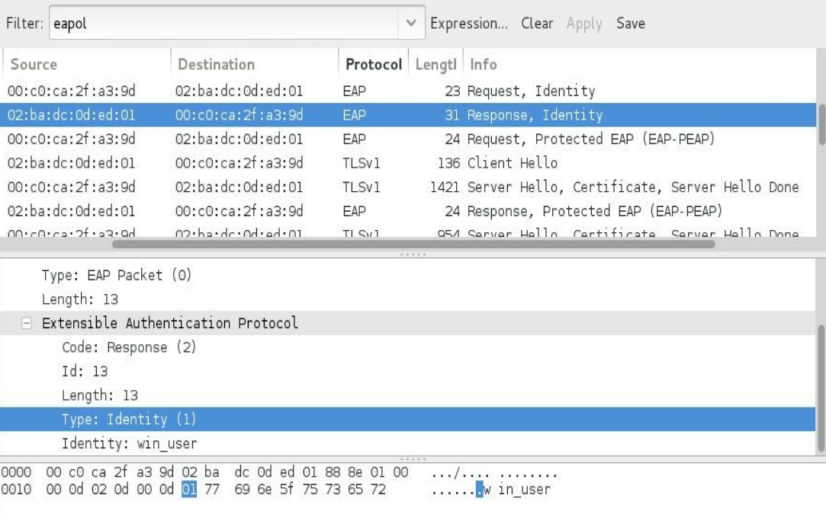
EAP Response Identity in Wireshark

Slide 11
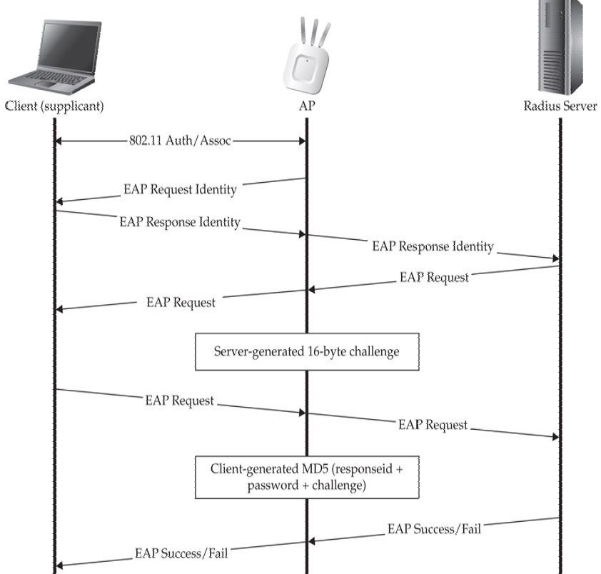
EAP-MD5

Slide 12
EAP-MD5 (Cont’d)
The client first supplies its username within the EAP Response Identity message
The server sends the client an identifier and a 16-byte challenge.
The client takes its password, the identifier and challenge (concatenates them all together) and hashes the string using MD5.
The client sends the hashes string to the server, which then computes the same string and compares it to the one received by the client (If they match, the client will then authenticated)

Slide 13
Setting up the RADIUS Server
Add a username/password in users file
Make EAP-MD5 the default EAP type in eap.conf
Ensure the shared secret is correct for the AP RADIUS server in clients.conf

Slide 14
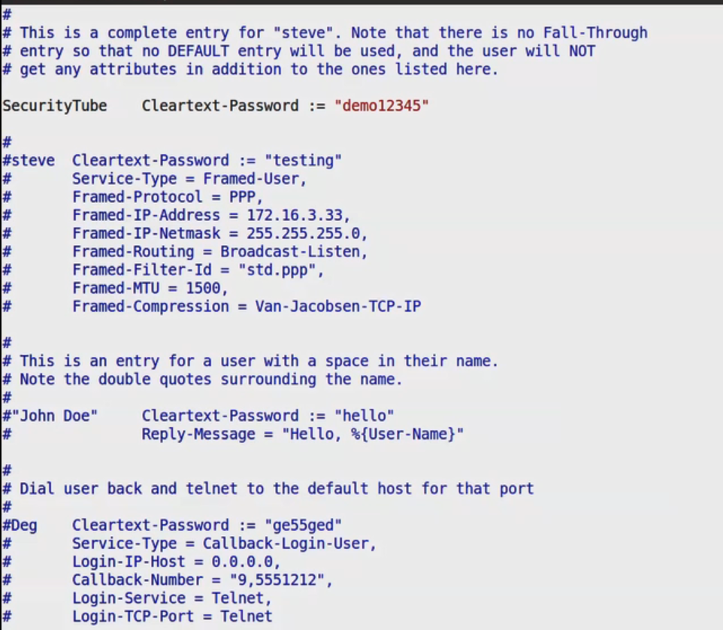
Setting up the RADIUS Server

Slide 15
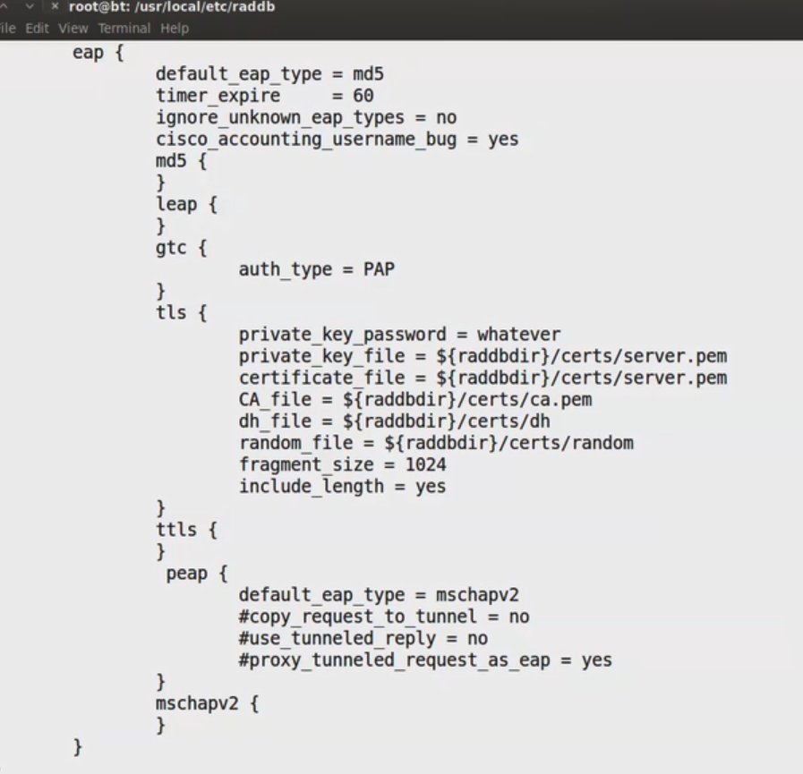
Setting up the RADIUS Server

Slide 16
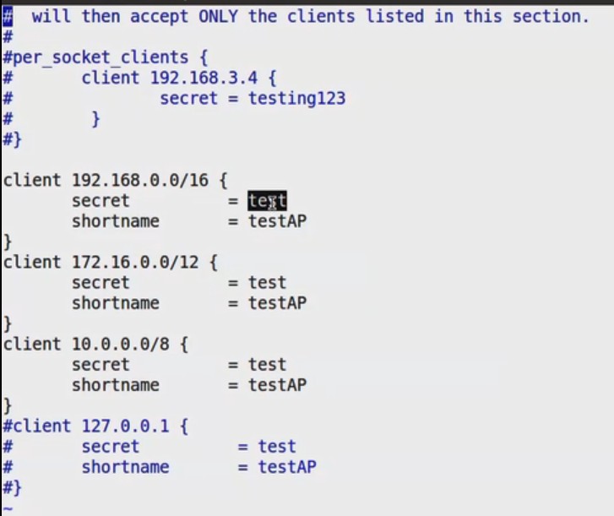
Setting up the RADIUS Server

Slide 17
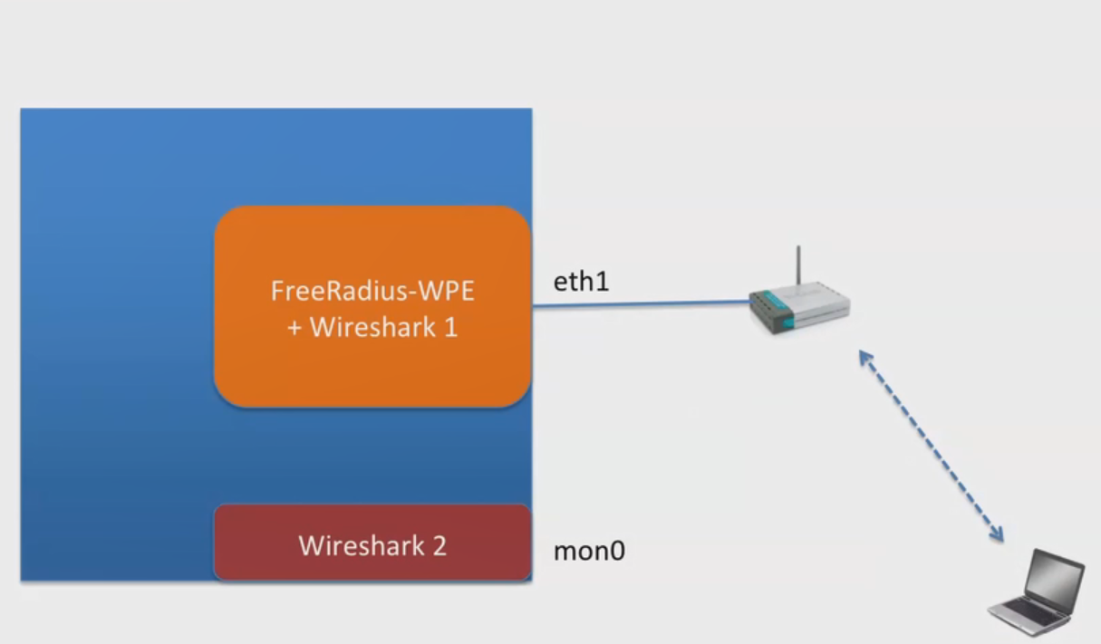
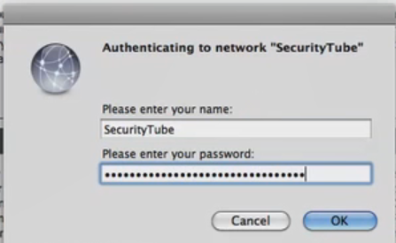
Observing the Traffic

Slide 18
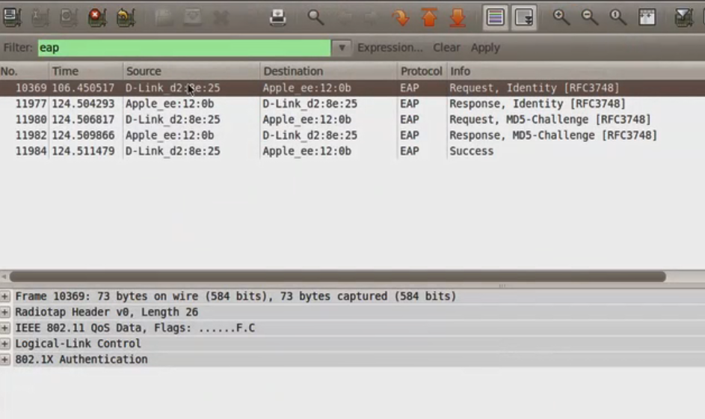
Packets on Mon0

Slide 19
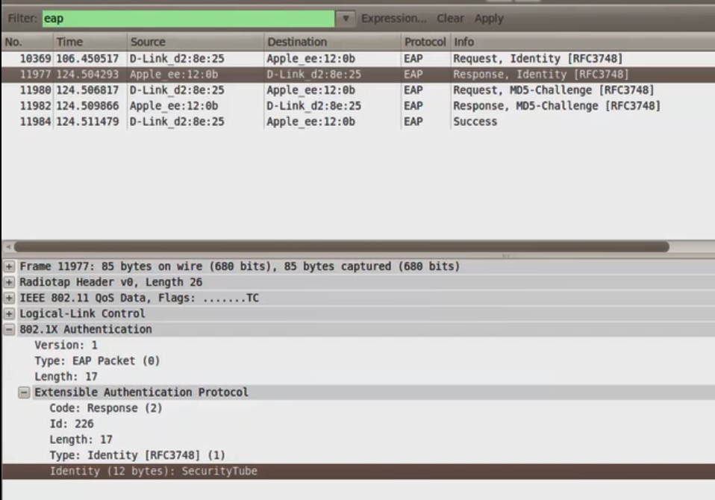
Packets on Mon0

Slide 20
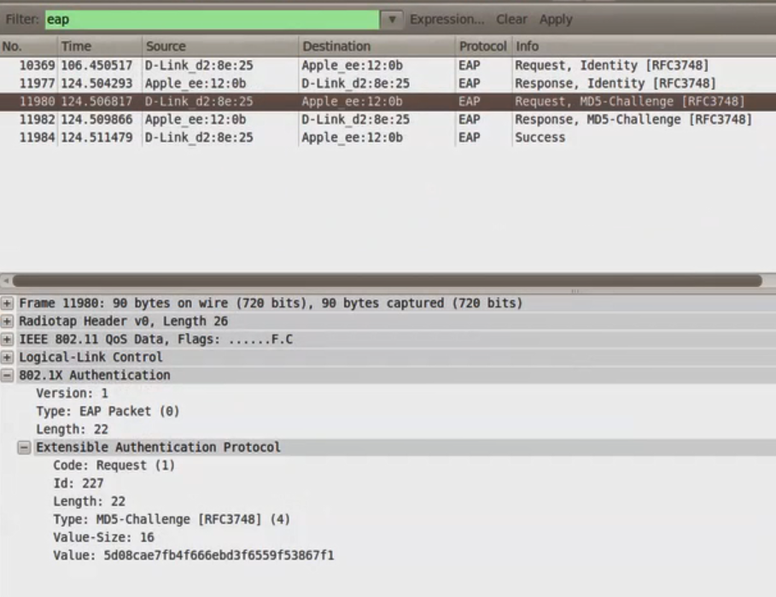
Packets on Mon0

Slide 21
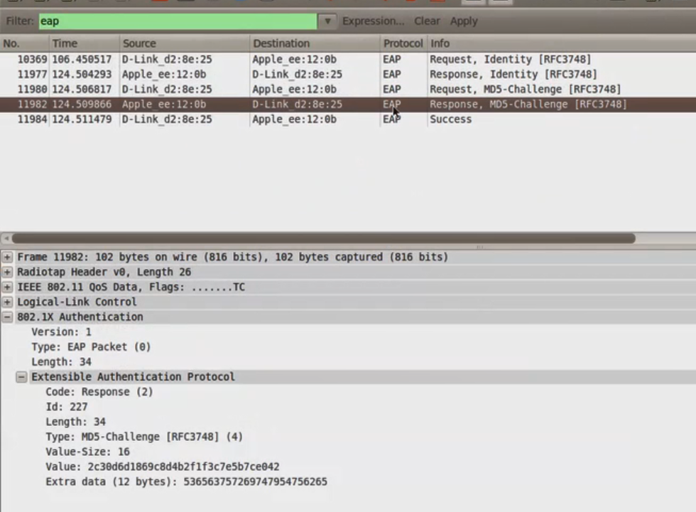
Packets on Mon0

Slide 22
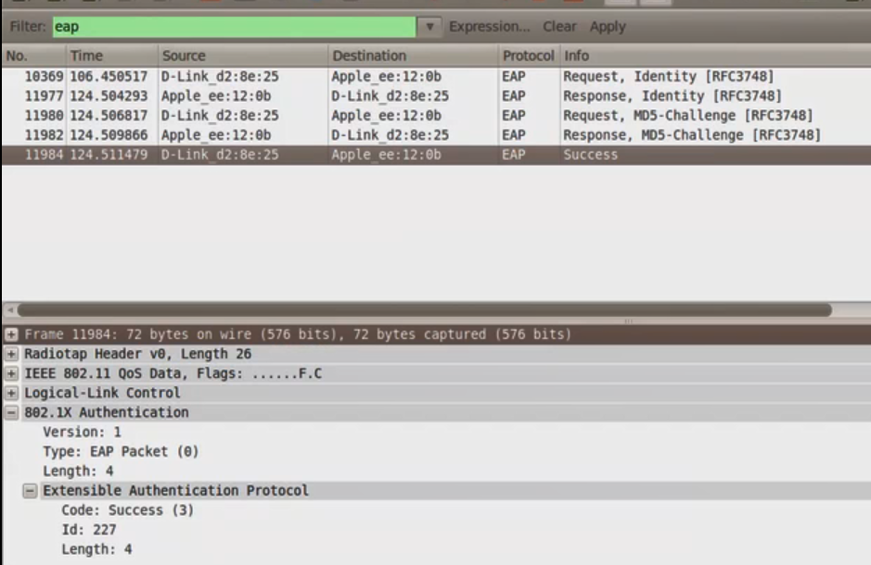
Packets on Mon0

Slide 23
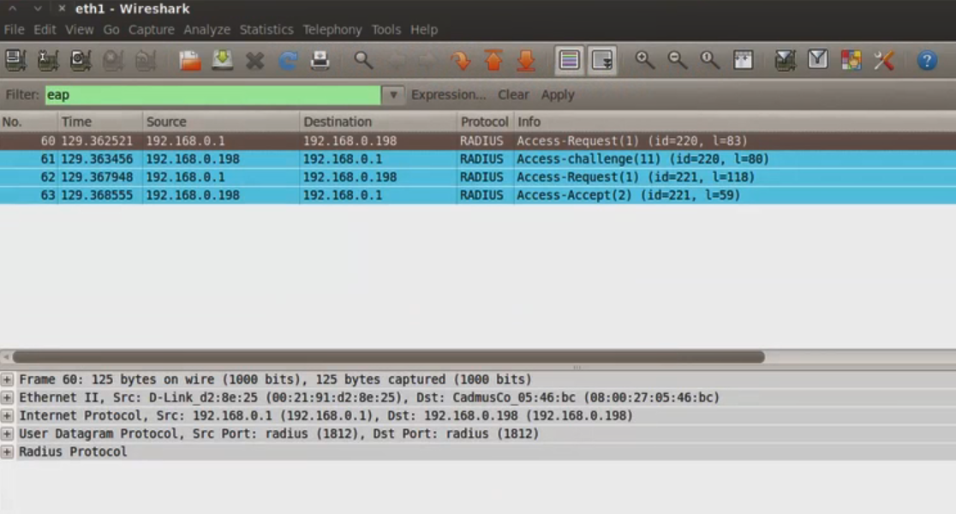
Packets on eth1

Slide 24
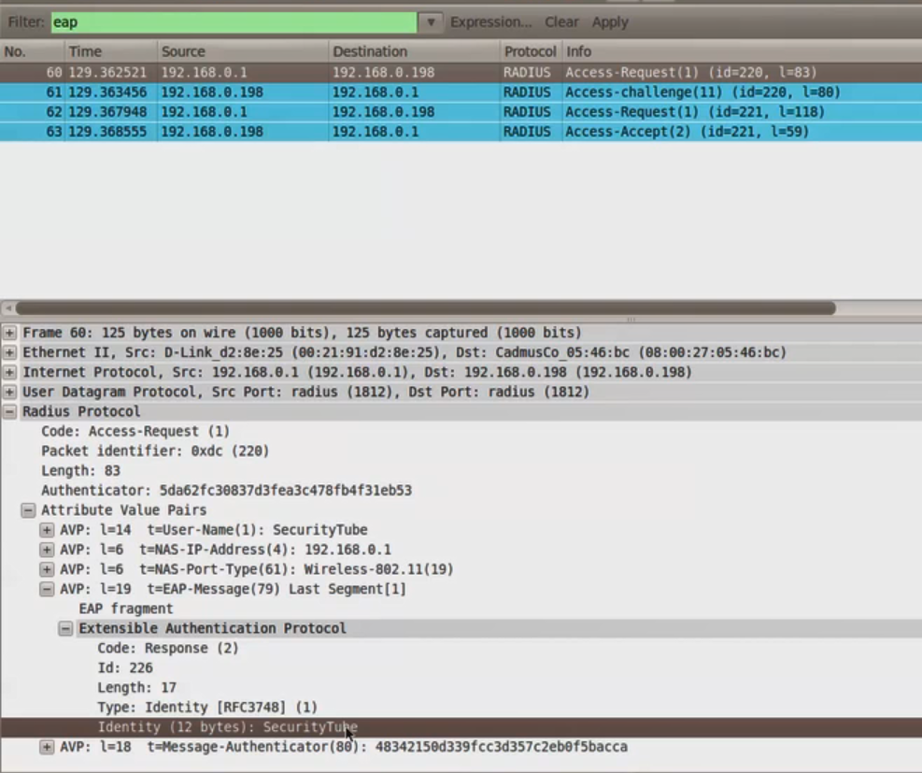
Packets on eth1

Slide 25
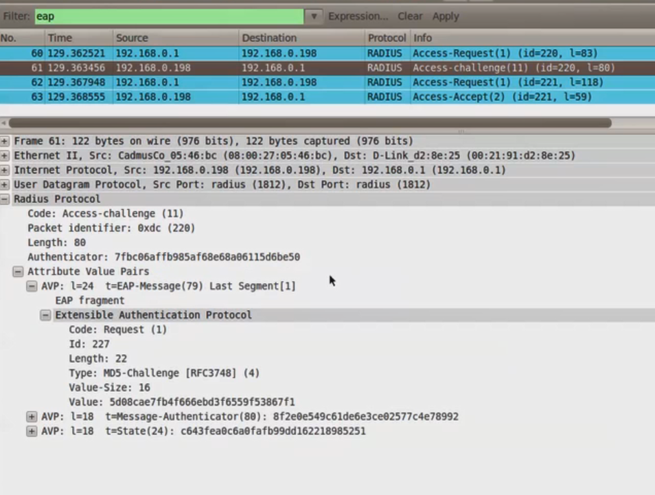
Packets on eth1

Slide 26
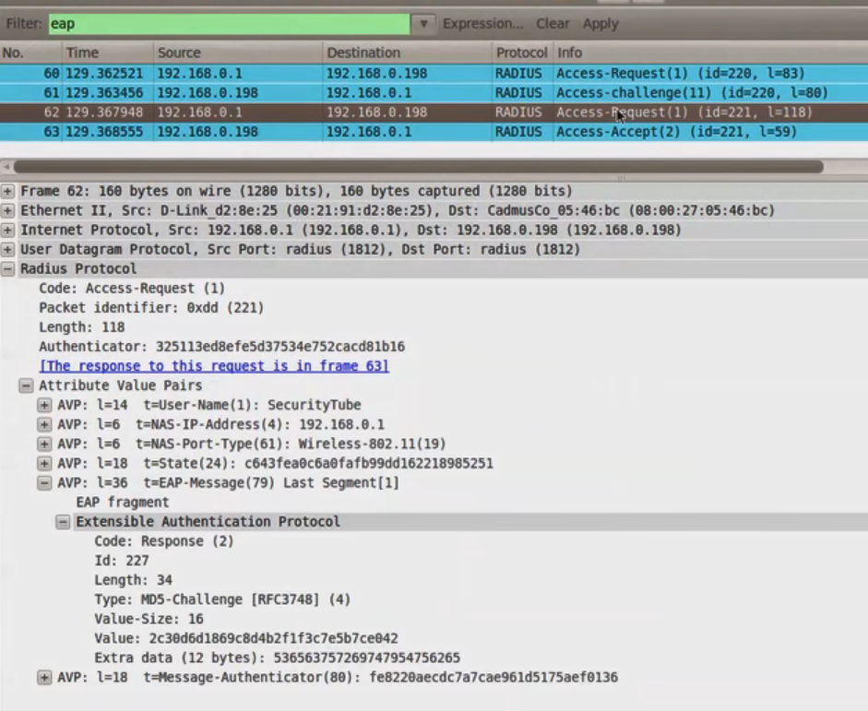
Packets on eth1

Slide 27
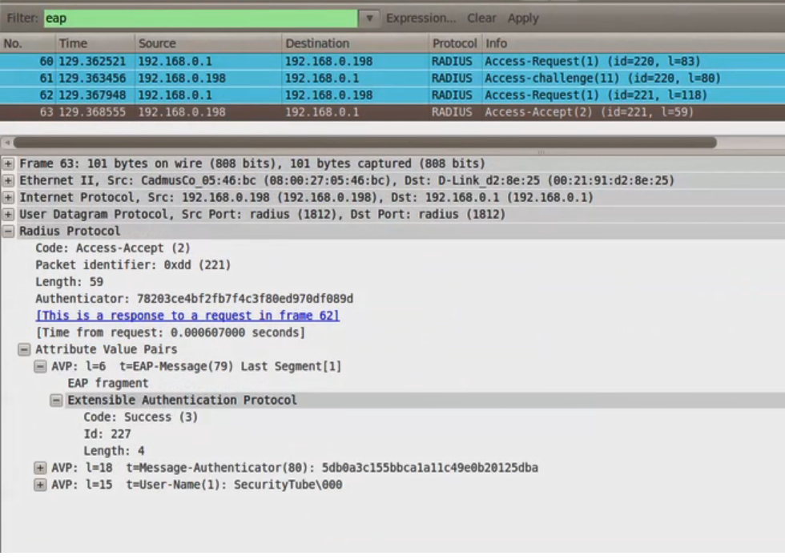
Packets on eth1

Slide 28
Cracking EAP-MD5 with Eapmd5pass
EAP-MD5 cannot be used for Wi-Fi as does not support key generation
Does not support mutual authentication
Both plaintext challenge and response goes over the air unencrypted
Attacker can easily execute brute force and dictionary attack

Slide 29
Cracking EAP-MD5 with Eapmd5crack
Hash= MD5 (EAP Response ID + Password + RADIUS Challenge)
Available to attacker (hash + Response ID + Challenge)
Simple Equation (keep guessing the password till hash match)
The tool eapmd5crack.py can be used to crack the password

Slide 30
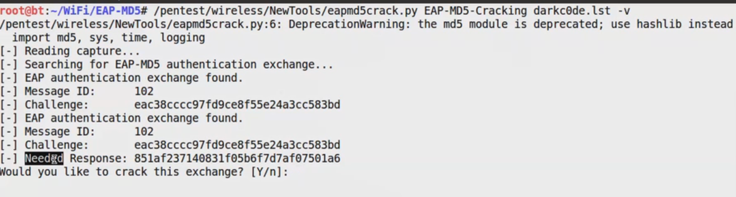
Cracking EAP-MD5 with Eapmd5crack

Slide 31
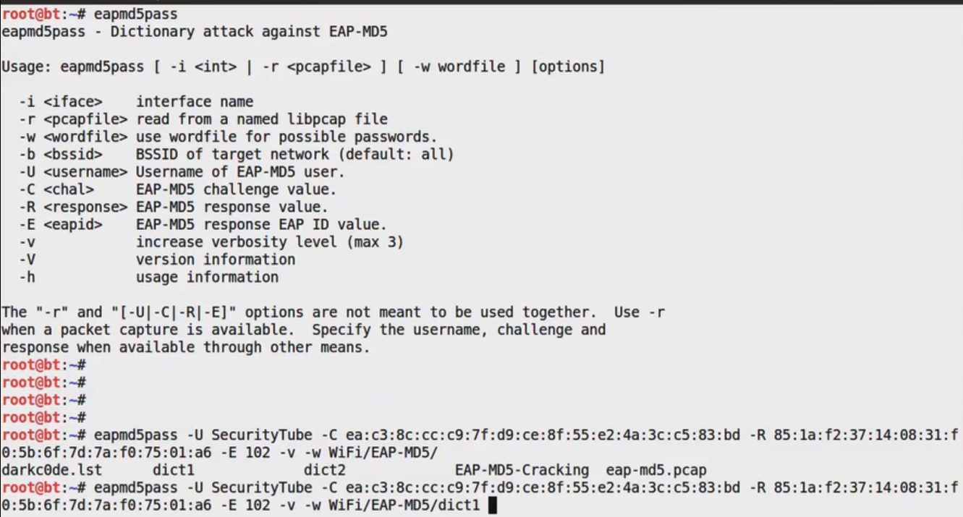
Cracking EAP-MD5 with Eapmd5pass

Slide 32
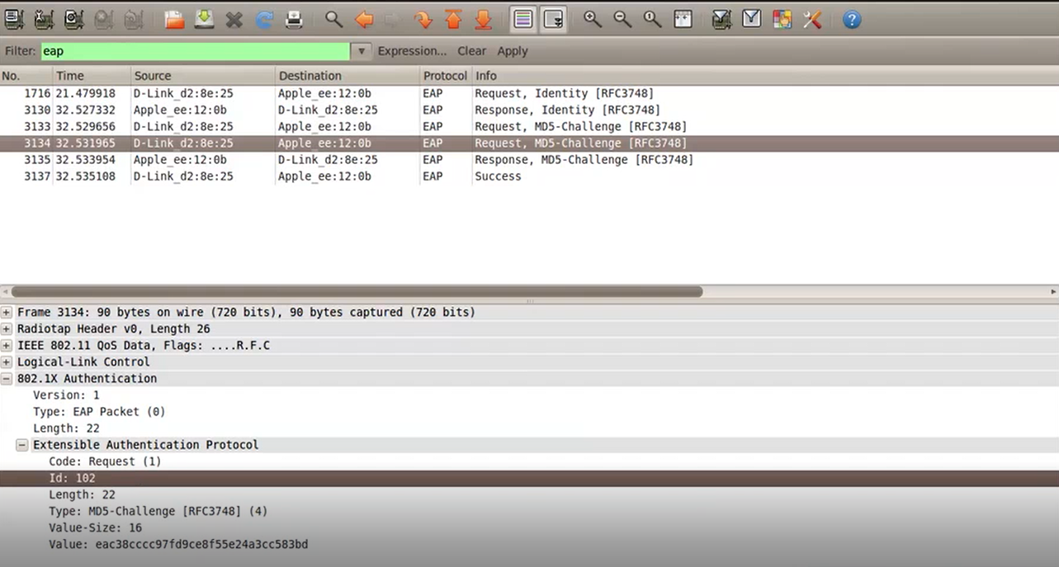
Cracking EAP-MD5 with Eapmd5pass
Where to find the last parameter (the ID)?

Slide 33
Lightweight EAP (LEAP)
LEAP (Lightweight EAP) is one of Cisco’s proprietary EAP types and is based on the MSCHAPv2 challenge-response protocol.
A Client connects to the network, sending it username and the authentication server returns an eight-byte challenge.
The client then computes the NT hash of the password and uses that as seed material to encrypt the challenge using DES.
The results are concatenated and returned to the server, the server does the same computation and verifies the results. (We saw that scenario before)

Slide 34
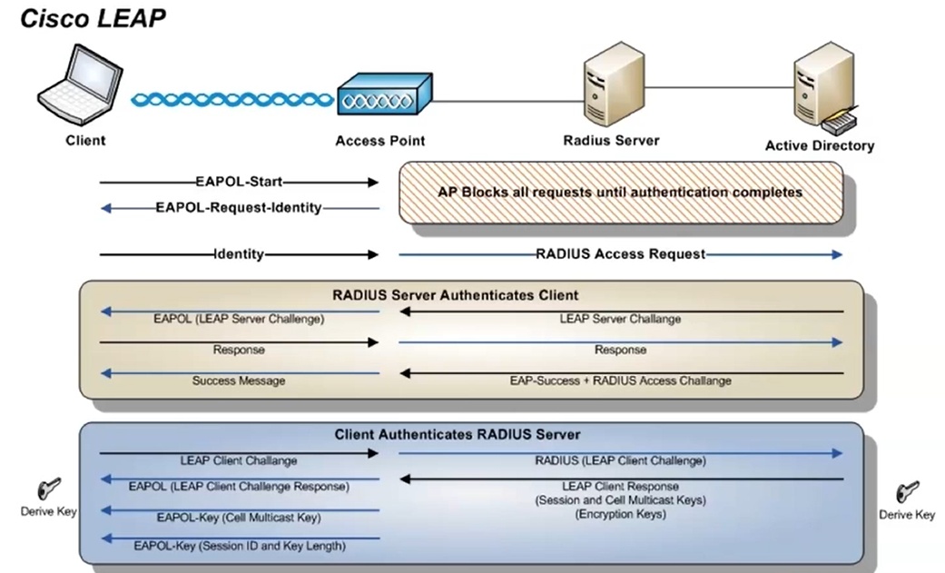
Lightweight EAP (LEAP)

Slide 35
Attacking LEAP
LEAP’s vulnerabilities were first identified and demonstrated by Joshua Wright with his cleverly named tool “Asleap”
Asleap can be used to obtain the EAP handshake or you can use any sniffer of your choice.
The first thing we need to do is create a hashed dictionary file that can be used to recover password from any LEAP-protected network

Slide 36
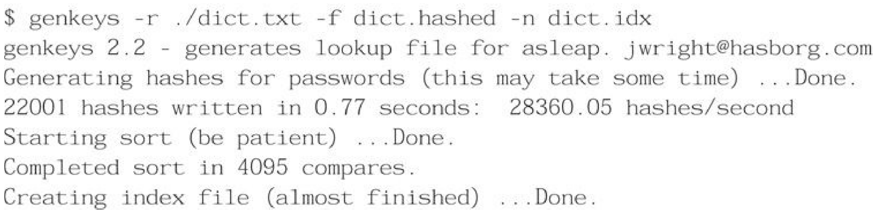
Attacking LEAP (Cont’d)

Slide 37
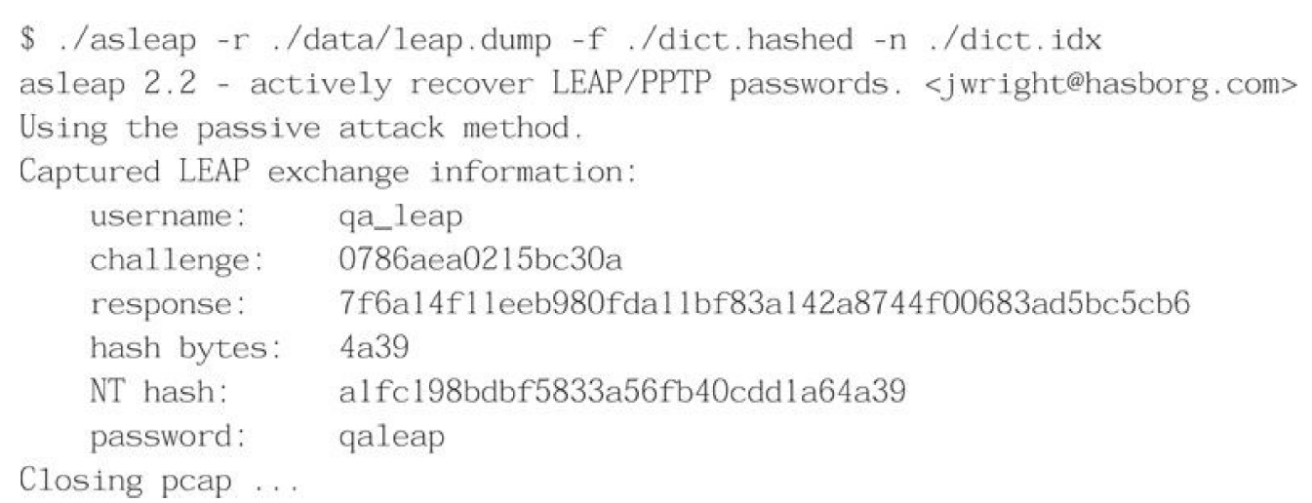
Attacking LEAP (Cont’d)
This command outputs two files: and index file (.idx) and the hashed dictionary file (dict.hashed).
Then you can launch the attack using the following command:

Slide 38
EAP-FAST
EAP FAST is an EAP method developed by Cisco Systems.
This authentication method establishes a secure tunnel between the client and the authentication server and passes the user credentials through that tunnel.
The secure tunnel creation is referred to as Phase 1 and the client transmitting its credentials through that tunnel is referred to as Phase 2
This authentication is more secure than the LEAP but still vulnerable to rare types of attacks like a honeypot AP

Slide 39
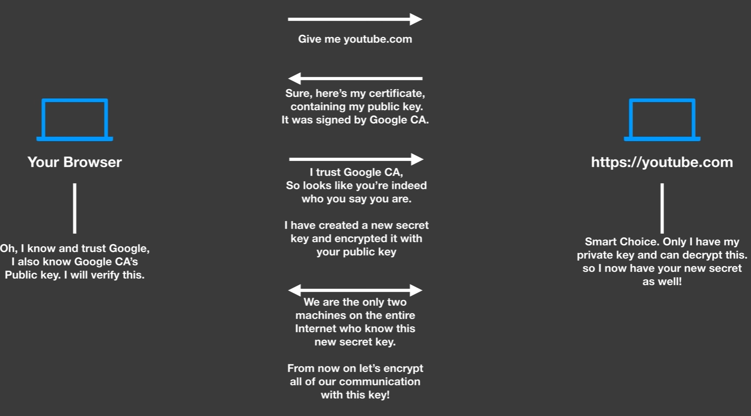
How Does HTTPS Work? (Revision)

Slide 40
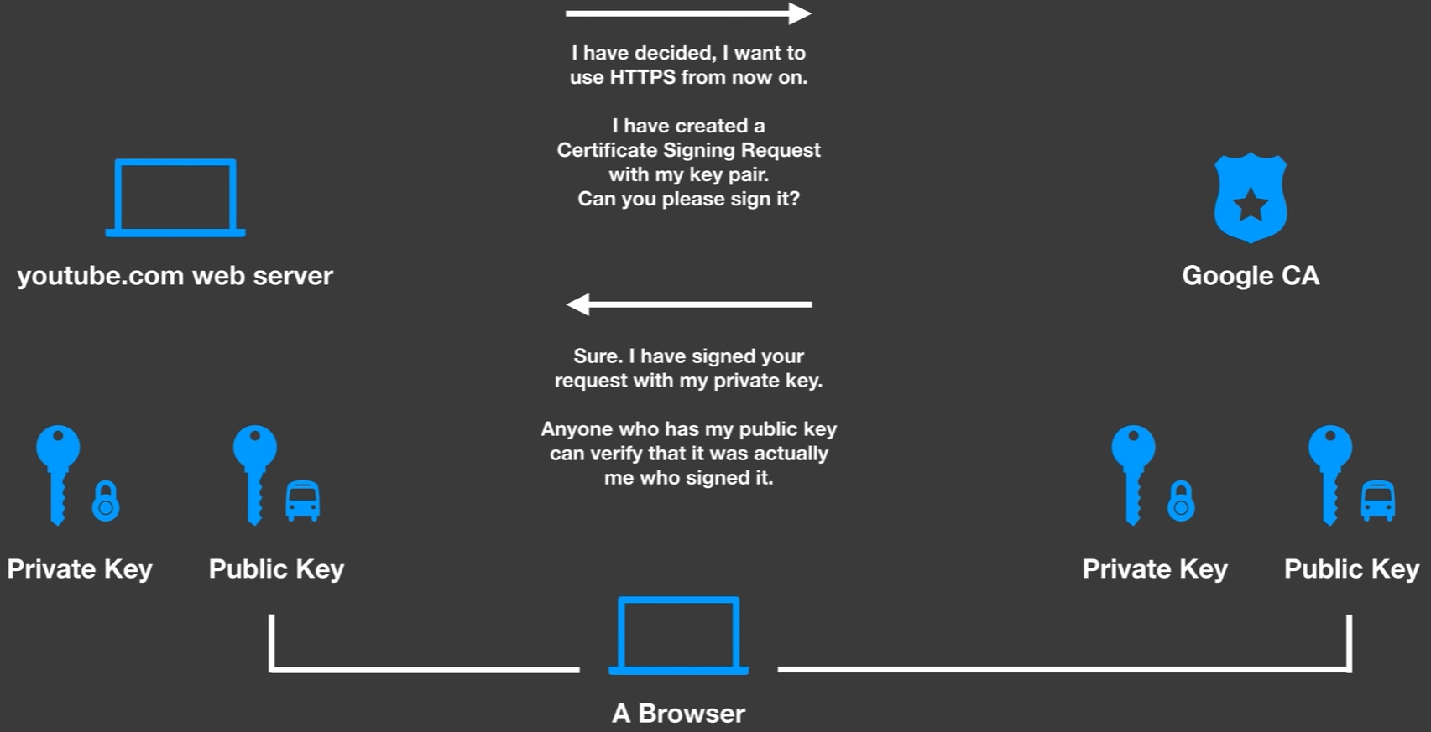
How Does Certificate Authority Work (Revision)

Slide 41
Protected Extensible Authentication Protocol (PEAP)
Protected Extensible Authentication Protocol is the most popular enterprise Wi-Fi security mechanism used
Can be used by both Windows and OS X
PEAP has two versions:
A- PEAPv0 with EAP-MSCHAPv2 (most popular and supports by default in Windows)
B- PEAPv1 with EAP-GTC

Slide 42
Protected Extensible Authentication Protocol (PEAP) (Cont’d)
PEAP uses server-side certificates for validation of the Radius server.
Almost all attacks on PEAP leverage mis-configuration in certificate validation
  Windows has native support for PEAP.
  The attack takes place when the Certification Verification is turned off

Slide 43
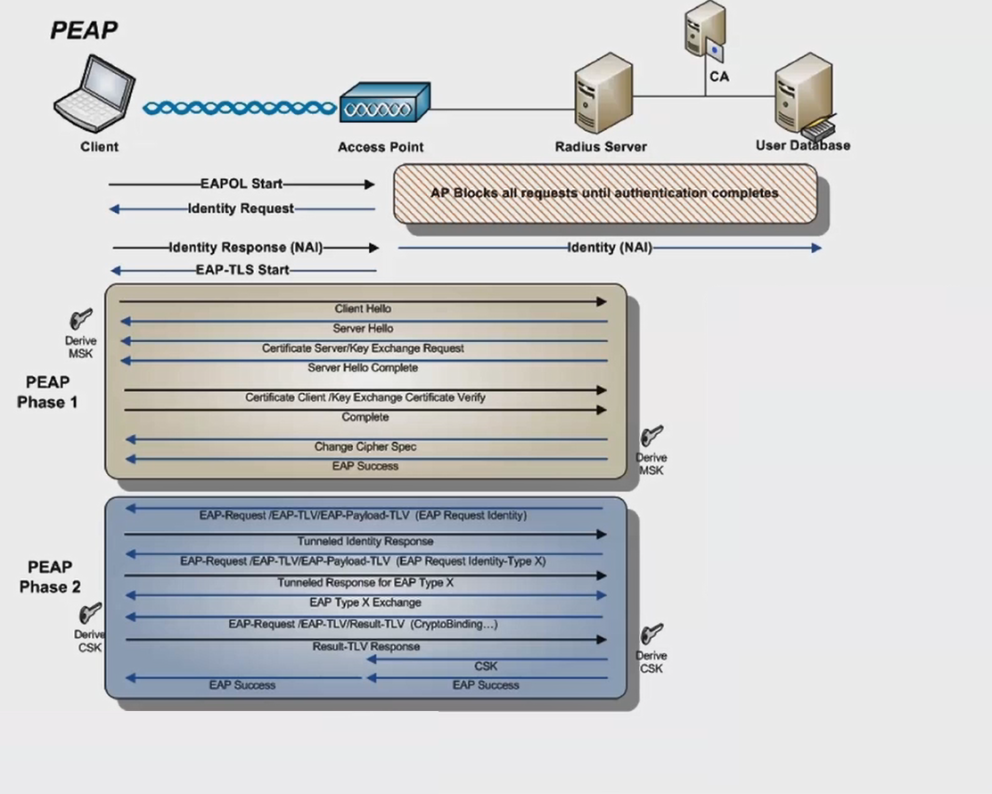
Protected Extensible Authentication Protocol (PEAP) (Cont’d)

Slide 44
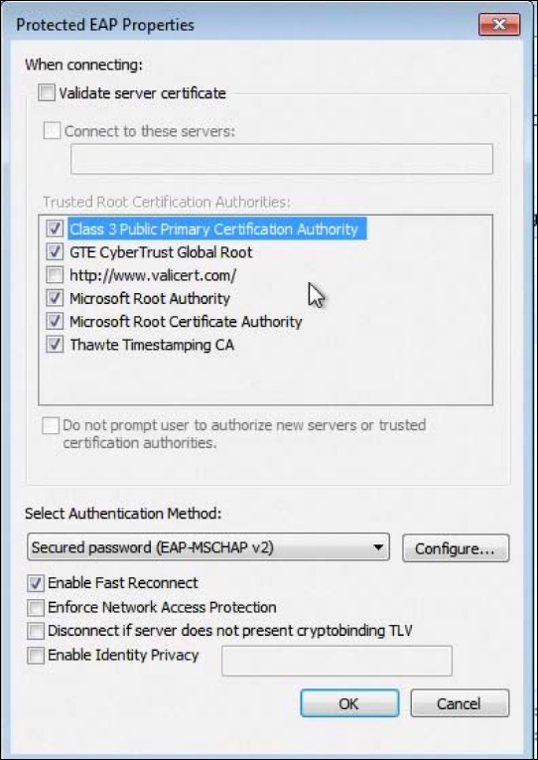
Windows PEAP Configuration

Slide 45
Attacking PEAP
  The attacker needs to create a FreeRadius-WPE Honeypot to lure the victim to connect to the server.
  The client is configured to not use certificate validation with PEAP.
  This would allow the attacker to present his own fake certificate to the client which it gladly accepts.
  Once this happens, MSCHAP-V2 the inner authentication protocol kicks in as the client uses our fake certificate to encrypt the date we are easily able to recover the username and the challenge

Slide 46
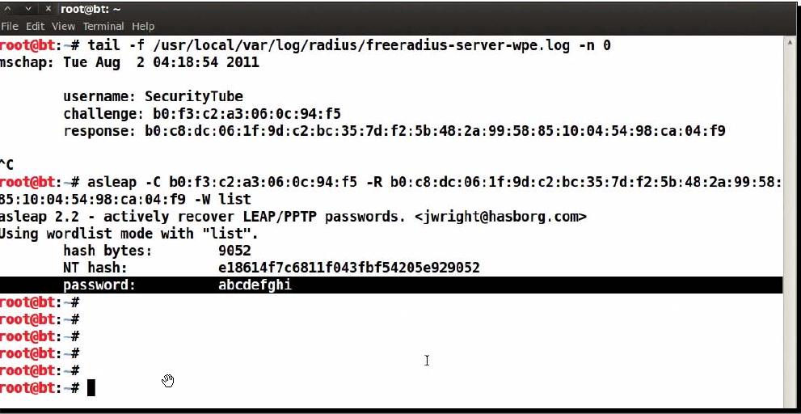
Attacking PEAP (Cont’d)
  The attacker monitors the Radius log file and as soon as the clients enters his creds , he uses Asleap to carry on his attack

Slide 47
EAP-TTLS
  EAP- Tunneled Transport Layer Security
  Server authenticates with Certificate
  Client needs to verify it’s certificate
  No native support on Windows (3rd party utilities )
  There are two versions
  EAP-TTLSv0
  EAP-TTLSv1

Slide 48
EAP-TTLS (Cont’d)
  The inner authentication protocols that implemented in this protocol are one of the following:
  MSCHAPv2
  MSCHAP
  CHAP
  PAP

Slide 49
EAP-TLS
EAP-TLS is considered very secure, mostly because it uses client and server certificates to authenticate the users on a network.
This, however, is also its major downfall; managing certificates for all the users in an organization of any size can be a daunting challenge.
The server sends the client its certificate which is verified and the public key included is used to encrypt further messages
The client and server then proceed to generate a random key. (SSL) which will be used to create the PMK

Slide 50
Security Best Practices for Enterprises
  Use WPA2-PSK with a strong passphrase (you have up to 63 characters at your disposal!. Make use of it)
  For large enterprises, use WPA2-Enterprise with EAP-TLS this uses both client and server-side certificates for authentication and currently is unbreakable
  If you have to use PEAP or EAP-TTLS with WPA2- Enterprise, then ensure that the certificate validation is turned on
  Use your own OS’s inbuilt utility (don’t use 3rd party utilities)

Slide 51
Last Questions
  Why you should care about WLAN Hacking?
  What will happen if your Wi-fi network got hacked?
  How bad the attack can be?

