Slide 1
Wireless Security
Unit 5 – Software Defined Radio
Dr. Haitham Alani
Faculty of Computer Engineering
Course number: 25444

Slide 2


Course Outline
Introduction to Software Defined Radio – RTL-SDR
SDR Architecture
Choosing a Software Radio
Exploring RTL-SDR on Windows
Decoding ADS-B Signals
Decoding Pager Traffic
2G Network Security
GSM Network Model
GSM Security
GSM Attacks
Summary

Slide 3
Introduction
Each sound wave can be described by two factors: Frequency and Amplitude
Sound waves can be described through x and y coordinates, despite the facts that sound propagates through the medium in spherical geometry, however it could be illustrated in two dimensions (x, y) where x represents the frequency and y represents the amplitude
Amplitude describes the loudness of the sound wave, waves with low amplitude value can be amplified for a certain level to be heard. (Measured in dB)
Human ears can sense a range of frequency from 20 Hertz to 20000 Hertz

Slide 4
Introduction (Cont’d)
Do you remember the sounds your V.92 dial-up modem used to make?
Those screech whistles, and buzzes were the sounds of your information traveling across the phone line to your ISP.
You could tap your phone line, record the entire phone call to a wav file, and write a program to convert the sound waves into a pcap file.
Since you can turn audio into a pcap file, then you should be able to reverse the process and transmit information as well.

Slide 5
Introduction (Cont’d)
You could design a MitM system with nothing but a sound card and a sufficiently fast computer.
Just replace sound waves with radio waves, by using a special radio soundcard you can receive and transmit arbitrary signals
The advent of inexpensive software-defined radios (SDR) has redefined the wireless hacking landscape.

Slide 6
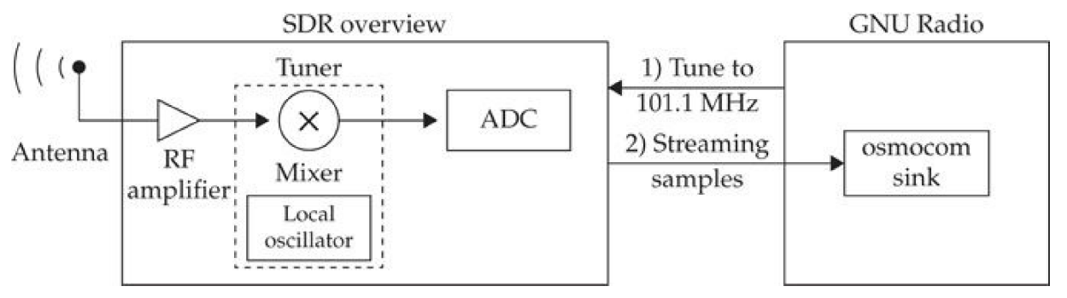
SDR - Architecture
Most radios have three main parts: the radio frequency (RF) amplifier, the tuner, and the ADC

Slide 7
SDR – Architecture (Cont’d)
Antenna is responsible for “picking up” radio signals, some antennas function well across many frequencies, whereas others only function well at one frequency.
Isotropic antennas works well for transmitting and receiving (Transceiving) signals from any direction
Directional antennas (Yagi) may be a better choice if you are trying to communicate with only one distant station.

Slide 8
SDR – Architecture (Cont’d)
The RF amplifier is responsible for boosting weak signals.
The user specifies a gain value in decibels (dB), which controls the amount of amplification. Without gain, you might not receive weak signals.
Too much gain, however, will distort your signal just like a sound system turned up too loud.

Slide 9
SDR – Architecture (Cont’d)
Next comes the tuner, the mixer selects the portion of the radio spectrum to analyze.
Dragging a range of frequencies down to a lower frequency.
Finally, the selected radio signal is passed to an analog-to-digital converter (ADC)
The ADC is responsible for converting the analog waveform to a stream of digital numbers in process known as sampling

Slide 10
Choosing a Software Radio
There are four main characteristics of interest when choosing an SDR
Sample Rate/Bandwidth: The sample rate usually specified in millions of samples per second (MSPS) defines the maximum bandwidth you are able to view simultaneously.
To look at 802.11 b/g or LTE signals, you will need an adapter with at least 20 MSPS of bandwidth. (2 MSPS of bandwidth is plenty for many popular signals)

Slide 11
Choosing a Software Radio (Cont’d)
Dynamic Range/ADC Resolution: The ADC resolution, specified in bits, it is similar to contrast ratio and dots per inch on modern TV.
It lets you view loud signals and quiet signals together and observe smaller differences in the signal.
To view LTE or GPS, 8 bits may not be enough. However, 8 bits is enough to track airplanes, decode pager messages and more

Slide 12
Choosing a Software Radio (Cont’d)
Transmit Capability: Some SDRs are receive only, while other devices are meant to send and receive.
Some allows you to transmit and receive (Simultaneously) full duplex but others are half duplex
Tuner Range: The tuner range determines what frequencies you are able to receive. If you want to receive Bluetooth, for example you better make sure this range includes 2.4 GHz

Slide 13
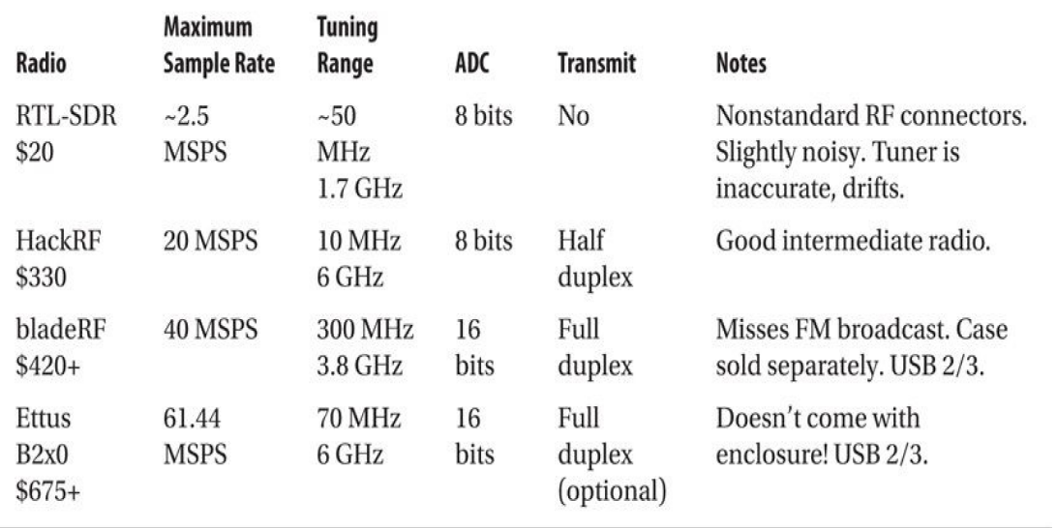
Choosing a Software Radio (Cont’d)
The RTL-SDR started its life as a cheap consumer device for watching digital broadcast television (DVB-T) in Europe, Asia and Oceania. By plugging it into your laptop, you could watch TV wherever you had a signal.

Slide 14
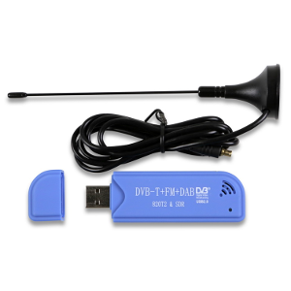
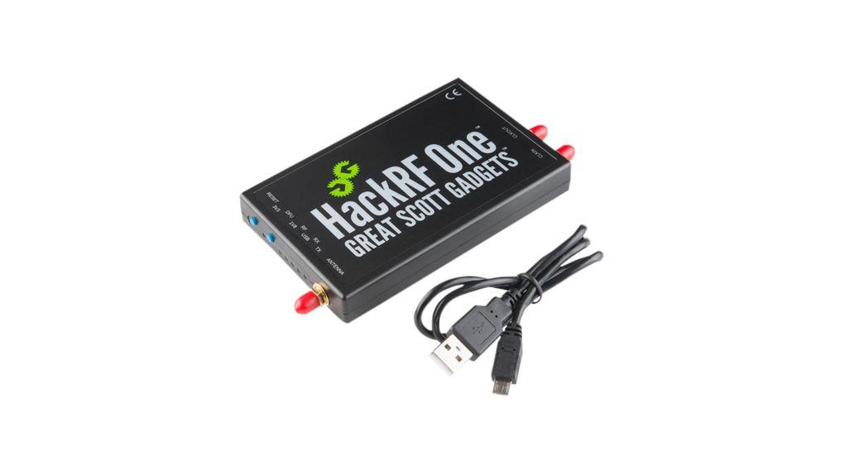
Adapters
RTL-SDR Adapter HackRF Adapter

Slide 15
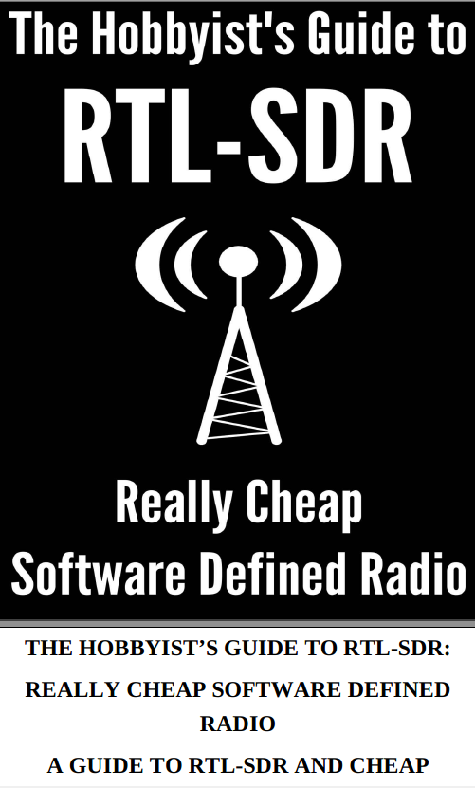
Choosing a Software Radio (Cont’d)
This is a good resource for RTL-SDR projects

Slide 16
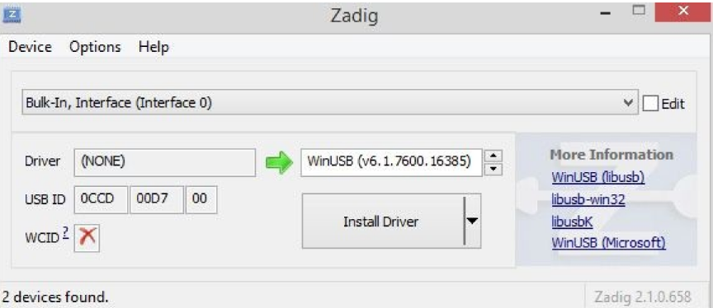
Playing with RTL-SDR on Windows
A popular tool for interacting with the RTL-SDR and other SDR platforms on Windows is SDRSharp
SDR# was written by Youssef Touil, can be downloaded from this website https://airspy.com/

Slide 17
ADS-B stands for “Automatic Dependent Surveillance-Broadcast (ADS-B)”
Airplanes use the frequency 1090 MHz to transmit their position and flight number
You can download and compile the tool dump1090 on Linux
Decoding ADS-B

Slide 18
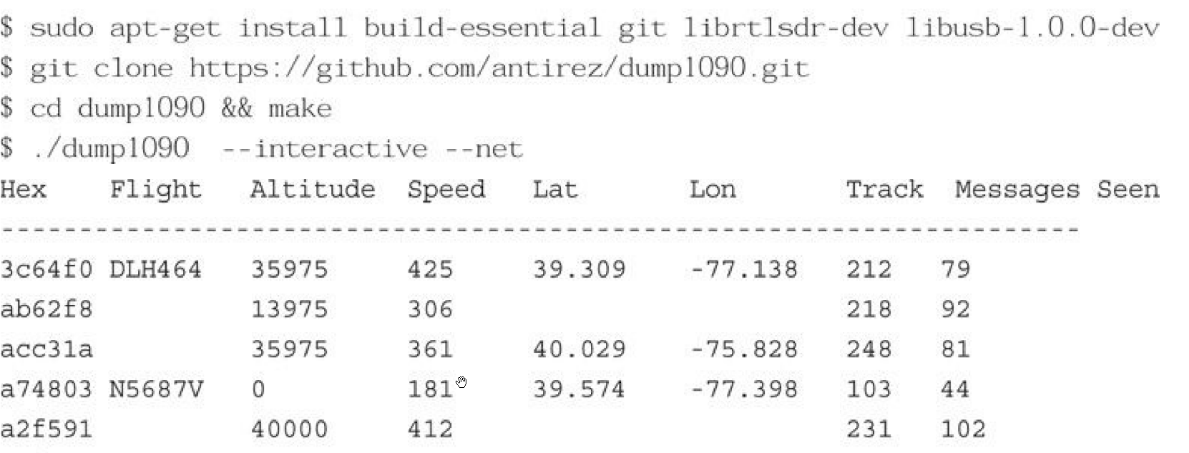
Decoding ADS-B (Cont’d)

Slide 19
Decoding ADS-B (Cont’d)
This tool works by demodulating the ADS-B signals that aircraft transmit on 1090 MHz. This information is intended for use by other aircraft in the area as well as ground stations
It is not encrypted and can easily be picked up from miles away using RTL-SDR and HackRF

Slide 20
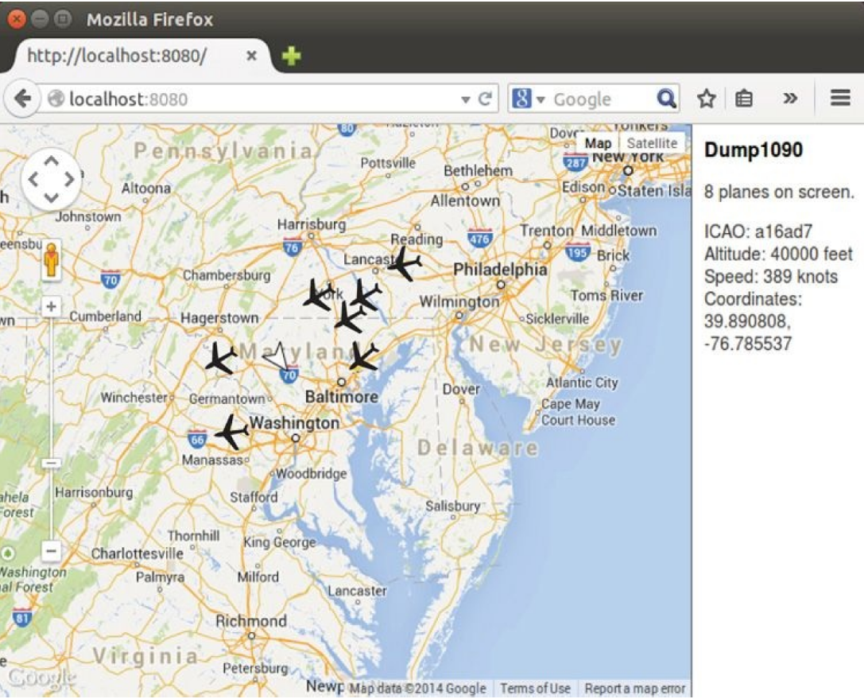
Decoding ADS-B (Cont’d)

Slide 21
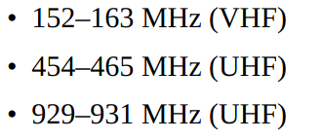
Decoding Pager Traffic
Pagers are still widely used in medical and industrial settings, there’s a good chance you’ll be able to hear some from your home.
Pager signals are easy to identify and decode, as long as you can find them
The frequency ranges in use vary significantly by geography, so you will have to hunt for the signals

Slide 22
Decoding Pager Traffic using Gqrx tool
This technology is called as well POCSAG or (Post Office Code Standardization Advisory Group) pager traffic.
You can use the tool gqrx to stream the audio over UDP for demodulation and conversion by different tools.

Slide 23
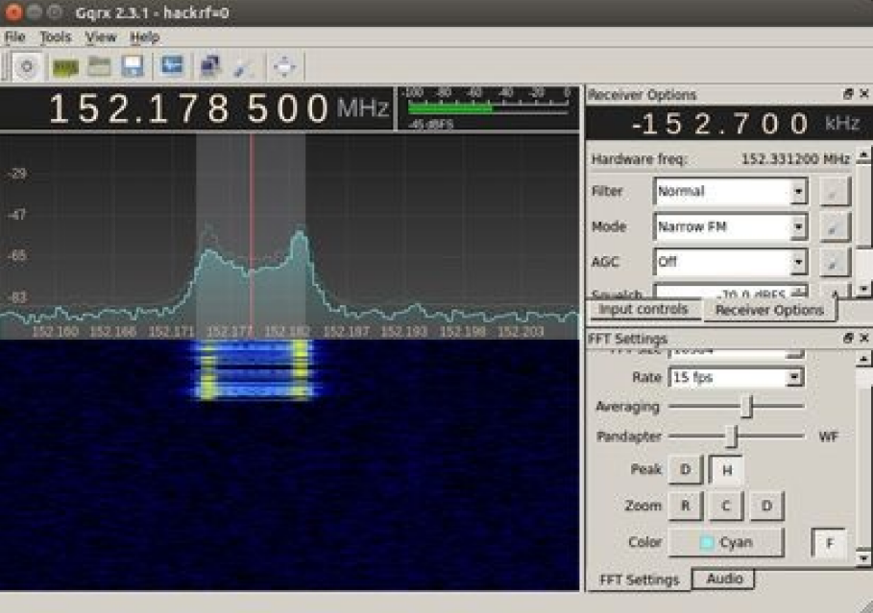
Decoding Pager Traffic using Gqrx tool

Slide 24
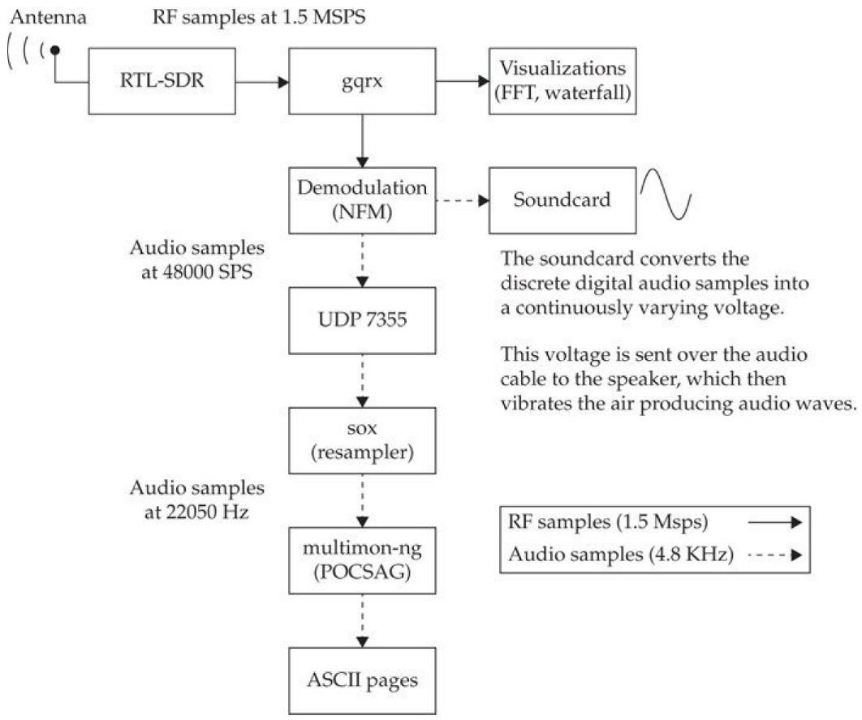
Decoding Pager Traffic using Gqrx tool

Slide 25
Finding and Capturing an RF Transmission
You can capture the signal of the car key using RTL-SDR using the tool osmocom_fft
Then you simply need to get rid of the signal noise
Afterward, you retransmit the signal using HackRF adapter

Slide 26
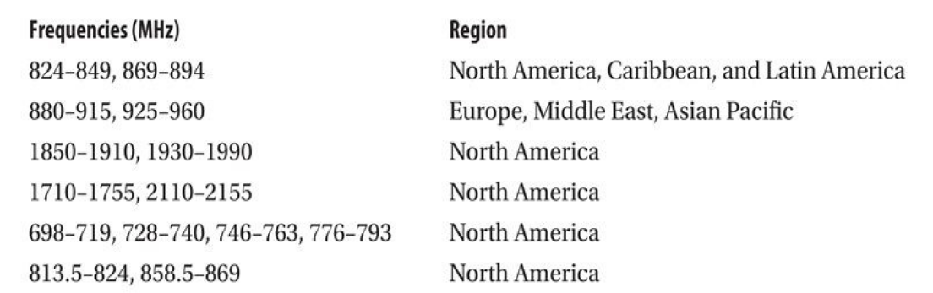
Fundamentals of Cellular Communication
Cell phones use a number of different frequencies to transmit data.
Which frequency they use depends on the country and the mobile operator network.
Each Mobile operator network (called cell phone providers, mobile operators, telecom, telco, carriers and so on) leases or owns a specific spectrum of radio frequency for their customers’ use

Slide 27
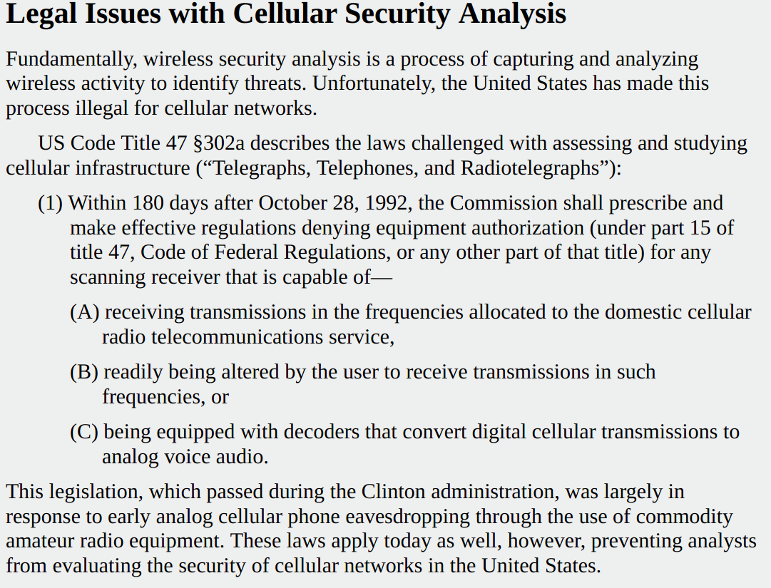
A Friendly Warning by the Book’s Authors

Slide 28
2G Network Security
2G networks, including 2.5G Global System for Mobile (GSM) and General Packet Radio Service (GPRS) have been widely scrutinized revealing many security flaws in the protocol.
This technology is still the most widespread cellular protocol used worldwide.
Many devices are backward-compatible with early 2G technology, leaving them exposed to those attacks.

Slide 29
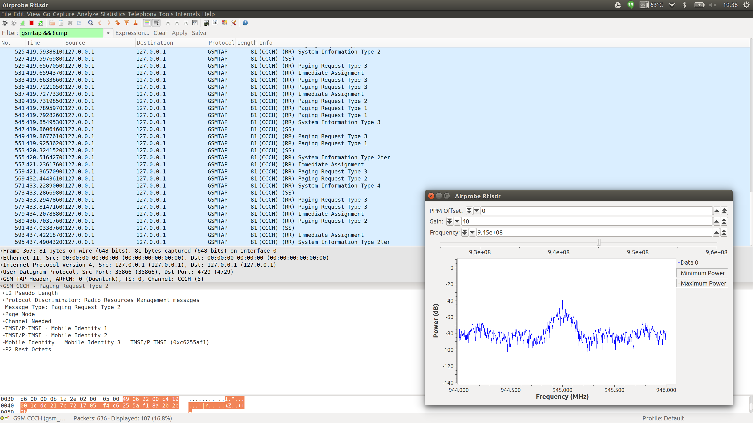
GSM Analysis in Wireshark

Slide 30
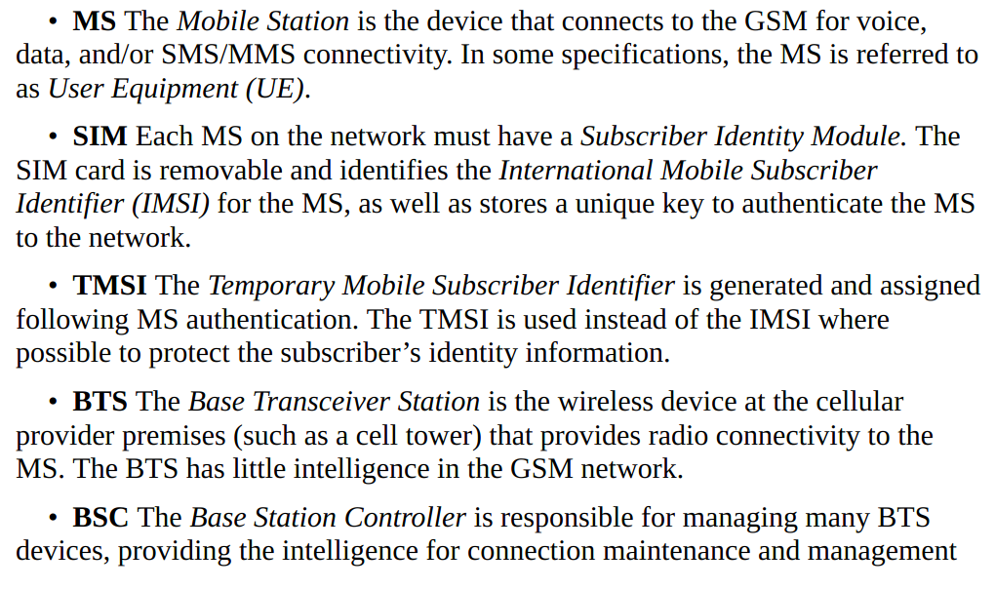

GSM Network Model
The following are the major components in GSM technology:

Slide 31
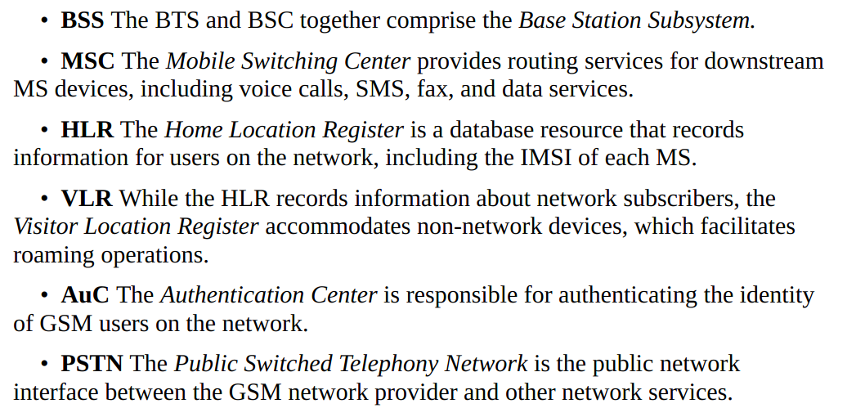
GSM Network Model (Cont’d)
.

Slide 32
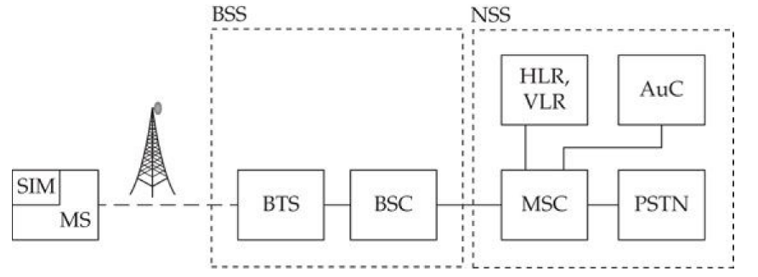
Basic GSM Network Architecture Model
.

Slide 33
GSM Encryption
.
GSM networks use the A5/1 cipher to provide confidentiality controls of traffic delivered over the GSM between the ME and the BSC.
The temporary cipher key Kc is used as the A5/1 input to generate keystream data.
The plaintext data is XOR’d with the keystream data to generate ciphertext
Ciphertext is similarly XOR’d with matching keystream data at the recipient to decrypt the data

Slide 34
GSM Attacks
.
GSM attacks can be classified into three categories:
Privacy attacks, particularly leading to the disclosure of IMSI information
Confidentiality attacks, including the disclosure of voice and data communications over the GSM air interface
Integrity attacks, it involves altering and modifying the GSM voice and data over the air

Slide 35
GSM Eavesdropping
.
GSM packet captures will disclose basic information about the network (it will not reveal the content of phone call audio traffic, SMS/MMS messages or data activity because that content is encrypted.
You can use the RTL-SDR adapter to for GSM reception using the tool Airporbe in Linux
Airprobe is an air-interface sniffer tool for Linux systems consisting of three primary components:
GSM signal acquisition, demodulation, and packet analysis.

Slide 36
GSM Eavesdropping
.
Using an RTL-SDR and supporting libraries including GNU Radio, Open Source Mobile Communications (Osmocom), and Wireshark, Airprobe captures and decodes GSM activity for analysis
The installation of Airprobe is straightforward, however the installation of the GNU Radio dependency can be complex. However, there is a script that automates much of the download and build process for Ubuntu and other Debian-based systems.

Slide 37
GSM Eavesdropping (Cont’d)
.
Next, we download Leech’s GNU Radio build script and you run it
After the GNU Radio installation script completes, download and install the Open Source Mobile Communications library (OSMOCOM)
Then, you can download and install Airprobe, then you can use it alongside Wireshark to send the GSM encrypted traffic through UDP to the loopback address

Slide 38
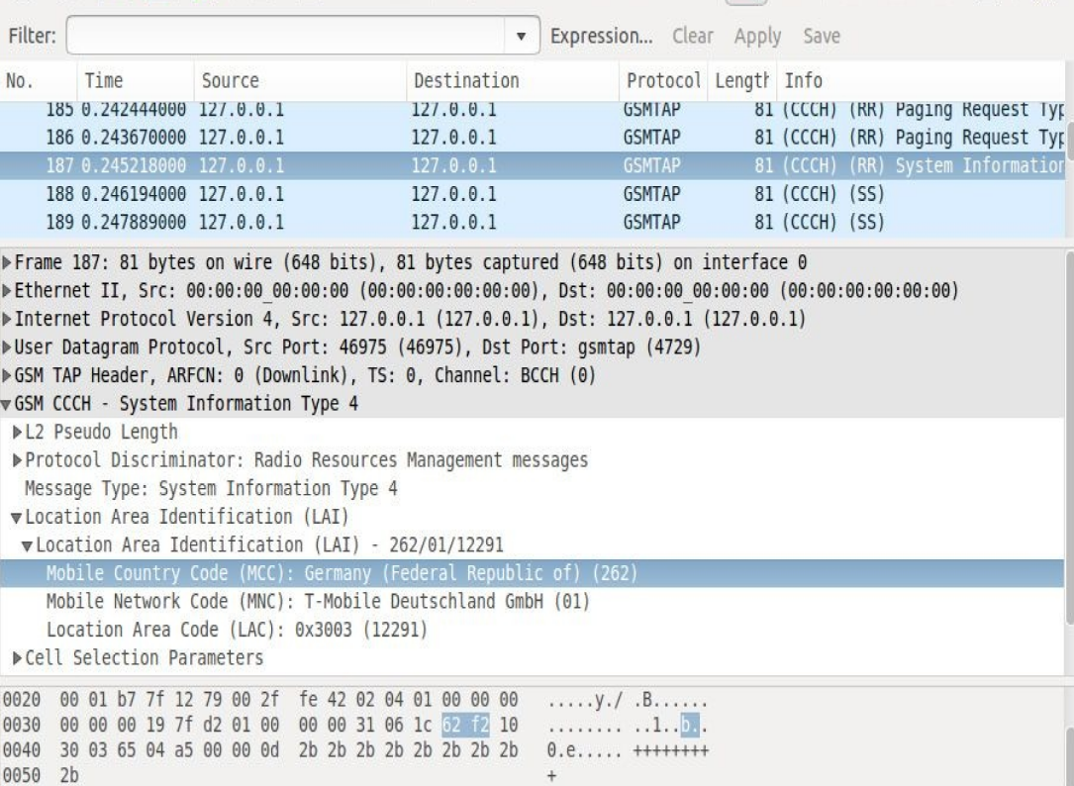
GSM Eavesdropping (Cont’d)
.

Slide 39
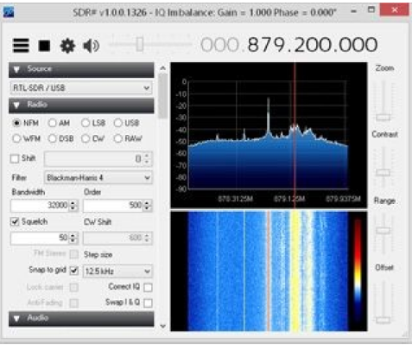
GSM Eavesdropping (Cont’d)
.
Because GSM frequencies vary depending on the carrier’s selections, it is necessary to scan for local GSM activity using SDR# or Kalibrate GUI-based Software

Slide 40
GSM Eavesdropping (Cont’d)
.
There is also yet another calibration tool to help you set the proper frequency dubbed “gsm_receive_trl.py”
In this example, we reduce the sample rate to 1 million samples/second to lessen the overhead on the host system and match the bandwidth used by GSM networks (-s 1e6) with a center frequency of 890 MHz.
The gain value is set to 24 dB, but you can adjust it as needed for channels with lower power level

Slide 41
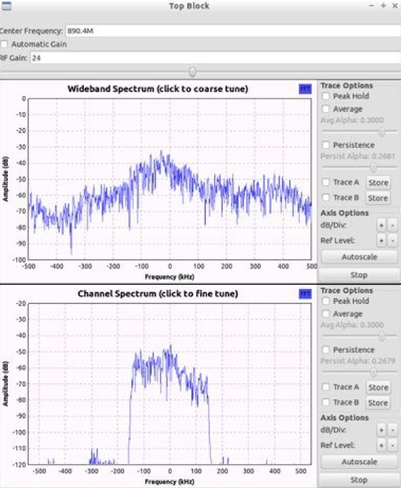
GSM Eavesdropping (Cont’d)
.

Slide 42
GSM Eavesdropping (Cont’d)
.
Some networks outside of North America and Europe still use the A5/0 cipher and will transmit unencrypted voice, data or SMS/MMS activity
However, networks that use A5/1 cipher also make it vulnerable to key recovery attack allowing an adversary to overcome this security obstacle

Slide 43
GSM A5/1 Key Recovery
.
In 2008, David Hulton and Steve from The Hacker’s choice (THC), came up with a very dangerous attack against A5/1 cipher.
The attacker needs to compute the keystream of several known-plaintext packets through observer ciphertext and identifies the encryption key by mapping the keystream data to known keystream state information in the lookup tables.
The attacker would recover the key in around 30 minutes using a set of precomputed lookup tables consisting of 288 millions entries (approximately 2TB)
The attack was carried out by a tool dubbed “gsm-tvoid” tool

Slide 44
GSM A5/1 Key Recovery (Cont’d)
.
In 2011, A5/1 cracking project team released Kraken, a practical tool that integrates with AirProbe for the effective capture and decryption of GSM traffic with the A5/1 tables.
Another developer released yet another tool dubbed “Pytacle”, a tool that automates the capture of GSM activity (through AirProbe), the decryption of GSM traffic (through Kraken), and the conversion of decrypted audio content into files that are easily played back for a full and simple passive GSM decryption attack

Slide 45
GSM IMSI Catcher
.
GSM networks authenticate the identity of the mobile equipment by verifying the correct IMSI and corresponding K
This authentication mechanism does not validate the identity of the network to the client device
The attacker can impersonate the legitimate GSM network and collect the subscribe IMSI through a device known as an IMSI catcher (using YateBTS tool)
The attacker can provide network services similar to those offered by the legitimate provider making it difficult for subscribers to recognize that they are connected to an imposter network

Slide 46
Defending Against A5/1 Recovery
.
From defensive perspective, avoid the use of GSM networks
Modern 3G, 4G and 5G networks are not vulnerable to the A5/1 key recovery attack, making them a more secure option for users.
The question is, what makes the LTE more secure than the 2G networks?

Slide 47
Summary
.
Early 2G networks are known to be vulnerable to several attacks stemming from their use of weak cryptography and weak authentication protocols.
Tools such as AirProbe, Kraken, and Pytacle have allowed attackers to establish passive sniffing, key recovery, decryption, and data extraction tools.
Tools like YateBTS and OpenBTS have created straightforward opportunities to mount GSM MitM attacks

