Slide 1

Water Resources Engineering Lecture 1
Introduction, Global Freshwater, and Future of Water Resources
Dr. Zada Tawalbeh
Ajloun National University
Fall 2025

Slide 2
Course Objectives
• Understand the hydrologic cycle and its components.
• Apply fundamental principles of fluid mechanics to hydraulic systems.
• Analyze precipitation, infiltration, and runoff data using standard methods.
• Evaluate water availability and demand for engineering projects.
• Use modern geospatial and computational tools in hydrologic analysis.

Slide 3
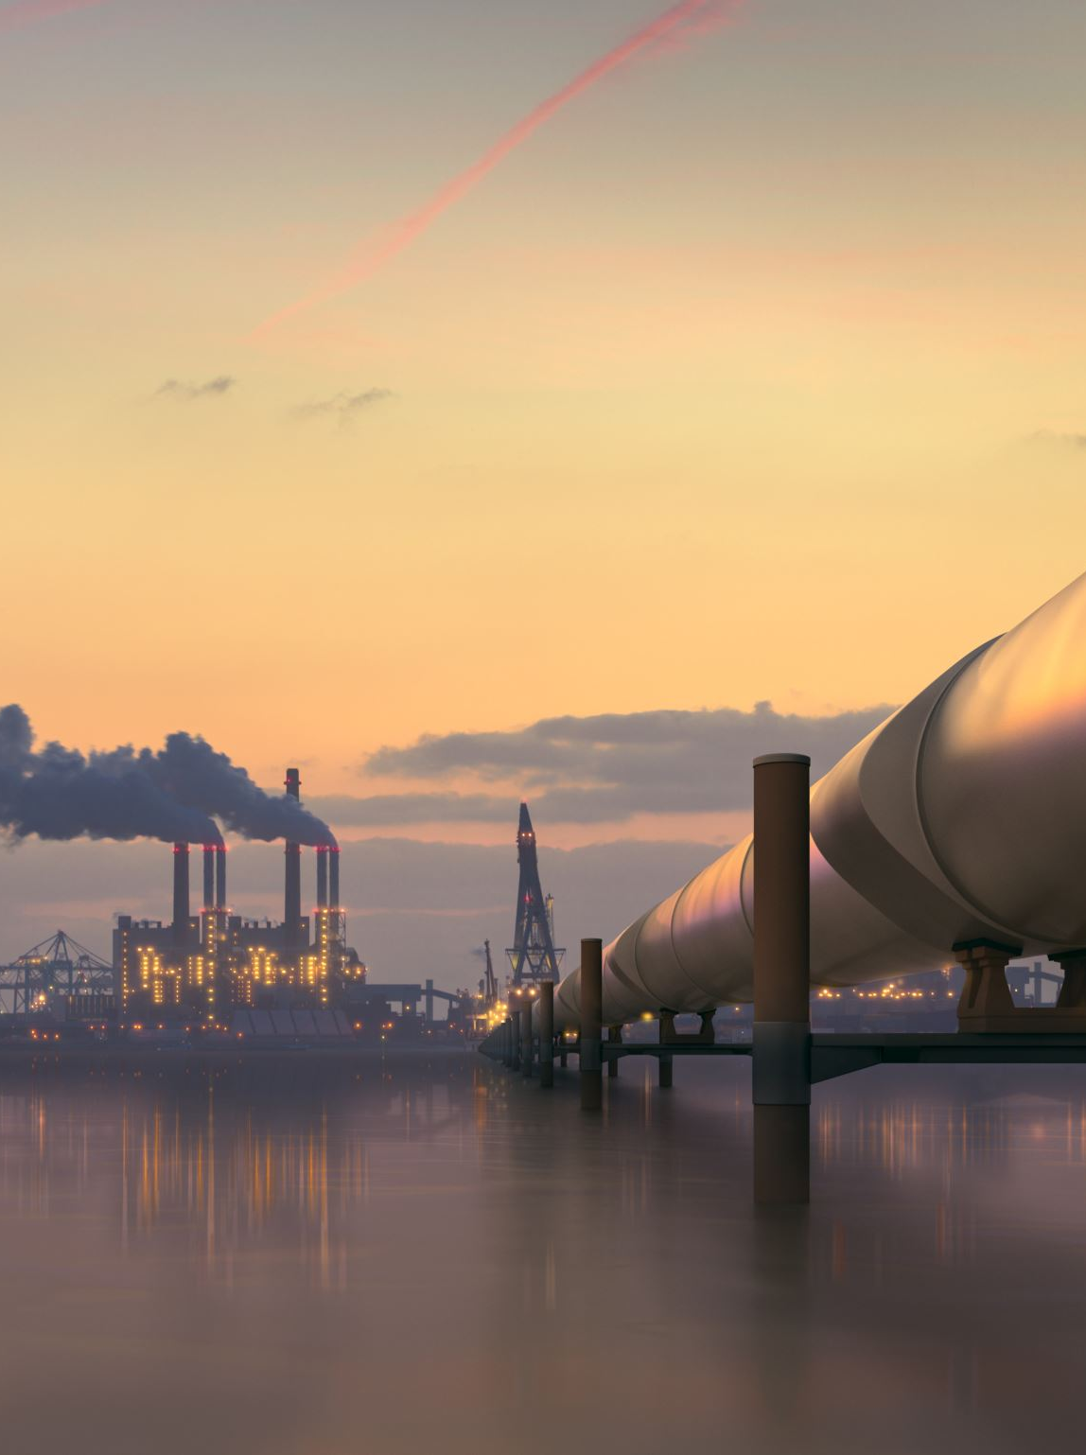
What is Water Resources Engineering?
• Application of engineering principles to develop, utilize, and protect Earth’s water resources.
• Focuses on design, planning, operation, and management of water systems.
• Ensures sustainable water use for people and ecosystems.

Slide 4
Major Sub-Disciplines
• Hydrology – study of the water cycle and rainfall–runoff relationships.
• Hydraulics – behavior of flow in channels and pipes.
• Environmental & Water Quality – chemical and biological aspects of water.
• Planning & Management – allocation, modeling, and optimization of resources.

Slide 5
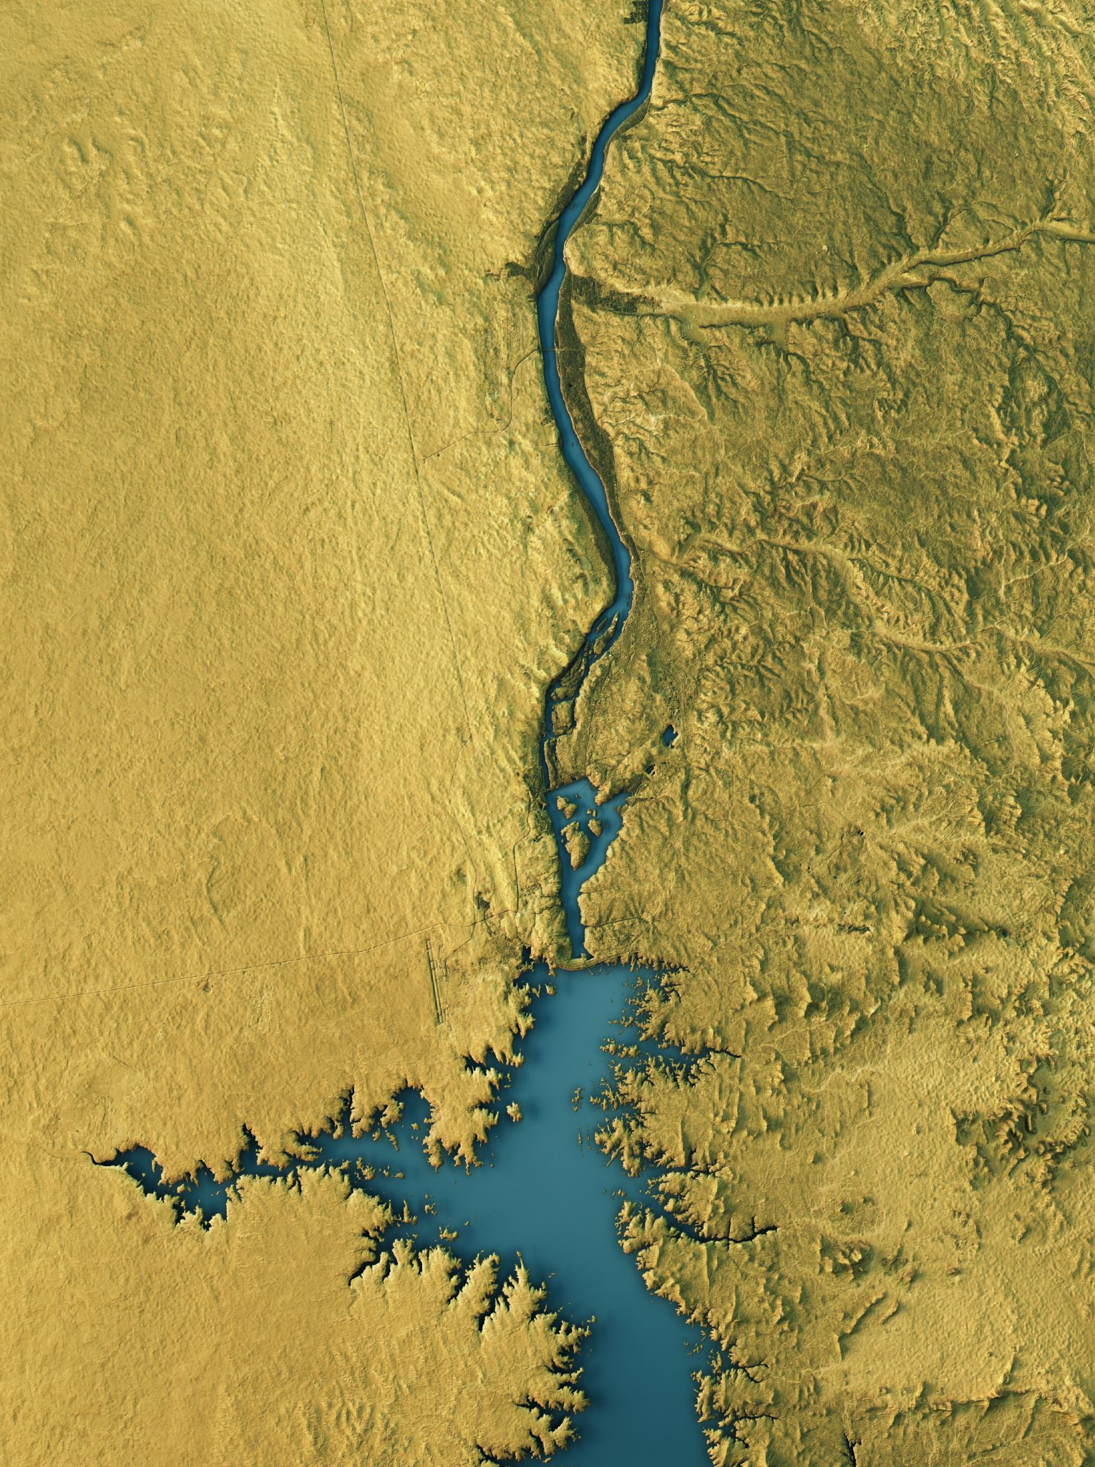
The World’s Fresh Water Resources
• Earth’s water: ~97.5% saline, only 2.5% fresh.
• Of total freshwater: 68% in glaciers, 30% in groundwater, <1% in lakes and rivers.
• Freshwater availability varies significantly by region (Mays 2010).

Slide 6
Water Use in the United States
• Total withdrawals ≈ 322 billion gallons/day (USGS 2015).
• Major sectors: Thermoelectric power (41%), Irrigation (37%), Public supply (12%), Industrial (5%).

Slide 7
Global and Regional Water Use
• Globally: Agriculture ~70%, Industry 20%, Domestic 10%.
In Jordan and across the Middle East and North Africa (MENA) region, more than 80% of all available freshwater resources (from rivers, groundwater, and rainfall) are consumed by agriculture, mainly for irrigating crops.
The remaining less than 20% of freshwater is left for domestic use (drinking, sanitation, etc.) and industrial activities.

Slide 8
Systems of Units
• SI (International System): meters (m), kilograms (kg), seconds (s), cubic meters per second (m³/s).
• U.S. Customary System: feet (ft), pounds (lb), cubic feet per second (cfs).
• Unit conversion accuracy is critical for hydraulic and hydrologic calculations.

Slide 9
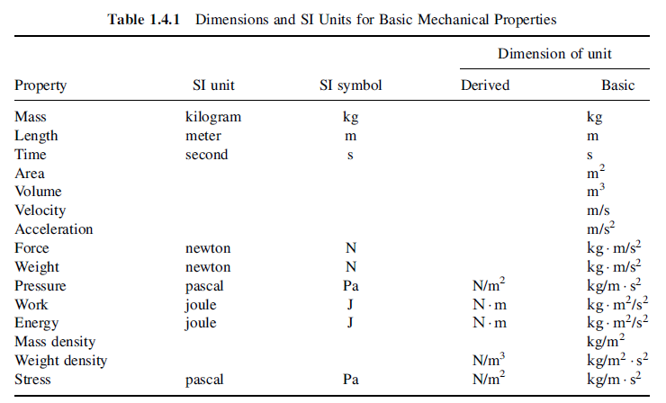

Slide 10
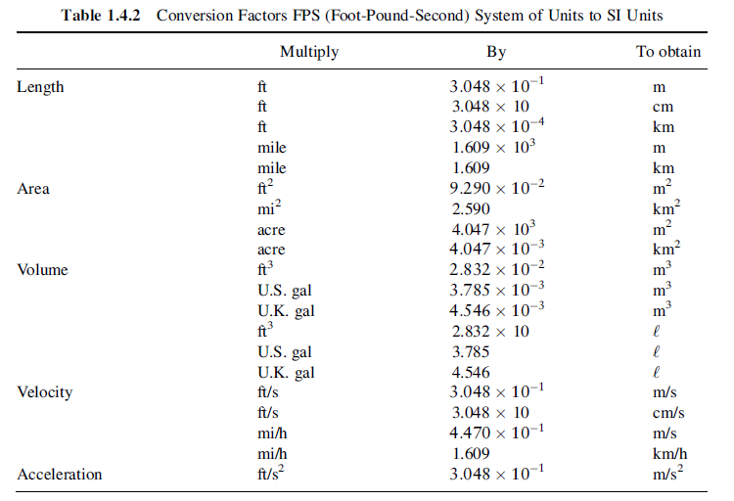
Conversion Factors

Slide 11
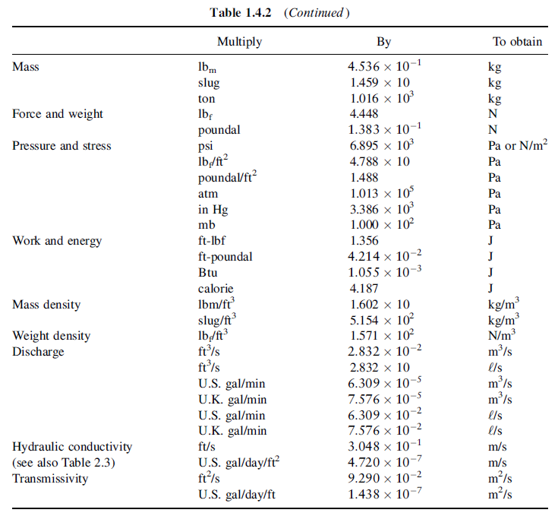

Slide 12
Challenges for Water Engineers
Challenge | Impact | Engineering Implications
Population Growth & Urbanization | Higher municipal and industrial demand | Need for new water-supply networks and wastewater recycling
Climate Variability | Changing rainfall patterns, floods, droughts | Requires resilient design, adaptive management, and real-time monitoring
Pollution & Ecosystem Degradation | Rivers and aquifers contaminated by agriculture and industry | Necessitates stronger water-quality control and treatment systems
Energy–Water Nexus | Water required for power generation | Optimize use through renewable-energy-powered desalination

Slide 13
Solutions & Innovations
IWRM (Integrated Water Resources Management):
Coordinated management of water, land, and environment to balance human and ecosystem needs.
Desalination and Reuse:
Seawater desalination using energy-efficient reverse osmosis (e.g., Aqaba–Amman project).
Treated wastewater used for irrigation and aquifer recharge (a key part of Jordan’s water strategy).
Digital Water & Smart Technologies:
Real-time sensors for flow, pressure, and quality.
Use of AI, GIS, and remote sensing for predictive water-system modeling.
Green Infrastructure:
Urban rainwater harvesting, permeable pavements, and wetlands that reduce runoff and pollution naturally.

