Slide 1

Water Resources Engineering Lecture 2
Hydrologic Processes
Dr. Zada Tawalbeh
Ajloun National University
Fall 2025

Slide 2
Learning Objectives
• Define the hydrologic cycle and describe its major processes.
• Quantify precipitation, evaporation, and infiltration using analytical formulas.
• Explain the energy and mass balance concepts underlying each process.
• Apply hydrologic processes to engineering design and water management.

Slide 3
Overview of Hydrology
• Hydrology studies the occurrence, movement, and distribution of water.
• Focuses on rainfall, runoff, infiltration, evaporation, and groundwater flow.
• Essential for flood analysis, irrigation design, and water supply planning.

Slide 4
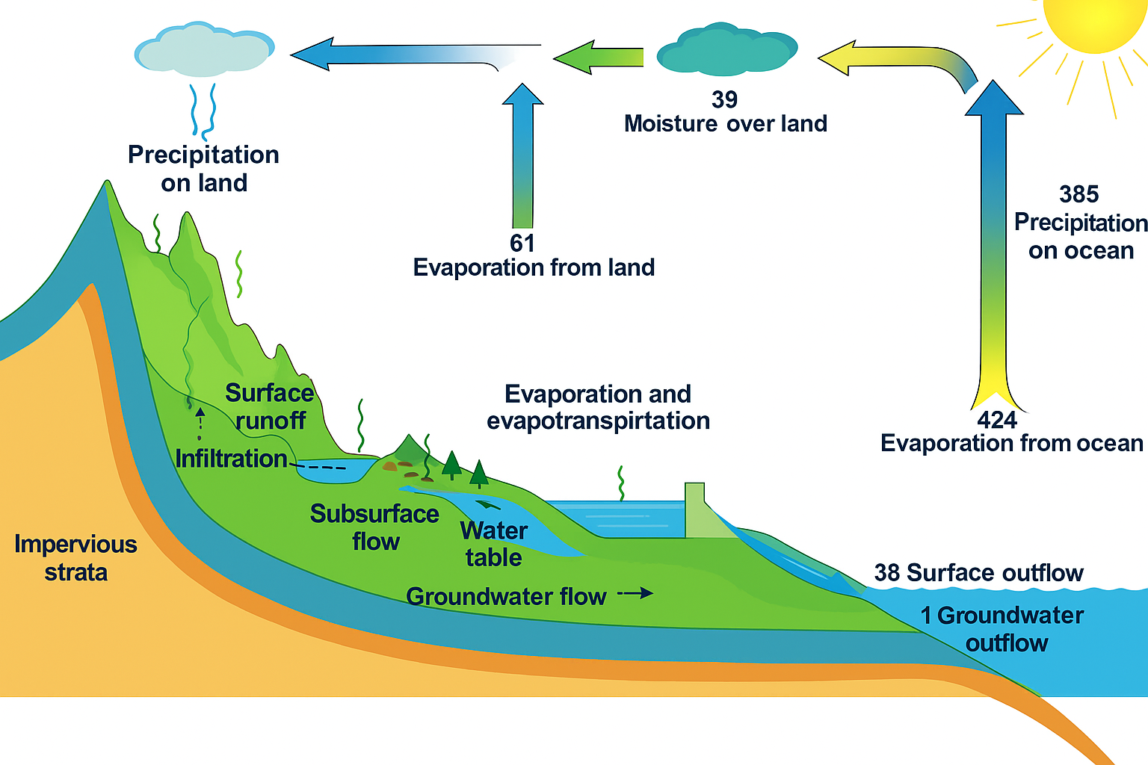
Hydrologic Cycle Concept
Figure: The Hydrologic Cycle showing major fluxes (Precipitation, Evaporation, Runoff, and Infiltration).

Slide 5
Hydrologic System and Water Balance
• Hydrologic systems convert precipitation into runoff and groundwater flow.
• Basic water balance: P = Q + E + ΔS.
• Inputs: Precipitation;
Outputs: Evapotranspiration and Runoff;
Storage: Soil and Groundwater.
• Used for watershed, reservoir, and climate modeling.

Slide 6
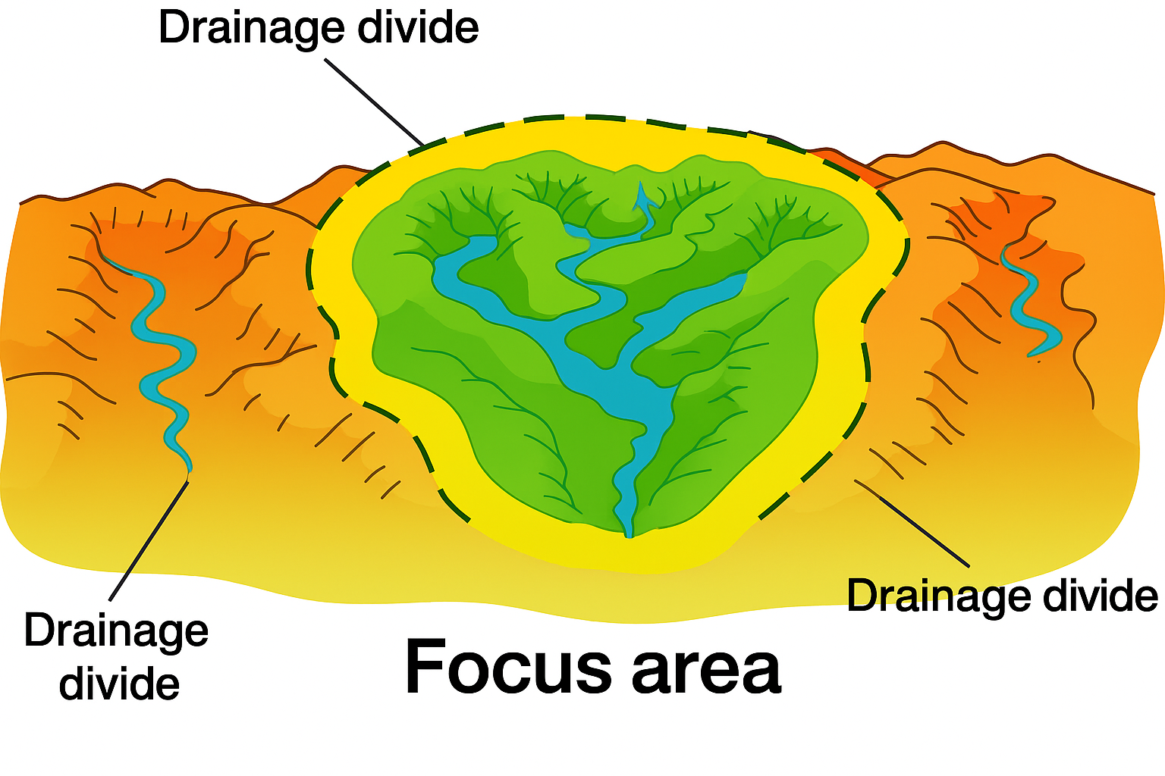
Hydrologic Systems
Drainage basins, catchments, and watersheds are three synonymous terms that refer to the
topographic area that collects and discharges surface streamflow through one outlet or mouth.

Slide 7
Precipitation Processes
• Precipitation includes rainfall, snow, sleet, and hail.
• Mechanisms: orographic uplift, frontal uplift, and convective lifting.
• Measured using rain gauges, radar, and satellite data (GPM, TRMM).
• Design rainfall used in hydrologic modeling (IDF curves, PMP estimation).

Slide 8
Types of Precipitation
1. Convectional
Convectional precipitation results from the heating of the earth's surface. The warm ground heats the air over it. As the air warms, the air molecules begin to move further apart. With increased distance between molecules, the molecules are less densely packed. Thus, the air becomes “lighter” and rises rapidly into the atmosphere. As the air rises, it cools. Water vapour in the air condenses into clouds and precipitation.

Slide 9
2.Orographic
Orographic precipitation results when warm moist air moving across the ocean is forced to rise by large mountains. As the air rises, it cools. Why? A higher elevation results in cooler temperatures
Cold air cannot hold as much moisture as warm air. As air cools, the water vapour in the air condenses and water droplets form. Clouds forms and precipitation (rain or snow) occurs on the windward side of the mountain. The air is now dry and rises over top the mountain. As the air moves back down the mountain, it collects moisture from the ground via evaporation. This side of the mountain is called the leeward side. It receives very little precipitation.

Slide 10
Cyclonic
Cyclonic or Frontal precipitation results when the leading edge of a warm, moist air mass (warm front) meets a cool and dry air mass (cold front). The molecules in the cold air are more tightly packed together (i.e., more dense), and thus, the cold air is heavier than the warm air. The warmer air mass is forced up over the cool air.
As it rises, the warm air cools, the water vapour in the air condenses, and clouds and precipitation result. This type of system is called Frontal Precipitation because the moisture tends to occur along the front of the air mass.

Slide 11
Rainfall Data and Distribution
• Rainfall varies spatially and temporally based on topography and climate.
• Data analysis: hyetographs, depth–area–duration curves, and frequency analysis.
• Thiessen polygon and isohyetal methods used for areal averaging (estimation).

Slide 12
Evaporation Fundamentals
• Evaporation: liquid to vapor; controlled by solar radiation, temperature, and humidity.
• Energy Balance Method: E = (Rn - G) / (λρw).
• Aerodynamic Method: depends on vapor pressure gradient and wind speed.
• Penman Method: combines energy and aerodynamic factors for accuracy.

Slide 13
Evapotranspiration (ET)
• Evapotranspiration = evaporation + transpiration through vegetation.
• Estimated using Penman-Monteith, Blaney-Criddle, and FAO-56 methods.
• ET represents the largest water loss term in arid regions like Jordan.
• Measured using lysimeters and remote sensing techniques.

Slide 14
Infiltration Concepts
• Infiltration: downward water movement from surface into soil.
• Affected by soil type, porosity, moisture, vegetation, and slope.
• Infiltration decreases with time as the soil becomes saturated.
• Important for recharge studies, irrigation, and runoff estimation.

Slide 15
Infiltration Models
• Horton Equation: ft = fc + (f0 - fc)e^(-kt).
• Green-Ampt Equation: f = Ks((ψΔθ / F) + 1).
• SCS Curve Number (CN) method links land use, soil, and runoff.
• φ-index and f-index used for storm loss estimation in hydrology.

Slide 16
Hydrologic Modeling and Applications
• Integrates P, E, and I into catchment-scale models.
• Used in flood forecasting, reservoir operations, and water-budget analysis.
• Tools: HEC-HMS, SWAT, MODFLOW, and GIS-based modeling systems.
• Calibration ensures models reflect real watershed responses.

Slide 17
Case Study – Jordan Hydrology
• Rainfall: seasonal (November–March) and spatially variable.
• Evaporation exceeds 2000 mm/year in the Jordan Valley.
• Limited infiltration due to impermeable and urban surfaces.
• Results in low runoff and groundwater decline; reuse and desalination needed.

