Slide 1

Water Resources Engineering Lecture 10
Hydrologic Analysis-Rainfall-Runoff Estimation Methods 3
Dr. Zada Tawalbeh
Ajloun National University

Slide 2
Rainfall-Runoff-NRCS Method
• Estimates runoff from rainfall
• Based on watershed characteristics
NRCS = Natural Resources Conservation Service
Used to estimate runoff from rainfall
Based on watershed characteristics (soil, land use, cover, slope)
Previously known as the SCS Curve Number Method

Slide 3
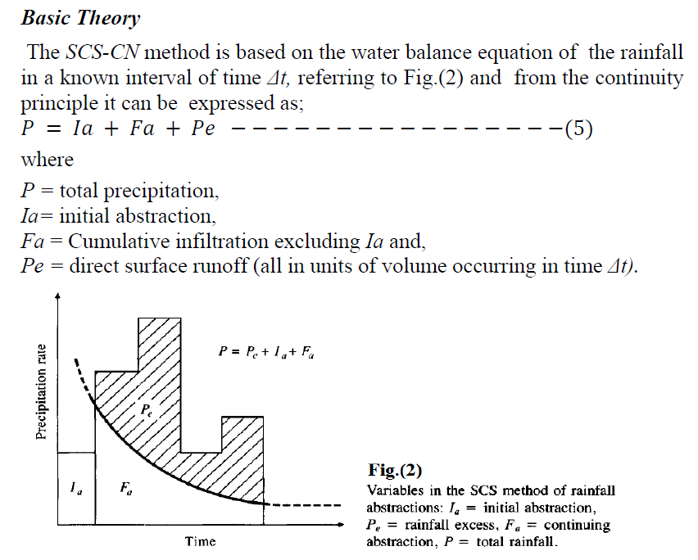

Slide 4
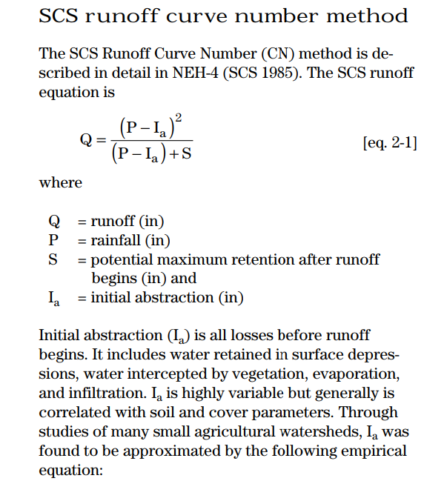
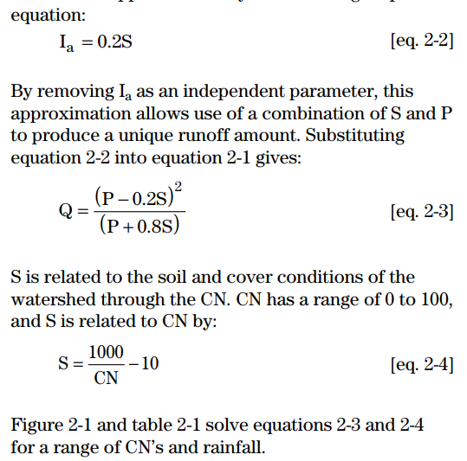
Rainfall-Runoff-NRCS Method

Slide 5
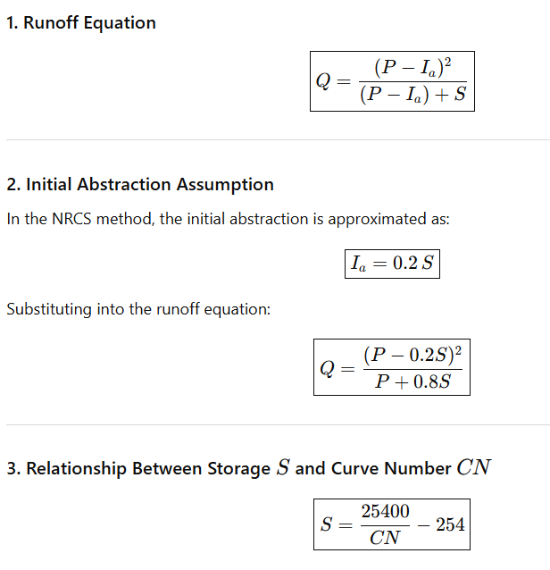
Rainfall-Runoff-NRCS Method-Metric Unit

Slide 6
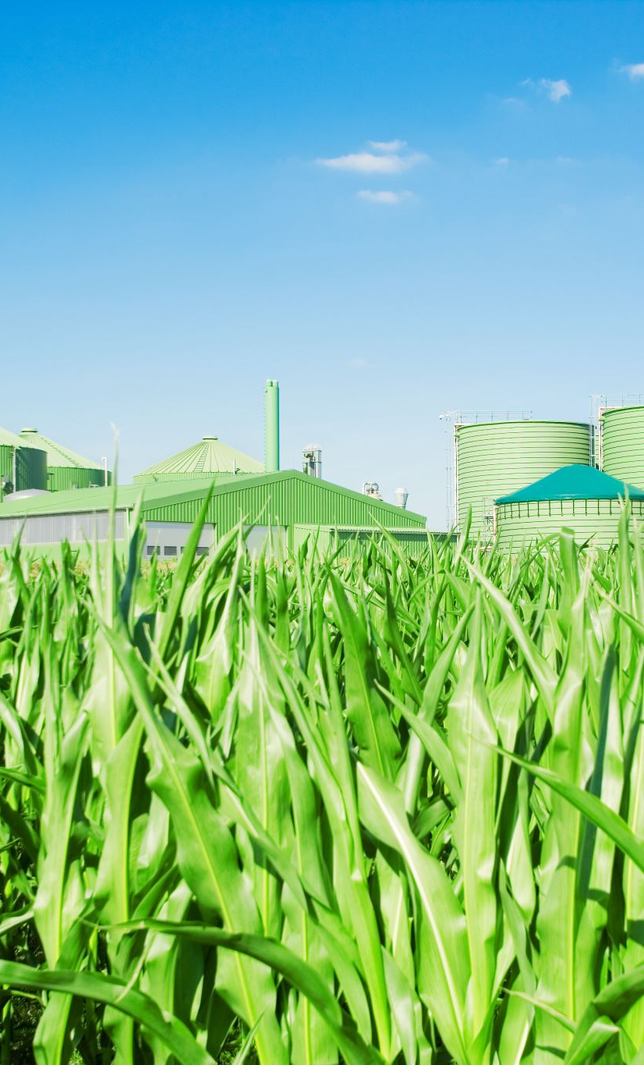
CN Depends On
• Soil type
• Land use
• Land condition
• Hydrologic soil group A–D
CN represents watershed ability to absorb water
Low CN → more infiltration → less runoff
High CN → less infiltration → more runoff
Depends on: Soil group (A, B, C, D)
Land use (urban, agriculture, forest)
Soil treatment/condition
Hydrologic condition (poor/Fair/good)
Low CN (e.g., forests, sandy soils) → water infiltrates easily
High CN (e.g., urban areas, clay soils) → water runs off quickly

Slide 7
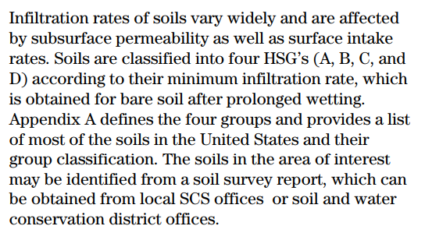
Soil Hydrologic Groups

Slide 8
a) Soil Hydrologic Groups
A: high infiltration (sand) → least runoff
B: moderate infiltration
C: low infiltration
D: very low infiltration (clay) → most runoff

Slide 9
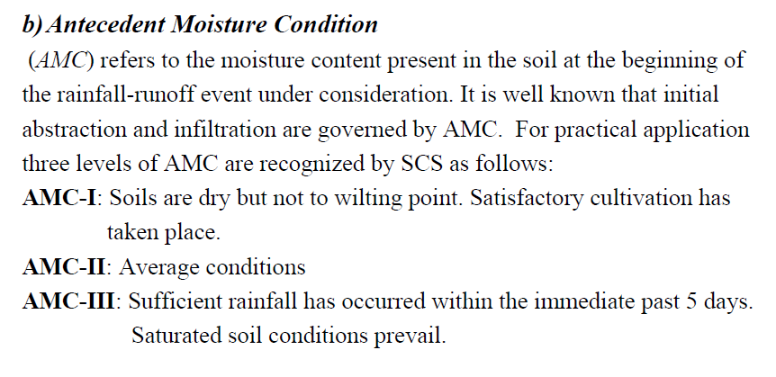

Slide 10
Curve Number
Curve number CN depends upon:
a) Soil type
b) Antecedent moisture condition
c) Land use/cover

Slide 11
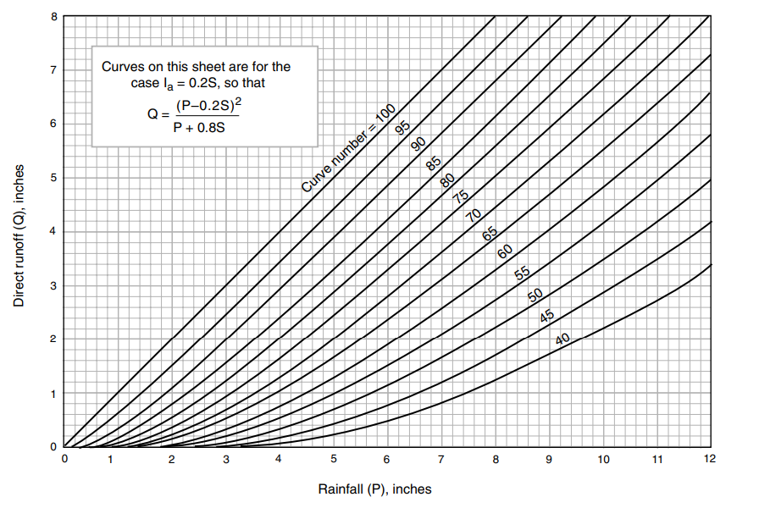

Slide 12
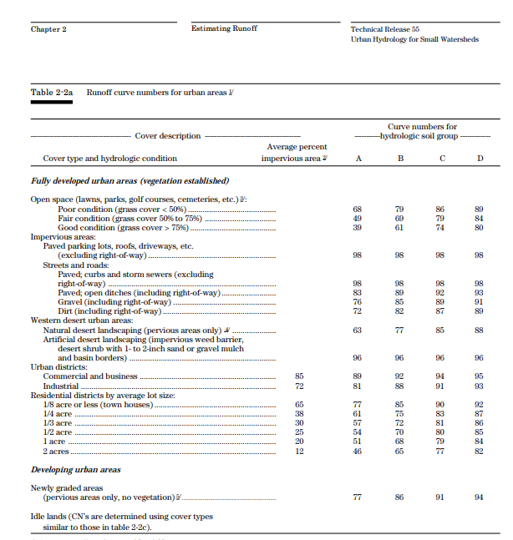

Slide 13
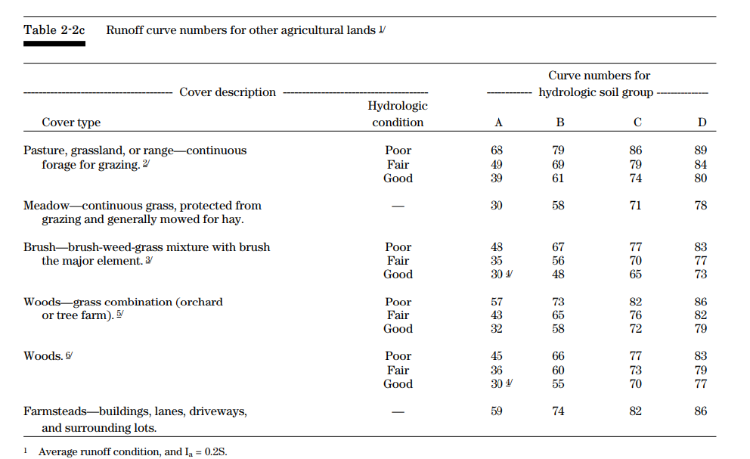

Slide 14
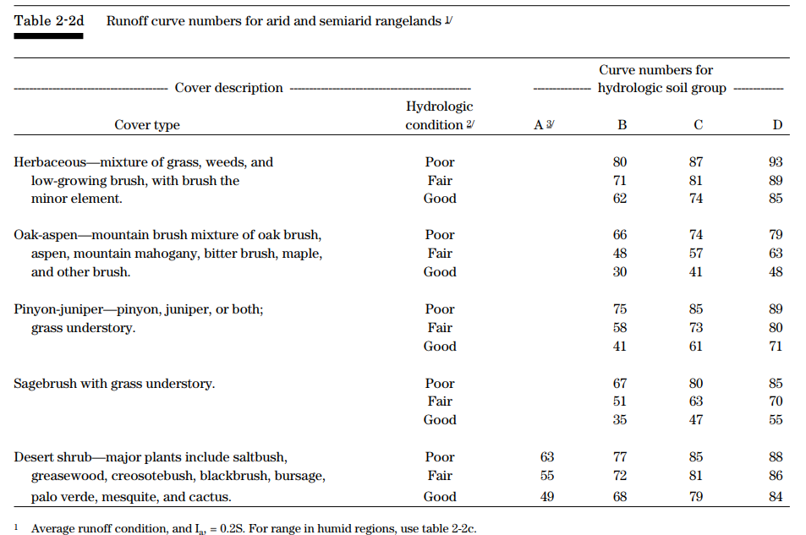

Slide 15
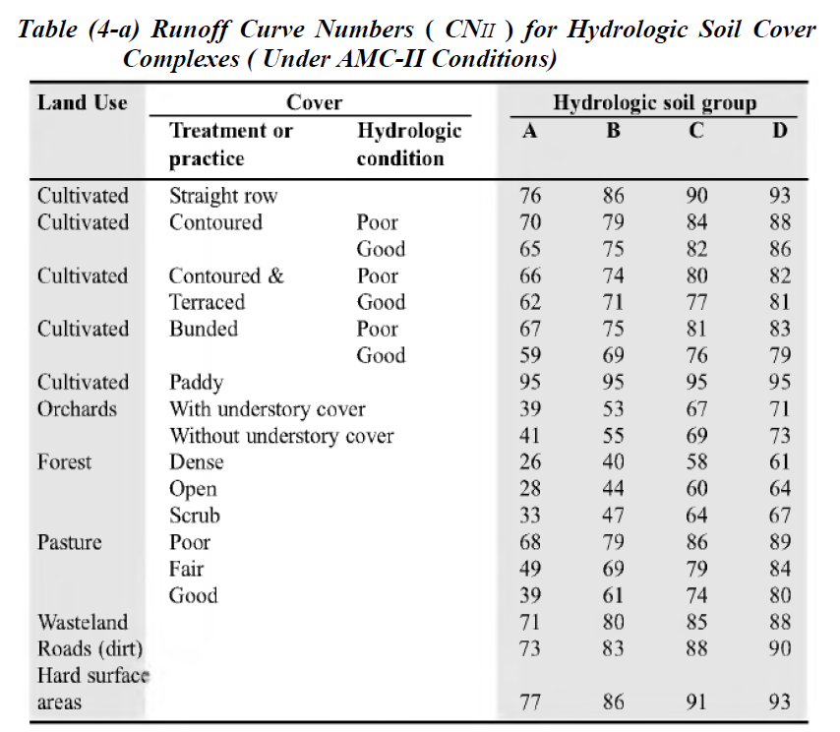

Slide 16
Initial Abstraction (Ia)
Initial Abstraction (Ia)
Includes:
  Surface storage
  Interception
  Infiltration before runoff starts
Traditional assumption:
Ia = 0.2 S
(where S depends on CN)

Slide 17
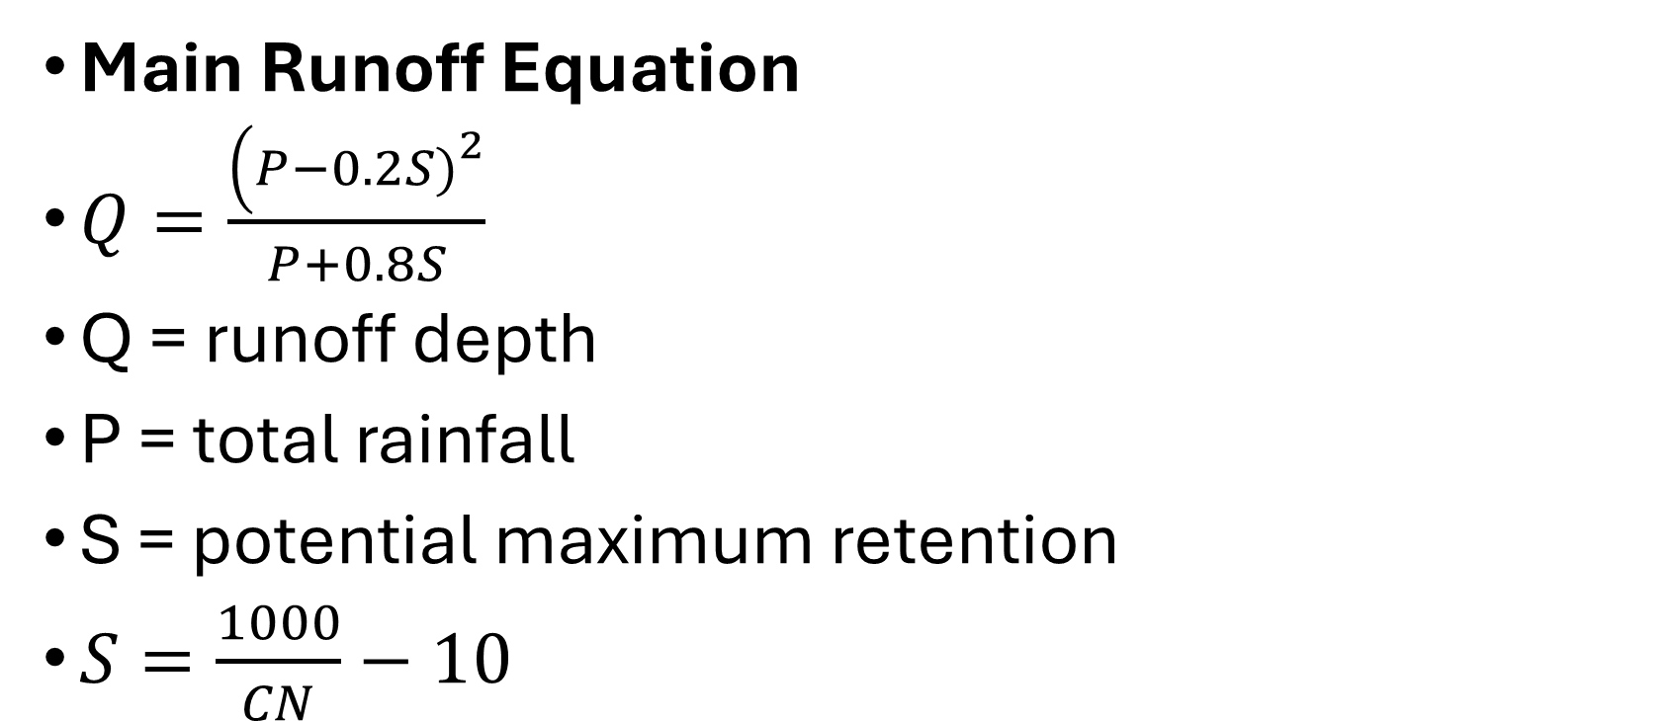
Runoff Equation
Main Runoff Equation
$Q=\frac{\left(P−0.2S{\left.)\right.}^{2}\right.}{P+0.8S}$
Q = runoff depth
P = total rainfall
S = potential maximum retention
$S=\frac{1000}{CN}−10$

Slide 18
Time of Concentration (Tc)
Time of Concentration (Tc)
The time required for water to travel from the farthest point in watershed to outlet
Determines hydrograph peak time
Depends on:
  Slope
  Surface roughness
  Flow path length
  Land use

Slide 19
Summary: NRCS Unit Hydrograph
Watershed Response (Hydrograph)
NRCS uses dimensionless unit hydrograph
Need:
  Excess rainfall
  Time of concentration
  Watershed area
Produces:
  Peak discharge
  Runoff volume
  Hydrograph shape

Slide 20
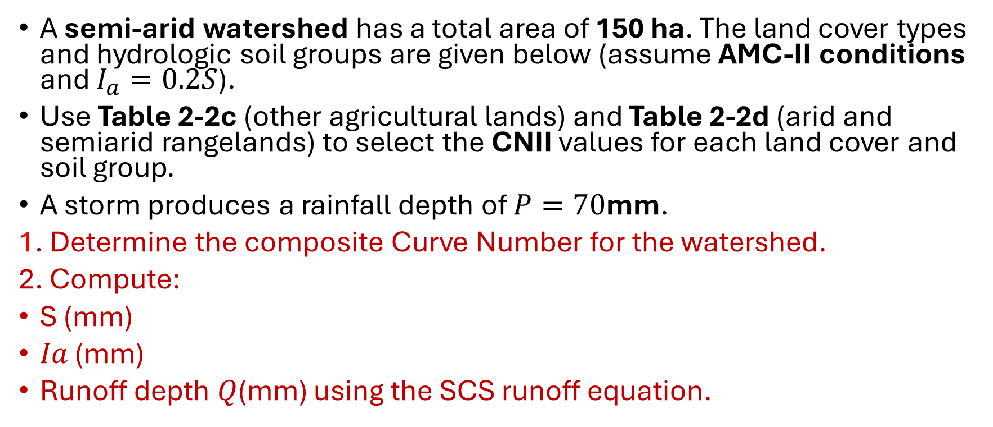
Example 1:
A semi-arid watershed has a total area of 150 ha. The land cover types and hydrologic soil groups are given below (assume AMC-II conditions and $I_{a}=0.2S$).
Use Table 2-2c (other agricultural lands) and Table 2-2d (arid and semiarid rangelands) to select the CNII values for each land cover and soil group.
A storm produces a rainfall depth of $P=70$mm.
1. Determine the composite Curve Number for the watershed.
2. Compute:
S (mm)
𝐼𝑎 (mm)
Runoff depth 𝑄(mm) using the SCS runoff equation.

Slide 21
Land cover type (from tables) | Hydrologic condition | Soil group | Area (ha)
Pasture, grassland, or range (continuous grazing) | Good | C | 40
Brush (brush-weed-grass mixture) | Fair | B | 30
Desert shrub | Poor | D | 50
Woods | Good | B | 20
Farmsteads (buildings, lanes, driveways, lots) | — | C | 10

Slide 22
Solution
Land cover | Area (ha) | CN
Pasture (Good, C) | 40 | 74
Brush (Fair, B) | 30 | 56
Desert shrub (Poor, D) | 50 | 88
Woods (Good, B) | 20 | 55
Farmsteads (C) | 10 | 82

Slide 23
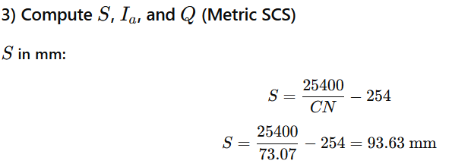
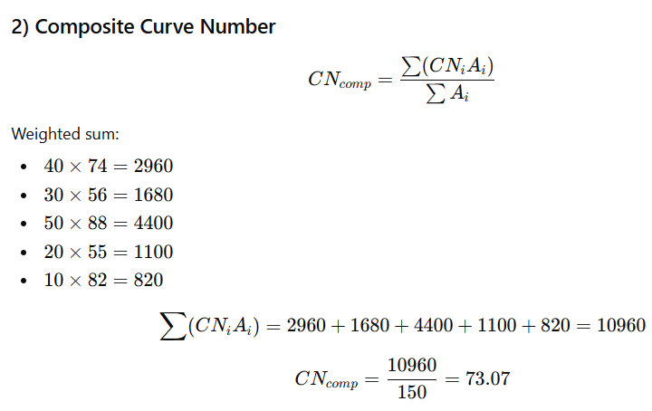

Slide 24

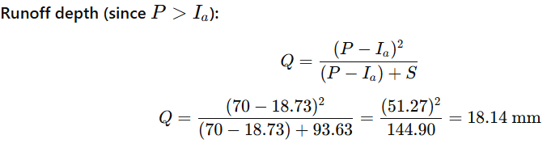

Slide 25
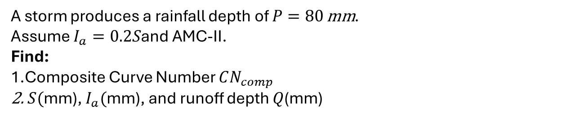
Example 2:
A watershed has a total area of 100 ha with the following land uses:
Land Use (from Table 4-a) | Hydrologic condition / practice | Soil group | Area (ha)
Cultivated – Contoured | Good | C | 30
Forest | Open | B | 25
Pasture | Fair | D | 20
Roads (dirt) | — | C | 15
Hard surface areas | — | D | 10
A storm produces a rainfall depth of $P=80 \text{mm}$.
Assume $I_{a}=0.2S$and AMC-II.
Find:
Composite Curve Number $CN_{comp}$
$S($mm), $I_{a}($mm), and runoff depth $Q$(mm)

Slide 26
Solution
Land Use | Treatment / Condition | Hydrologic Soil Group | Curve Number (CN)
Cultivated land | Contoured (Good) | C | 82
Forest | Open | B | 44
Pasture | Fair | D | 84
Roads (dirt) | — | C | 88
Hard surface areas | — | D | 93

Slide 27
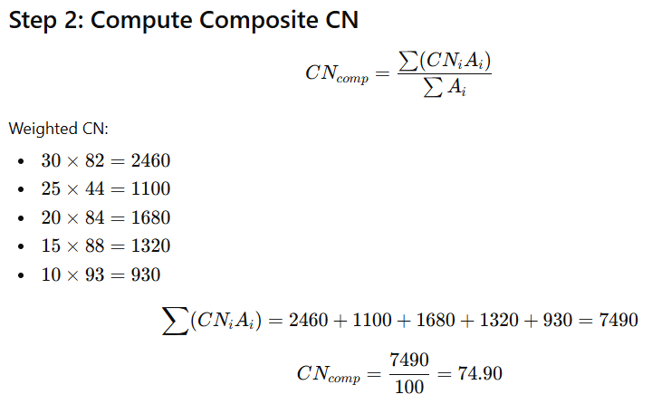
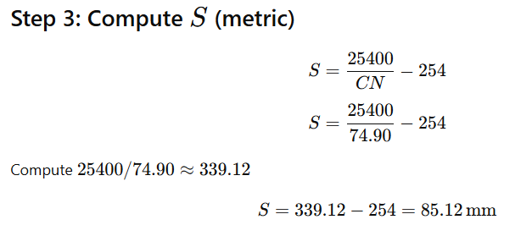

Slide 28
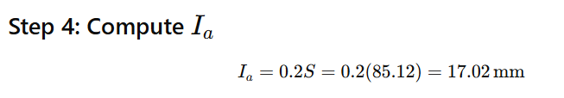
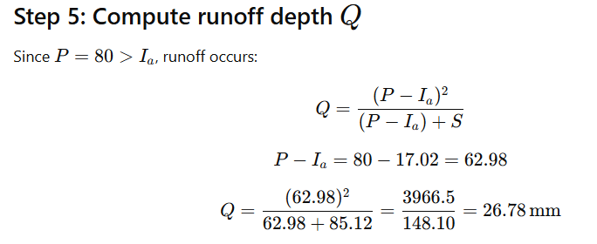

Slide 29
Example3
Find CN from Table (4-a) and Compute Composite CN
A watershed has a total area of 120 ha. The land use, condition/practice, soil group, and areas are:
Land Use (Table 4-a) | Treatment / Condition | Hydrologic Soil Group | Area (ha)
Cultivated | Contoured & Terraced (Poor) | B | 30
Cultivated | Bunded (Good) | C | 25
Orchards | With understory cover | D | 15
Forest | Dense | A | 20
Pasture | Good | B | 20
Roads (dirt) | — | D | 10

