Slide 1
Chapter Three
Boolean Algebra and
Digital Logic

Slide 2
Overview
Introduction to this Lecture's activities
In this lecture, you will be introduced to the Boolean Algebra, where you will learn about the Boolean operators and functions, and identify the relation between it and the design of the computer circuits, the simplicity that constitutes the essence of the computer systems that are implementations of Boole’s Law of Thought.
After completing the lecture, you will be able to:
  Describe the fundamental concepts of the Boolean Algebra.
  Identify the relationship between Boolean logic and digital computer circuits.
  Design simple logic circuits based on Boolean Algebra.
  Explain how digital circuits work together to form complex computer systems.

Slide 3
Introduction to Boolean Algebra
Boolean algebra: is a mathematical system for the manipulation of variables that can have one of two values.
In formal logic, these values are “true” and “false”
In digital systems, these values are “on” and “off,” 1 and 0, or “high” and “low.”
Boolean algebra returns to its inventor, the famous mathematician and logician George Boole.
Now, we will define some terms you will be witnessing through the coming sections.

Slide 4
Introduction to Boolean Algebra
Boolean variable: is a variable that can take only one of two values : 0 (false) or 1 (true). Example: x, y, z, … where, for instance, “x” could be 0 or 1.
Boolean expression: is a combination of Boolean variables and operators (AND, OR, NOT, …). Example: x AND y, x OR y, …
Boolean function: typically has one or more input values and yields a result in the range {0,1}, based on these input values.
Example: F(x, y, z) = (x AND y) OR z.
In Boolean expressions and functions, the following rules of precedence should be respected:
  1) Parentheses first
  2) NOT next
  3) AND next
  4) OR finally

Slide 5
Boolean Operators
Common Boolean operators include AND, OR and NOT.
To better understand these operators, we need a mechanism to allow us to examine their behaviors.
A Boolean operator can be completely described using a table that list the inputs, all possible values for these inputs, and the resulting values of the operations for all possible combinations of these inputs.
This table is called the Truth Table.
A truth table shows the relationship, in tabular form, between the input values and the results of a specific Boolean operator or function on the input variables.
Let us look at the Boolean operators AND, OR, and NOT to see how each is represented, using Boolean algebra and truth tables.

Slide 6
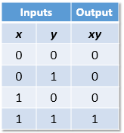
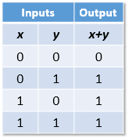
Boolean Operators
The logical operator AND:
It is typically represented by either a dot or no symbol at all.
  (a AND b) is expressed as a Boolean product: a.b or simply ab.
The behavior of AND operator is characterized by the truth table shown below:
Where 0 = false and
1= true
The logical operator OR:
It is typically represented by a plus symbol.
  (a OR b) is expressed as a Boolean sum: a+b
The behavior of the OR operator is characterized by the truth table shown below:

Slide 7
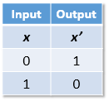
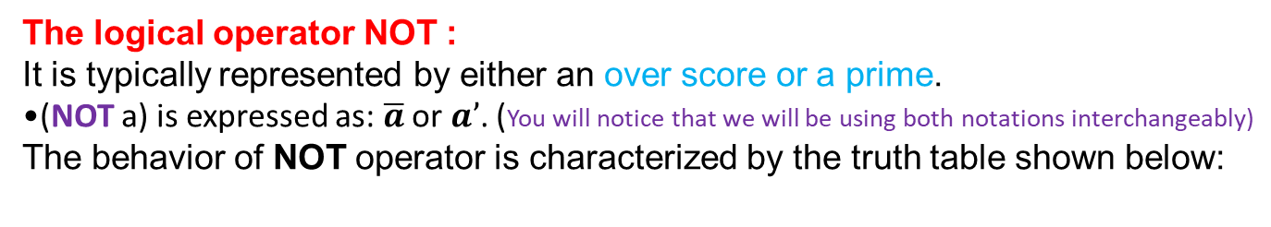
Boolean Operators
The logical operator NOT :
It is typically represented by either an over score or a prime.
(NOT a) is expressed as: $\overline{a}$ or $a’$. (You will notice that we will be using both notations interchangeably)
The behavior of NOT operator is characterized by the truth table shown below:
You are urged to memorize these truth tables, as you will be using them to identify, simplify, and design logic circuits.
Important note: since each Boolean variable has two possible values (0 or 1), the truth table will include a number of combinations equal to 2^{n} combinations of the n inputs.
For example: if we have one variable, then the number of combinations will be 2 (as in the NOT truth table). If we have two variables, then the number of combinations will be four (as in the AND /OR truth tables)

Slide 8
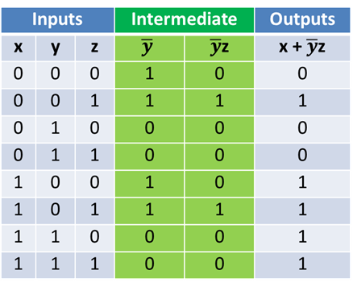
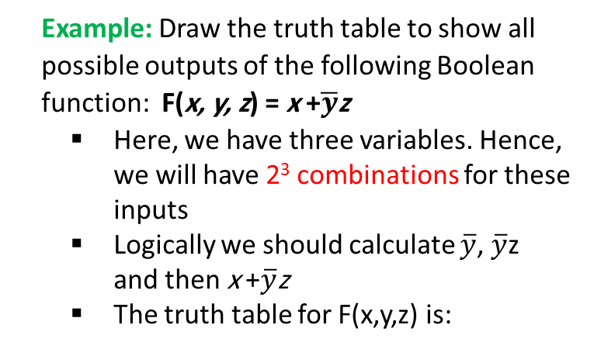
Boolean functions
A Boolean function has:
  At least one Boolean variable,
  At least one Boolean operator, and
  At least one input from the set {0,1}.
It produces an output that is also a member of the set {0,1}.
A Boolean function can also be described using a truth table. You just need to include in your table the needed intermediate results, and then come up with the final result.
Example: Draw the truth table to show all possible outputs of the following Boolean function: F(x, y, z) = x +$\overline{y}$z
  Here, we have three variables. Hence, we will have 2³ combinations for these inputs
  Logically we should calculate $\overline{y}$, $\overline{y}$z and then x +$\overline{y}$z
  The truth table for F(x,y,z) is:

Slide 9
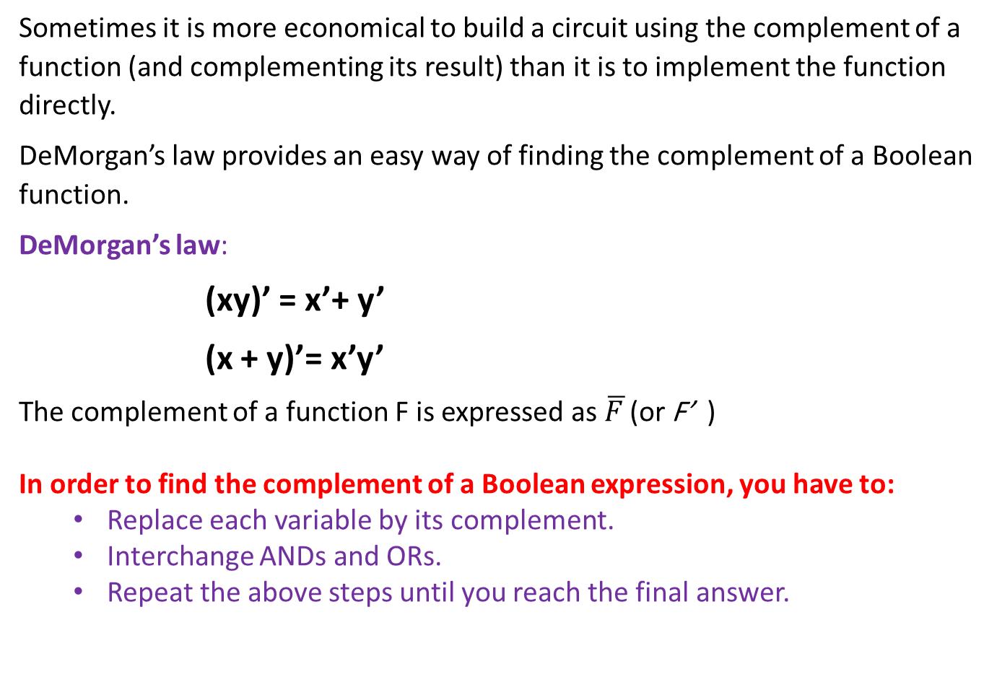
Complements
Sometimes it is more economical to build a circuit using the complement of a function (and complementing its result) than it is to implement the function directly.
DeMorgan’s law provides an easy way of finding the complement of a Boolean function.
DeMorgan’s law:
(xy)’ = x’+ y’
(x + y)’= x’y’
The complement of a function F is expressed as $\overline{F }$(or F’ )
In order to find the complement of a Boolean expression, you have to:
  Replace each variable by its complement.
  Interchange ANDs and ORs.
  Repeat the above steps until you reach the final answer.

Slide 10

Complements
Example 1: Find the complement $\overline{F }$of the function F(x,y) = x+y.
$\overline{F(x,y)}$= $\overline{x+y }$ = $\overline{x}\overline{ y}$ (OR form of the DeMorgan’s law)
Example 2: Find the complement $\overline{F }$of the function F(x,y,z) = x+y+z
$\overline{F(x,y,z)}$ = $\overline{x+y \text{+} \text{z} }$
= $\overline{(x+y)+z}$
= $\left(\overline{x+y}\right)\overline{z }$
= $\left(\overline{x}\overline{y}\right)\overline{z}$
= $\overline{x}\overline{ y}\overline{ z}$
Similarly, if you use of Demorgan’s law, you find that:
($\overline{xyz}$) = $\overline{x}$ + $\overline{y}$ + $\overline{z}$

Slide 11
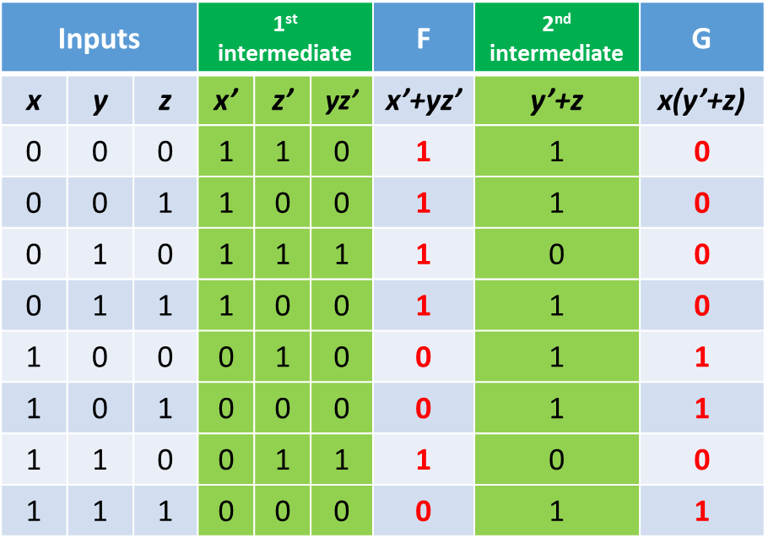
Complements
A good way to verify whether your work is correct or not, is to check it using the truth table.
Example 3: Using truth table, prove that if F= x’+yz’, then G= x(y’+z) is its complement.
Based on what you have learned earlier, you will design the truth table, including the intermediate results. The truth table will be:
As you can see, F and G columns show that the two functions have opposite outputs. When one function is 0 the second is 1, and vice versa. Therefore, G is the complement of F

Slide 12
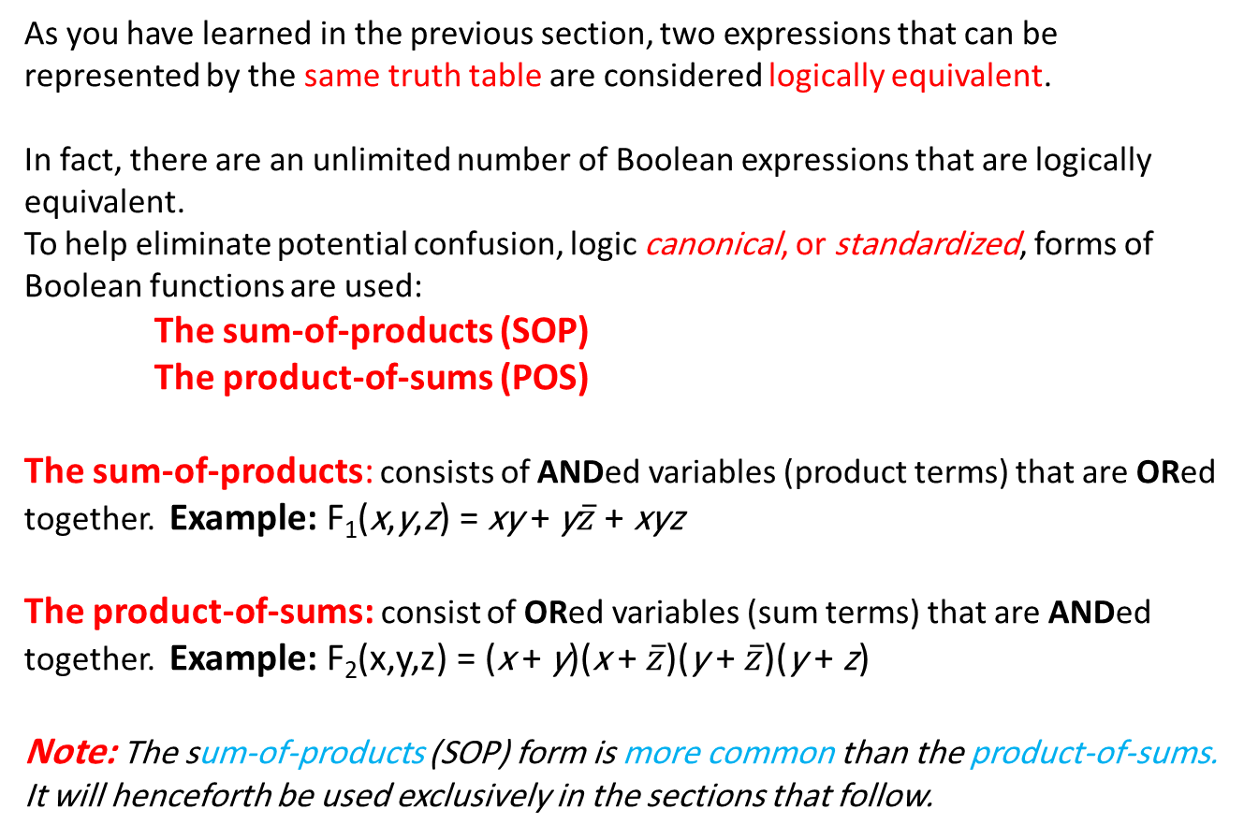
Representing the Boolean functions
As you have learned in the previous section, two expressions that can be represented by the same truth table are considered logically equivalent.
In fact, there are an unlimited number of Boolean expressions that are logically equivalent.
To help eliminate potential confusion, logic canonical, or standardized, forms of Boolean functions are used:
The sum-of-products (SOP)
The product-of-sums (POS)
The sum-of-products: consists of ANDed variables (product terms) that are ORed together. Example: F₁(x,y,z) = xy + y$\overline{z}$ + xyz
The product-of-sums: consist of ORed variables (sum terms) that are ANDed together. Example: F₂(x,y,z) = (x + y)(x + $\overline{z}$)(y + $\overline{z}$)(y + z)
Note: The sum-of-products (SOP) form is more common than the product-of-sums. It will henceforth be used exclusively in the sections that follow.

Slide 13
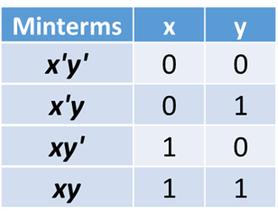
Representing the Boolean functions
Any Boolean expression can be represented in the sum-of-products (SOP) form, and it can also be represented as a truth table.
So, any truth table can also be represented in the sum-of-products form, choosing the minterms that let the function have a value of 1.
A minterm is a product term that contains all of the function’s variables exactly once, whether complemented or not.
The minterms for a function having two inputs x and y are: x’y’, x’y, xy’, xy
For example, the Boolean function, F (x , y), will have the above four minterms.

Slide 14
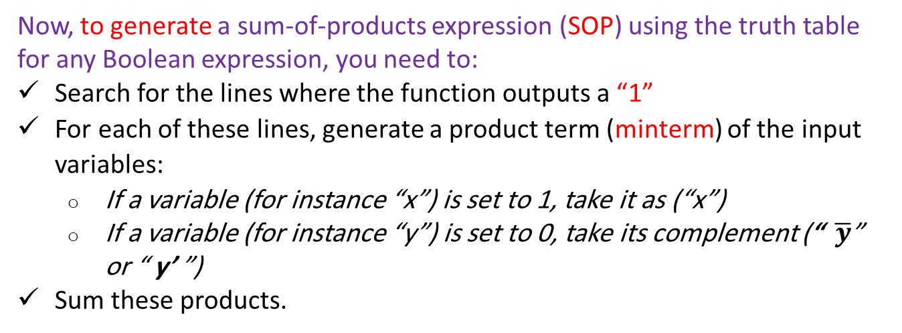
Representing the Boolean functions
Similarly, a function having three inputs, F(x, y, z), has the minterms:
Now, to generate a sum-of-products expression (SOP) using the truth table for any Boolean expression, you need to:
Search for the lines where the function outputs a “1”
For each of these lines, generate a product term (minterm) of the input variables:
  If a variable (for instance “x”) is set to 1, take it as (“x”)
  If a variable (for instance “y”) is set to 0, take its complement (“$\overline{y}$” or “ y’ ”)
Sum these products.

Slide 15
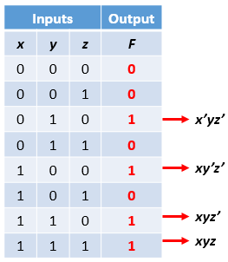
Representing the Boolean functions
For instance, consider the following truth table, with the minterms as well:
The sum-of-products expression, SOP, of the above function is:
F(x,y,z) = x’yz’ + xy’z’ + xyz’ +xyz
Note that the above expression may not be the in the simplest form; we are only guaranteeing a standard form.

Slide 16
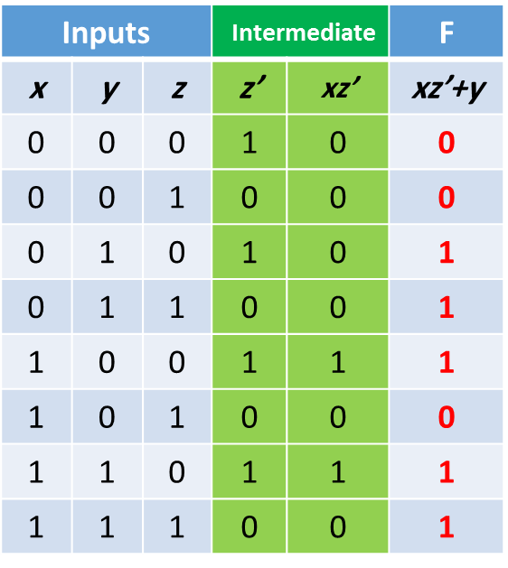
Representing the Boolean functions
Example: Deduce the SOP of the following function based on its truth table.
F(x,y,z) =xz’ + y
Answer:
x’yz’
x’yz
xy’z’
xyz’
xyz
The sum-of-products form for our function is:
F(x,y,z) = x’yz’ +x’yz + xy’z’ + xyz’ + xyz

Slide 17
Boolean Simplification using Karnaugh Map (K-map)
Frequently, a Boolean expression is not necessarily to be in its simplest form.
Simplification of Boolean functions leads to simpler (and usually faster) digital circuits.
Two methods for simplification exist:
  Using Boolean algebra identities (covered in other modules)
  Using Karnaugh maps (these are dealt with in what follows)
This section presents an easy, systematic graphical method for visualizing and reducing Boolean expressions – Karnaugh Map or K-map.
K-maps: Description and Terminology
A K-map is a matrix consisting of rows and columns that represent the output values of a Boolean function.
The output values placed in each cell are derived from the minterms of a Boolean function.

Slide 18
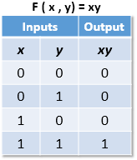

Boolean Simplification using Karnaugh Map (K-map)
Note that a K-map has a cell for each minterm. This means that it has a cell for each line of the truth table of a function.
The truth table for the function F(x,y) = xy is shown below along with its corresponding K-map.

Slide 19
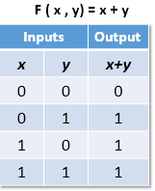
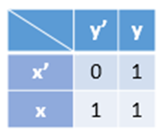
Boolean Simplification using Karnaugh Map (K-map)
As another example, you can see below, the truth table and K-map for the function, F(x,y) = x + y.
This function is equivalent to the OR of all of the minterms that have a value of 1. Thus,
^{F(x,y)= x+y = x’y+xy’+xy}

Slide 20
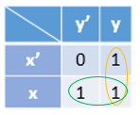
Boolean Simplification using Karnaugh Map (K-map)
K-map Simplification for Two Variables
Certainly, the minterm function that we derived from our K-map was not in the simplest terms.
You can, however, reduce the complicated expression to its simplest terms by finding adjacent 1s in the K-map that can be collected into groups that are powers of two.
Recall that in our previous example, we have two such groups.
We see that both groups are powers of two. However, the groups overlap.
Is it acceptable to do that? How are we going to select the groups? Are there any rules?
Well, the answer is yes.
The function is F(x,y)=x+y

Slide 21
Boolean Simplification using Karnaugh Map (K-map)
Rules of K-map simplification:
  Groupings can contain only 1s; no 0s.
  Groups can be formed only at right angles; diagonal groups are not allowed.
  The number of 1s in a group must be a power of 2, even if it contains a single 1 (i.e 2,4 ,8, … ).
  The groups should be made as large as possible.
  Groups can overlap and wrap around the sides of the K-map.

Slide 22
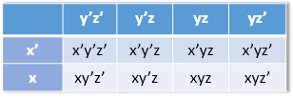
Boolean Simplification using Karnaugh Map (K-map)
K-map Simplification for Three Variables
A K-map for three variables is constructed as shown in the diagram below.
We have placed each minterm in the cell that will hold its value.
Notice that the values for the yz combination at the top of the matrix form a pattern that is not a normal binary sequence. The sequence is y’z’ y’z yz yz’ (00 01 11 10), and not y’z’ y’z yz’ yz (00 01 10 11). This is because adjacent minterms should have only one different bit, and not more.
(You should memorize this sequence, in order to reach the correct result)
Thus, the first row of the K-map contains all minterms where x has a value of zero, while the first column contains all minterms where y and z both have a value of zero, and so on.

Slide 23

Boolean Simplification using Karnaugh Map (K-map)
Consider the function:
F(x,y,z)= x’y’z + x’yz + xy’z + xyz
The K-map of the above function is given below.
What is the largest group of 1s that is a power of 2?
Reminder: Larger groups dominate, that is, if you have a group of four 1s, we discard groups of two 1s that are found in the larger one. However, if some 1s are left over and the exist some adjacent 1s that are used in a neighbor group, you can compose a new group.

Slide 24

Boolean Simplification using Karnaugh Map (K-map)
Now, Back to our example. In the figure below, we have a group of four 1s that constitute one term.
z
This grouping tells us that changes in the variables x and y have no influence upon the value of the function: They are irrelevant.
To illustrate more, you have to discard the variable that change its value from column to another or from a row to another while reading the representation of a group as a term, as they are considered as irrelevant variables. You only keep the variable(s) that stayed constant through all transitions (significant).
Looking at the above grouping, you can clearly see that the variable y changes its state from 0 to 1. The same happens to the variable x. What remains is z as a significant value. This means that the function F(x,y,z)= x’y’z + x’yz + xy’z + xyz reduces to F(x)=z.

Slide 25
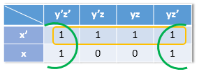
Boolean Simplification using Karnaugh Map (K-map)
Consider the function: F(x,y,z)= x’y’z’+ x’y’z + x’yz + x’yz’+ xy’z’+ xyz’
The K-map of the above function is shown below. There are (only) two groupings of 1s.
The green group wraps around the sides of the K-map. This group tells us that the values of x and y are not relevant. That keeps z’ as a significant value in the green group.
In the orange group, you can see that the variables y and z are irrelevant. Hence, what is left is x’ as a significant value in the orange group.
Our reduced function is F(x,y,z) = x’+ z’

Slide 26
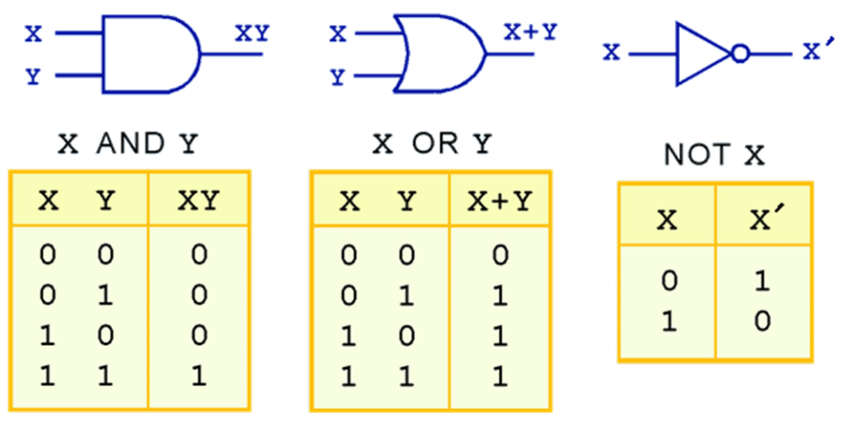
Logic Gates
A gate is an electronic device that produces a result based on two or more input values.
In reality, gates consist of one to six transistors, but digital designers think of them as a single unit.
Integrated circuits contain collections of gates suited to a particular purpose.
Symbols of the Logic Gates
The three simplest gates are the AND, OR, and NOT gates.
They correspond directly to their respective Boolean operations, as you can see by their truth tables.

Slide 27
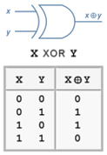
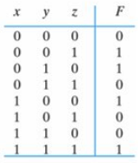

Logic Gates
Another very useful gate is the exclusive OR (XOR) gate. Its symbol and truth table is shown below.
Note the special symbol ⊕ for the XOR operation.
In general, XOR gate is a digital logic gate that gives an output =1 if and only if the number of 1’s in the input combination is odd.
➔
x ⊕ y ⊕ z = 1, IFF (if and only if) the number of 1’s in the input combination is odd.

Slide 28
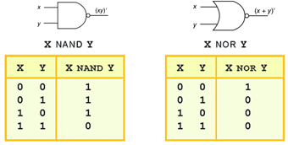
Logic Gates
Universal gates
NAND and NOR are two very important gates. Their symbols and truth tables are shown below.
NAND (xy)’
NOR (x+y)’
NAND and NOR are known as the universal gates.
They are considered important in designing logic circuits because:
Complex integrated circuits are often much easier to build using the same building block (several NAND gates or OR gates) rather than a collection of the basic building block.
Universal gates are cheaper to build than other gates.

Slide 29
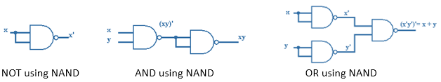
Logic Gates
NAND Universal gate
In our course, we will consider only the NAND gate, as it is less expensive to manufacture, in addition to its smaller size.
Moreover, in practice, NAND gates are used for implementing an expression in sum of-products (SOP) form.
As we have said earlier, any Boolean function could be constructed using only NAND gates.
You can find below how you can construct the three simplest gates (AND, OR, and NOT) using the NAND gate.

Slide 30


Logic Gates
Multiple Input Gates
In our examples thus far, all gates have accepted only two inputs.
Gates are not limited to two input values, however. There are many variations in the number and types of inputs allowed for various gates.
For example, we can represent x+y+z using one OR gate, and xy’z using one AND gate, with three inputs as shown below.

Slide 31
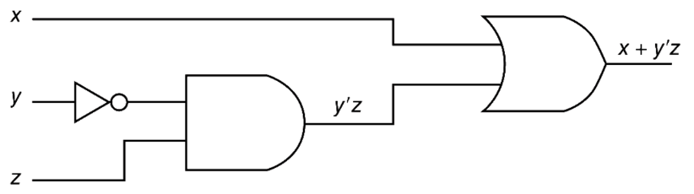
Logic Gates
Digital Components and Circuits
When you open a computer and look inside, you would recognize that there is a lot to know about the digital components that make up the system.
A computer is built using connected collections of gates. These collections of gates are often quite standard, resulting in a set of building blocks.
These building blocks are constructed using the basic AND, OR, and NOT operations.
The main thing to remember is that combinations of gates implement Boolean functions.
The circuit below implements the Boolean function F(x,y,z) = x + y’z:

Slide 32
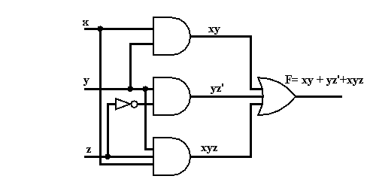
Logic Gates
For example, consider the function F(x,y,z)=xy +yz’ +xyz.
Each term corresponds to an AND gate, and the sum is implemented by a single OR gate, resulting in the following circuit:
Summary
To wrap up things, we conclude that:
Simple Boolean operation, such as AND, OR, or NOT, can be represented by a simple logic gate.
Any Boolean expression can be represented in a logical diagram.
A logical diagram is a combination of AND, OR, and NOT gates that describes a Boolean expression.

Slide 33
Combinational Circuits
Combinational logic is used to build circuits that contain basic Boolean operators, inputs, and outputs.
The output of a combinational circuit is a function of its inputs at any given moment. Hence, combinational logic has no memory.
A combinational circuit may have several outputs. If so, each output represents a different Boolean function.
In this section, you will be introduced to the following combinational circuits:
Half-Adder
Full-Adder
Decoder
Multiplexer

Slide 34
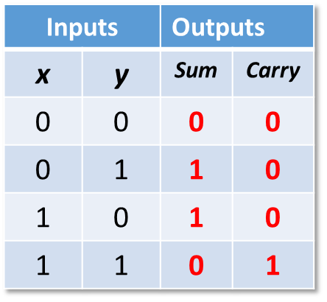
Combinational Circuits
Half-Adder
A half-adder is one of the most basic combinational logic circuits in computing. It is used to combine single-digit binary numbers. The half adder produces two numbers as output: the carry and the sum. The sum is the first digit of the answer, while the carry is any additional digit. Half adders only work with single digit inputs.
Consider the example of adding two binary digits together. Three cases are possible:
0 + 0 = 0
1 + 0 = 1 or 0 + 1 = 1
1 + 1 = 1 0 (the result is “0” with a carry of “1”)
In the third case, you have two inputs (the bits to add) and two outputs (the “sum” and the “carry”).
Drawing the truth table leads us to the Boolean function of a half-adder.

Slide 35
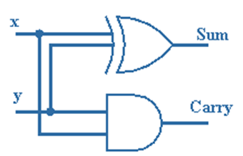

Combinational Circuits
Note that each output has a Boolean function.
Thus, we have Sum and Carry functions.
Sum: The sum is “1” when only one of the inputs (x, y) is equal to “1”
This is the job of an XOR!
Sum = 𝑥⊕𝑦
Carry: The carry is “1” when only both inputs (x and y) are “1”
This is the job of an AND!
Carry = xy
The logic diagram of the Half Adder will be:

Slide 36
Combinational Circuits
Full-Adder
Half adders only work with single digit inputs. When numbers containing more than one digit are to be combined together, a full adder is used.
A half adder could be extended to a circuit that allows the addition of larger binary numbers: A full-adder.
Remember how we added binary numbers!
We add each column without forgetting the carry from the nearest right column
A full-adder have three inputs:
The two bits to add (x and y)
The carry from the nearest right column (carry-in)
A full-adder has two outputs (the “sum” and the “carry”)
A full-adder can only add two bits and a carry (three bits)

Slide 37
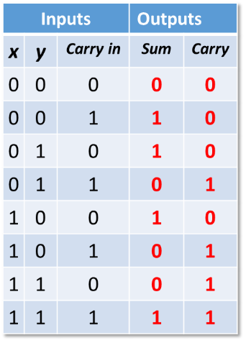
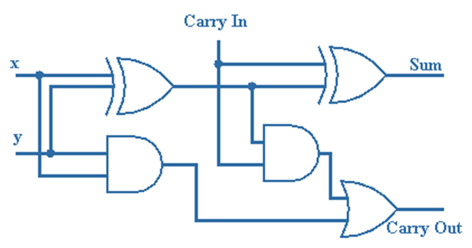
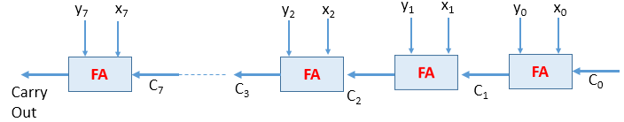
Combinational Circuits
The truth table and the Logic representation of the full-adder are depicted below:
Note that a full-adder is composed of two half-adders and an OR gate.
If you need to add large binary numbers, the simplest way is to use a ripple-carry adder.
A ripple-carry is a succession of full-adders but it is slow. The diagram below shows its diagram.

Slide 38
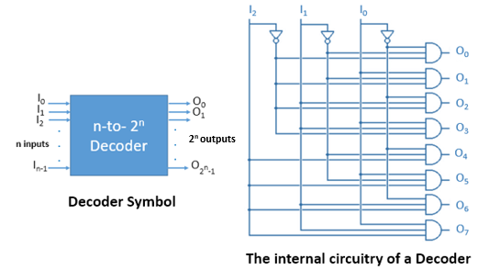
Combinational Circuits
Decoders
Decoders are another important type of combinational circuit.
A decoder decodes binary information of a set of n inputs to a maximum of 2^{n} outputs.
A decoder uses the inputs and their respective values to select one specific output line
For a given input combination, only one output is set to “1” and all others are set to “0” ( AND gate)

Slide 39
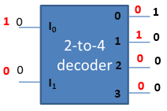
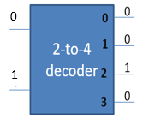
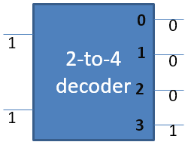
Combinational Circuits
The example below 2-to-4 decoder , demonstrates how the decoder works.
In the above figures, you can notice the following:
If the input I₁I₀ =00, then the output 0 will be 1, as 00 is equivalent to 0₁₀.
If the input I₁I₀ =01, then the output 1 will be 1, as 01 is equivalent to 1_{10.}
If the input I₁I₀ =10, then the output 2 will be 1, as 10 is equivalent to 2₁₀.
If the input I₁I₀ =11, then the output 3 will be 1, as 11 is equivalent to 3₁₀.

Slide 40
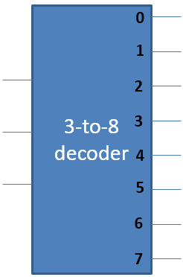
Combinational Circuits
A 3-to-8 decoder (n=3; 2³=8) is depicted below:
Among other things, decoders are useful in selecting a memory location according a binary value placed on the address lines of a memory bus.
Address decoders with n inputs can select any of 2^{n} locations.

Slide 41
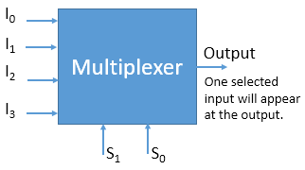
Combinational Circuits
Multiplexers
A multiplexer does just the opposite of a decoder.
A multiplexer selects binary information from one of many input lines and directs it to a single output line.
Selection of the particular input line, to get data from, is controlled by a set of selection variables or control lines.
To be able to select among 2^{n} inputs, n control lines are needed.

Slide 42
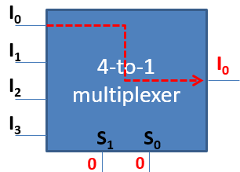
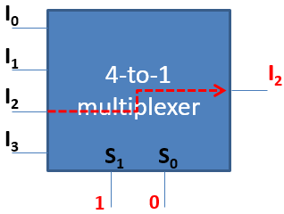
Combinational Circuits
4-to-1 multiplexer:
We have 4=2² input lines
To select one of the 4 inputs we need 2 selection bits: S₀, S₁
When S₀S₁=00, the output I₀ will be directed to the output.
When S₀S₁=01, the output I₁ will be directed to the output.
When S₀S₁=10, the output I₂ will be directed to the output.
When S₀S₁=11, the output I₃ will be directed to the output.

Slide 43
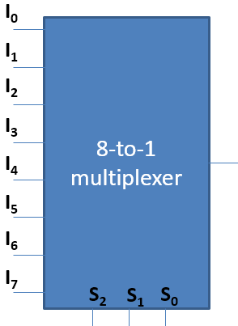
Combinational Circuits
8-to-1 multiplexer:
We have 8=2³ input lines
To select one of the eight inputs we need three selection bits: S₀, S₁, S₂

Slide 44
Sequential Circuits
As you have noticed in the previous section, combinational circuits are memoryless; they do not have the concept of storage.
As the name implies, sequential logic circuits require a means by which events can be sequenced.
The output of a sequential circuit is a function of its inputs at any given moment as well as its past inputs and states.
Thus, sequential logic circuits must have a memory to remember values and store previous inputs and outputs.
In order to “remember” a past state, sequential circuits rely on feedback, where the output of a circuit is fed back as an input to the same circuit.
There are two types of sequential circuits representing two ways to order events:
  Asynchronous: they become active the moment any input value changes. Circuit output can change at any time (clock less)
  Synchronous: Circuit output changes only at some discrete instants of time. Synchronization is achieved by using a timing signal called the “clock” to order events.

Slide 45
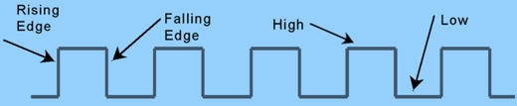
Sequential Circuits
Clocks control state changes.
A “clock” is a special circuit that sends electrical pulses through a circuit.
Clocks produce electrical waveforms. State changes occur in sequential circuits only when the clock ticks.
Circuits can change state on the rising edge, falling edge, or when the clock pulse reaches its highest voltage.

Slide 46
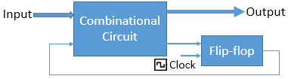
Sequential Circuits
To retain their state values, sequential circuits rely on feedback.
Feedback in digital circuits occurs when an output is looped back to the input.
Sequential circuits remember previous inputs by flip-flops.
The flip-flops receive their inputs from the combinational circuit and from a clock signal with pulses that occur at fixed intervals of time, as shown in the diagram.

Slide 47
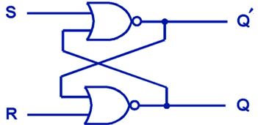
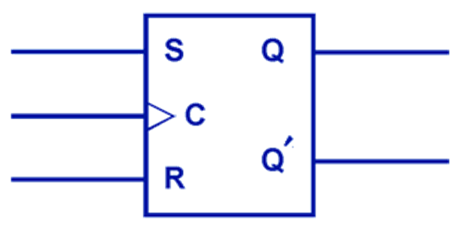
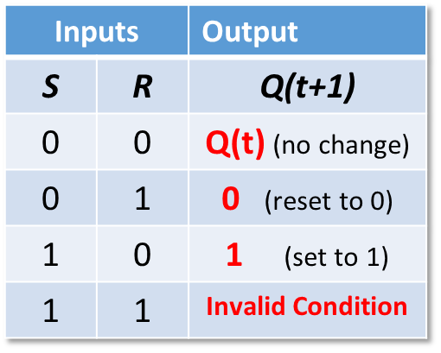
Sequential Circuits
SR Flip-Flops
The most basic flip-flop is called an SR flip-flop. The “SR” stands for set/reset.
The internals of an SR flip-flop are shown below, along with its block diagram.
The following characteristic table describes the behavior of an SR flip-flop:
P.S: Q(t) means the value of the output at time t; Q(t+1) is the value of Q after the next clock pulse. Invalid condition means that you cannot know whether the value at the output is 0 or 1.
Hence, when both S and R are 1, you will have an undefined state. (This is the major drawback of the SR F.F)

Slide 48
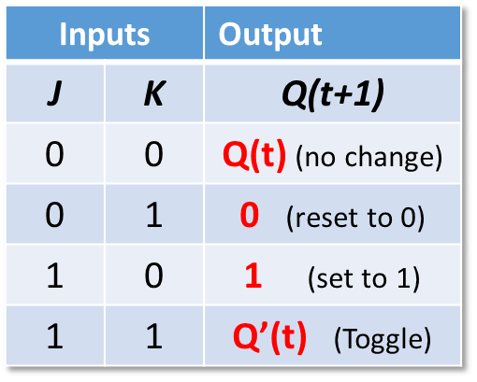
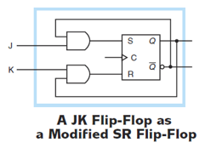
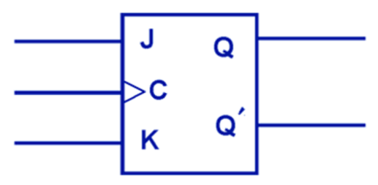
Sequential Circuits
JK Flip-Flops
JK flip-flop (in honor of Jack Kilby) is a modified version of the SR flip-flop that provides a stable state when both inputs are 1, hence preventing a race condition which can occur when both inputs of an RS flip-flop are active at the same time.
The block diagram of the JK flip-flop is shown below, in addition to its characteristic table.
The characteristic table indicates that the flip-flop is stable for all inputs.
When J and K are 1, the output Q(t+1) will be the complement of the previous one Q(t).

Slide 49
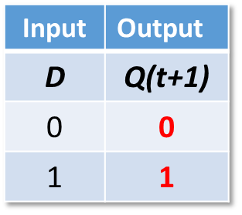


Sequential Circuits
D Flip-Flops
Another modification of the SR flip-flop is the D flip-flop, shown below with its characteristic table.
As you notice, the output of the flip-flop remains the same during subsequent clock pulses. The output changes only when the value of D changes.
D flip-flop is considered the basic memory storage in many circuits, as it stores one bit that remains there until another input is stated.
When the clock is pulsed:
  If 1 is asserted on the input line D, the output line Q becomes 1 (and remains 1 until the next clock pulse).
  If 0 is asserted on the input line, the output becomes 0 (and remains 0 until the next clock pulse).

Slide 50

Sequential Circuits
Registers
A register holds data within a digital system. You can see, below, the symbol (block diagram) and the logic diagram of a 4-bit parallel-in/parallel-out register implemented using D flip-flops.
In a parallel in–parallel out register:
  On a clock tick, all inputs are sent to the output lines
  These outputs are still on their states until the next clock tick (the D flip-flops store the inputs during one clock cycle)
  The same clock signal is tied into all four D flip-flops, so they change at the same time
A 4-bit parallel in – parallel out register

Slide 51

Sequential Circuits
Counters
An N-bit counter is formed by N flip-flops that are connected is such a way as to produce the prescribed sequence of binary states.
For instance, a 4-bit counter, which needs 4 flip-flops, produces a sequence from 0000 to 1111.
The symbol and the logic diagram of a 4-bit counter are shown in the figure below, using D flip-flops.

Slide 52
End of
Chapter 3
Try to solve all exercises related to chapter 3

