Slide 1
Marie Simulator
TM103: Computer Organization and Architecture

Slide 2
Objective
Presents the basic steps required to enter, assemble, and execute a program in Marie Simulator.
Using the Executable JAR File
Quick Start Steps

Slide 3
Using the Executable JAR File
Be sure that the Java virtual machine version 1.4 (JRE) or later is installed on your machine
It is not necessary to unpack (unJAR) the MARIE machine simulator
All that you need to do is double click on the MarieSim.jar icon to invoke the MARIE simulator, or the MarieDP1.jar file to invoke the datapath simulator.

Slide 4
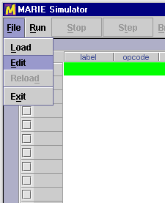
Quick Start Steps
Start the simulator
- Simply double click on the MarieSim JAR icon
- If you've uncompressed the simulator files and prefer to run the simulator from a command prompt, log into the directory where you have installed MarieSim, and type:
java MarieSim1
Invoke the code editor.
From the [File] menu on the menu bar, select [Edit] as shown in the illustration.

Slide 5
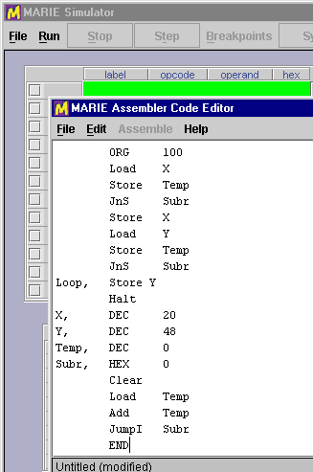
Quick Start Steps
Enter the program source code.
- Using the editor pop up window, type your MARIE assembly instructions.
- The MARIE editor supports basic editing functions such as cut and paste.

Slide 6
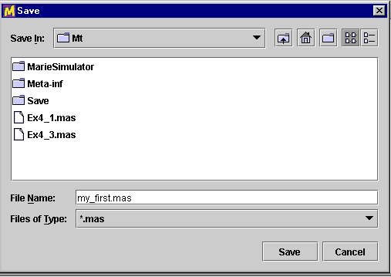
Quick Start Steps
4. Save the program source code.
Select [Save] from the menu bar of the editor. The simulator automatically saves the file with a .mas extension.

Slide 7
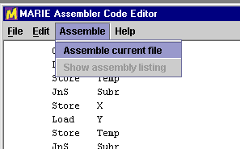
Quick Start Steps
5. Assemble the program source code.
Select [Assemble] from the menu bar.
If your program contains no errors, a message displays at the bottom of the editor telling you that the assembly was successful.
If your file contains errors, the assembly listing will pop up on the screen, and the message at the bottom of the editor will be highlighted.

Slide 8
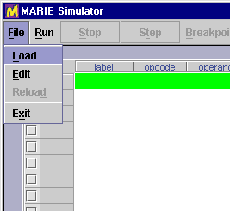
Quick Start Steps
6. Close the editor.
Close the editor window by selecting [File] [Exit] or by clicking on the close icon at the upper right-hand corner of the editor panel.
7. Load the program.
From the main simulator pane select [Load] from the [File] menu bar option.
The file dialog pops up, showing you all of the MARIE executable files (.mex) files in the current directory.

Slide 9
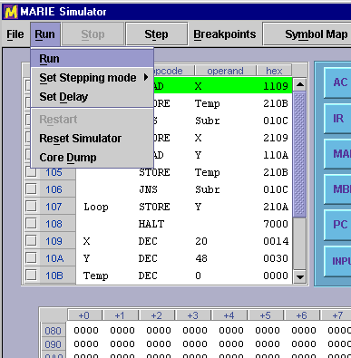
Quick Start Steps
8. Run the program.
Select any of the run mode options from the [Run] menu. This menu allows you to turn step mode off and on, and set a delay between each instruction.

Slide 10
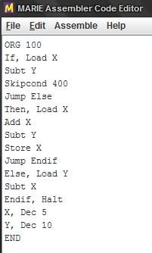
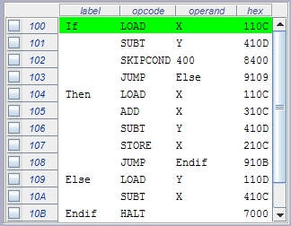

Example
ORG 100
If, Load X
Subt Y
Skipcond 400
Jump Else
Then, Load X
Add X
Subt Y
Store X
Jump Endif
Else, Load Y
Subt X
Endif, Halt
X, Dec 5
Y, Dec 10
END

Slide 11
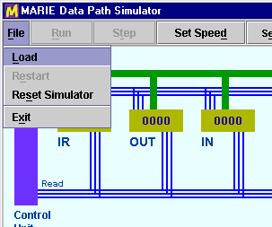
Quick Start Steps
9. Observe data path instruction execution using Marie DP1
Type: java MarieDP1
10. Load an executable Marie file.
- Select [Load] from the [File] menu on the menu bar
- Note: The data path simulator will load only executable (.mex) files that have been assembled in the Marie simulator.

Slide 12
Quick Start Steps
11. Run the program.
- To begin execution, you can select [Run] or [Step].
- If you select [Step], a single fetch-decode-execute cycle is processed in the simulator.
- [Run] executes the program without pausing.

