Slide 1
Chapter 5
(Addressing modes)
Prepared by Dr. Ahmad Mikati

Slide 2
Addressing Modes
We saw in the previous sections, while discussing the MARIE’s Instructions, that the 12 bits in the operand field can be interpreted in two different ways: the 12 bits represents either the memory address of the operand (direct addressing) or a pointer to a physical memory address ( indirect addressing).
Addressing modes allow us to specify where the operands are located. An addressing mode can specify a constant, a register, or a location in memory. Certain modes allow shorter addresses, and some allow us to determine the location of the actual operand, often called the effective address of the operand, dynamically.
In this section, we will investigate the most basic addressing modes.

Slide 3
Addressing - Introduction
Addressing modes specify where an operand is located.
They can specify a constant, a register, or a memory location.
The actual location of an operand is its effective address.
Certain addressing modes allow us to determine the address of an operand dynamically.
Although there are other different addressing modes, we will focus on four modes:
Immediate Addressing.
Direct Addressing.
Indirect Addressing.
Indexed Addressing.

Slide 4
Addressing Modes
Immediate addressing: where the data is part of the instruction.
Example: If we have the instruction Load 008, the numeric value 8 is loaded into the AC.
Direct addressing: where the address of the data is given in the instruction.
Example: For the instruction Load 008, the data value found at memory address 008 is loaded into the AC.

Slide 5
Addressing Modes
Indirect addressing: Gives the address of the address of the data in the instruction.
Example: Consider the instruction Load 008.
The data value found at memory address 008 is actually the effective address of the desired operand.
Now, suppose we find the value 2A0 stored in location 008.
2A0 is the “real” address of the value we want.
Then, the value found at location 2A0 is loaded into the AC.
Indexed addressing: uses a register (implicitly or explicitly) as an offset, which is added to the address in the operand to determine the effective address of the data. (i.e. effective address =offset + address)
Example: Suppose that we have the instruction Load X.
The index register holds the value 100.
The effective address of the operand in actually X + 100.
The value found at location X+100 will then be loaded into the AC.

Slide 6
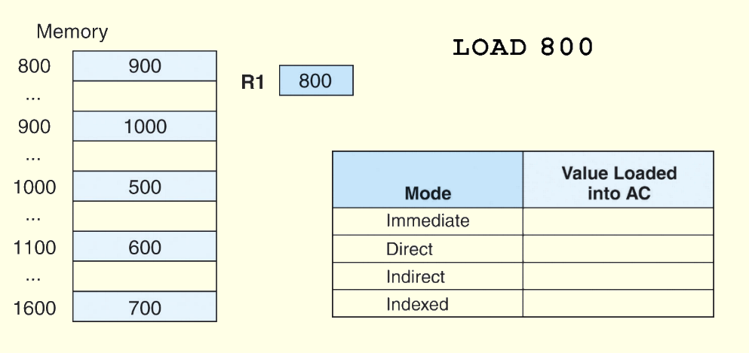
Addressing Modes
Example: For the instruction shown, what value is loaded into the accumulator AC for each addressing mode?
800

Slide 7
Addressing Modes
Example: For the instruction shown, what value is loaded into the accumulator for each addressing mode?
800
900

Slide 8
Addressing Modes
Example: For the instruction shown, what value is loaded into the accumulator for each addressing mode?
800
900
1000

Slide 9
Addressing Modes
Example: For the instruction shown, what value is loaded into the accumulator for each addressing mode?
800 + 800 = 1600
800
900
1000
700

Slide 10
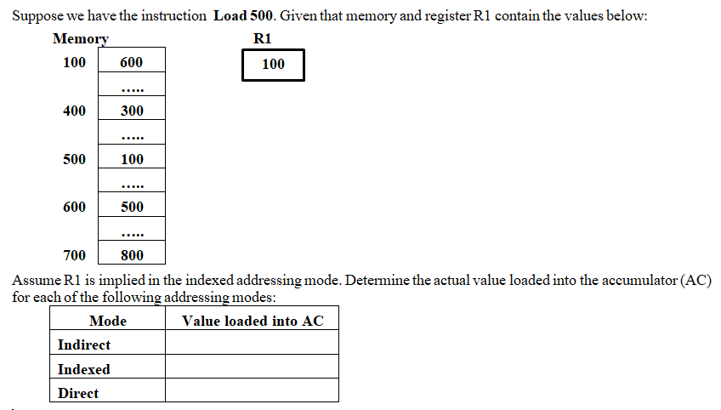
Example

Slide 11
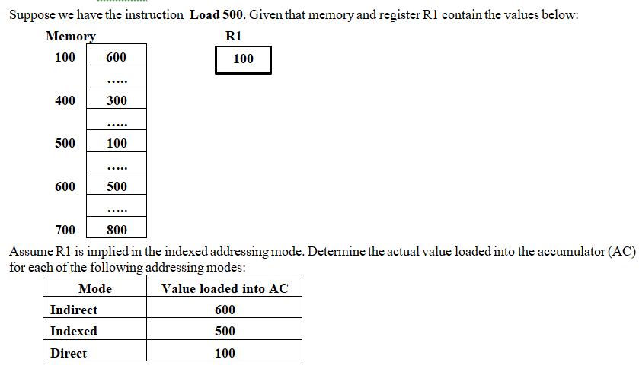

Slide 12
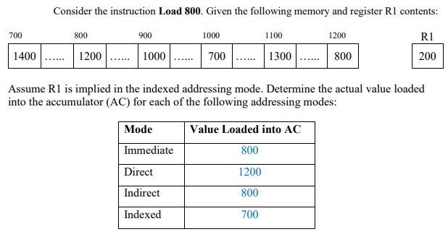
Example

Slide 13
End of chapter 5 (addressing modes)
Try to solve all exercises related to addressing modes in chapter 5

