Slide 1
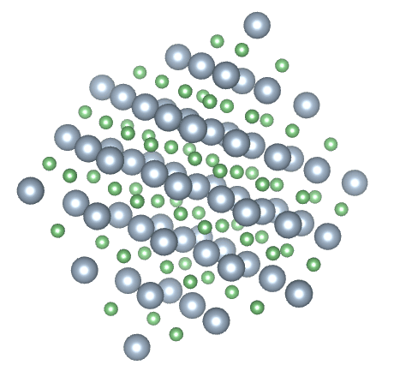

Melting Point Measurement (M.P.)
Melting Point Definition.
Reasons for Melting Point Measurement.
Sample preparation.
Consideration for M.P. measurement.

Slide 2
Many organic compounds are solids at room temperature as a result of strong intermolecular forces which hold the individual molecules together in a crystal lattice.
The nature and strength of these intermolecular forces are responsible for the observed differences in melting point.
In general, if the forces are strong, the melting point will be high, and if they are relatively weak, the melting point will be low

Slide 3
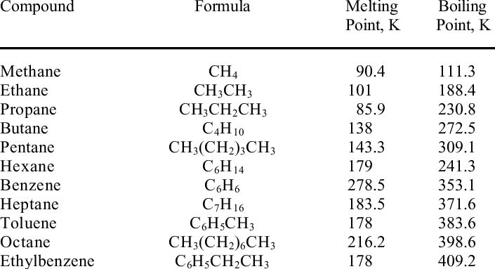
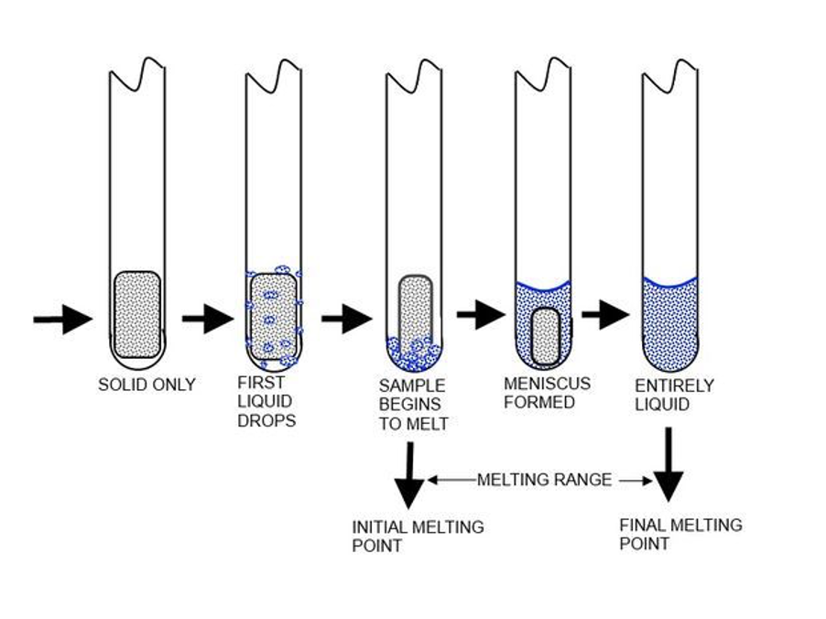
Melting Point Definition.
- The temperature at which the first crystal just starts to melt until the temperature at which the last crystal just disappears. for example, M.P. 147-149°C. (from solid to liquid)

Slide 4
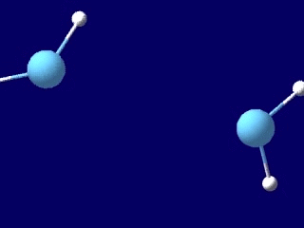
Melting Point Definition.
It requires that the intermolecular forces that hold the solid together have to be overcome, the temperature at which melting occurs will depend on the structure of the molecule involved.
A pure, nonionic, crystalline organic compound usually has a sharp and characteristic melting point (usually 0.5-1.0 C range).
A mixture of very small amounts of miscible impurities will produce a depression of the melting point and an increase in the melting point range.

Slide 5
Soluble impurities affect the melting point of a solid in the following manner:
Lower the melting point of the substance, with the upper limit considerably below the true melting point. The presence of an impurity in the molten compound, reduces its vapor pressure thus lowering the melting point of the compound. The greater the amount of impurity, the greater is the melting point depression.
Broaden the melting point range. Depending on the amount of impurity, the melting process may extend over a range of 2-20 oC or more.
Insoluble impurities (e.g., glass, sand ...etc.) do not affect the melting point or the melting point range.

Slide 6
Mixture melting points can be used in the following manner to determine whether two compounds are the same or different even though they have similar melting points.
If a given organic compound (A) melts sharply at 120 oC,
and benzoic acid (compound B) also has a melting point of 120 oC. Is compound (A) benzoic acid or a different compound?
If compound (A) is benzoic acid, then a mixture melting point of (A) and (B) will melt sharply at 120 ºC, i.e., the same as each individual compound alone.
If, on the other hand, compound (A) is not benzoic acid, then the mixture melting point of (A) and (B) will be lowered and the melting range will be broadened. Since they are different compounds, each behaves as an impurity in the other.

Slide 7
Reasons for Melting Point Measurement.
Determination of purity. ( pure substance has sharp range from 1 to 2
Identification of unknowns.
a - measure then go to M.P. sheet
b - mix with Known substance with different ratio.
if two substances have the same M.P. then take different ratio to be sure.
if not the same, you will notice lowering in the M.P. and Broad Range

Slide 8
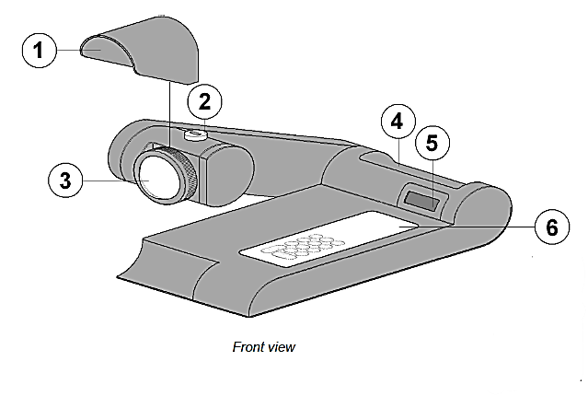
USING DIGITAL MELTING POINT APPARATUS
Number | Description
1 | Lens hood
2 | Capillary Guide
3 | Lens
4 | Capillary tube Holder
5 | Digit display
6 | Keypad

Slide 9
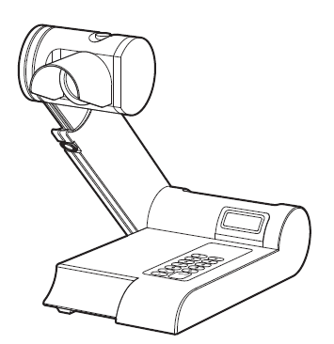

Slide 10
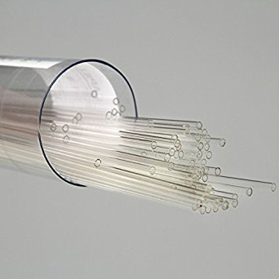
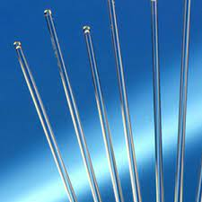
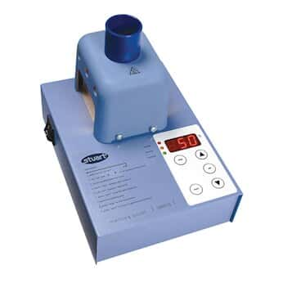
Sample preparation

Slide 11
GENERAL PROCEDURE
The digital melting point apparatus units must always be kept upright.
Place a small quantity (about 0.5 cm in tube) of the solid to be melted in a capillary tube (labeled melting point tubes).
Tap the closed end of the tube on the desk, clean the outside, and compact the solid down to the closed end of the melting point capillary tube.
Drop the tube (closed end down) down a section of glass tubing (see TA) to compact the solid in the bottom or closed end of the tube even more.
Place the tube loaded with the sample into the sample holder of the apparatus with the closed end down. The crystals can be ground up if they are too big to fit into the capillary tube.
Melting point capillary tubes are placed (closed end down) in the slots directly in front of the magnifying lens where they are viewed during melting. (Up to three samples can be viewed at once).

Slide 12
Record the temperature that the crystals begin to melt; crystals will look wet, (this is the melting start point), and the temperature at which the substance becomes a clear liquid; no solid material remaining (this is the melting end point).
Determine the melting range (Starting point – End point).
Calculate the melting point by taking the average point between the start point and the end point.
Melting Point Range = (Start Point → End Point)
Melting point Midpoint= (Start Point + End Point)/ 2
Note
The heating rate of the digital apparatus is adjusted by setting a temperature ramp along with a start and end temperature following the "Quick Start Instructions" on the front of the digital apparatus.
A ramp of 20 °C per minute will result in a rapid temperature rise while a ramp of say 2 °C per minute will give a slower rise that will more accurately measure the melting range of a solid.

Slide 13
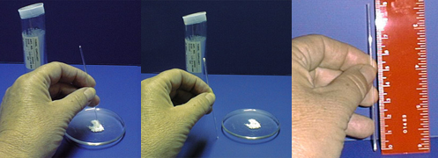
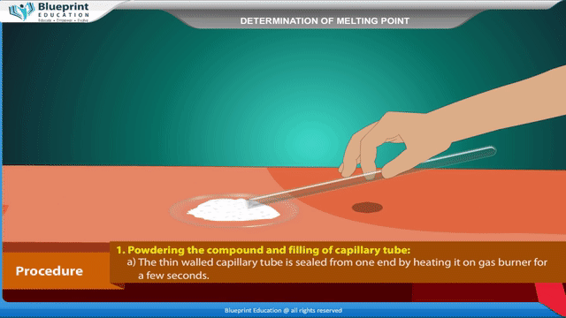
Procedure

Slide 14
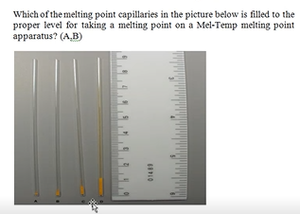

Slide 15

Consideration for M.P. measurement.
1. Use only the smallest amount that you can see melt. Larger samples will heat
unevenly.
2. Pack down the material as much as you can. Left loose, the stuff will heat
unevenly.
3. Never remelt any sample. They may undergo nasty chemical changes such as
oxidation, rearrangement and decomposition.
4. Make up more than one sample. One is easy, two is easier. If something goes
wrong with one, you have another. Duplicate, even triplicate runs are common.
**Never repeat melting point’s measurement with the same capillary as most of
organic compounds decompose or react in other ways upon heating. This
resulted in new materials with new melting points.

Slide 16
EXPERIMENTAL
MATERIALS NEEDED
Equipment: digital melting point apparatus
Glassware: Capillary tubes (open one side only)
Chemicals:.
DETERMINATION OF MELTING POINTS OF PURE COMPOUNDS
IDENTIFICATION OF AN UNKNOWN

Slide 17
Measure the melting point by using the digital Melting point apparatus but you must first measure its melting range.
Tap a small amount of your unknown into two different capillary tubes. Just a few crystals are adequate. You may need to grind some of your unknown into a powder if it is too coarse to fit into the capillary tube.
Find the melting point range of the pure unknown substance by first quickly determining an approximate melting range on a fast ramp (20 ºC/min from 70-210 ºC)
Conduct a slow, careful melting range with the second capillary tube you prepared (use a ramp of 2 ºC/min and start about 15 ºC below the melting range to 10 ºC above the range). Make sure the Digital Melting apparatus is below 70 ºC before starting the first melting range and 10-20 ºC below the compound’s melting range before doing a slow careful melting range.
After determining the range, now you can calculate the approximate melting point midpoint

