Slide 1


Recrystallization
Ali Salama

Slide 2
Definition
Recrystallization is the most widely used method for purifying solid organic compounds. In this technique, an impure solid is dissolved in a solvent and then allowed to slowly crystallize as the solution cools. The impurities remain dissolved in the solvent while the compound forms a pure, ordered crystal lattice.

Slide 3
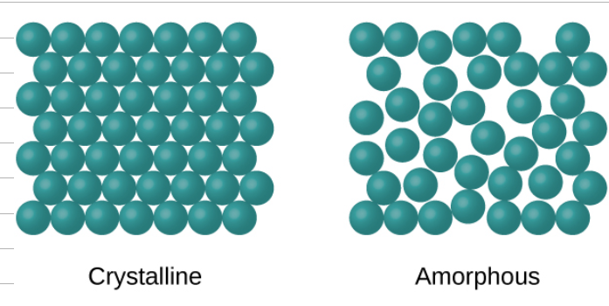
Crystallization vs Precipitation
Crystallization differs from precipitation. Crystallization involves a slow, selective formation of an ordered crystal structure that excludes impurities, producing a pure compound. In contrast, precipitation happens rapidly and often produces an amorphous solid with many trapped impurities inside the lattice.

Slide 4
Principle of Recrystallization
The process depends on solubility changes with temperature. Most solids are more soluble in hot solvent and less soluble at lower temperatures. By heating the solvent, the impure solid dissolves completely; as the solution cools, the desired compound crystallizes while impurities remain in solution.

Slide 5
Steps of Recrystallization
Choose a suitable solvent.
Dissolve the impure solid in a minimal amount of hot solvent.
Filter out insoluble impurities.
Slowly cool to allow crystals to form.
Filter and collect the purified crystals.
Wash the crystals to remove any residual impurities.

Slide 6
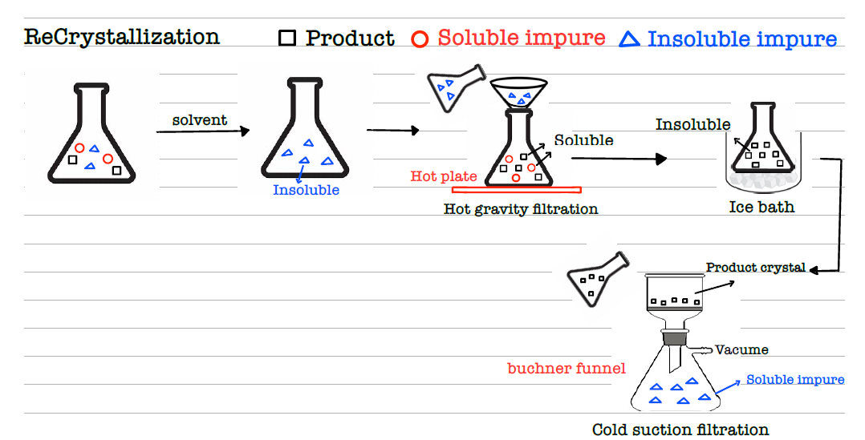
Steps of Recrystallization

Slide 7
Choosing the Right Solvent
The compound should be highly soluble in hot solvent but sparingly soluble at room temperature.
Impurities should either remain dissolved at room temperature or be insoluble in hot solvent.
The solvent must not react with the compound.
The solvent should be volatile so it can be easily removed after crystallization.

Slide 8
Conclusion
Recrystallization is a reliable purification method for solid compounds. By exploiting differences in solubility, it separates the desired product from impurities. Careful solvent selection and slow crystallization are essential for obtaining pure, crystalline compounds suitable for further analysis or use.

