Slide 1
EXPERIMENT 6: CHROMATOGRAPHY
A Separation and Purification Technique

Slide 2
Chromatography is a technique that may be used to separate the
components of a mixture as well as to identify organic substances and
examine their purity.
Chromatography encompasses several techniques
such as column, thin-layer, paper, gas liquid, etc. chromatography

Slide 3
Two principles are basically involved in chromatography: adsorption (as in thin- layer chromatography) and partition (as in paper chromatography),
In adsorption chromatography, separation depends on the selective desorption of the components of a mixture by the eluent (mobile phase) from the surface of a solid adsorbent (stationary phase). The adsorbent maybe packed in a column (column chromatography) or spread as a thin layer on a glass plate as in thin-layer chromatography.
In partition chromatography, separation depends on partition of the components of a mixture between the stationary and mobile phases. The mobile phase may be a liquid (liquid-liquid partition chromatography) or a gas (gas-liquid partition chromatography).

Slide 4
THIN-LAYER CHROMATOGRAPHY (TLC)
This is one application of adsorption chromatography in which an adsorbent, usually silica gel or alumina, is spread out as a thin layer on an inert surface, such as a glass plate or microscope slide.
The mixture is applied at one end of the coated plate and, as the mobile phase (a liquid) moves up the solid adsorbent by capillary action, the adsorbed components of the mixture get desorbed and carried along at different rates by the moving solvent.
Adsorption of the components of the mixture, on the surface of the adsorbent, occurs to differing extents depending on their structural features and polarity.
The more strongly adsorbed a given compound is, the slower it is transported by the mobile phase, and conversely, the more weakly adsorbed the compound is, the faster it is transported up the stationary phase. The result is that the components of the mixture are separated into different zones or spots

Slide 5
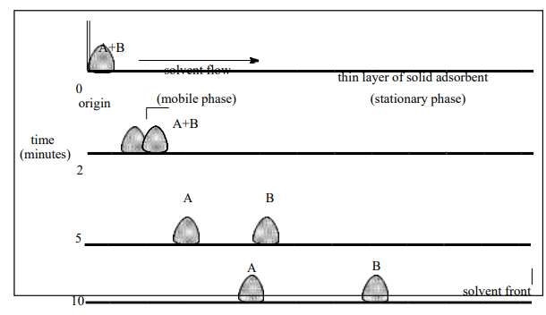
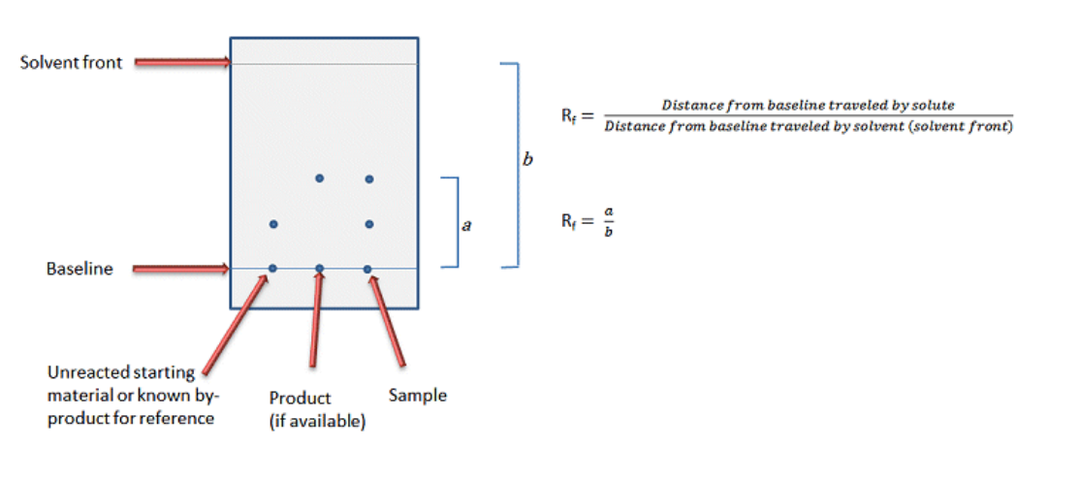

Slide 6
Separation by thin-layer chromatography depends on:
The kind and activity of the adsorbent (stationary phase)
The polarity of the eluent (mobile phase) and
The chemical nature of the components of the mixture
The most common adsorbents(stationary phase) employed in tlc are silica (sio2. Solvent front -64- xh2o) and alumina (al2o3. Xh2o), and the activity of these adsorbents is largely determinedby their water content.
the greater the polarity of the eluent(mobile phase), the greater is its ability to move the compound from the surface of the silica, and therefore the higher the rf -value.
Eluting power of solvents: acetic acid > ethyl alcohol > acetone > diethyl ether > dichloromethane >hexan

Slide 7
PREPARATION OF TLC PLATES
Large glass plates (20x20 cm) are commonly used for quantitative separations, while microscope slides are usually used for qualitative purposes.
Three steps are involved in TLC: spotting, developing, and visual Spotting.
First a glass chamber should contains the mobile phase, a filter paper should insert inside it and then close the jar to help saturate the atmosphere with solvent vapors.
Spotting
The sample to be dissolved in a suitable solvent (1% solution). Using small capillary tube with open two ends, a small amount of the smaple is spotted on the TLC plate about 1.5 cm from the bottom
The spots should have a diameter not larger than 1-2 mm, since larger spots result in "tailing" and overlapping of close spots.
Once the solvent evaporates from the spots, the plate is ready for developing.
Development of the Chromatogram.
It is best to choose the solvent that will give a satisfactory separation within the range of 0.2-0.8 Rf values. The plate is placed in a developing chamber (e.g., a covered beaker) containing the mobile phase and lined with filter paper When the solvent front reaches the finish line, the plate is removed from the beaker and placed on the bench top to air-dry.

Slide 8
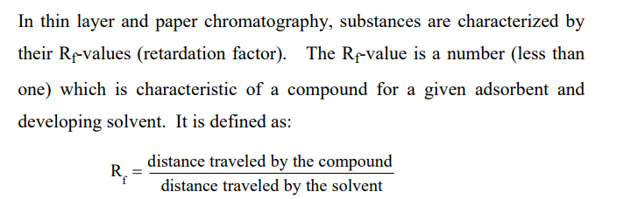
1cm
1cm
After the TLC runs in the chamber
1cm
1cm
1cm
1cm
STD1 STD2 STD3 S1 S2 S3 S4
1cm
STD1 STD2 STD3 S1 S2 S3 S4
1cm

Slide 9
Visualization of Spots.
If the spots are colored, they can be observed in ordinary light
If the compounds are colorless,
can be seen under UV-light
using iodine staining where they appear as dark spots on a white background or spraying agent (e.g. anisealdehyde. Sulfuric acid may also be used to make colorless spots visible
Heating the plate

Slide 10
Paper chromatographic analysis of a dye
Paper chromatography is used to separate mixtures of soluble substances. These are often coloured substances such as food colourings, inks, dyes or plant pigments.
is a technique used for the separation of compounds based on the differential solubility in the stationary phase and mobile phase (solvent).

Slide 11
